Slide 1
ENGR 240: Lab 2 PCB OMEMS Design
Akash Levy, Dylan Woodhead

Slide 2

Analysis of Designs
Using cantilever formulas discussed in class and FEM

Slide 3


Proof Masses
Parameters
$ρ_{PCB}=2078\frac{kg}{m^{3}}$, $ρ_{m}=7500\frac{kg}{m^{3}}$
$A={(30 mm)}^{2}$, $H=0.5334 mm$
$R_{m}=3 mm$, $H_{m}=3 mm$
$m_{m}= πR_{m}^{2}H_{m}ρ_{m}=636.2 mg$
NOTE: FEA with magnet did not work in FreeCAD so eigenfrequency estimates are used here instead
Proof mass
Without magnet:
$m=ρ_{PCB}AH=997.56 mg$
With magnet:
$m^{′}=m+m_{m}=1.634 g$

Slide 4
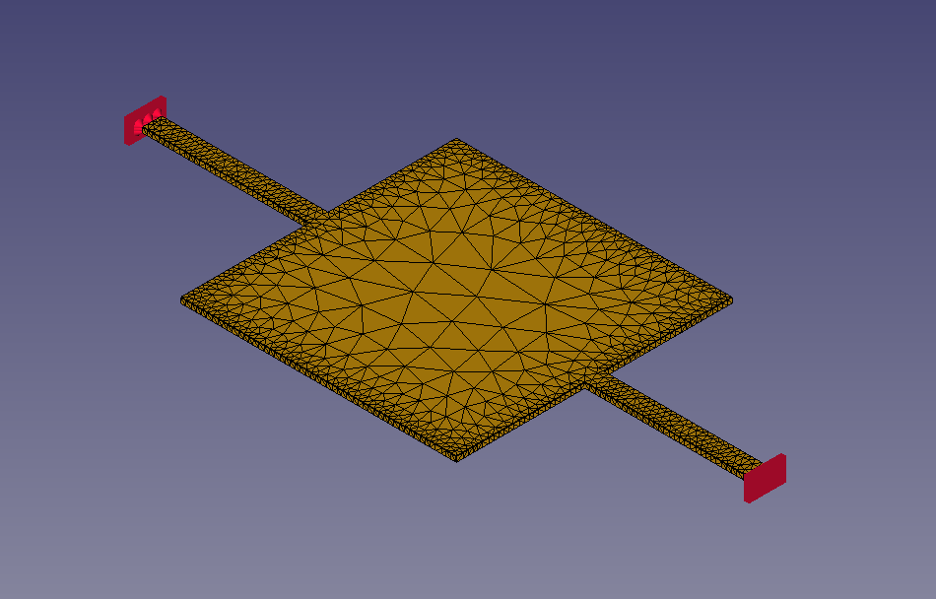

Design 1
X Scanning:
1st eigenmode
Resonance frequency (no magnet)
$f_{0}=176.46 Hz$
Est. resonance frequency (with magnet)
$f_{0}^{′}=f_{0}\sqrt{m_{0}/m′}=137.88 Hz$
Bounce:
2nd eigenmode
Resonance frequency (no magnet)
$f_{0}=189.14 Hz$
Est. resonance frequency (with magnet)
$f_{0}^{′}=f_{0}\sqrt{m_{0}/m′}=147.78 Hz$
Y Scanning:
3rd eigenmode
Resonance frequency (no magnet)
$f_{0}=555.74 Hz$
Est. resonance frequency (with magnet)
$f_{0}^{′}=f_{0}\sqrt{m_{0}/m′}=434.23 Hz$

Slide 5
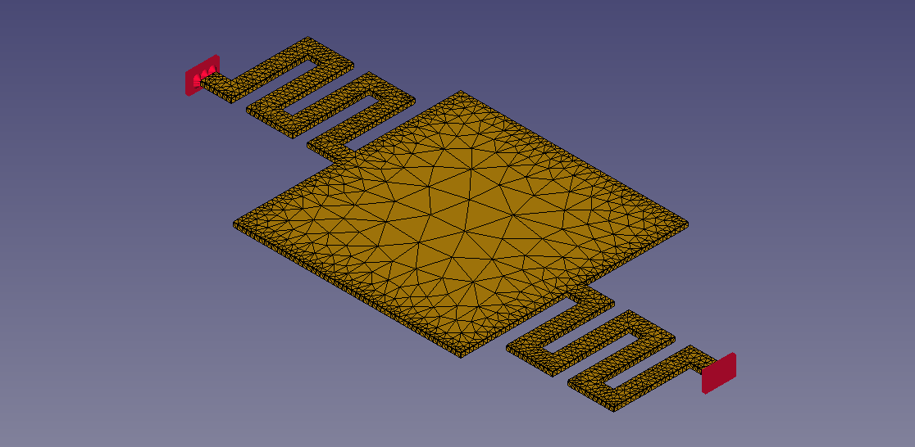

Design 2
X Scanning:
1st eigenmode
Resonance frequency (no magnet)
$f_{0}=92.34 Hz$
Est. resonance frequency (with magnet)
$f_{0}^{′}=f_{0}\sqrt{m_{0}/m′}=72.15 Hz$
Bounce:
2nd eigenmode
Resonance frequency (no magnet)
$f_{0}=126.25 Hz$
Est. resonance frequency (with magnet)
$f_{0}^{′}=f_{0}\sqrt{m_{0}/m′}=98.65 Hz$
Y Scanning:
3rd eigenmode
Resonance frequency (no magnet)
$f_{0}=338.18 Hz$
Est. resonance frequency (with magnet)
$f_{0}^{′}=f_{0}\sqrt{m_{0}/m′}=264.2 Hz$

Slide 6
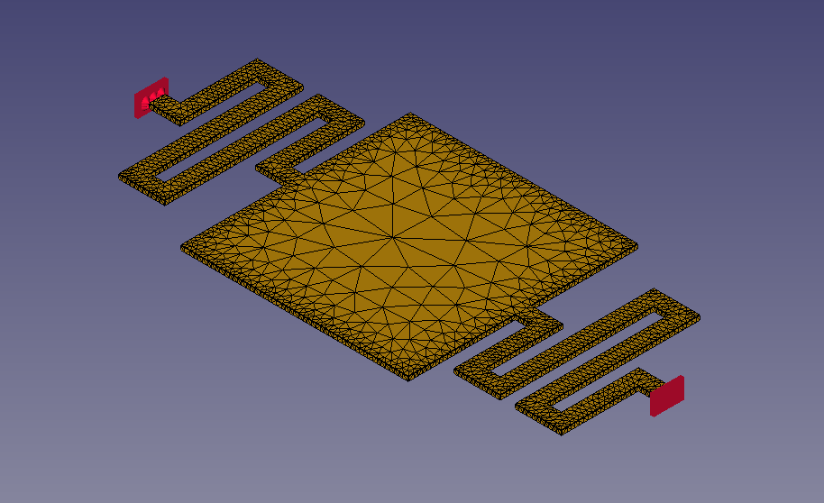

Design 3
X Scanning:
1st eigenmode
Resonance frequency (no magnet)
$f_{0}=74.23 Hz$
Est. resonance frequency (with magnet)
$f_{0}^{′}=f_{0}\sqrt{m_{0}/m′}=58 Hz$
Bounce:
2nd eigenmode
Resonance frequency (no magnet)
$f_{0}=87.74 Hz$
Est. resonance frequency (with magnet)
$f_{0}^{′}=f_{0}\sqrt{m_{0}/m′}=68.56 Hz$
Y Scanning:
3rd eigenmode
Resonance frequency (no magnet)
$f_{0}=213.34 Hz$
Est. resonance frequency (with magnet)
$f_{0}^{′}=f_{0}\sqrt{m_{0}/m′}=166.69 Hz$

Slide 7
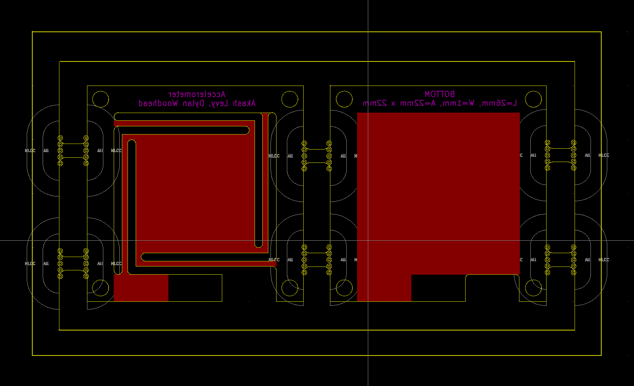
Layout with Panelization

