Slide 1
Python-based SPICE Generator & Tester for RRAM Crossbar Arrays
Akash Levy
Stanford Accelerate Group Meeting
10/24/19

Slide 2
Motivation
Problem:
Need to test variety of array types/configurations
Need different test waveforms for programming/reading to enable different schemes
Extensible framework can enable reuse of most components
Solution:
Pyxbar (https://github.com/akashlevy/pyxbar)
JSON configuration for each array and test waveforms associated with it
Allows 1R and 2R crossbar right now
V/2, V/3, float schemes available (only V/2 tested so far)
Allows checkerboard (“CB”) program+verify right now
Verify schemes: current-based (1R, 2R = todo), voltage-based (2R), gap (1R)
Support for array parasitics
Up to 1KBit verified working!

Slide 3
Well-Posed RRAM Model
Need a robust model with good convergence properties in SPICE
Solution:
Berkeley RRAM Model
Verilog-A solution that avoids manual time integration
Uses smooth stepping to enable fast convergence with Newton-Raphson method
Based on same filamentary evolution mechanism as Stanford model
Much shorter code = more understandable
Uses internal electrical node to represent the gap, tricking SPICE into performing time integration
To initialize RRAM to particular state, can use .nodeset on internal gap node
No convergence issues encountered so far
More details:
Wang, Tianshi, and Jaijeet Roychowdhury. "Well-posed models of memristive devices." arXiv preprint arXiv:1605.04897 (2016).

Slide 4
Well-Posed RRAM Model
`include "disciplines.vams"
`include "constants.vams"
module RRAM_v0(t, b, nGap);
inout t, b, nGap;
electrical t, b, nGap;
parameter real g0 = 0.25 from (0:inf);
parameter real V0 = 0.25 from (0:inf);
parameter real Vel0 = 10 from (0:inf);
parameter real I0 = 1e-3 from (0:inf);
parameter real Beta = 0.8 from (0:inf);
parameter real gamma0 = 16 from (0:inf);
parameter real Ea = 0.6 from (0:inf);
parameter real a0 = 0.25 from (0:inf);
parameter real tox = 12 from (0:inf);
parameter real maxGap = 1.7 from (0:inf);
parameter real minGap = 0.0 from (0:inf);
parameter real smoothing = 1e-8 from (0:inf);
parameter real GMIN = 1e-12 from (0:inf);
parameter real Kclip = 50 from (0:inf);
real Gap, ddt_gap, Gamma, Fw1, Fw2, clip_0, clip_maxGap;
analog function real smoothstep;
input x, smoothing;
real x, smoothing;
begin
smoothstep = 0.5*(x/sqrt(x*x + smoothing)+1);
end
endfunction // smoothstep
analog begin
Gap = V(nGap, b);
I(t, b) <+ I0 * limexp(-Gap/g0) * sinh(V(t, b)/V0) + GMIN*V(t, b);
Gamma = gamma0 - Beta * pow(Gap, 3);
ddt_gap = -Vel0*exp(-Ea/$vt)*sinh(V(t, b)*Gamma*a0/tox/$vt);
Fw1 = smoothstep(minGap-Gap, smoothing);
Fw2 = smoothstep(Gap-maxGap, smoothing);
clip_minGap = (limexp(Kclip*(minGap-Gap)) - ddt_gap) * Fw1;
clip_maxGap = (-limexp(Kclip*(Gap-maxGap)) - ddt_gap) * Fw2;
I(nGap, b) <+ ddt_gap + clip_minGap + clip_maxGap;
I(nGap, b) <+ ddt(-1e-9*Gap);
end
endmodule

Slide 5
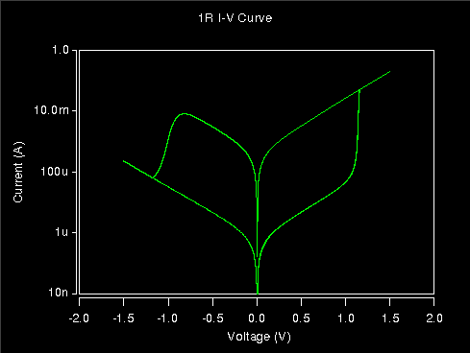
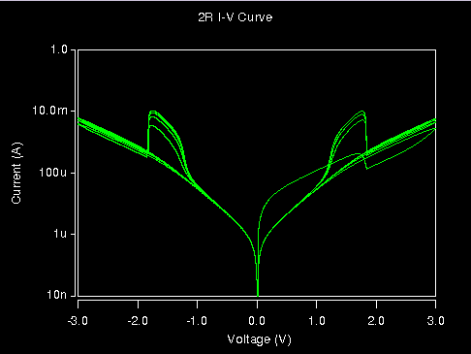
I-V of 1R & 2R devices (no selector, 4 cycles overlaid)

Slide 6
Example JSON Config File
{
"title" : "test_1R_cb_16x16_2f",
"type" : "1R",
"includes" : [],
"models" : ["../models/rram_wp.va"],
"modname" : "RRAM_v0",
"options" : ["post=2"],
"params" : [],
"probes" : [],
"modparams" : "",
"rows" : 16,
"cols" : 16,
"rrow" : 0.18,
"crow" : 0.108e-12,
"rcol" : 0.18,
"ccol" : 0.108e-12,
"tstep" : 1e-7,
"gap0" : 1.7,
"tests" : [
{
"name" : "cb",
"set" : {
"rowV" : 1.5,
"colV" : 0,
"pw" : 1e-6
},
"reset" : {
"rowV" : 0,
"colV" : 1.5,
"pw" : 1e-6
},
"read" : {
"rowV" : 0.2,
"colV" : 0,
"pw" : 1e-6
},
"scheme" : "V/2",
"flips" : 2,
"slewtime" : 1e-7,
"wait" : 1e-6,
"verify" : {
"method" : "current",
"bounds" : {
"lo" : [0, 0.0025],
"hi" : [0.0025, 0.005]
}
}
}
]
}

Slide 7
Python Code
Generator:
172 lines of code including comments
Takes in JSON file with array specs and test waveform specs
Produces HSPICE netlist with test waveform
Tester:
120 lines of code including comments
Takes in JSON file with array specs and verification scheme
Generates PASS/FAIL
Can visualize checkerboard with Matplotlib
Verbose option allows you to see which pieces of the tests failed

Slide 8
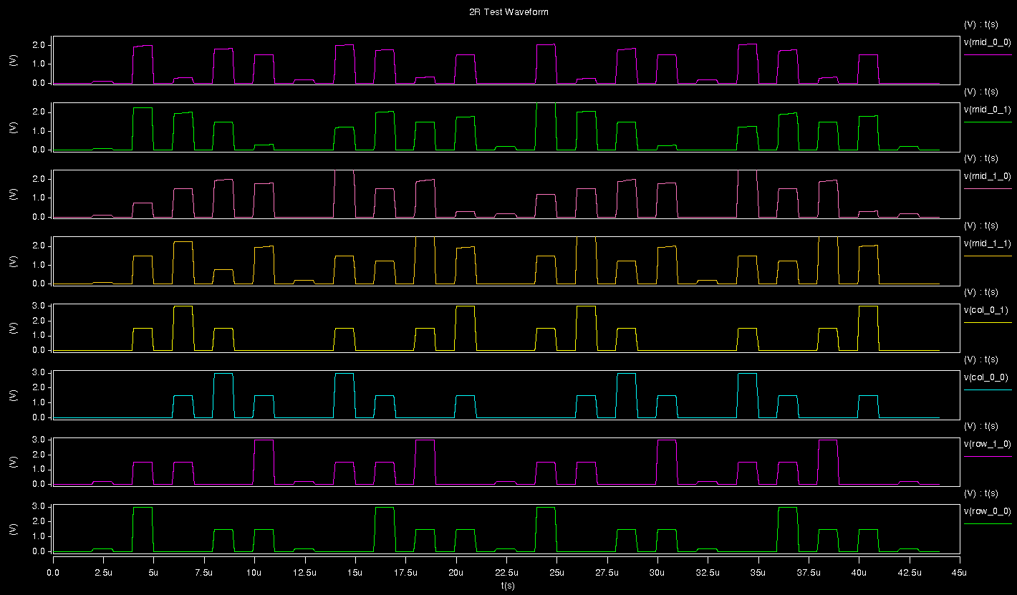
Waveform Example (1R, 2x2, 4 flips)
READ
Flip 1
READ
Flip 2
READ
Flip 3
READ
Flip 4
READ

Slide 9
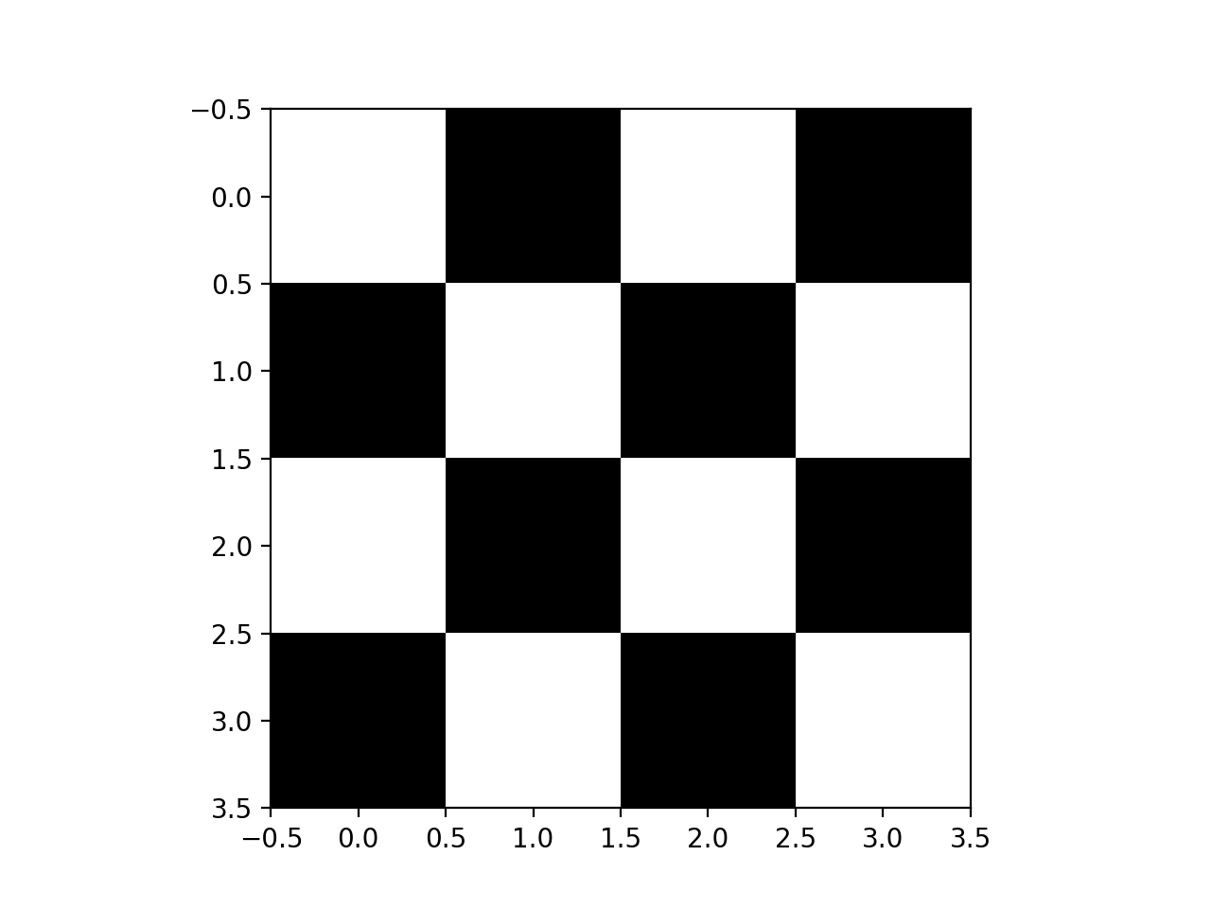
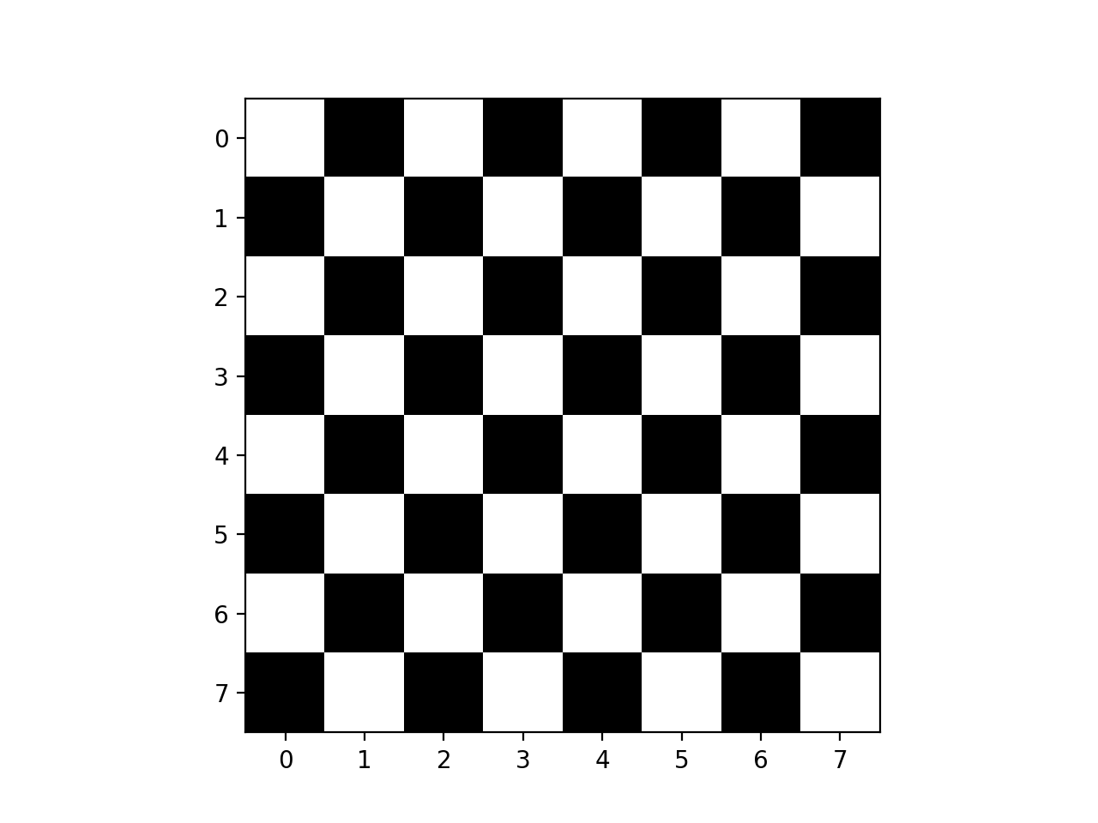
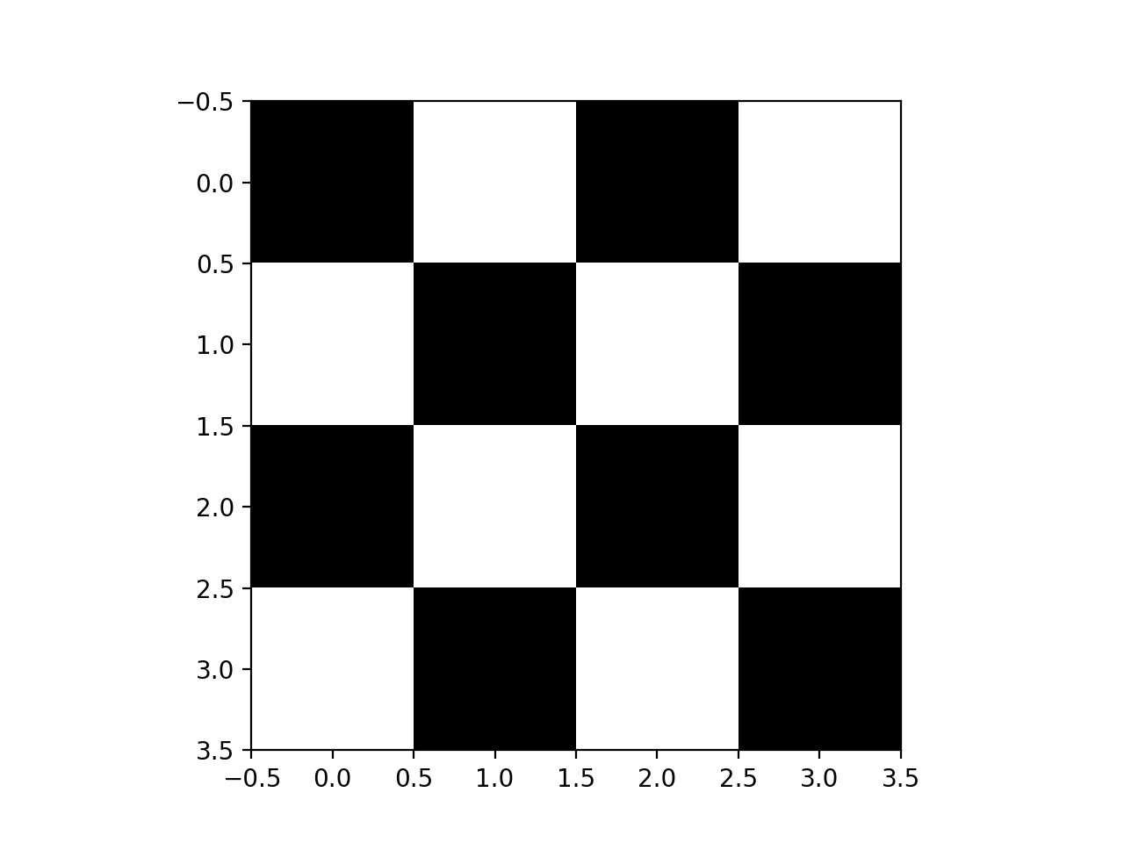
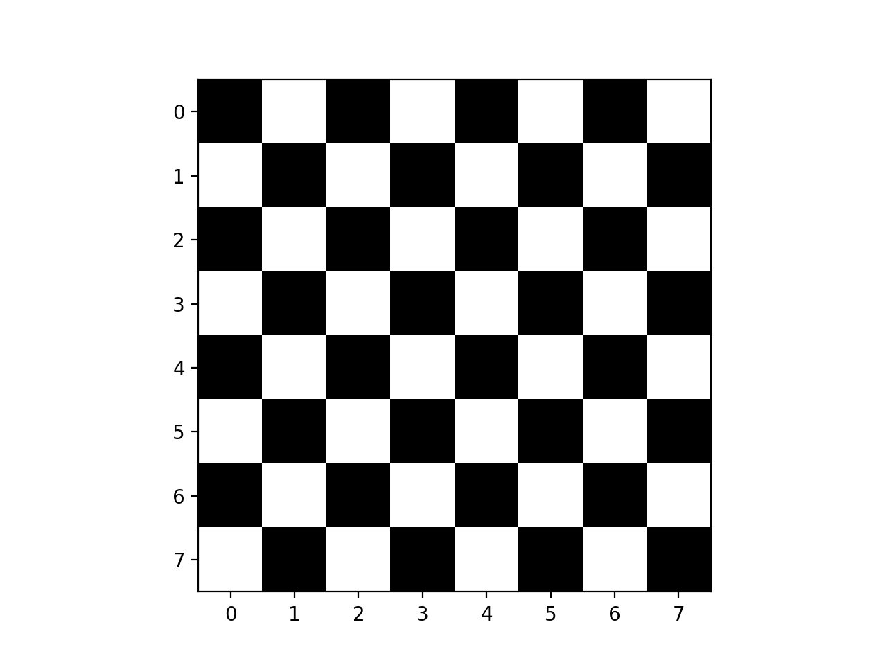
Visualization Examples (PASS)

Slide 10
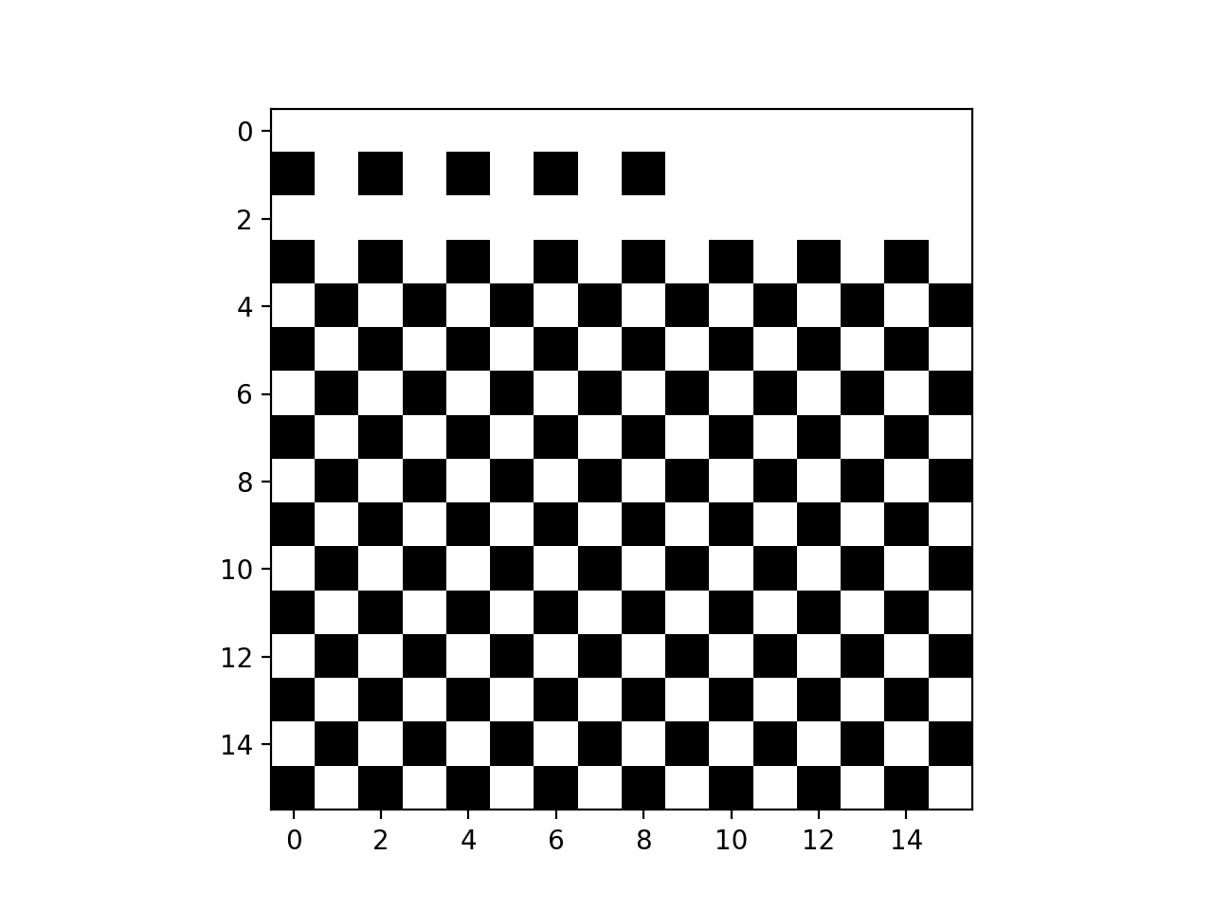
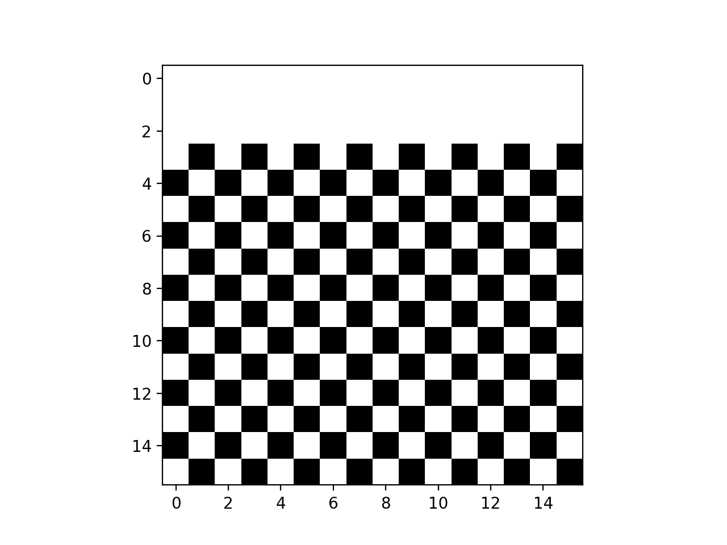
Visualization Examples (FAIL)
Small sense margin from sneak paths! Problem is exacerbated in non-CB configurations

Slide 11
CB Scalability: Netlist Generation Time
> 10 mins for 128
Probably runs out of memory around 64

Slide 12
CB Scalability: Netlist File Size
Several GB for netlist at 128

Slide 13
CB Scalability: HSPICE64 Simulation Time

Slide 14
CB Scalability: HSPICE64 Peak Memory
Probably scalable at least to 256x256: can also try nanopower cluster!

Slide 15
CB Scalability: Output File Size
Going larger means 50+ GB files!

Slide 16
CB Scalability: Testbench time

Slide 17
Possible Scalability Improvements
Less comprehensive testing
Probably cannot do full checkerboard beyond 4KBits
Full CB: O(N²) timesteps required, sim time is the real issue!
Can instead test subarrays at different locations in array
O(1) timesteps required
Most important are far edges because of parasitic effects!
Will make all components much more scalable (hopefully up to 1MBit)
Netlist generation
Replace Python templating system with something faster
Flush netlist to disk to prevent storing everything in RAM
Waveform testing
Buffer file read instead of reading tiny chunks
Skip over time points instead of checking each one esp. when far away

Slide 18
Upcoming
Test V/3 and float schemes
Test scalability with reduced checkerboard
Test scalability, power with different parasitics
Add tests for doing matrix multiply in memory
Add support for differential crosspoint (DX) array
Add support for 1TNR arrays
Test with different RRAM parameters
Try fitting RRAM model to different kinds of RRAM i.e. N-doped AlO_{x}
Near-term goal: comparison of selector/selector-less, voltage/current-based sensing

Slide 19
Thank you!

