Slide 1

MiniProject 1
Akash Dalzell

Slide 2

Data

Slide 3
Data
Age and Region
Age and Gender
Gender and Region
Industries

Slide 4
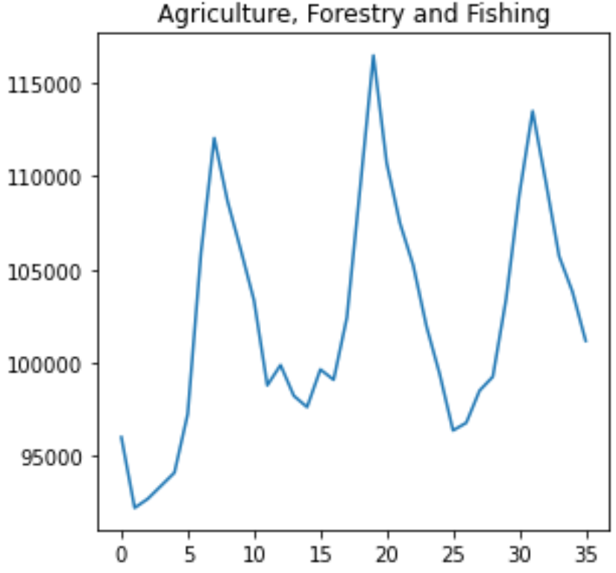
General Uptrend
Seasonal highs and lows
Possibly due to winter

Slide 5
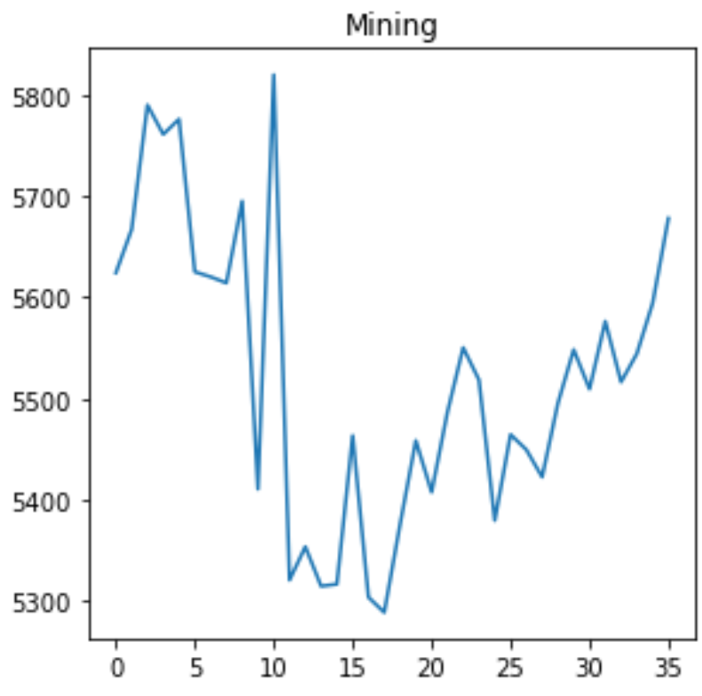
Sudden drop in the middle
Return back to general uptrend
Possible reasons:
Kiwisavers cease investments into mining
Closer of Canteburry Mine
Tougher regulations

Slide 6
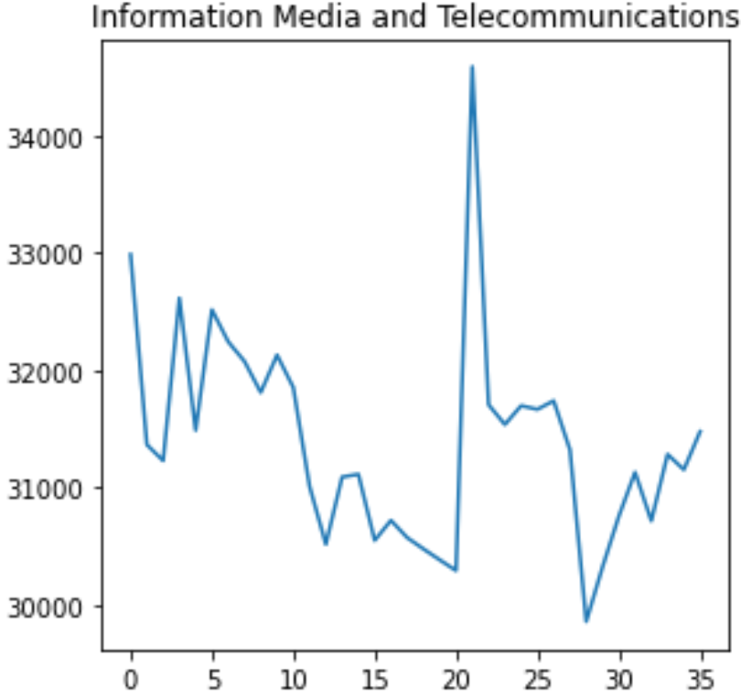
General downtrend
Giant spike
Possible reason:
Introduction to 5g

Slide 7
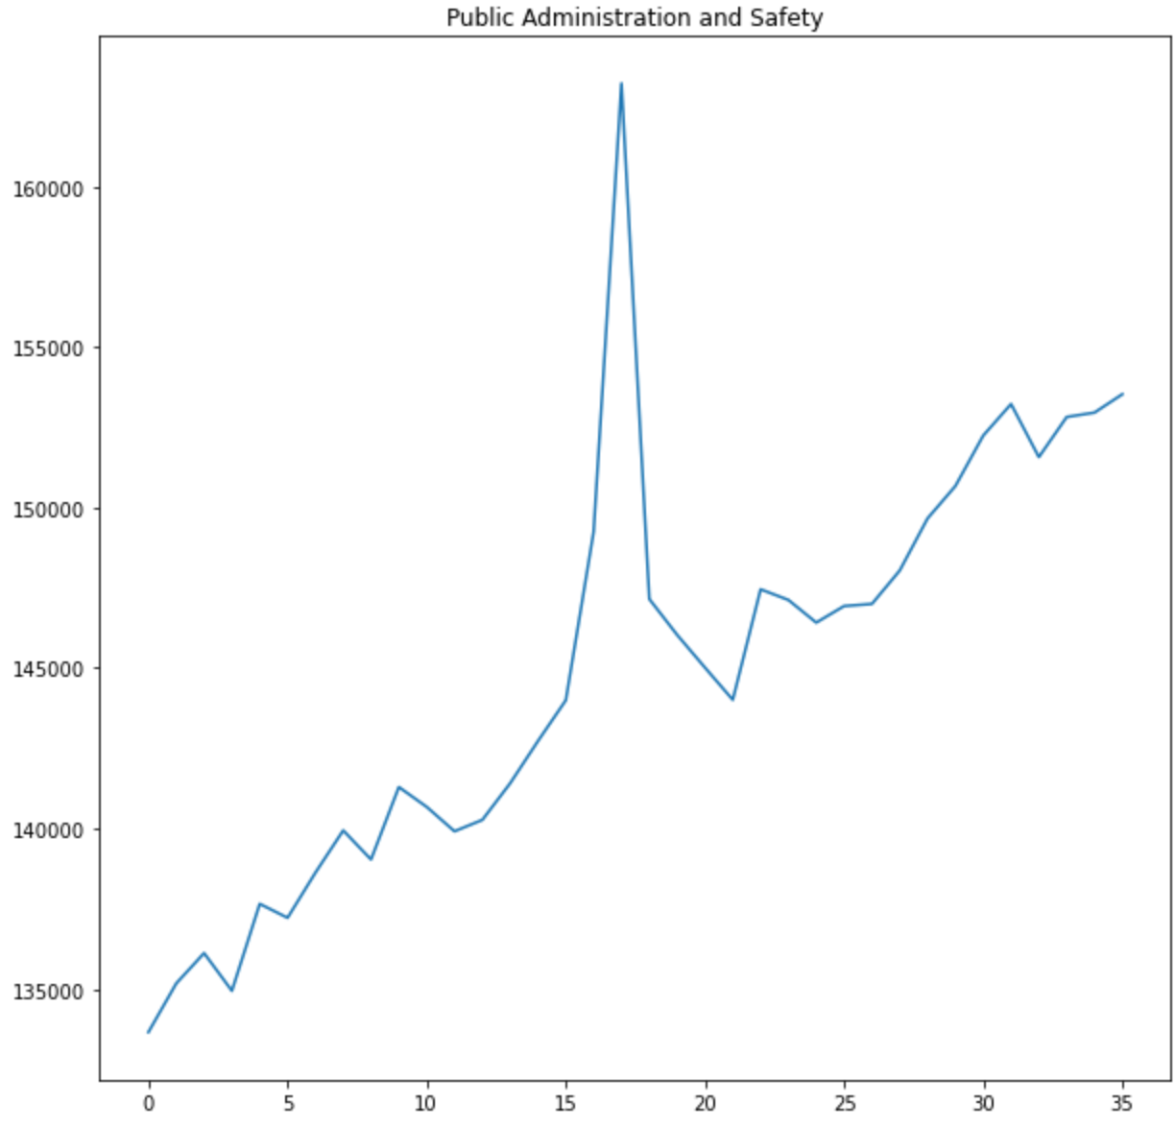
General uptrend
Giant spike
Possible reason:
General Election Oct 2020

Slide 8
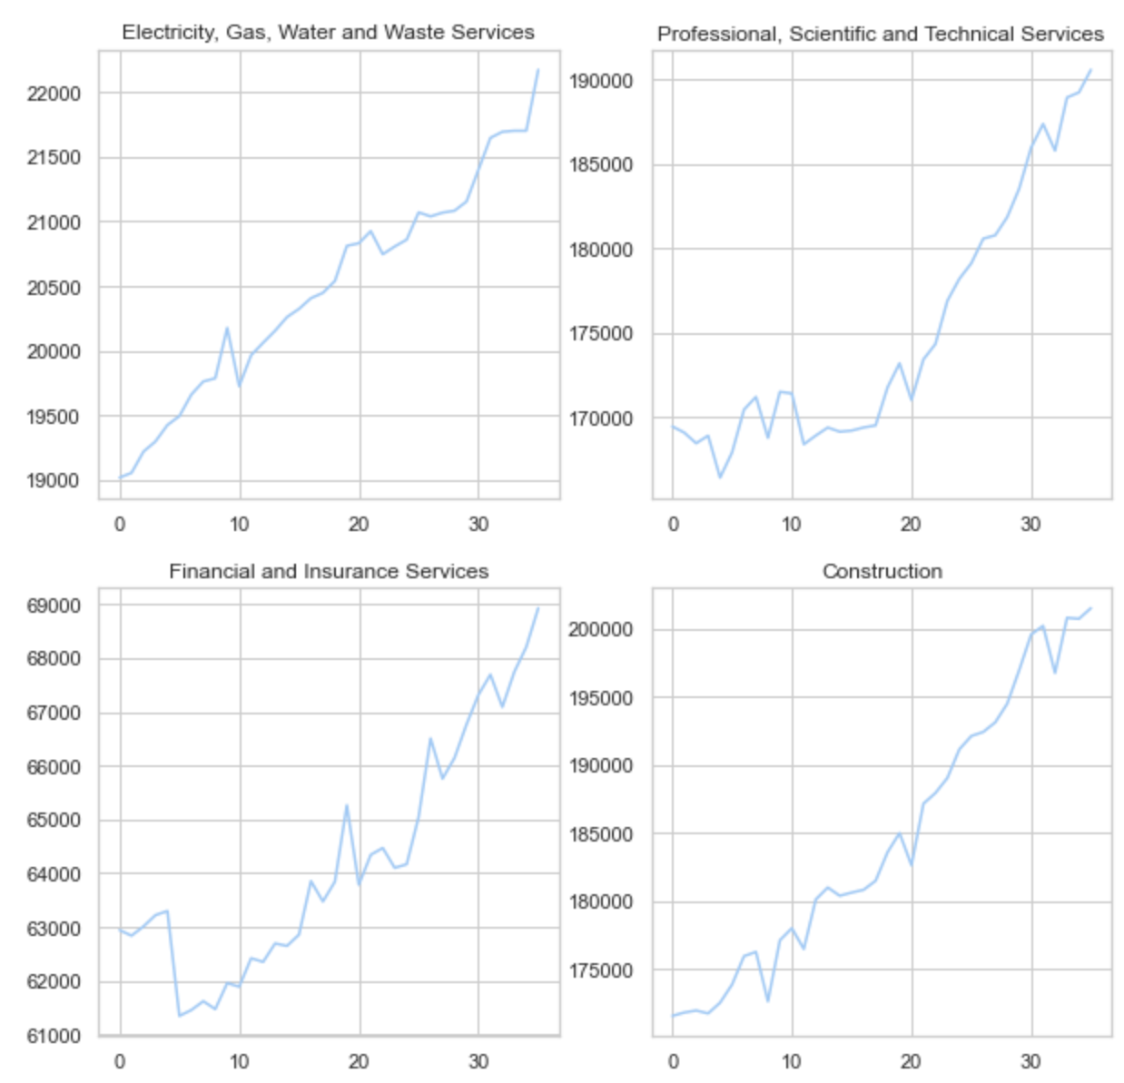
Emerging Industries

Slide 9
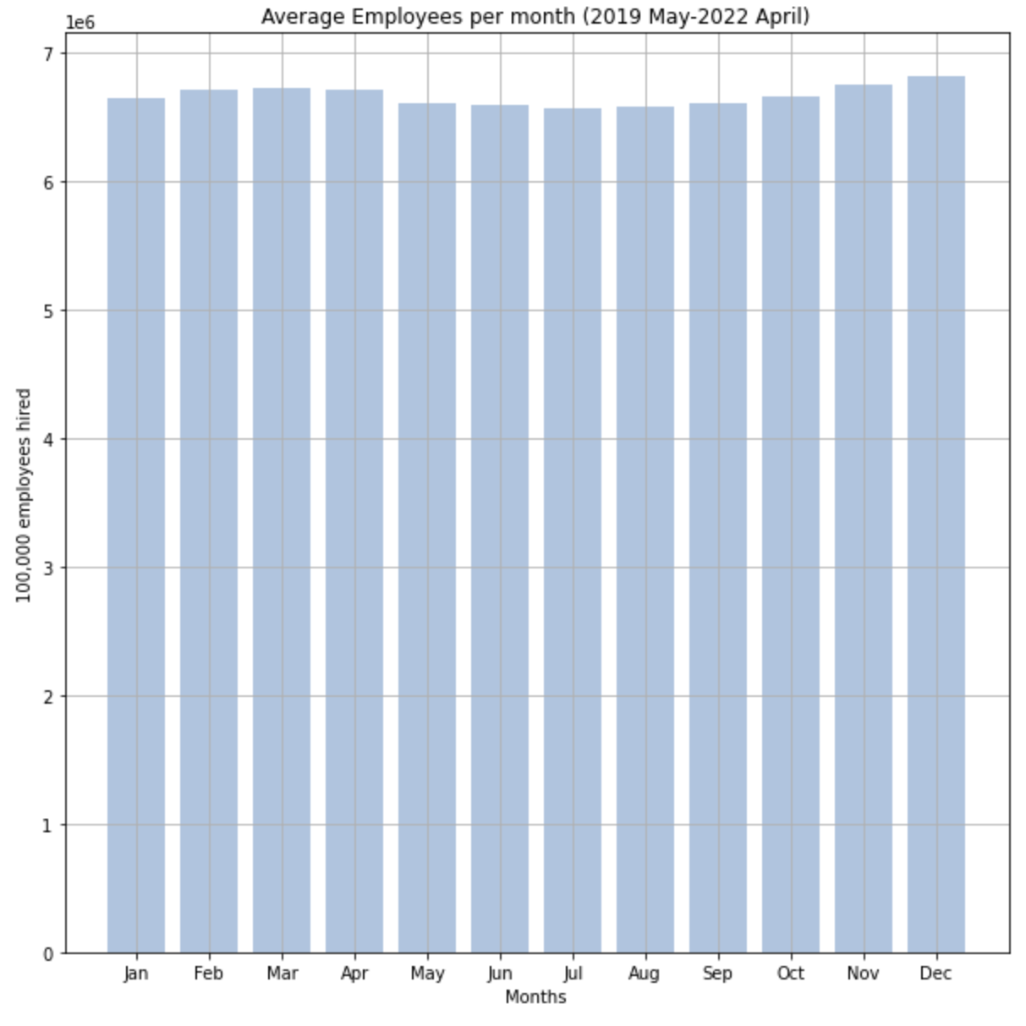
Seasonal Effects
Goes through a lull during the middle of the year
Highest month is December
Lowest month is July

Slide 10
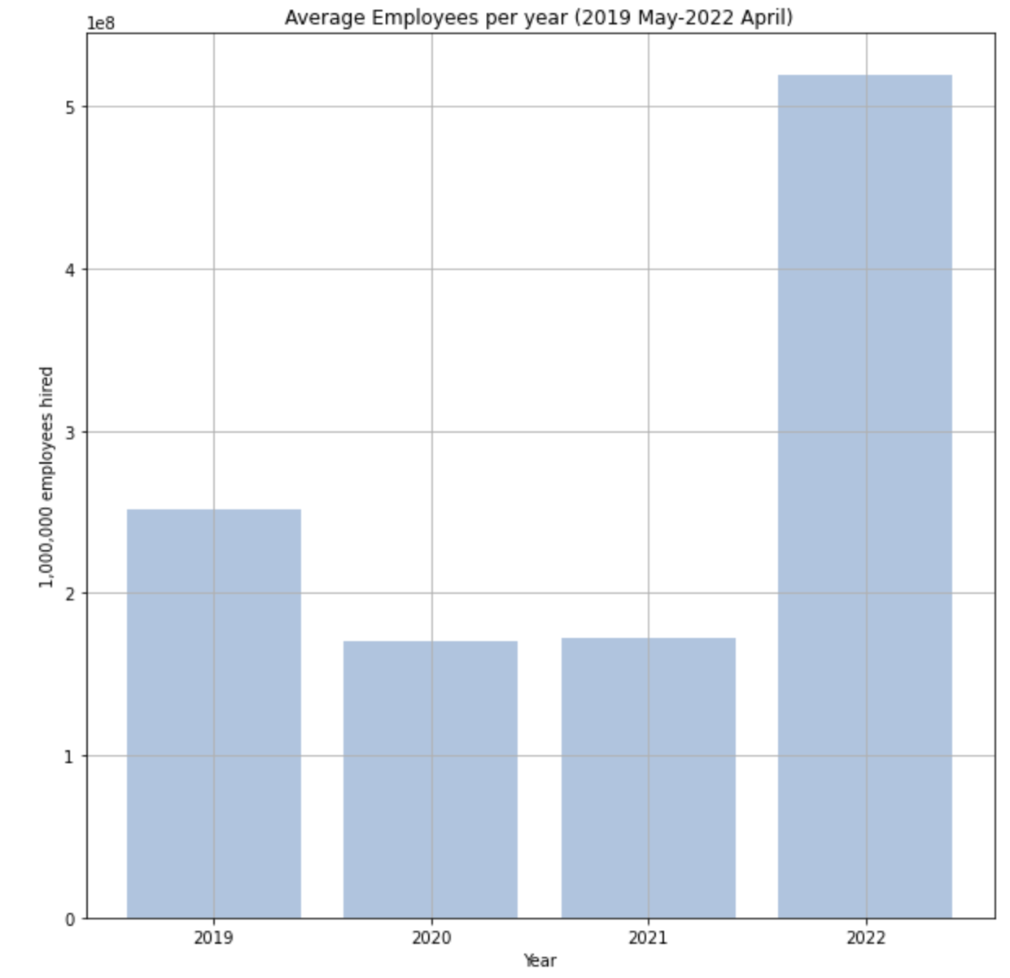
Lockdown for COVID resulting in less employment
Possible bounce back with COVID restrictions gone
Uneven number of months per year in dataset
2022 doesn’t contain the middle months that historically has the lowest employment

Slide 11
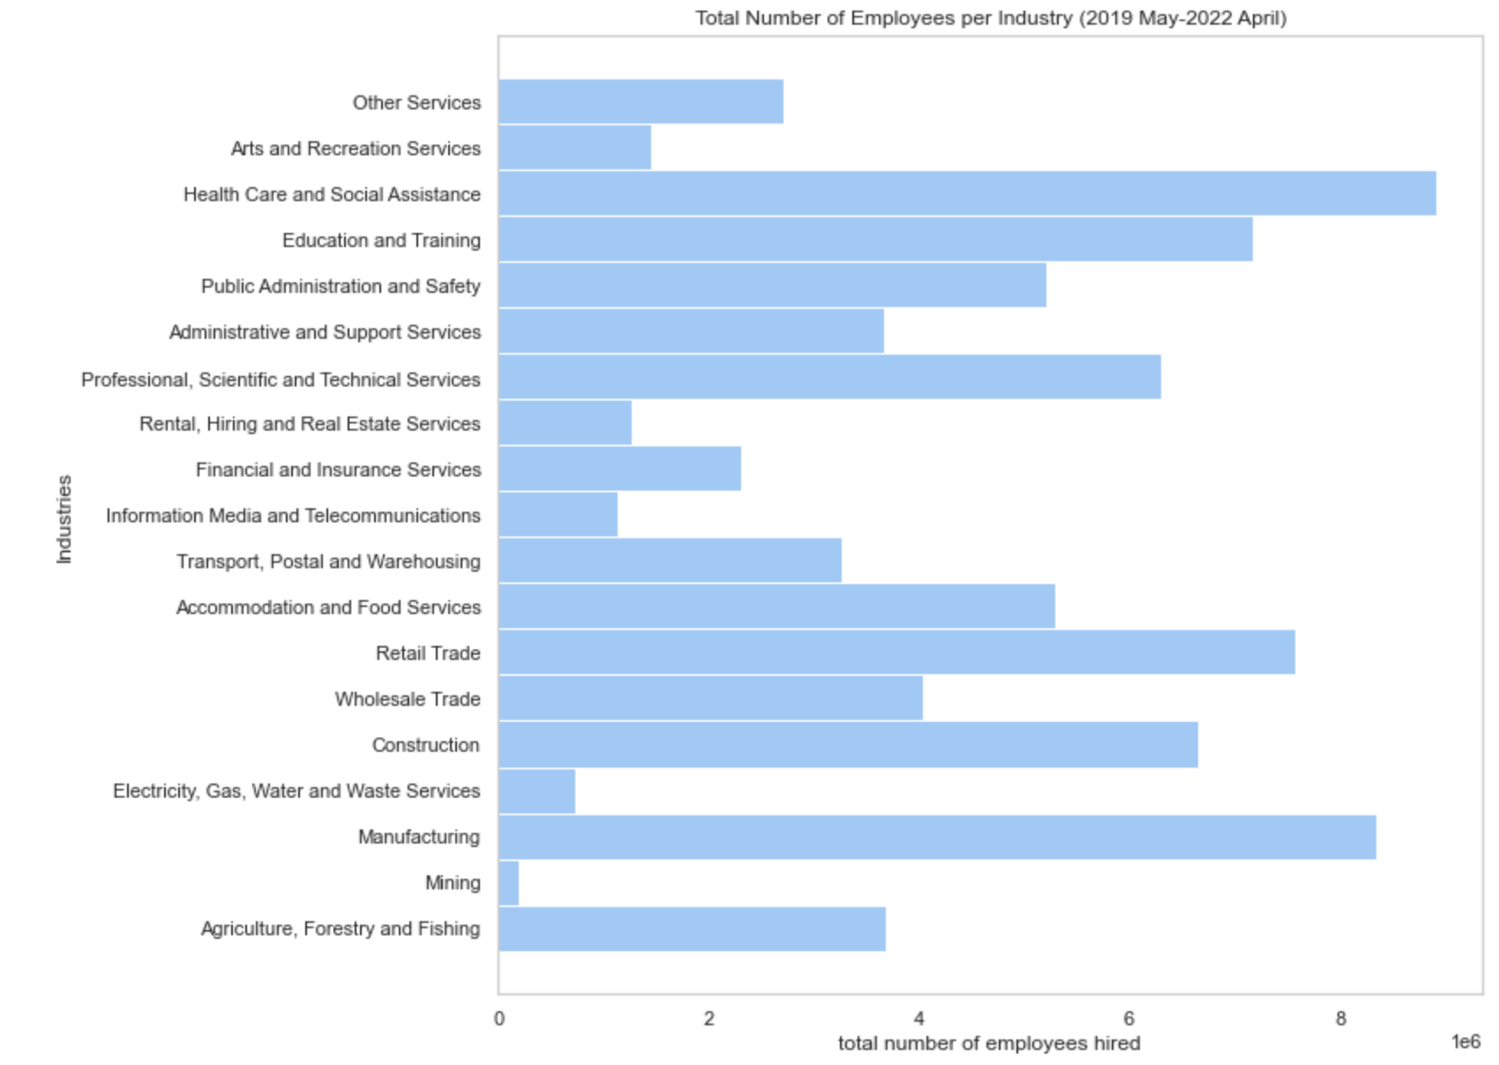
Large spread of the distribution between the sectors
Most employed sector: Health Care
Possibly due to COVID
Least employed sector: Mining
Agriculture being the biggest contributor towards GDP
Not the most employed, meaning money is distributed against less people.

Slide 12
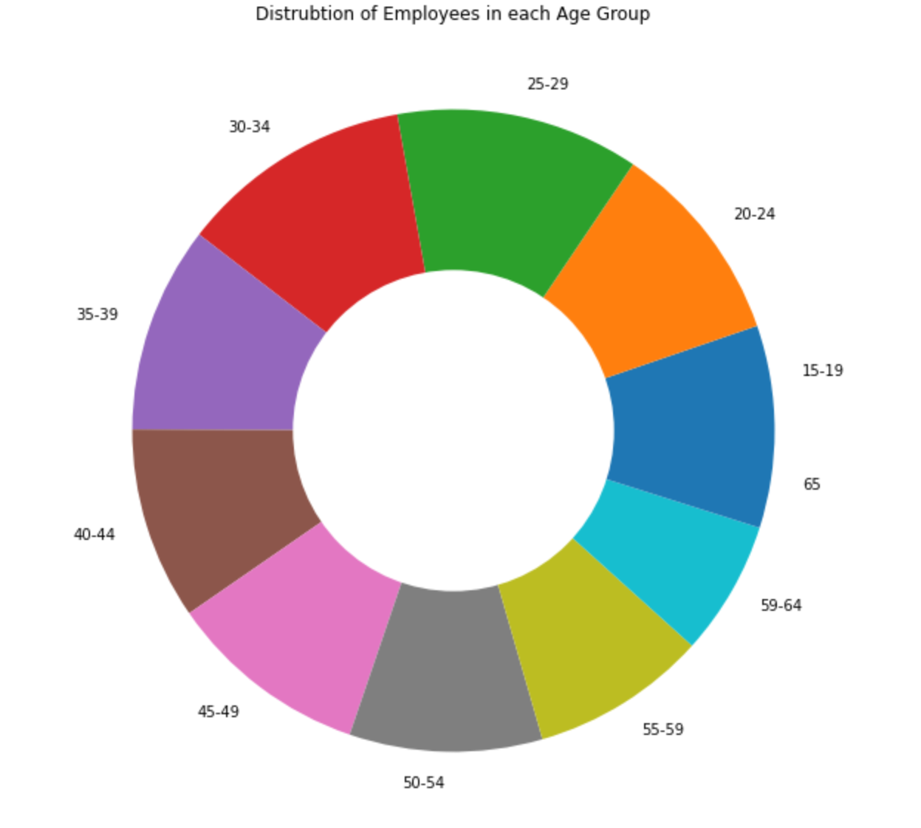
Age
Great distribution between the ages
No disparities
No aging workforce

Slide 13
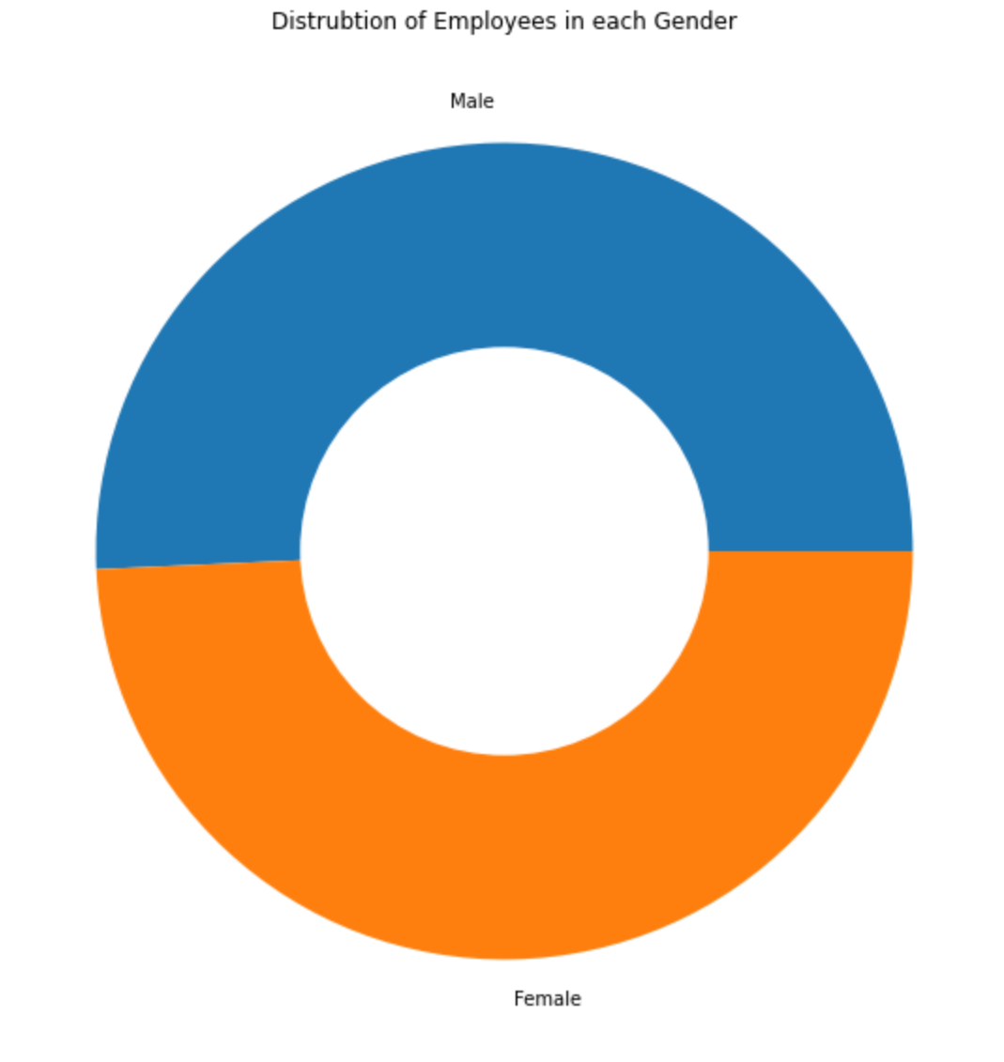
Gender
Great distribution between the genders

Slide 14
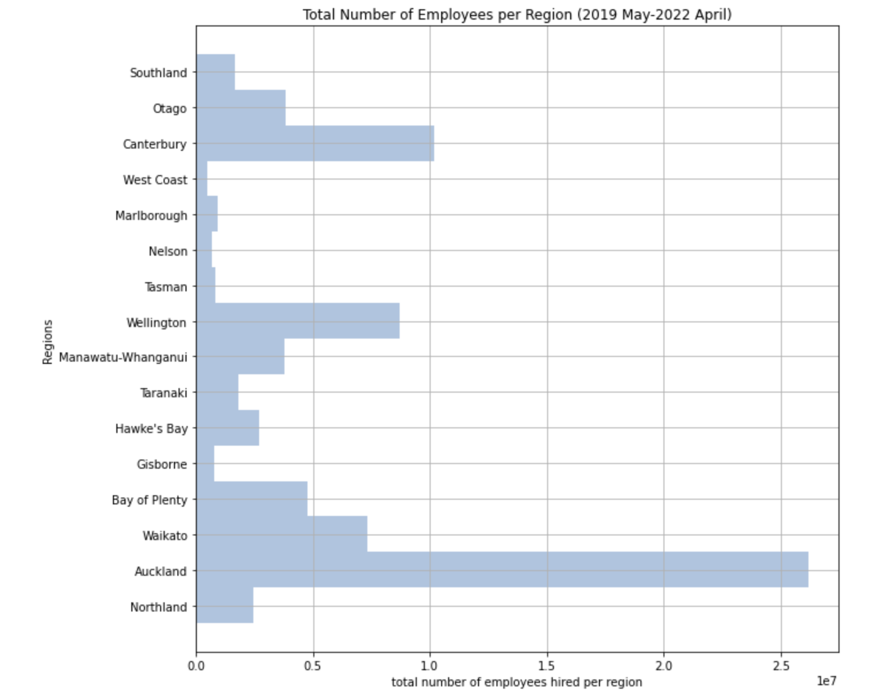
Auckland by far employees the most people
Christchurch is second, closely followed by Wellington and Waikato

Slide 15
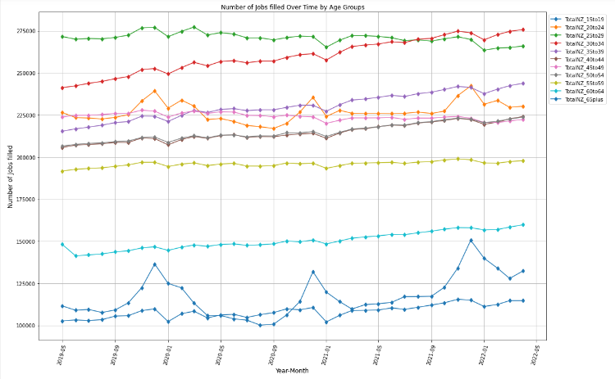
Higher the age, less seasonal employment
Very well proportioned age groups working
Highest age group (25-29)
Lowest age group (65+)
Most trending upwards
Uneven records per month

Slide 16
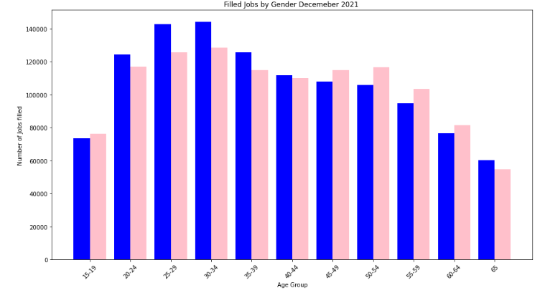
Start off equal
Females don’t increase as much as men
Possible reason for difference is pregnancy
45 women start to go back to work presumably after children
Most retired 60~65

Slide 17
Questions

