Slide 1
Machine Learning
© Templateswise.com
Presented By :
Nishant Goel(2K18/PS/028)
Ritwik Shekhar(2K18/PS/040)

Slide 2
SENTIMENT ANALYSIS
This project addresses the problem of sentiment analysis in twitter, that is classifying tweets according to the sentiment expressed in them: positive, negative or neutral. This project of analyzing sentiments of tweets comes under the domain of “Pattern Classification” and “Data Mining” and it would heavily rely on techniques of “Natural Language Processing” in extracting significant patterns and features from the large data set of tweets and on “Machine Learning” techniques for accurately classifying individual unlabeled data samples (tweets) according to whichever pattern model best describes them.

Slide 3
METHODOLOGY
NLP
ML CLASSIFICATION MODELS
VISUALIZATION TECHNIQUES
Natural Language Processing techniques used in Data Preprocessing.
Some visualizations like pie chart, bar chart etc. used to compare Efficiency.
Different Classification models(self as well as pre implemented) used.

Slide 4
Data Insights and Preprocessing
Raw Data
The data consists of user tweets for an airline company on their flight experience and the rating whether the their tweet showed negative, neutral or positive feedback. The data is in tabular form having 1 column for tweets and the other column for the feedback.

Slide 5
Pos(Part of Speech) Tagging & Lemmatization
For removal of stop words and unuseful words, Lemmatization techniques have been used to filter out the tweet such that it helps in accurate prediction.
Post Tagging is used on the raw data to ensure the correctness of the class each word of the belongs to.

Slide 6
Tokenizing & Splitting Textual Data
Tokenization is the process of breaking a stream of text up into words, symbols and other meaningful elements called “tokens”. Tokens can be separated by whitespace characters and/or punctuation characters.
The data is then split into 7:3 ratio to form training and testing data.
The training data is used to train the classifiers and the classifier is tested on the testing data giving the predictions it makes about the feedbacks for testing data’s tweets.

Slide 7
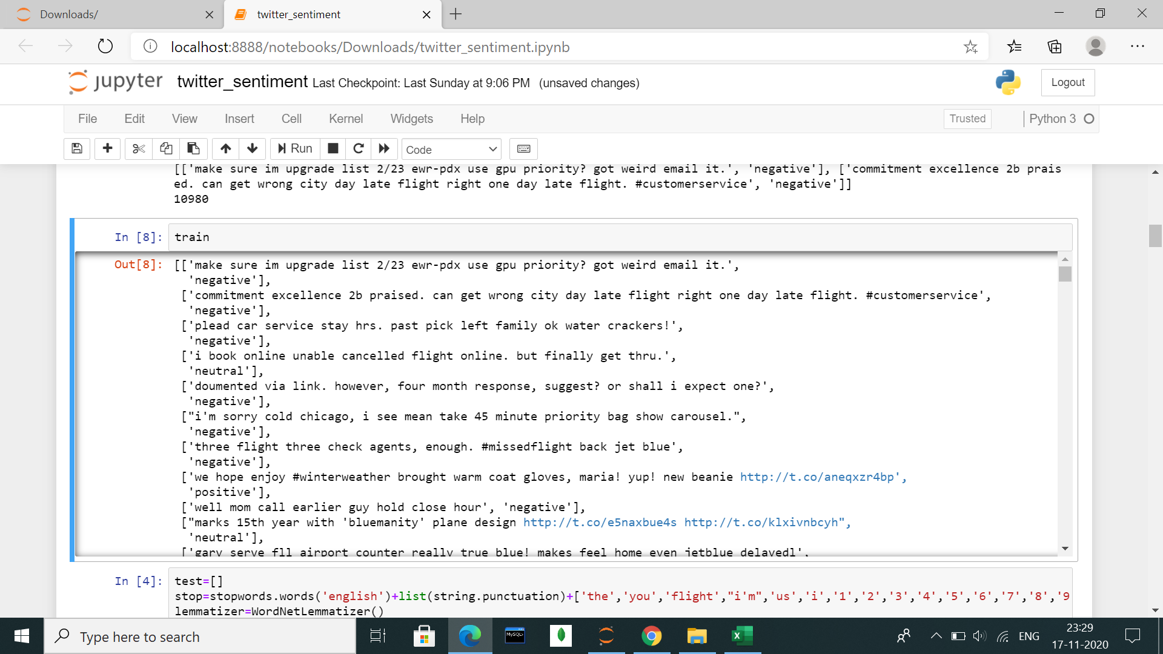

Slide 8
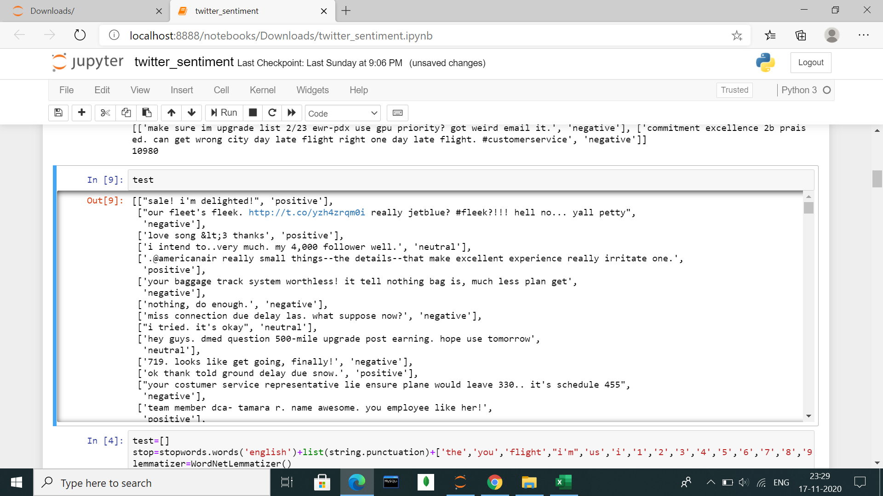

Slide 9
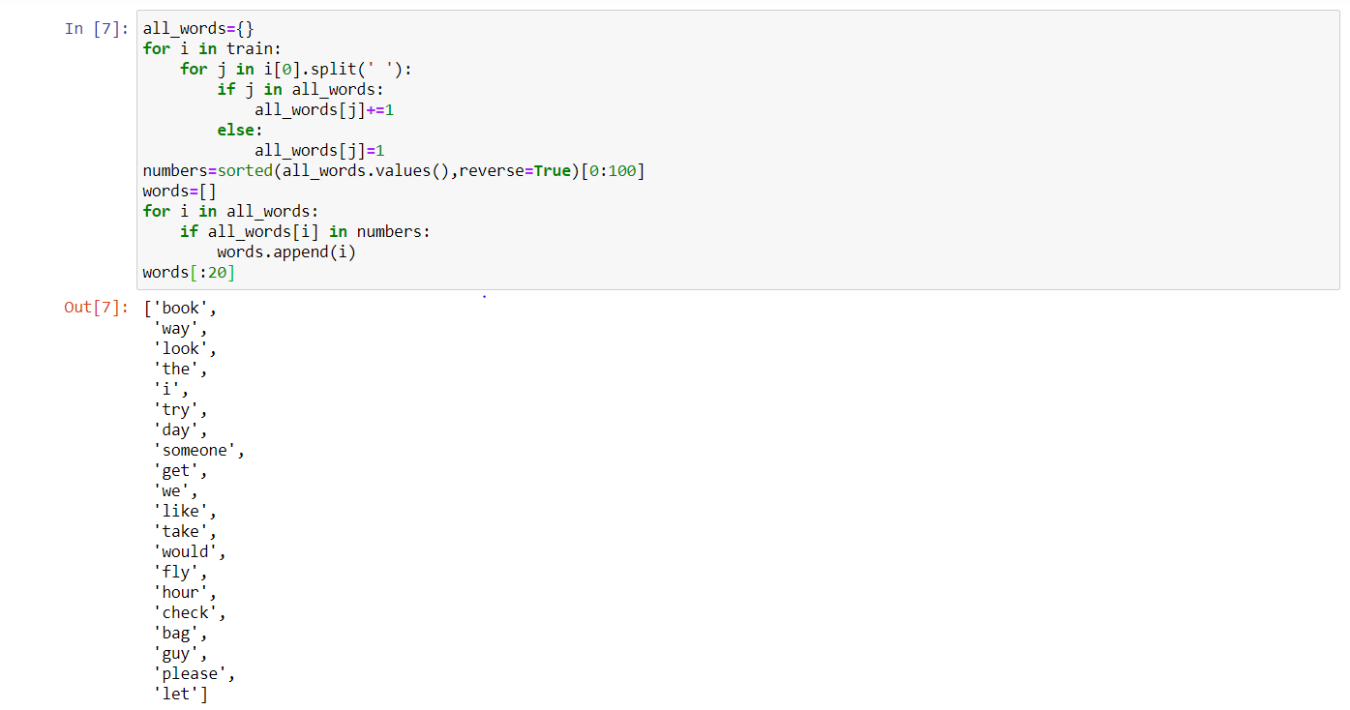
After Tokenization

Slide 10
Implementing TF-IDF on Resulting Data
Tf-Idf stands for term frequency-inverse document frequency, and the Tf-Idf weight is a weight often used in information retrieval and text mining.
We have implemented Tf-Idf to bring the textual data to numerical form and to further ensure the respective weightage of each word in a sentence.

Slide 11
Textual Data to Numerical Data
As numerical data is required by classifiers to make predictions the tweets and the feedback values need to be changed to numerical values in order to make predictions. The training and testing data related to tweets is prepared using count vectorization method. Inverse Document frequency techniques has been used to effectively prepare the vectorized data in order to accurately train the classifiers which will result in making accurate predictions.

Slide 12
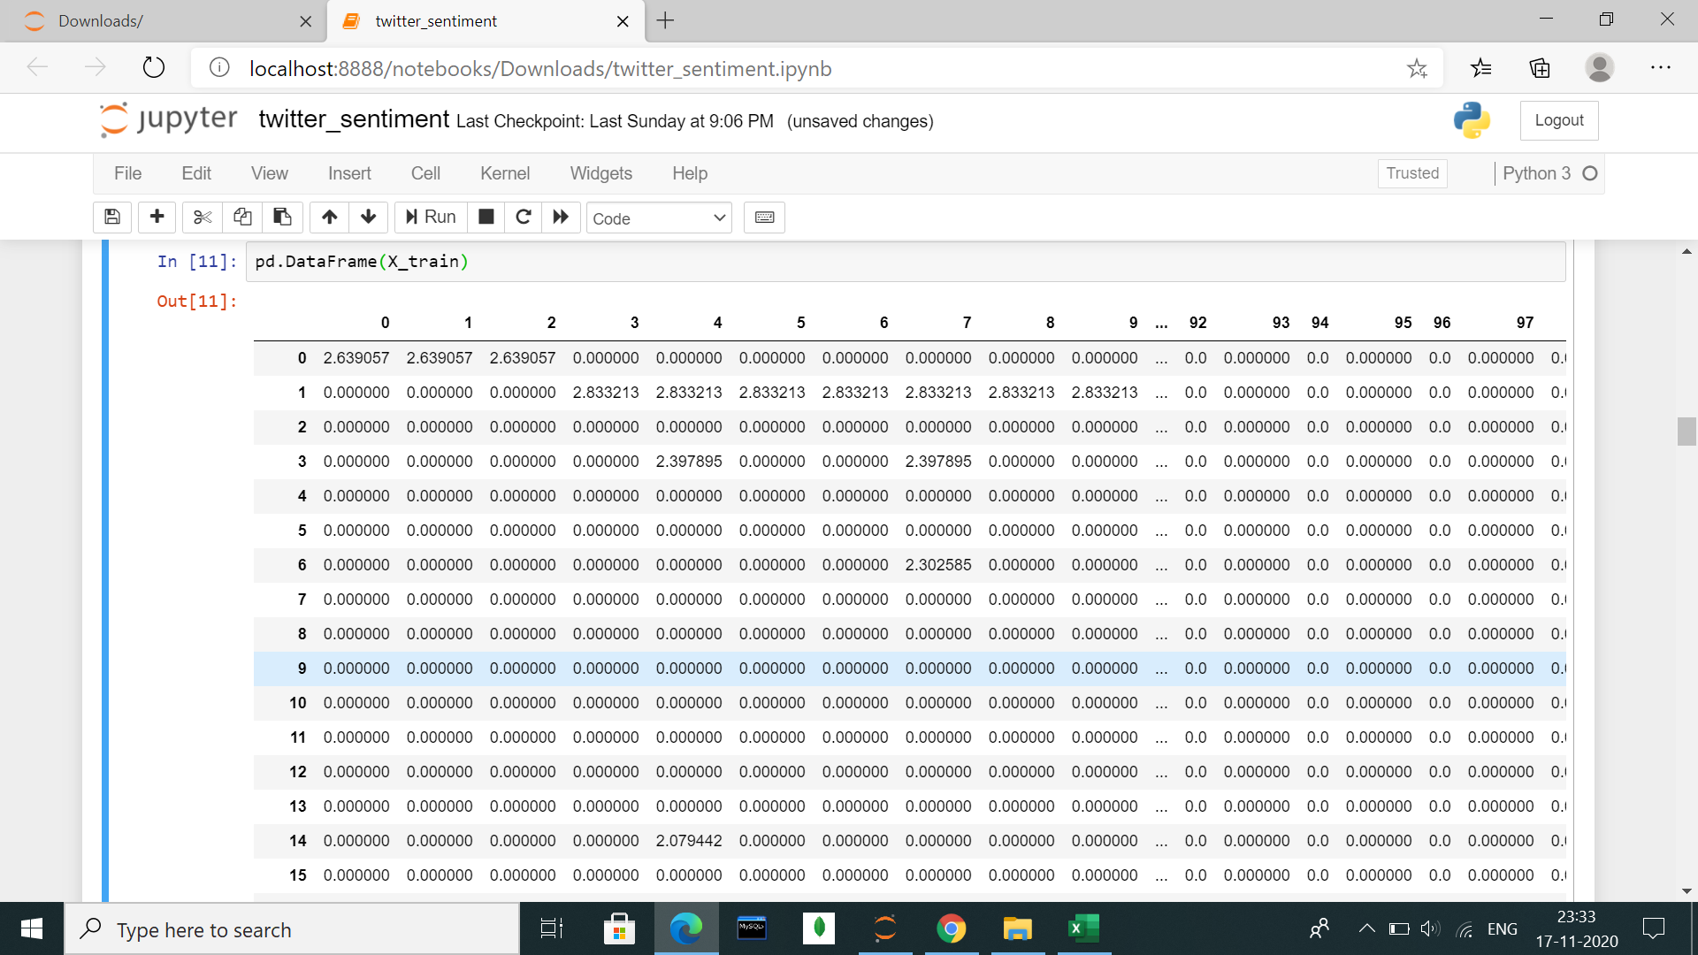

Slide 13
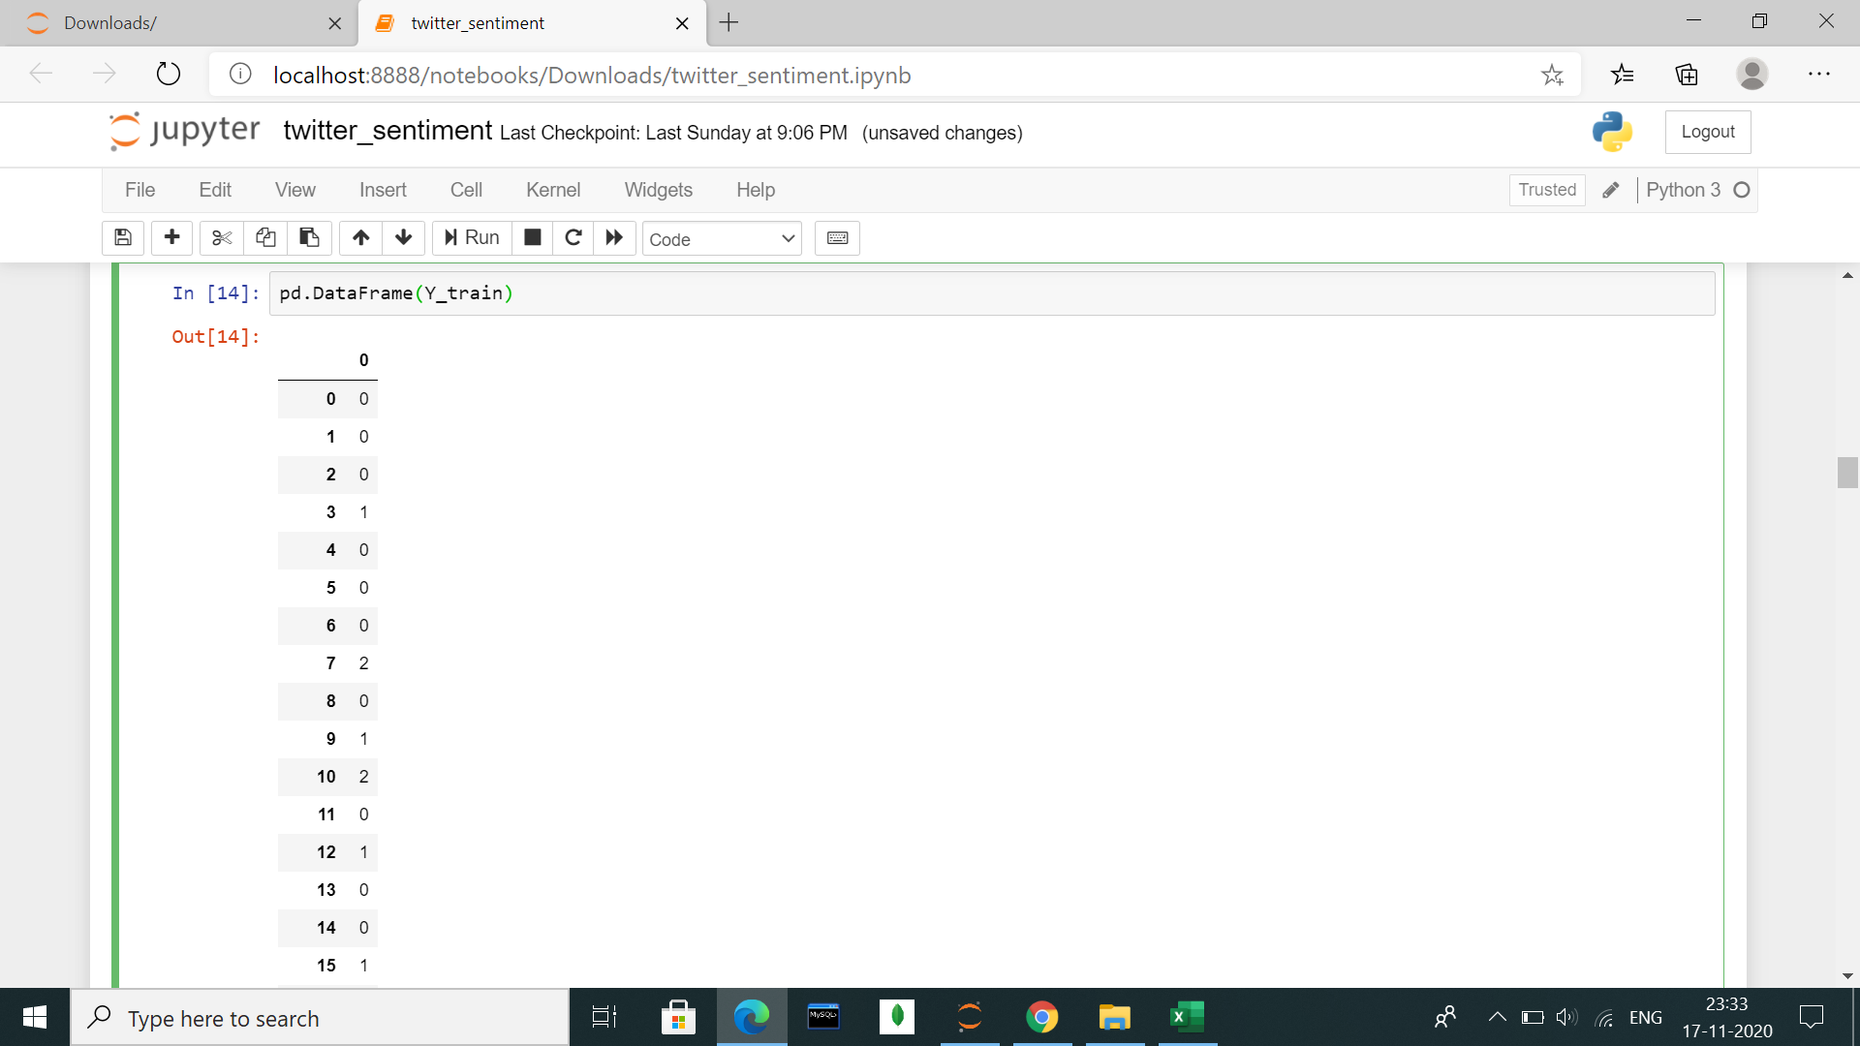

Slide 14
Classifiers Used
After preparing the training and testing data, we are now ready to build and use pre-implemented classifiers (from sklearn library). Variety of classifiers such as :
Multinomial Naive Bayes
Decision Tree (Three parameter-based trees)
Logistic Regression Classifier
SVC
KNN
have been scratch implemented and the predictions have been made predicting the feedbacks of the tweets. Pre-implemented versions of the above-mentioned classifiers have also been used to make predictions. The predictions of the self built and prebuilt classifiers are then compared.

Slide 15
NAIVE BAYES CLASSIFIER
The Multinomial Naive Bayes Classifier has been scratch implemented to make predictions. The classifier predicts the feedbacks of the tweets using the basic naive bayes theorem shown below. The predictions are made in form of numerical values (0,1,2) which can later be converted into the negative, neutral or positive feedbacks. The pre-built Multinomial NB classifier from sklearn has also been used to make predictions. The predictions from the self built classifier and the pre-built classifier are compared to measure the performance of the two classifiers. The graphs are plotted showing the difference in prediction accuracy of the 2 classifiers. Precision and recall values for both the classifiers have also been printed.

Slide 16
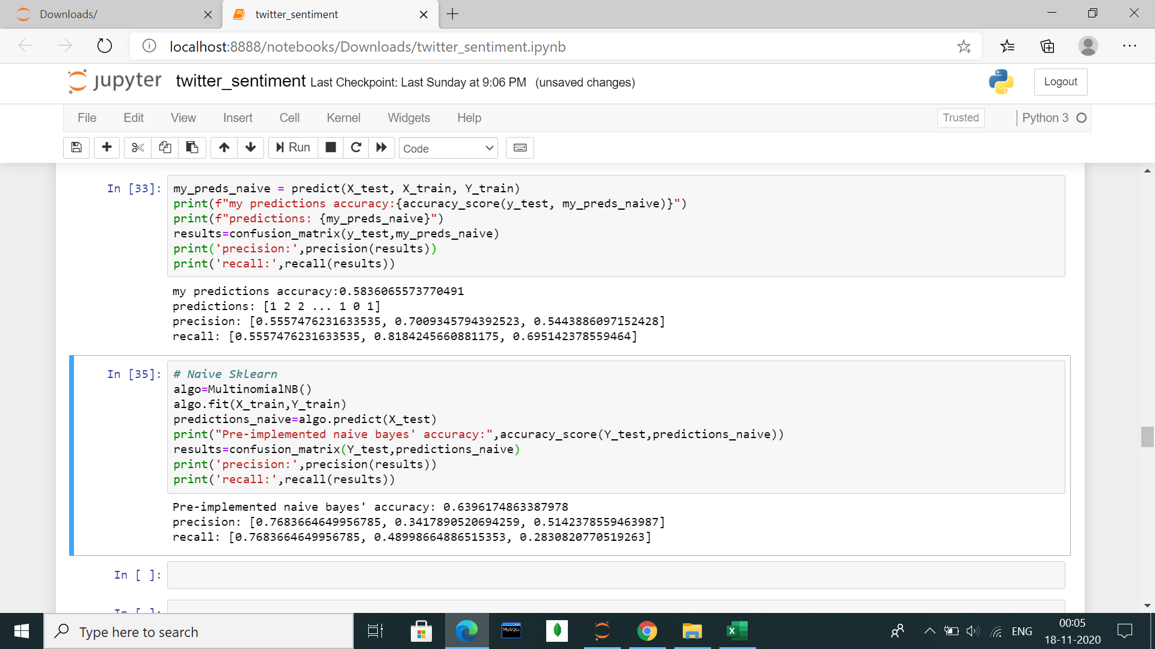

Slide 17
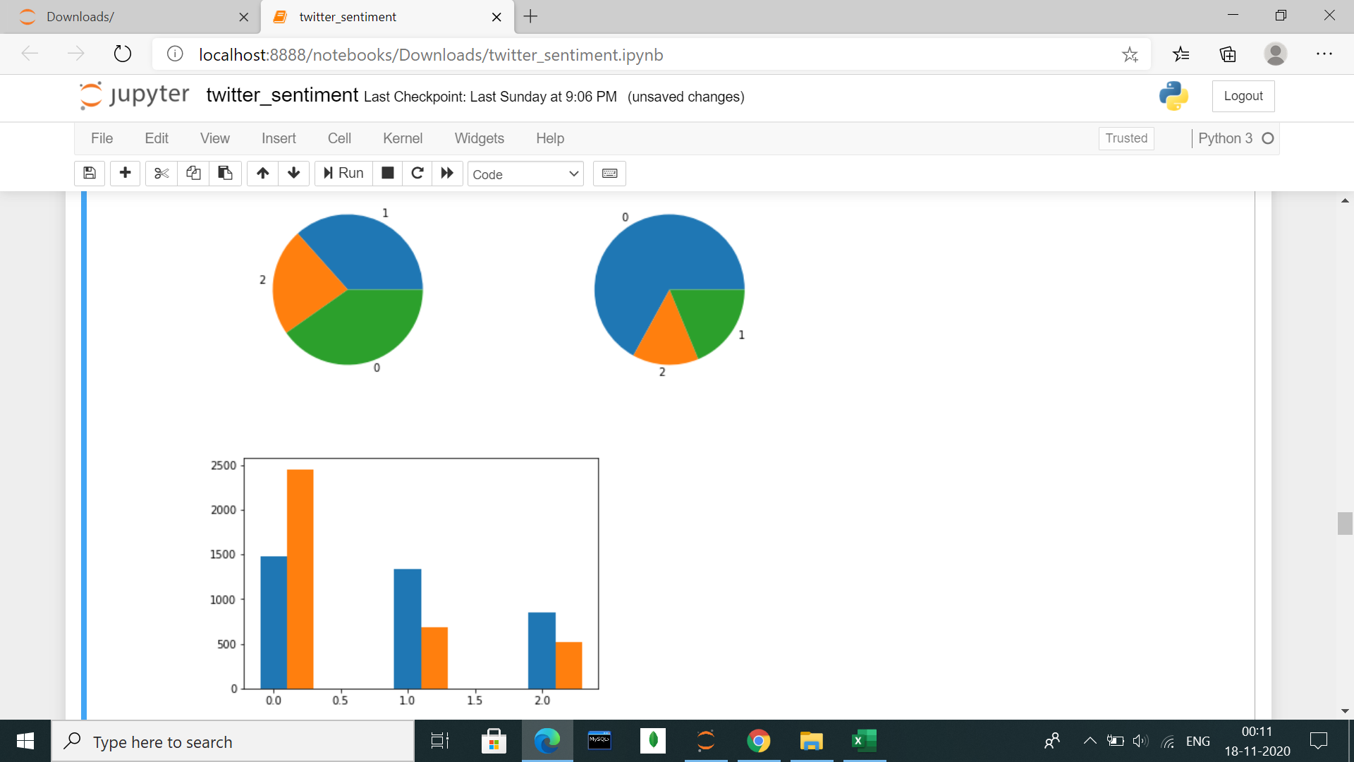

Slide 18
K-Nearest Neighbors Classifier
The K-nearest neighbours Classifier has been scratch implemented to make predictions. The classifier predicts the feedbacks of the tweets using the feedbacks of the k-nearest neighbours of point whose feedback needs to be predicted. The predictions are made in form of numerical values (0,1,2) which can later be converted into the negative, neutral or positive feedbacks. The pre-built KNN classifier from sklearn has also been used to make predictions. The predictions from the self built classifier and the pre-built classifier are compared to measure the performance of the two classifiers. The graphs are plotted showing the difference in prediction accuracy of the 2 classifiers. Precision and recall values for both the classifiers have also been printed.

Slide 19
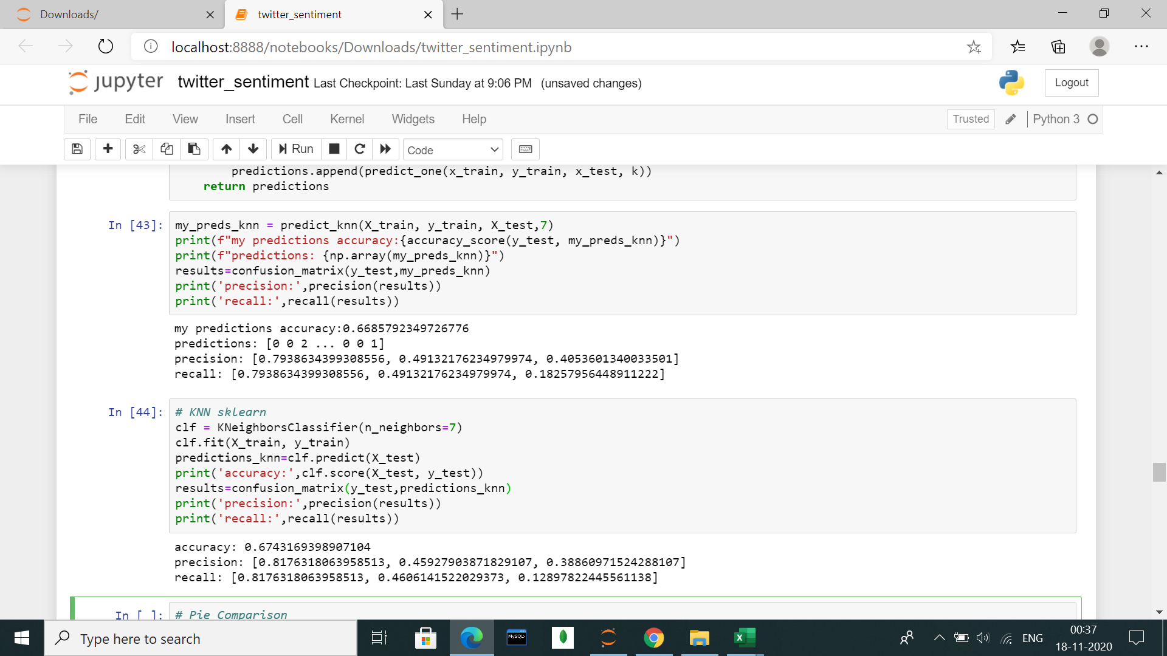

Slide 20
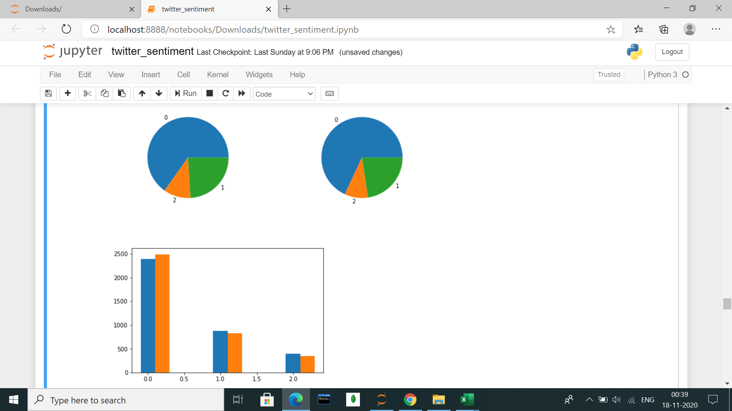

Slide 21
Logistic Regression Classifier
The Logistic Regression Classifier has been scratch implemented to make predictions. The classifier predicts the feedbacks of the tweets using the regression technique and putting a sigmoid function over the answer to classify the feedback binomially. One vs One approach has been used for multinomial classification in the following case. The predictions are made in form of numerical values (0,1,2) which can later be converted into the negative, neutral or positive feedbacks. The pre-built Logistic Regression classifier from sklearn has also been used to make predictions. The predictions from the self built classifier and the pre-built classifier are compared to measure the performance of the two classifiers.Precision and recall values for both the classifiers have also been printed.

Slide 22
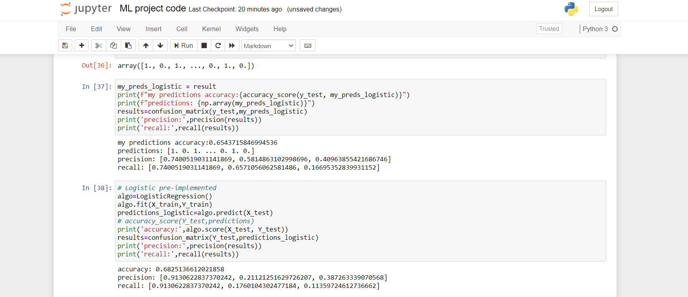

Slide 23
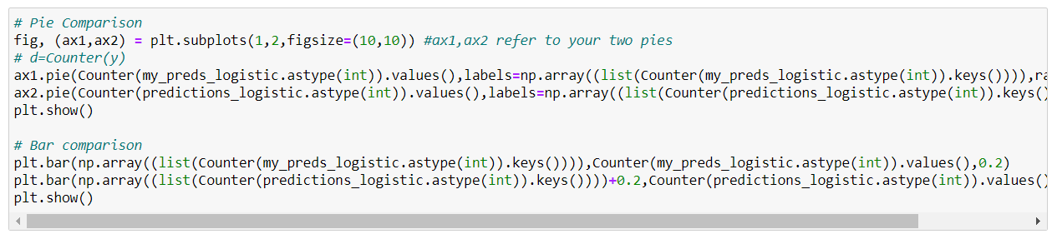
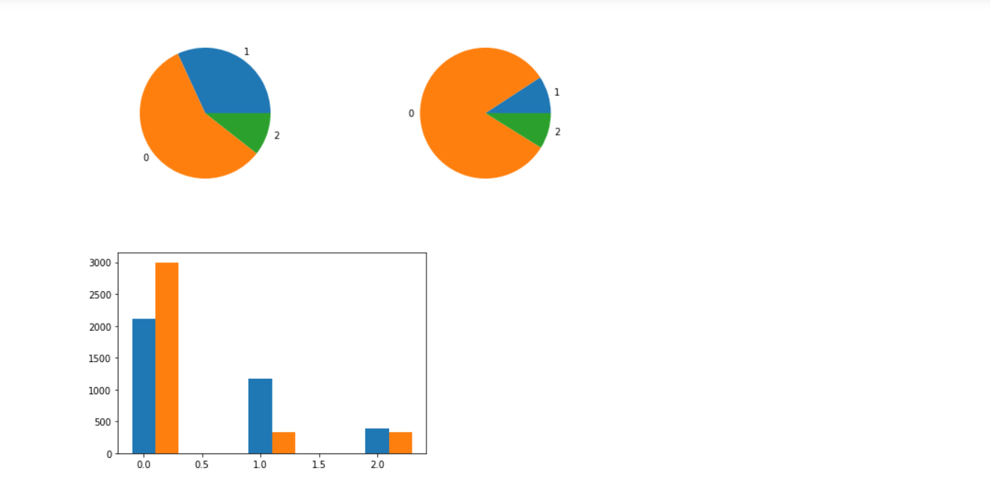

Slide 24
SVM Classifier
The support vector classifier(SVC) from sklearn’s SVM module has been used to make prediction of feedbacks for the test data’s tweets. The precision and recall are found and printed. The distribution of classification is also shown using pie plot and bar plot.

Slide 25
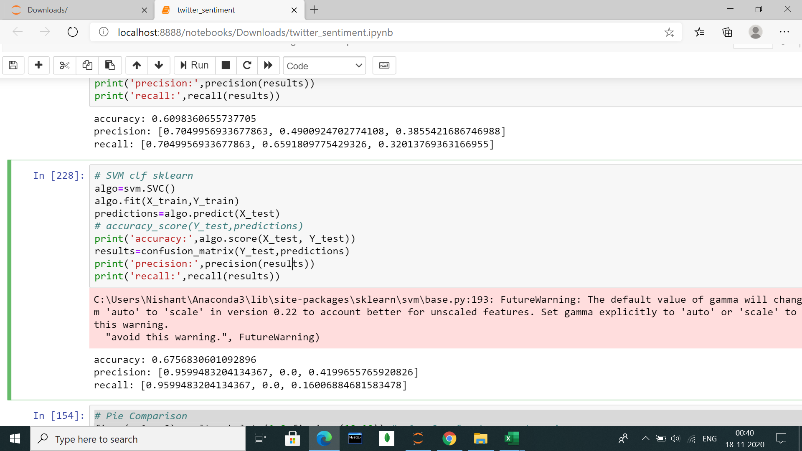

Slide 26
Decision Tree Classifier
The Decision Tree Classifier has also been used to make predictions. The classifier predicts the feedbacks of the tweets by building a tree that is split on features with maximum information gain. Traversing through the decision tree will give the feedback for test data. The predictions are made in form of numerical values (0,1,2) which can later be converted into the negative, neutral or positive feedbacks. Precision and recall values for the classifier have also been printed.

Slide 27
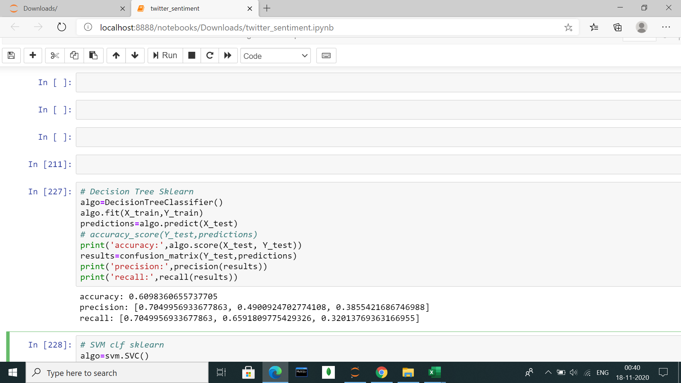

Slide 28
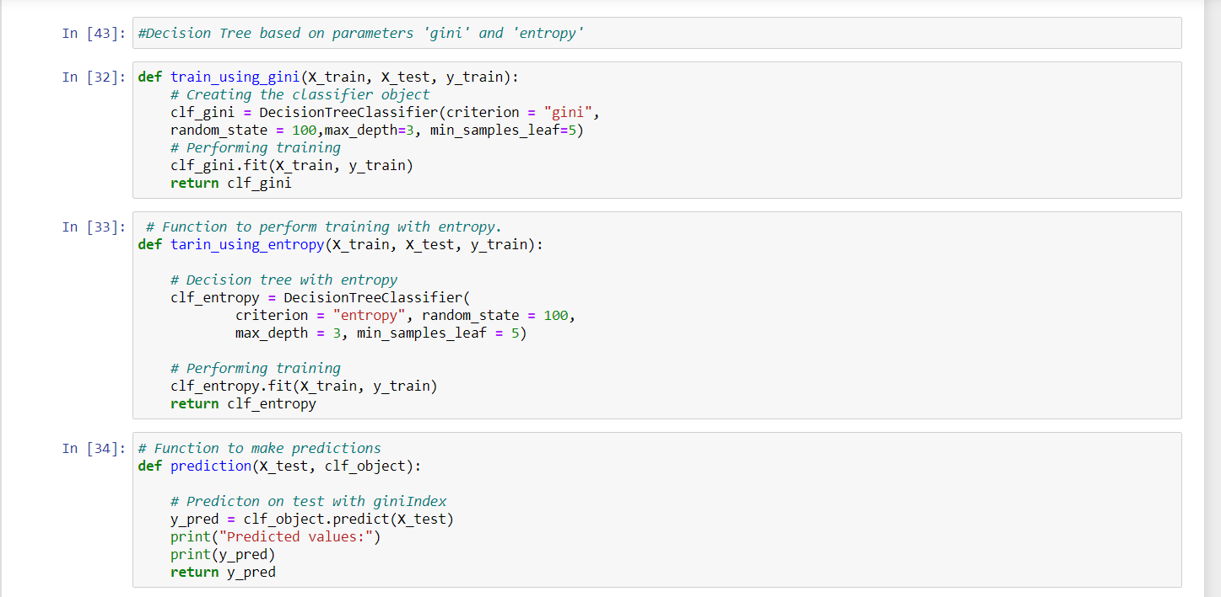

Slide 29
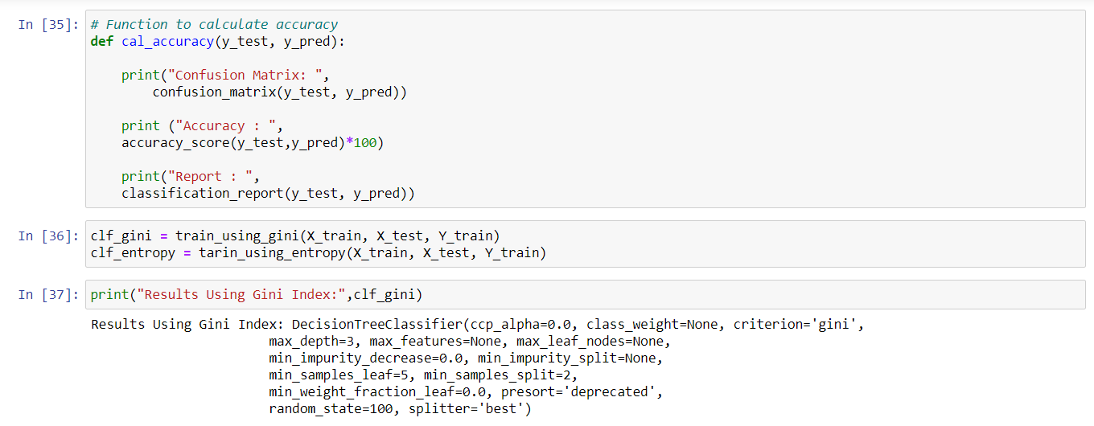
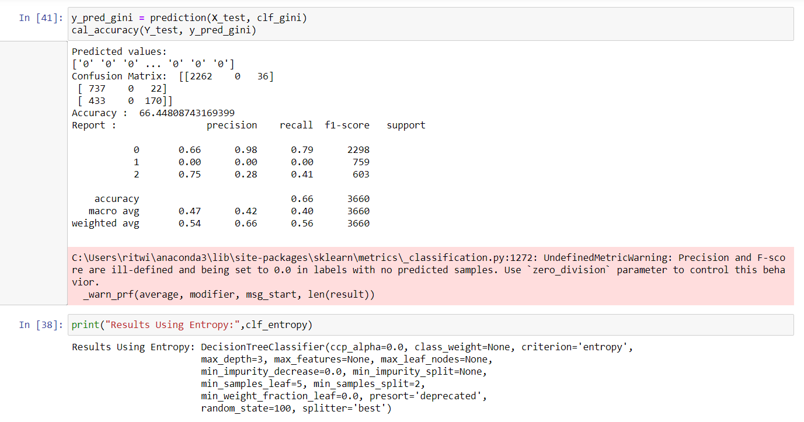

Slide 30
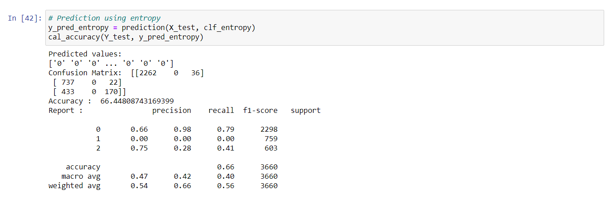

Slide 31
CONCLUSION
Different Classifiers have been used and compared. Various kinds of graphs have also been plotted to help visualize the classifier predictions.
Out of the pre implemented classifier models, SVC model performed best with 68.77 % accuracy.
Out of the self implemented classifier models, KNN model performed best with 66.17 % accuracy.
Sklearn library has been used for printing pie charts and bar plots. The functions have been written to calculate precision and recall for the predictions using the confusion matrix.

