Slide 1
MINI PROJECT USAGE OF IMAGE SEGMENTATION TECHNIQUES FOR OBJECT AND REGION IDENTIFICATION IN IMAGES Submitted By
TEAM MEMBERS:-
SHAM S – 2117230070149
VARUN S – 2117230070171
SETHURAMAN S - 2117230070147
Department of Artificial Intelligence and Data Science

Slide 2
PROBLEM STATEMENT
Modern computer vision applications require accurate object identification and region extraction from images. Traditional image processing methods struggle with complex backgrounds, shadows, lighting variations, and irregular object shapes.
Existing Problems
Poor object boundary detection
Difficulty handling complex backgrounds
Low segmentation accuracy
Lack of real-time visualization
High computational complexity
Proposed Solution
Develop a Deep Learning-Based Semantic Image Segmentation System using:
U-Net Architecture
MobileNetV2 Transfer Learning
TensorFlow & OpenCV
Streamlit Dashboard for real-time visualization

Slide 3
OBJECTIVES
Main Objective
To develop an intelligent semantic image segmentation system capable of accurate foreground object extraction and real-time region identification.
Specific Objectives
To preprocess and normalize image datasets
To implement U-Net architecture for segmentation
To perform foreground-background classification
To evaluate performance using IoU and Dice Coefficient
To generate probability heatmaps
To develop a Streamlit-based visualization dashboard
To support real-time webcam segmentation

Slide 4
SCOPE OF THE PROJECT
Included Scope
Binary semantic segmentation
Foreground-background extraction
U-Net deep learning model
Real-time segmentation
Webcam-based inference
Probability heatmap generation
Streamlit visualization dashboard
Excluded Scope
Multi-class segmentation
Cloud deployment
Mobile application deployment
High-resolution industrial datasets

Slide 5
LITERATURE REVIEW & RESEARCH GAP
Existing Technologies
Thresholding Techniques
Edge Detection Methods
Fully Convolutional Networks (FCN)
U-Net Architecture
MobileNetV2
Research Gap (Existing Systems)
Limited real-time segmentation
Lack of interactive visualization
High computational requirements
Poor accessibility for non-technical users
No webcam-based live segmentation
Proposed Improvement Integrated:
U-Net + MobileNetV2
Real-time webcam segmentation
Probability heatmap visualization
Streamlit interactive dashboard

Slide 6
PROPOSED METHODOLOGY
The proposed system uses a deep learning pipeline for semantic image segmentation and object region identification.
Steps
Dataset Collection
Image Preprocessing
Binary Mask Generation
U-Net Segmentation
Model Training & Evaluation
Segmentation Prediction
Probability Heatmap Generation
Streamlit Dashboard Visualization

Slide 7
SYSTEM ARCHITECTURE
Architecture Layers
Dataset Acquisition Layer
Preprocessing Layer
U-Net Segmentation Layer
Evaluation Layer
Visualization Layer
Webcam Integration Layer
Data Flow
Input Image → Preprocessing → U-Net Model → Segmentation Mask → Heatmap → Dashboard Visualization

Slide 8
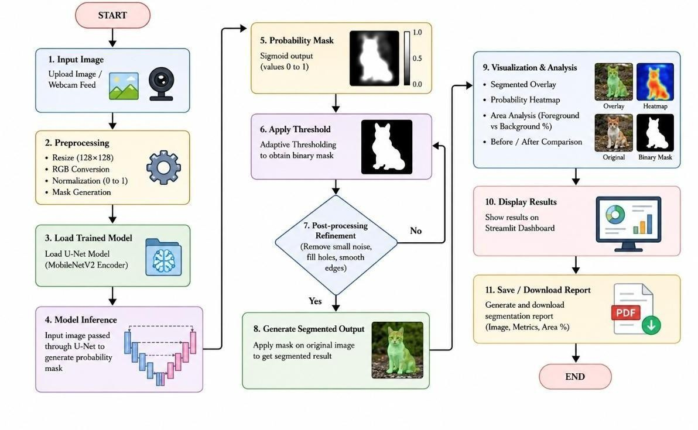
Layered Architecture of U-Net

Slide 9
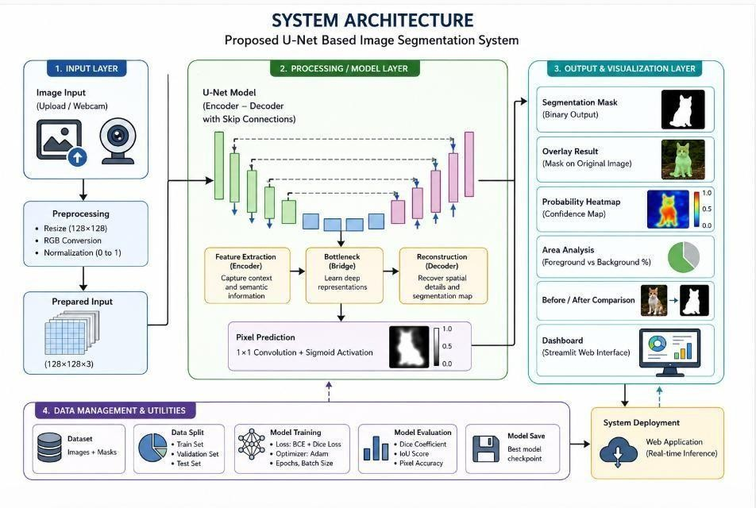
Overall System Architecture

Slide 10
MODULES USED
Modules
Dataset Preprocessing
U-Net Architecture
MobileNetV2 Encoder
Segmentation Prediction
Probability Heatmap
Streamlit Dashboard
Webcam Integration
Area Analysis Module
Features
Real-time segmentation
Overlay visualization
Heatmap generation
Foreground extraction
Live webcam support
Pixel-level classification

Slide 11
IMPLEMENTATION & TOOLS
Software & Technologies Used
Programming Language: Python
Deep Learning Framework: TensorFlow / Keras
Image Processing: OpenCV
Visualization: Matplotlib
Numerical Computing: NumPy
Frontend Interface: Streamlit
IDE: VS Code
Model Details
U-Net Architecture
MobileNetV2 Transfer Learning
BCE-Dice Loss Function
Adam Optimizer

Slide 12
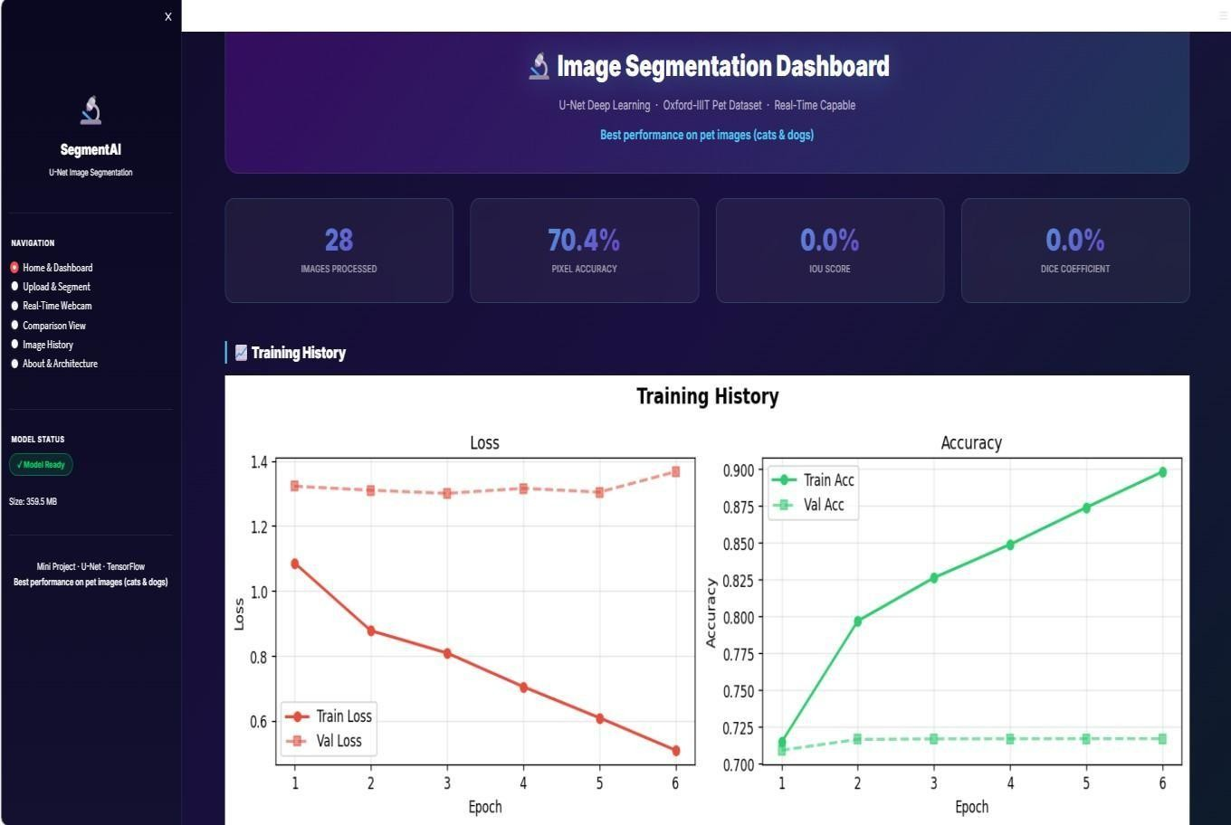
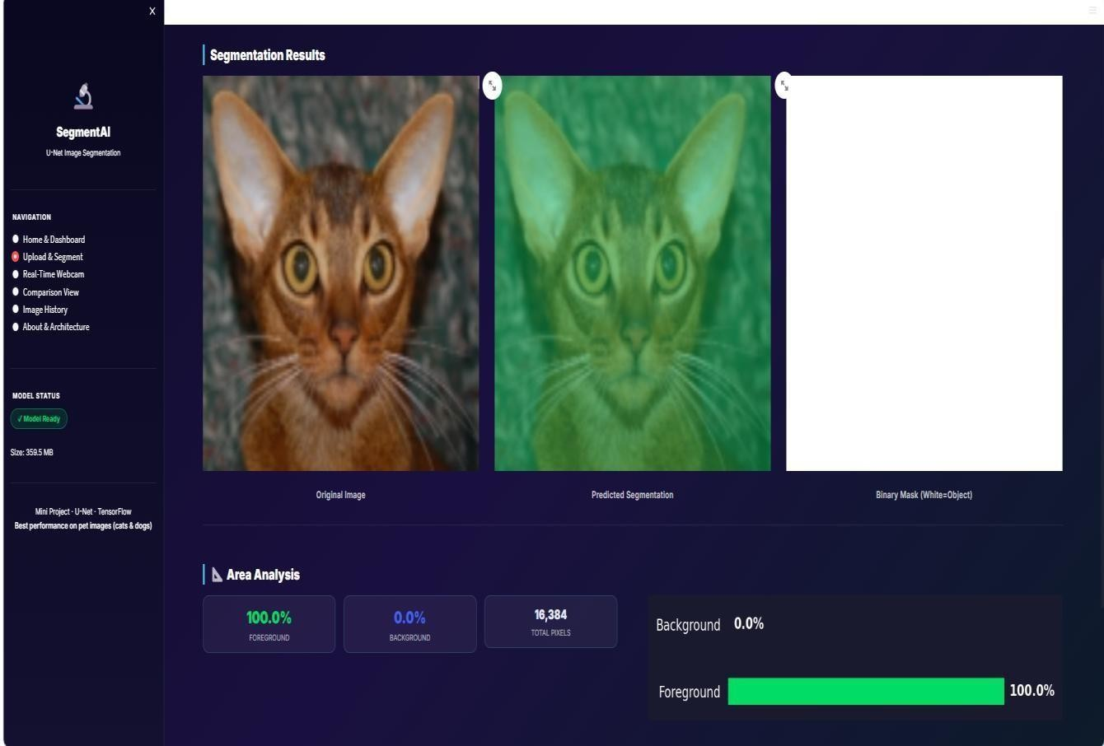
OUTPUT SCREENSHOT

Slide 13
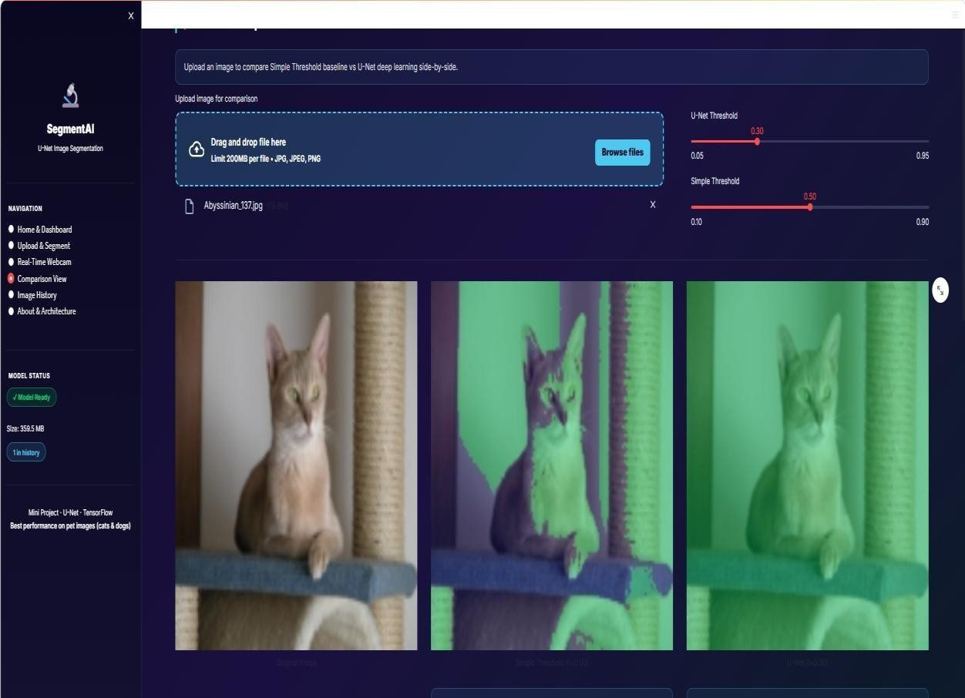
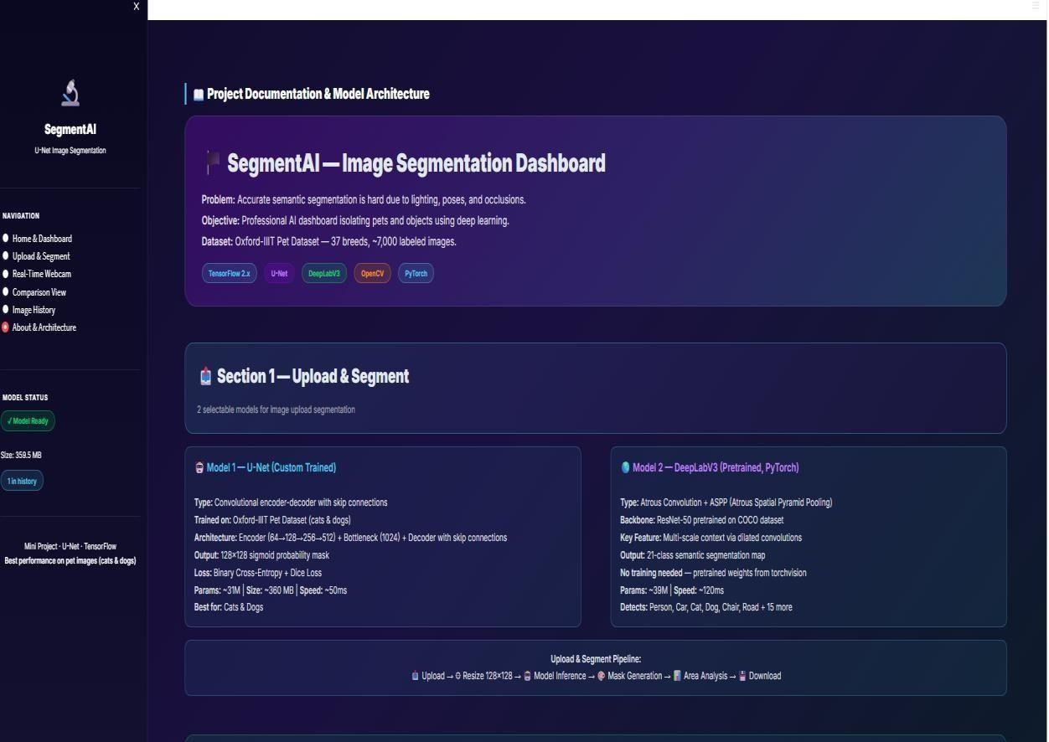

Slide 14
RESULTS & FUTURE ENHANCEMENTS
Achievements
Accurate semantic segmentation
Real-time webcam inference
Low inference latency
High Dice and IoU scores
Efficient foreground extraction
Interactive Streamlit dashboard
Performance Results
Average Inference Time: 120 ms
Real-Time Support: Enabled
Segmentation Resolution: 128×128
Future Enhancements
Multi-class segmentation
TensorFlow Lite deployment
Mobile application support
Medical image segmentation
Cloud & API integration
High-speed video segmentation

Slide 15
CONCLUSION
Developed an intelligent semantic image segmentation system using:
U-Net Architecture
MobileNetV2
TensorFlow
OpenCV
Streamlit Dashboard
Successfully achieved:
Accurate object extraction
Pixel-level classification
Real-time segmentation
Interactive visualization

Slide 16
THANK YOU!

