Slide 1
Presentation
on
LAPLACE TRANSFORMS AND ITS APPLICATIONS
Presented By-
Nusrat Easmin – 192-15-2860
Imtiaz Hasem Akash – 192-15-2829
Rahul Dutta – 192-15-2846
HM Shahadul Islam Robel – 192-15-2851
Akash Mia – 192-15-2860
Abdul Momin – 192-15-2870
Course Code: MAT 211
Course Title: Engineering Mathematics
Dept. of CSE , DIU
Under Guidelines Of
ANIP KUMAR PAUL
Lecture Dept. Of General Educational Development, DIU

Slide 2

LAPLACE TRANSFORMS
Laplace transform is a very powerful mathematical tool applied in various areas of engineering and science. With the increasing complexity of engineering problems, Laplace transforms help in solving complex problems with a very simple approach just like the applications of transfer functions to solve ordinary differential equations. it finds very wide applications in various areas of physics, electrical engineering, control engineering, optics, mathematics and signal processing.
Let F(t) be a function of t specified for t > 0. Then the Laplace transform of F(t), denoted by L{F(t)}, is defined by

Slide 3
IMPORTANT PROPERTIES OF LAPLACE TRANSFORMS
Linearity
Differentiation
Time Delay

Slide 4
LINEARITY
The Laplace transform of the linear sum of two Laplace transformable functions f(t) + g(t) is given by L(f(t) + g(t)) = F(s) + G(s)

Slide 5
DIFFERENTIATION
If the function f(t) is piecewise continuous so that it has a continuous derivative f n−1 (t) of order n1 and a sectionally continuous derivative f n(t) in every finite interval 0 ≤ t ≤ T, then let, f(t) and all its derivatives through f n−1 (t) be of exponential order e ct as t → ∞. Then, the transform of f n(t) exists when Re(s) > c and has the following form: Lf n(t) = s nF(s) − s n−1f(0+) − s n−2f (1)(0+) − ....... − s n−1f (n−1)(0+)

Slide 6
TIME DELAY
The substitution of t − λ for the variable t in the transform Lf(t) corresponds to the multiplication of the function F(s) by e −λs, that is L(f(t − λ)) = e −sλF(s)

Slide 7
APPLICATIONS OF LAPLACE TRANSFORMS
the applications of Laplace transforms in the areas of science and engineering. At first, simple application in the area of Physics and Electric Circuit theory is presented which will be followed by a more complex application to power system which includes the description of Load Frequency Control (LFC) for transient stability studies.

Slide 8
APPLICATION IN PHYSICS
A very simple application of Laplace transform in the area of physics could be to find out the harmonic vibration of a beam which is supported at its two ends [3]. Let us consider a beam of length l and uniform cross section parallel to the yz plane so that the normal deflection w(x,t) is measured downward if the axis of the beam is towards x axis. The basic equation defining this phenomenon is as given below:
EId4w/dx4 − mω2w = 0; (1) where E is Young’s modulus of elasticity; I is the moment of inertia of the cross section with respect to the y axis; m is the mass per unit length; and ω is the angular frequency.

Slide 9
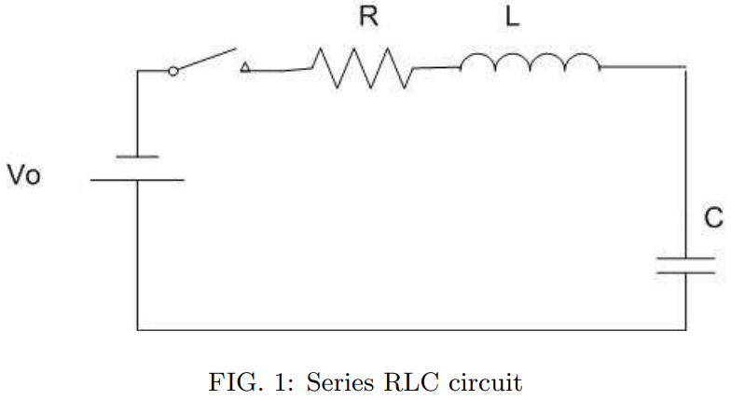
APPLICATION IN ELECTRIC CIRCUIT THEORY
The Laplace transform can be applied to solve the switching transient phenomenon in the series or parallel RL,RC or RLC circuits. A simple example of showing this application follows next. Let us consider a series RLC circuit as shown in Fig 1. To which a d.c. voltage Vo is suddenly applied. Now, applying Kirchhoff’s Voltage Law (KVL) to the circuit.

Slide 10
APPLICATION IN ELECTRIC CIRCUIT THEORY
The Laplace transform can be applied to solve the switching transient phenomenon in the series or parallel RL,RC or RLC circuits. A simple example of showing this application follows next. Let us consider a series RLC circuit as shown in Fig 1. To which a d.c. voltage Vo is suddenly applied. Now, applying Kirchhoff’s Voltage Law (KVL) to the circuit.

Slide 11
APPLICATION IN ELECTRIC CIRCUIT THEORY
Ri + Ldi/dt + 1/C R idt = Vo (3)
Differentiating both sides, Ld2 i/di2 + 1/Ci + Rdi/dt = 0; or, d2 i/dt2 + (R/L)di/dt + (1/LC)i = 0 (4) Now, applying laplace transform to this equation, let us assume that the solution of this equation is i(t) = Kest where K and s are constants which may be real, imaginary or complex.

Slide 12
APPLICATION IN POWER SYSTEMS LOAD FREQUENCY CONTROL
Power systems are comprised of generation, transmission and distribution systems. A generating system consists of a turbogenerator set in which a turbine drives the electrical generator and the generator serves the loads through transmission and distribution lines. It is required that the system voltage and frequency has to be maintained at some pre-specified standards eg. frequency have to be maintained at 50 or 60 Hz and voltage magnitude should be 0.95-1.05 per unit.

Slide 13
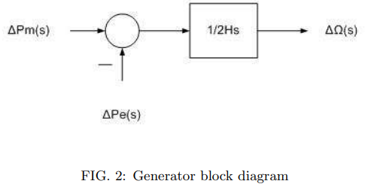
GENERATOR MODEL
The modeling of a generator by applying the swing equation of a synchronous machine. When small perturbation is applied to the swing equation, the equation modifies as follows: (2H/ωs)(d 2∆δ/dt2 ) = ∆Pm − ∆Pe (5) This can be written for a small deviation in speed with speed expressed in per unit as d∆ω/dt = 1/2H(∆Pm − ∆Pe) (6) Now, applying Laplace transform to Eq(6), we obtain ∆Ω(s) = 1/2Hs[∆Pm(s) − ∆Pe(s)] (7) This relation can be shown in the block diagram in Fig 2.

Slide 14
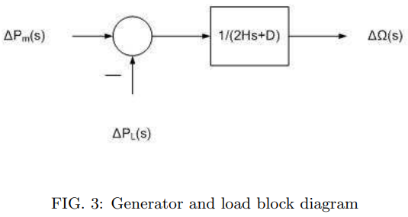
LOAD MODEL
he loads in the power system comprise of different kinds of electrical devices. Some loads are frequency dependent such as motor loads and other loads like lighting and heating loads are independent of frequency. The frequency sensitivity of the loads depend on the speed load characteristics of all the driven devices.

Slide 15
LOAD MODEL
The speed load characteristic of a composite load is approximated by ∆Pe = ∆PL + D∆ω (8) where ∆PL is the non frequency sensitive load change and D ∆ω is the frequency sensitive load change. D is expressed as a percentage change in load divided by percent change in frequency. The combined block diagram representation of generator and load is as shown in Fig 3.

Slide 16
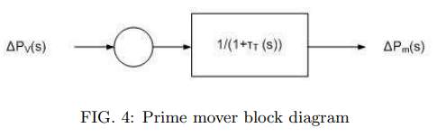

PRIME MOVER MODEL
Prime mover is the source of mechanical power which can be hydraulic turbines or steam turbines. The modeling of the turbine is related to the change in mechanical power output ∆Pm to the change in steam valve position ∆Pv. The simplest prime mover model for a steam turbine can be developed by a single time constant, τT and hence, the resulting transfer function is as follows:

Slide 17
Thank you

