Slide 1
SAFE STEPS FOR VISUALLY IMPAIRED
P.Phani Kumar (9922005063)
Akash Mishra (9922005079)
T. Siva Sai Chandan (9922005159)
A.Sai Durga Prasad. ( 9922005172)
Batch No. 2
Guided by
Dr. C. JENILA
Department of Electronics and Communication Engineering,
School of Electrical, Electronics and Biomedical Technology,
Kalasalingam Academy of Research and Education

Slide 2
INTRODUCTION:
•Navigating safely and independently can be challenging for visually impaired individuals, particularly in unfamiliar environments filled with potential obstacles. This project aims to develop an IoT-based navigation system that uses a camera module and image-processing software to assist visually impaired users by identifying and alerting them to obstacles in real-time.
•This innovative solution integrates IoT technology with software intelligence to enhance the independence and safety of visually impaired individuals, empowering them to navigate their surroundings .

Slide 3
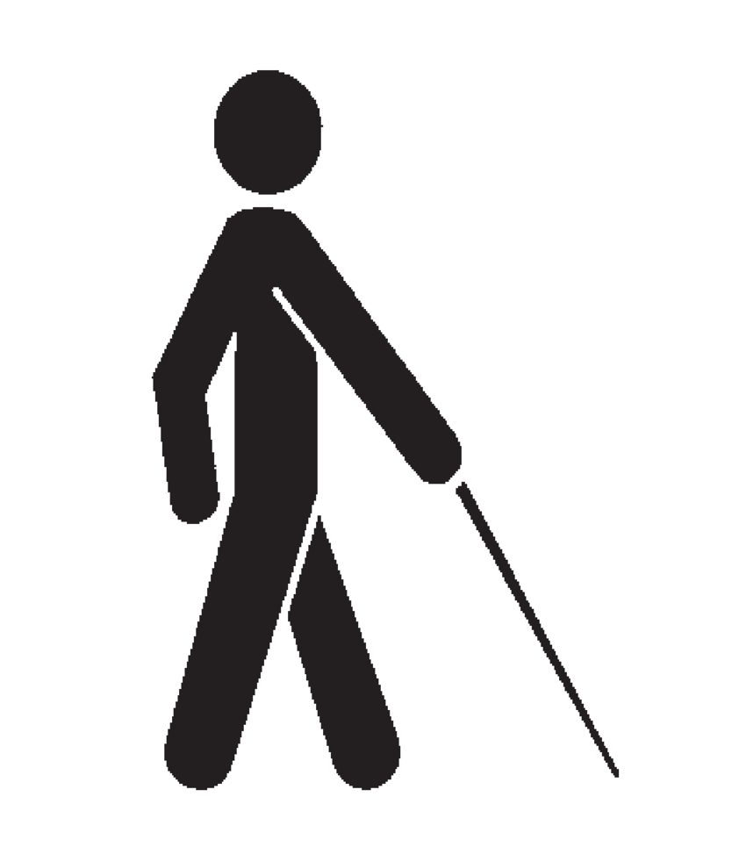
PROBLEM STATEMENT
Visually impaired individuals face challenges in safely navigating environments with obstacles. To improve safety and independence, there is a need for an IoT-based solution that uses real-time image processing to detect obstacles and provide immediate feedback.

Slide 4
Abstract
This project presents an IoT-based navigation system designed to enhance the mobility and safety of visually impaired individuals by providing real-time obstacle detection and feedback. Using a camera module integrated with image-processing software, the system captures images of the user’s surroundings, compares them to a database of predefined obstacles, and classifies detected objects to assess potential hazards. Upon identifying an obstacle, the system delivers immediate feedback to the user through audio, enabling safer navigation and greater independence. By leveraging IoT and computer vision, this solution addresses the limitations of traditional aids .

Slide 5
SOLUTION
Develop Real-Time Obstacle Detection: Design and implement a system that try to accurately detects obstacles in real time using a camera module and object detection models (YOLO,OPENCV), ensuring that visually impaired users receive timely notifications about potential hazards.
Improve Independence and Confidence: Enable visually impaired users to navigate complex and unfamiliar environments independently.
Active Feedback : Develop a simple, intuitive feedback mechanism that allows users to easily interpret the information provided by the system, either through audio .
Hardware : To detect proximity of the object using hardware sensor (ultra sonic senser)

Slide 6
IMPLEMENTATION PHASES
Requirements & Design
Hardware Setup
Software Development
Integration & Testing
Optimization
Deployment & Monitoring

Slide 7
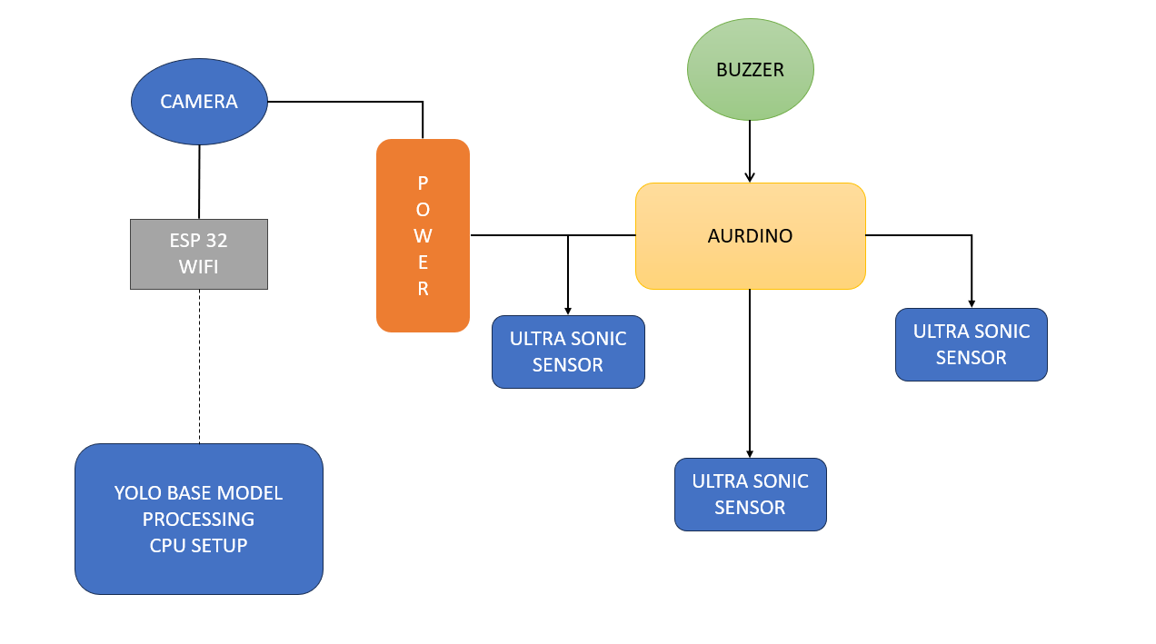
Block Diagram

Slide 8
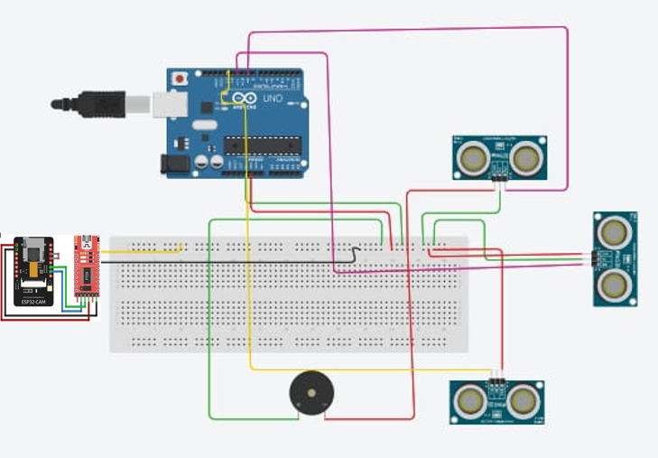
Circuit Diagram (Hardware)

Slide 9
Software Deployment
Yolo version : yolo8pt (it has higher weight count than nano , mid version of it )
Processing unit : Intel gen5 , RTX 3050 ( only delay of 200ms-300ms)
Code libraries : CVZONE(object framing ),CV(better detections),
PTTXS3(text to speech)

Slide 10
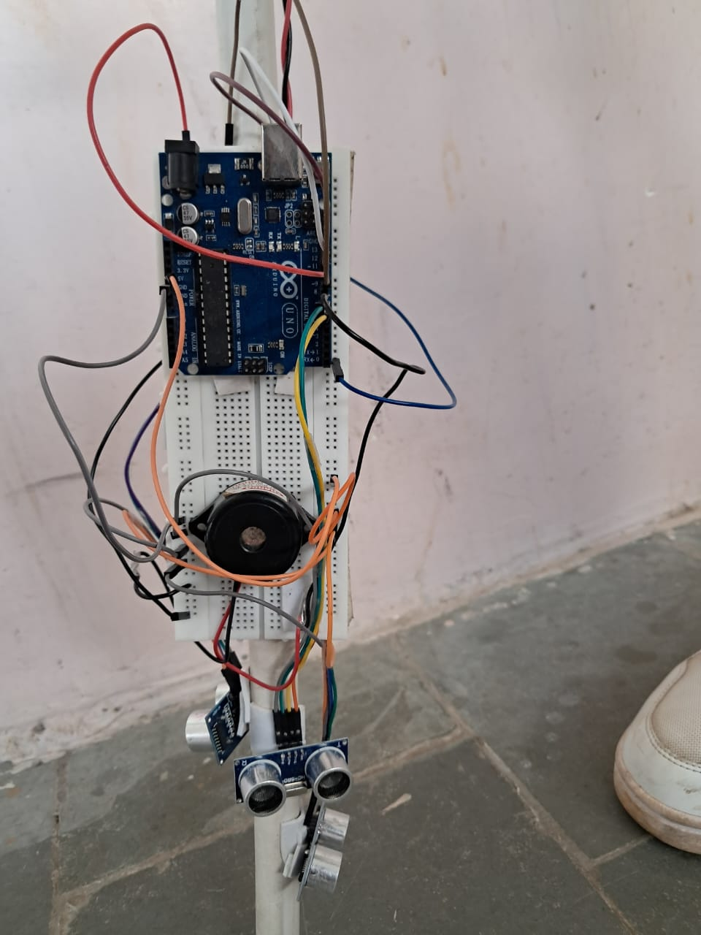
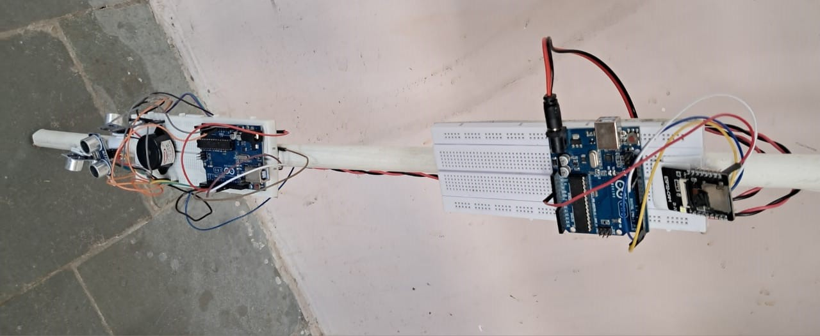
Prototype

Slide 11
Conclusion
This IoT-based navigation system provides a practical and empowering solution for visually impaired individuals, enhancing their ability to navigate safely and independently in complex environments. By combining real-time image processing with accessible audio and haptic feedback, the system addresses the limitations of traditional aids, offering users timely information about obstacles .

