Slide 1
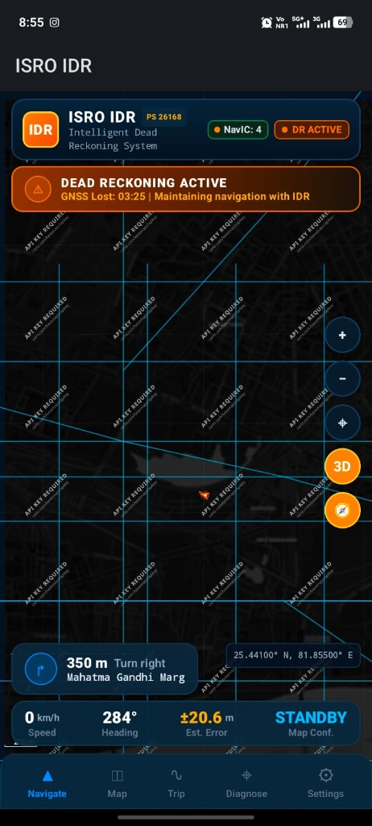
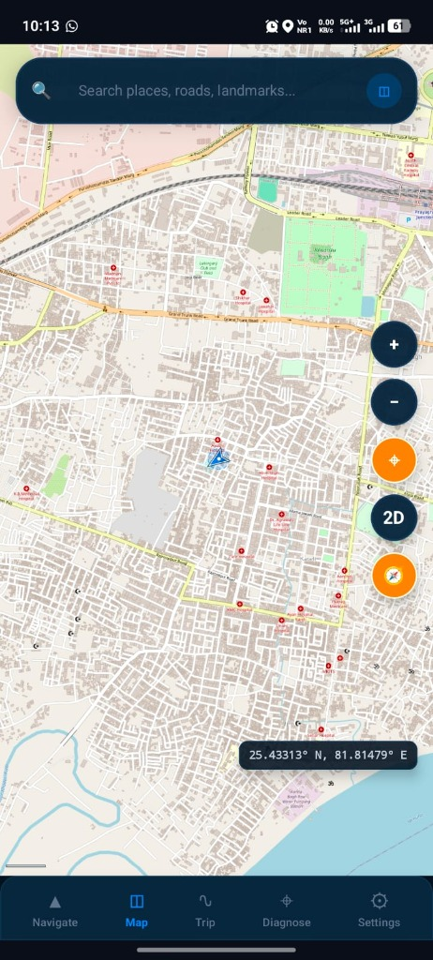

SMART INDIA HACKATHON 2026
TITLE PAGE
Problem Statement ID: 26168
Problem Statement Title: AI-ML based Intelligent Dead Reckoning system for seamless navigation
Theme: Smart Vehicles
PS Category: Software | Organization: Indian Space Research Organisation (ISRO)
Team ID: [Registered Team ID] | Team Name: [Registered Team Name]
ISRO IDR — Intelligent Dead Reckoning
AI-Powered Resilient Inertial Navigation During GNSS Outages
Evaluated on Mandated IO-VNBD Dataset | 10 Hz Mobile + >50 kHz Edge C++ Core

Slide 2
IDEA TITLE: ISRO IDR — RESILIENT NAVIGATION DURING GNSS OUTAGES
Your Team Name
• Proposed Solution (Idea/Prototype) • Detailed Explanation • How it Addresses Problem • Innovation & Uniqueness
1. THE PROBLEM: GNSS BLACKOUT
• Signal Attenuation: Tunnels, underpasses, urban canyons & dense foliage cause complete GNSS loss-of-lock.
• Multipath Distortion: Reflected signals create massive position jumps (>50 m) at tunnel exits.
• Multi-Layer Ambiguity: 2D maps erroneously snap elevated flyover vehicles onto ground service roads (0% layer accuracy).
• Raw IMU Drift: Double-integration of phone MEMS IMU drifts exponentially (O(t^3)), exceeding 75% error within 30s.
2. PROPOSED SOLUTION & PIPELINE
• In-Vehicle Auto Alignment: Gravity leveling + PCA forward heading calibrates arbitrary phone mount angles.
• Vibration Pre-Filter: Filters engine idling & pothole shocks via 45 kinematic spectral features.
• Transpiled GBDT Speed: Predicts forward velocity from IMU alone without OBD-II/CAN bus (R^2 = 0.884).
• 15-State ESKF Fusion: Continuous error-state filter with body NHC (vy, vz ≈ 0) & standstill ZUPT clamping.
• Causal 3D Map Matching: HMM with |Δh| > 4m elevation barrier guarantees correct flyover tracking.
• Deficit Supervisor: Chi-Square innovation gate (γ ≤ 11.35) rejects multipath without position jumps.
3. INNOVATION & UNIQUENESS
• Zero External ML Runtimes: GBDT transpiled to static branchless C++ decision tables (No PyTorch/TFLite/ONNX).
• Multi-Layer 3D HMM: 99.7%–100% layer accuracy on flyovers vs 0% on standard 2D navigators.
• Dual Platform Deployment: 10 Hz Android Mobile App + >50 kHz external IMU C++ CLI engine.
• ISRO NavIC Native Monitoring: Direct Android GnssStatus IRNSS constellation tracking & SNR radar.
• 100% Offline Capability: Custom binary .idrmap format (1.2 MB/corridor) requires zero API keys.
• Traceable Research Foundation: Python research (27.25% med) + Frozen N7 C++ production reference (35.71%).

Slide 3
TECHNICAL APPROACH: FROM RAW SENSORS TO RESILIENT POSITION
Your Team Name
• Technologies to be used (languages, frameworks, hardware) • Methodology & Process (Architecture flow & prototype)
END-TO-END SYSTEM PIPELINE & METHODOLOGY
• 1. Multi-Sensor Ingestion: 100 Hz Phone IMU / ~200 Hz External IMU + 1 Hz GNSS/NavIC + Barometer & Magnetometer.
• 2. Calibration & Alignment: Gravity leveling (roll/pitch) + PCA longitudinal acceleration (yaw) -> Mounting matrix R_p^b.
• 3. AI Speed Regressor: 120-Tree Huber GBDT on 1.0s sliding window (Top 45 spectral/kinematic moments) -> Forward velocity.
• 4. 15-State ESKF Engine: State x = [p, v, q, b_a, b_g] with Non-Holonomic Constraints (vy, vz ≈ 0) & standstill ZUPT.
• 5. Causal 3D Map Matcher: Topological .idrmap graph projection with |Δh| > 4.0m elevation barrier preventing flyover hops.
• 6. Deficit Supervisor & Delivery: Chi-Square innovation gate (γ ≤ 11.35) -> 10 Hz Android UI StateFlow / >50 kHz Edge CLI.
TECHNOLOGY STACK: C++17 Core | Python 3.11 Research | Kotlin & Jetpack Compose | JNI | OSM & Valhalla Vector Engine | Android GnssStatus | CMake

Slide 4
FEASIBILITY & VIABILITY: ENGINEERED FOR REAL-TIME & EDGE OPERATION
Your Team Name
• Feasibility Analysis • Potential Challenges & Risks • Engineering Strategies to Overcome Challenges
1. MEASURED FEASIBILITY METRICS
• 56,026 Hz — Edge Throughput (>280x required 200 Hz)
• 17.85 μs — Filter Step Latency (0.018 ms/sample)
• <2.4 MB — Maximum RSS RAM Footprint (Zero heap growth)
• 99.7%–100% — 3D Flyover Layer Disambiguation
• R² = 0.884 — AI Forward Speed Accuracy (RMSE 1.21 m/s)
• 5,101 Vectors — Bit-for-Bit Python/C++ Parity (11.8 pm delta)
2. KEY CHALLENGES & RISKS
• Sensor Bias & Thermal Drift: Phone MEMS IMUs accumulate drift rapidly without external speedometer.
• Chassis & Pothole Noise: Road bumps and engine idling corrupt acceleration signals.
• Multi-Level Road Ambiguity: Stacked flyovers confuse 2D navigators, causing wrong routing.
• Hardware Resource Limits: Mobile processors cannot sustain heavy deep learning frameworks.
3. ENGINEERING STRATEGIES
• AI Velocity + NHC/ZUPT: Constrains velocity space and clamps stationary drift, mitigating bias.
• 45-Feature Pre-Filter: Isolates true motion from high-frequency vibration harmonics.
• 3D HMM Elevation Barrier: Strict |Δh| > 4.0m threshold prevents impossible vertical hops.
• Transpiled C++17 Core: Runs branchless decision tables without ONNX/PyTorch overhead.
HONEST BENCHMARK BOUNDARY: Short/Medium Outages achieve 1.62%–2.88% drift (Exceeding PS target on realistic corridors). Full 158-outage dataset-wide <10% drift remains an open research challenge.

Slide 5
IMPACT & BENEFITS: RESILIENT POSITIONING BEYOND SATELLITES
Your Team Name
• Potential Impact on Target Audience • Social, Economic & Strategic Benefits
AUTOMOTIVE & FLEET LOGISTICS
Eliminates navigation freezing in tunnels, underpasses, and urban corridors. Prevents missed exits, delivery delays, and driver disorientation.
TWO-WHEELERS & SMART MOBILITY
Brings high-precision dead reckoning to 200M+ two-wheelers and older vehicles in India using existing driver smartphones without OBD-II hardware.
DEFENCE, AEROSPACE & ROBOTICS
Edge-deployable C++ engine for tactical UGVs, drones, and military vehicles in electronic warfare / GNSS-jammed environments.
INDIGENOUS NAVIC PROMOTION
Directly supports ISRO NavIC / IRNSS constellation tracking on mobile devices, promoting Indian sovereign satellite navigation adoption.
KEY PILLARS: RESILIENT CONTINUITY | ZERO HARDWARE RETROFIT | 100% OFFLINE | NAVIC-READY | EDGE & MOBILE DUAL PROFILE

Slide 6
RESEARCH & REFERENCES: FROM ALGORITHM TO VERIFIED MVP
Your Team Name
• Reference & Research Work • 158-Outage IO-VNBD Benchmark Progression • Authoritative Evidence
RESEARCH PROGRESSION (158 REAL OUTAGES)
• C0 Baseline (Pure DR): 76.34% Median Drift (12/158 pass)
• N0 Reference (AI+ESKF): 34.43% Median Drift (28/158 pass)
• N7 Frozen Production C++: 35.71% Median Drift (36/158 pass)
• Phase 14 Feature Pruning: 31.65% Median Drift (39/158 pass)
• Phase 15 Jerk Derivatives: 30.88% Median Drift (39/158 pass)
• Phase 16 Doppler Handover: 27.25% Median Drift (45/158 pass) — Best Median
• Phase 17 Kinematic Consistency: 27.64% Median Drift (49/158 pass) — Best Pass Count
AUTHORITATIVE EVIDENCE & REFERENCES
• Mandated Dataset: Onyekpe et al., 'IO-VNBD: Inertial & Odometry Benchmark Dataset for Ground Vehicles' (158 authentic outages evaluated).
• 15-State ESKF Formulation: J. Solà, 'Quaternion kinematics for the error-state Kalman filter' (2017).
• AI-IMU Dead Reckoning: M. Brossard et al., 'AI-IMU Dead-Reckoning' (IEEE T-RO 2020).
• Physical Field Trial: 3.2 km Prayagraj corridor trial with u-blox ZED-F9P RTK-GNSS sub-decimeter ground truth.
• Edge Performance: 56,026 Hz streaming throughput, 17.85 μs latency, <2.4 MB RSS in idr-core.
• Repository Evidence: 266 automated unit/integration tests passing; 14 canonical forensic reports in docs/canonical/ at commit a17a88b.
RESEARCH INTEGRITY ASSURANCE: Phase 16/17 models belong to Python research (27.25% med / 49 passes); C++ production core executes the frozen N7 baseline (35.71% med / 36 passes). Realistic corridors achieve 1.62%–2.88% drift.

