Slide 1


Risk Management for Insurance Companies against Firms
TEAM PARAMOUNT
Akash Mishra
Gopichand Yenikapalli
Hiranmai Vallabhaneni
Rahul Bankey
Shanmukh Peela
Surya Teja Pidakala
DATA MINING

Slide 2

Mission Statement
Challenges for an Insurance Company:
Lack of Trust.
Competition.
Economic Instability.
Business Intelligence.
In order to protect themselves from lending insurances to the wrong customers, an insurance lending organization must make sound financial decisions when assessing the likelihood of a company's bankruptcy.
DATA MINING

Slide 3

Past Analysis
To anticipate the success of predicting whether a company will go bankrupt or not, the author of this dataset has already taken on this task and offered a few data mining (DM) approaches like Decision Trees, Random Forest and K-NN by constructing a correlation matrix to observe the strength of relationships of each variable with bankruptcy and also built a few models with an accuracy of about 70 per cent.
DATA MINING

Slide 4

Potential Business Opportunities
•To Assist the upcoming insurance companies.
•To help the existing insurance firms to make better business decisions.
•To detect the fraudulent bankruptcy issue.
•To predict the economic instability of the market.
•To reevaluate the current customer and plan the strategy to overcome the impact.
DATA MINING

Slide 5
Data Description
Taiwan Economic Journal1 data from the years 1999 to 2009 are used in this analysis. We will examine the dataset, which has 96 columns and 6280 observations. The following data characteristics will enable us to determine if an insurance company should offer insurance to businesses based on those businesses' likelihood of bankruptcy.
Target Variables
Predictor Variables
Bankrupt: 1 if the company is going to be bankrupted, 0 if not
Net Income to Total Assets
Cash Flow to Liability
Retained Earnings to Total Assets
Total Asset Growth Rate
Operating Profit Rate
Cash flow rate
Cash Flow to Sales
Cash Reinvestment %
Cash/Current Liability and more…
DATA MINING

Slide 6
Summary of Data Cleaning
Loaded the Raw Data
96 Attributes 6820 observations
Split the Data into Test and Training Sets
Dropped High Correlation Columns
Balanced the Data using Over Sampling
Normalized the Data
DATA MINING

Slide 7
Selections of Predictors
Predictors with very high correlation have been dropped and the remaining have been chosen to run the model.
Net Income to Total Assets :- Return on assets is a metric that indicates a company's profitability in relation to its total assets.
Cash Flow to Liability:- If balance of a liability increases, cash flow from operations will increase.
Retained Earnings to Total Assets:-measure the extent to which a company relies on debt, or leverage
Total Asset Growth Rate :- shows how quickly a company has been growing its Assets
Operating Profit Rate :- company's operating income by its net sales.
Cash flow rate :- the long-term rate of growth of operating cash, the money that is actually coming into the bank from business operations.
Cash Flow to Sales :- reveals the ability of a business to generate cash flow in proportion to its sales volume
Cash Reinvestment % :- the process of taking the cash which is placed as collateral on the securities loaned and reinvesting this cash in other financial-products or money markets to generate additional revenue.
DATA MINING

Slide 8
Selections of Predictors (contd.)
Cash/Current Liability :a measure of cash flow within the company
CFO to Assets :- rates cash flows to the company assets without being affected by income recognition or income measurements.
Cash Flow Per Share after-tax earnings plus depreciation on a per-share basis that functions as a measure of a firm's financial strength.
Operating Expense Rate calculated by dividing all operating expenses less depreciation by operating income.
Interest Coverage Ratio a debt and profitability ratio used to determine how easily a company can pay interest on its outstanding debt.
Operating Profit Per Share Consolidated Net Earnings divided by the number of shares of Common Stock outstanding at the end of the Performance Period.
DATA MINING

Slide 9
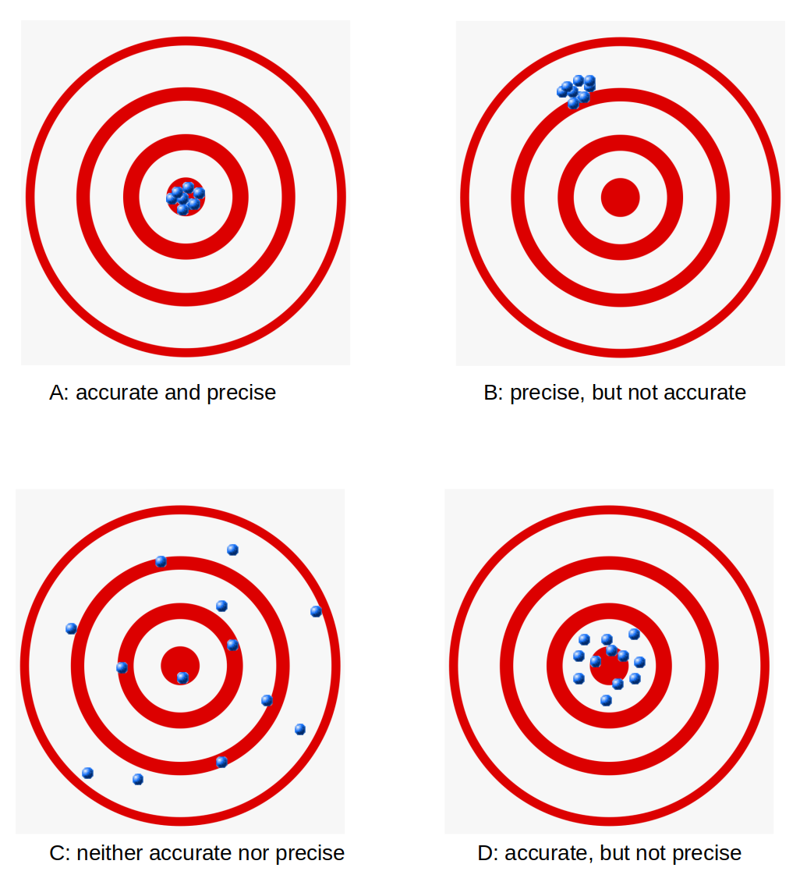
Performance Indicators
False Negative is the case when our model predicts that the company will not go bankrupt, but it actually will go bankrupt.
True Positive is the case when our model predicts that the company will go bankrupt, and it actually is True.
True Negative is the case when our model predicts that the company will not go bankrupt, and it actually did not go bankrupt.
False Positive is the case when our model predicts that the company will go bankrupt, but it actually will not go bankrupt.
DATA MINING

Slide 10
Process
Sequential Diagram of the whole process
Loaded the data
Split the dataset(70-30)
Balancing the Data
Standarized dataset was running according to our model requirement.
Models are utilized using the final predictors chosen in considering the business issue
DATA MINING

Slide 11
Large image
Models Selected
KNN
Decision Tree
Random Forest
Gradient
Boost
Logistic
Regression
Neural
Network
ADA
Boost
XG
Boost
DATA MINING

Slide 12
Outcomes of Our Model
Recall score from Optimized Model
96.67
DATA MINING

Slide 13
Conclusions
The insurance company offered 6800 existing firms the insurance. Of the 6800 firms, 220 went bankrupt. Since the firm must pay $1000 to the insurance company to purchase the insurance. The insurance company's profit from getting a firm to join them turns out to be $1000 but if the firm goes bankrupt the insurance company has to pay from its own pocket $50000 ultimately resulting in a loss of $49000 (-$50000 + $1000). If this 'null model' approach were used on the remaining 50,000 customers, this would result in a loss of $79,264,705.88.
Using different modelling techniques, the PARAMOUNT team figured out that the random forest model had the best recall value at 96.67. Using a random forest model with default parameters on the bankruptcy dataset, the expected total profit resulted out to be profit of $442,377,450.98.
Based on the expected performance of the proposed model by the paramount team, the Insurance company could proceed with implementing a profitable business. However, the data shows a significant imbalance as there are companies which went bankrupt. If we could reduce the negative effect of the unbalanced data set, there is an opportunity to develop a better-performing model resulting in greater profit for the Insurance company.
DATA MINING

Slide 14

Thank You
DATA MINING

