Slide 1
PARALLEL CAR PARKING SYSTEM
Automatic Car Parking:
We will create an autonomous car that can identify a parking space and parallel park by itself. The car drives down a street searching for a parking space to its left using a distance sensor. When the car has identified a space, the car checks to see whether that space is large enough to park in. If it determines that there is sufficient space, the car will begin parallel parking into that space.
Auto Pilot Mode:
The car will be able to move automatically in a dedicated lane on the highway at a fixed distance from the side of the road with sensors being used to navigate the car.

Slide 2
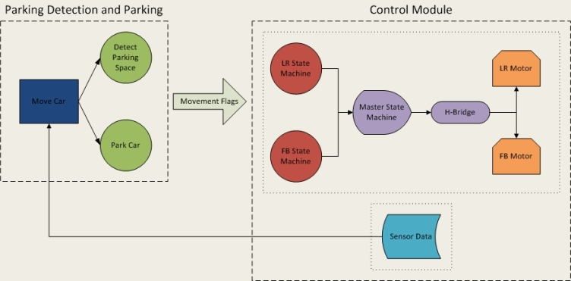
LOGICAL STRUCTURE

Slide 3
HARDWARE AND SOFTWARE
PIC18F242
Batteries
Distance Sensors
Autonomous Car
H Bridge

Slide 4
PIC18F242
Operation Frequency = 8 MHz
ADC Module : 1 x 5 channels with 10 bit resolution
Timer 0 and Timer 1 = 8/16 bit mode externally triggered
PORTs : A(7bits), B(8bits), C(8bits)
PWM : CCP pins for PWM control
EEPROM : 256 bytes 1,000,000 erase/write cycle Data EEPROM
memory

Slide 5
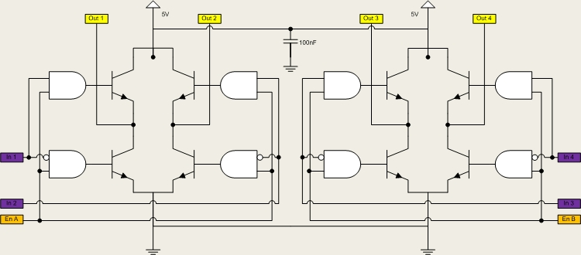
ST Micro L298HN H-Bridge

Slide 6
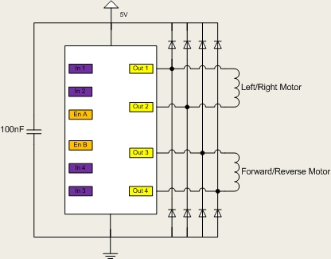
We use an ST Micro L298HN H-Bridge to control the motors of the car.
It allows us to switch between +/-5V across the motor.
It also allows us to source the power from the batteries while using the processor to control the transistors in the H-Bridge.
The control algorithm turns the appropriate transistors on/off, applying the proper voltage across the brush motor.
To protect the H-Bridge from inductive spikes caused by turning the DC brush motors on and off, we will use diodes on the output.

Slide 7
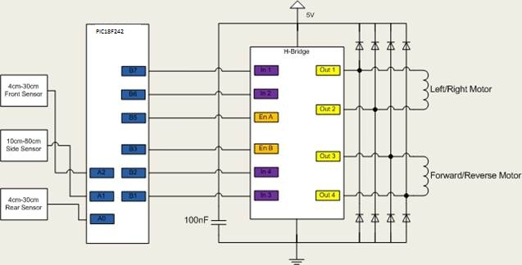
SCHEMATIC

Slide 8
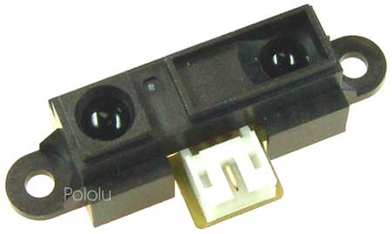
DISTANCE SENSORS
We use three Sharp infrared distance sensors to determine the distance between our car and nearby objects.
The challenge with using these sensors is that their voltage output is nonlinear (inverse function) and each sensor varies slightly. Therefore, we scoped the output of each sensor at various distance values, linearized the plot, curve fit the line, and implemented an analog to digital conversion so that we had reliable distance values.

Slide 9
Measurements and Linearization
Distance (cm) | Front Sensor Output (V)
4 | 2.78
5 | 2.36
6 | 2.06
8 | 1.6
10 | 1.32
12 | 1.12
15 | .92
18 | .776
21 | .664
24 | .567
27 | .536
30 | .476

Slide 10
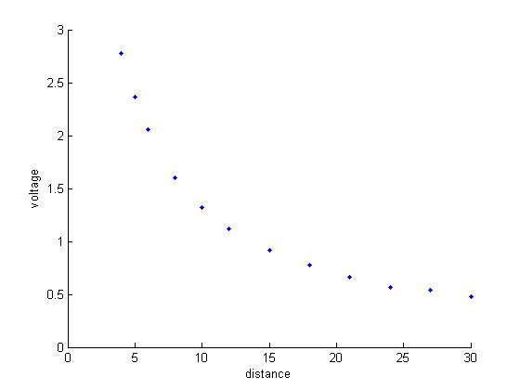
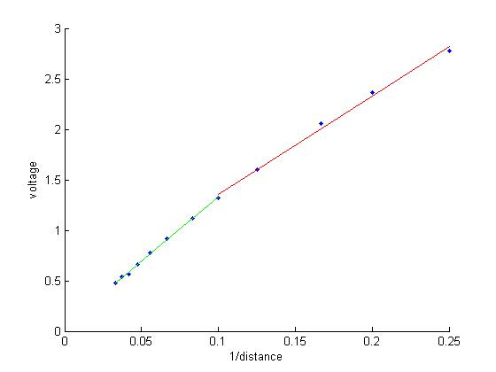
Front Sensor Plots of Distance vs. Voltage and Distance⁻¹ vs. Voltage

Slide 11
After taking the inverse of the distance versus voltage plots, we determined it would be best to fit the curve using two linear lines rather than one. The equations of the lines are:
Front Sensor
voltage=9.759*[1/distance]+0.381, >1.5V
voltage=12.738*[1/distance]+0.057, <1.5V
The analog to digital conversion uses a different equation depending on the value of the measure voltage. If the measured voltage is above a certain threshold, the ADC will use the equation in the top row. If it is below a certain threshold, the ADC will use the equation in the bottom row. The threshold for the front sensor is 1.5v.

Slide 12
Measurements and Linearization
Distance (cm) | Side Sensor Output (V)
10 | 2.28
15 | 1.64
20 | 1.28
25 | 1.08
30 | .808
35 | .728
45 | .672
50 | .612
55 | .556
60 | .516
65 | .488
70 | .452
75 | .432
80 | .42

Slide 13
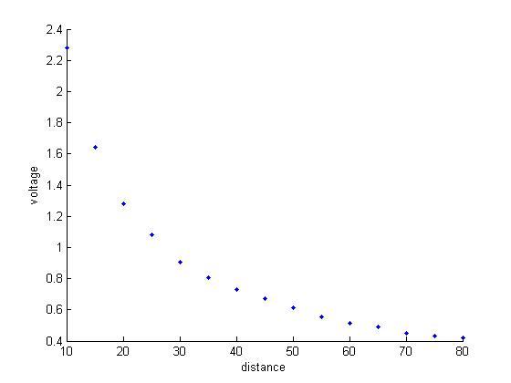
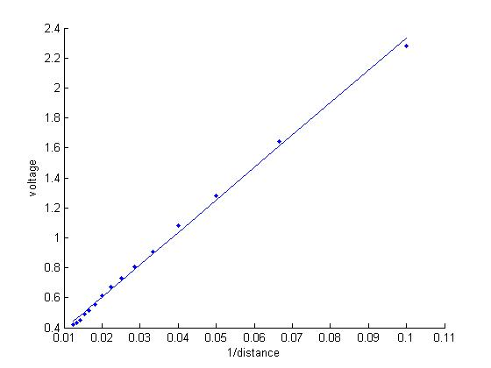
Side Sensor Plots of Distance vs. Voltage and Distance⁻¹ vs. Voltage

Slide 14
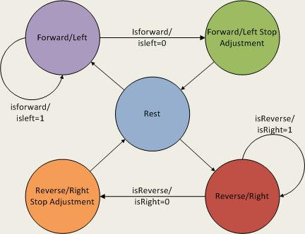
Control Module - FB/LR Motor State Machine

Slide 15
masterStateMachine()
This uses the FB and LR control bits to call the required functions in order to send the appropriate input signals to the H-Bridge and make the motors rotate in the appropriate direction.
In this function, the 2 FB and LR control bits are combined to create 4 master control bits by left shifting the FW bits by 2 and adding it to the LR bits.
As a result, each of the 7 car movements (stop, forward, forward-left, forward-right, reverse, reverse-left, reverse-right) have a unique masterBits combination associated with them. The master control bits are then used in the function to decide which motor control function is to be called.

Slide 16
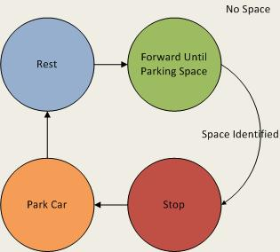
Algorithm Module - moveCar()

Slide 17
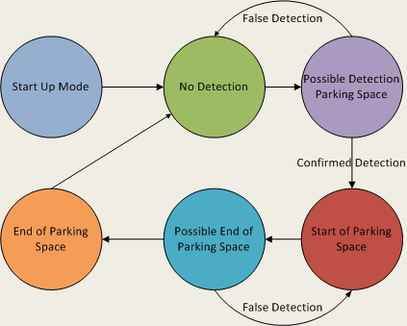
detectParking()

Slide 18
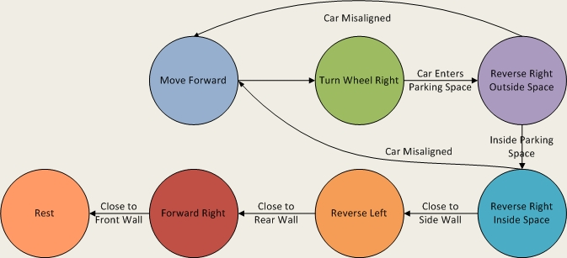
parkCar()

Slide 19
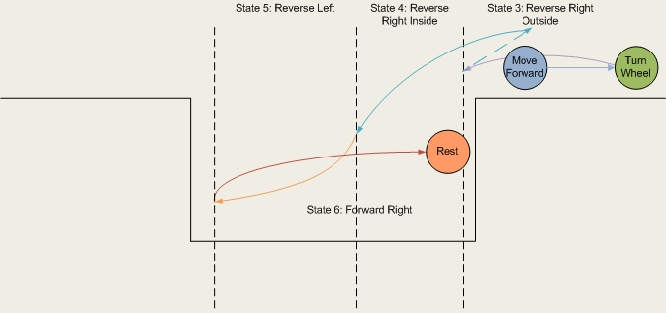

Slide 20
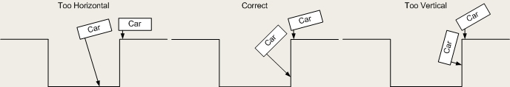
MISALIGNMENT DETECTION

