Slide 1
Surveillance – Enhanced
Collision Avoidance
Final Presentation
Rohit Annigeri Akash Joshi Yifei Shen Thaddaeus Voss
Notes:
<number>

Slide 2
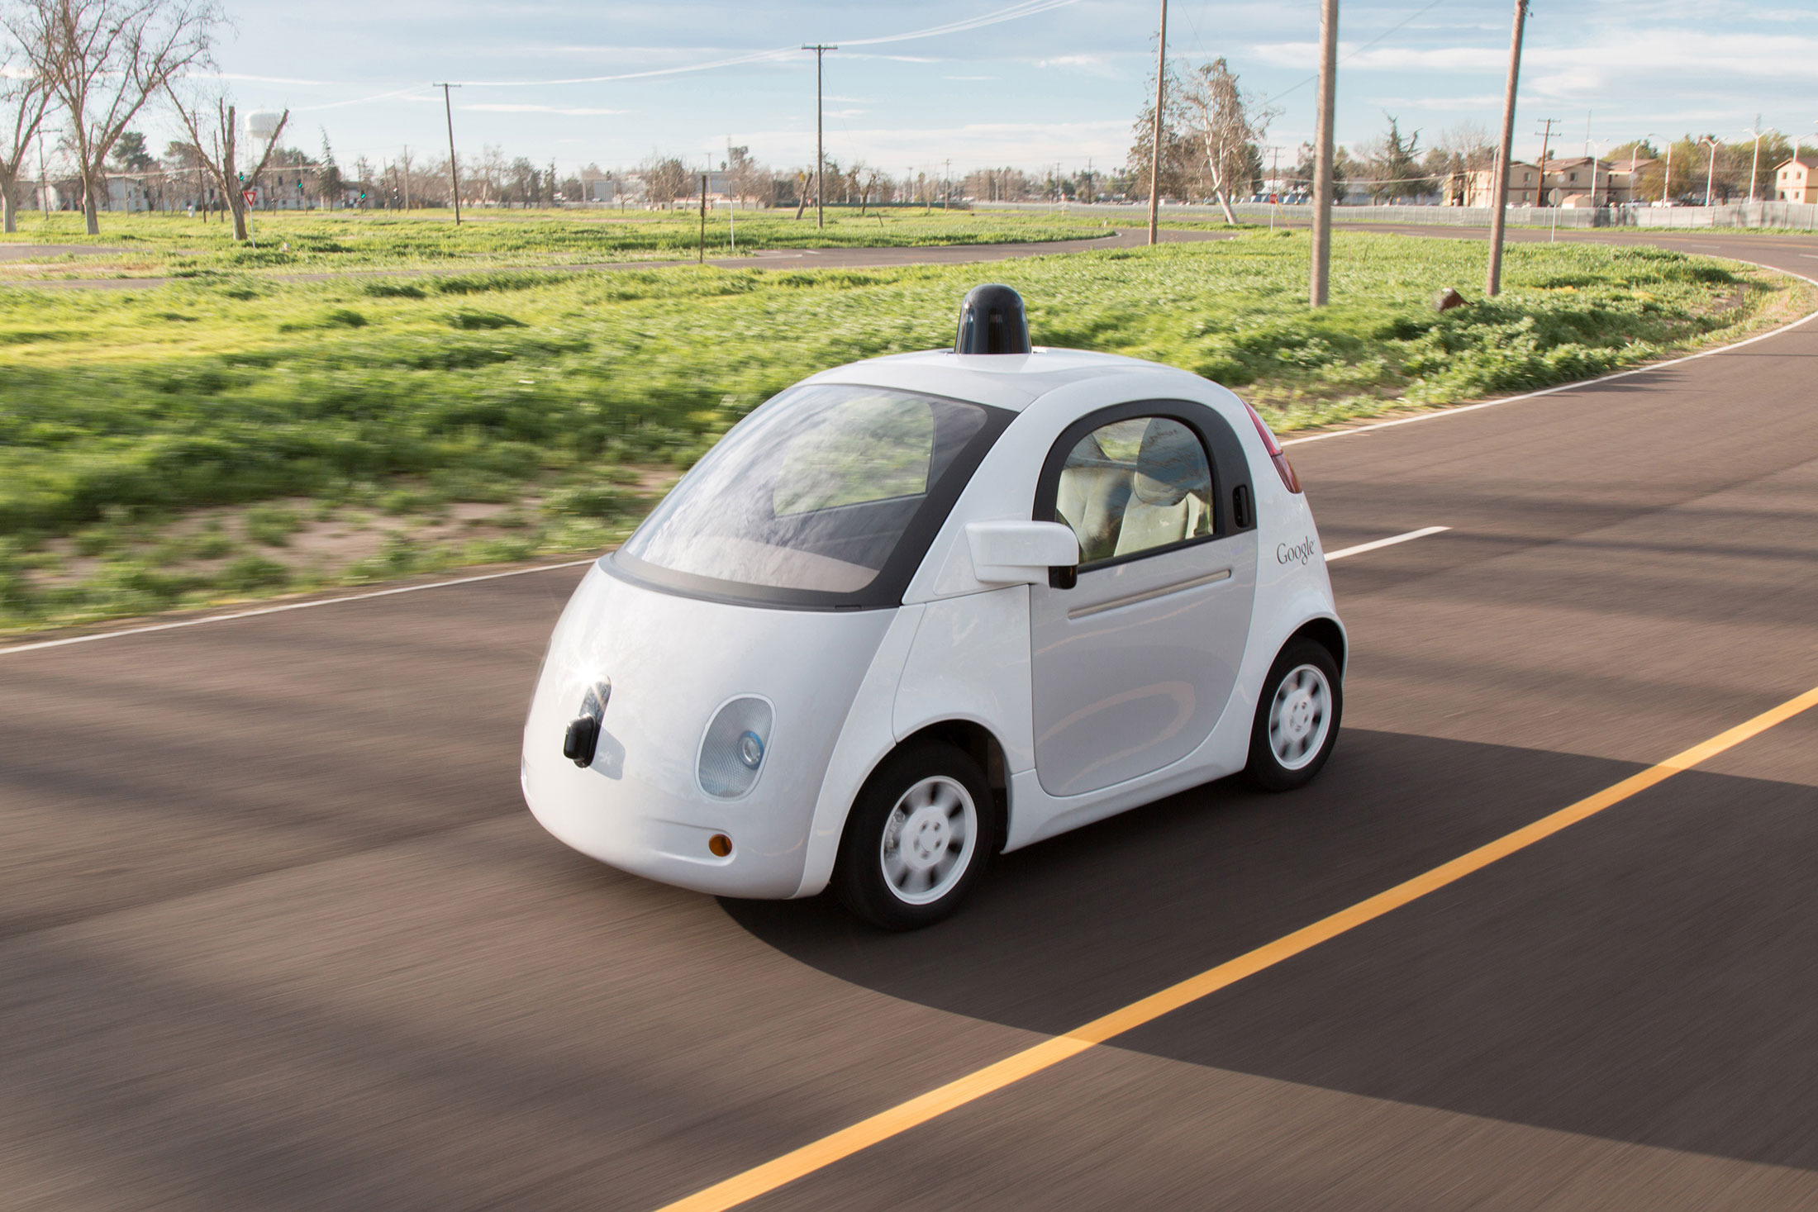
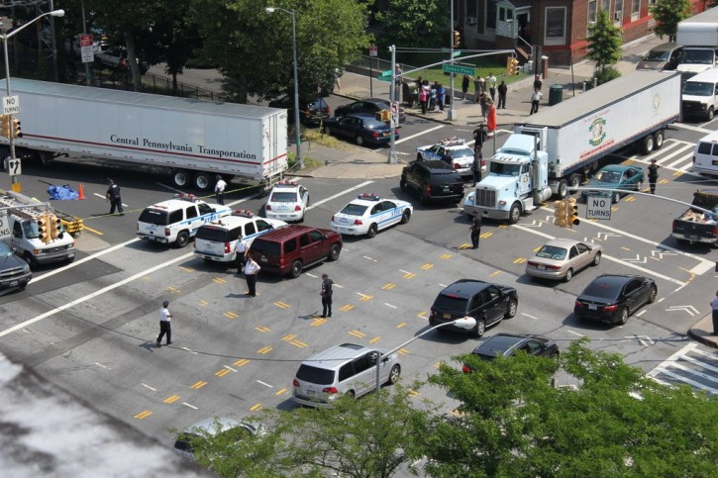
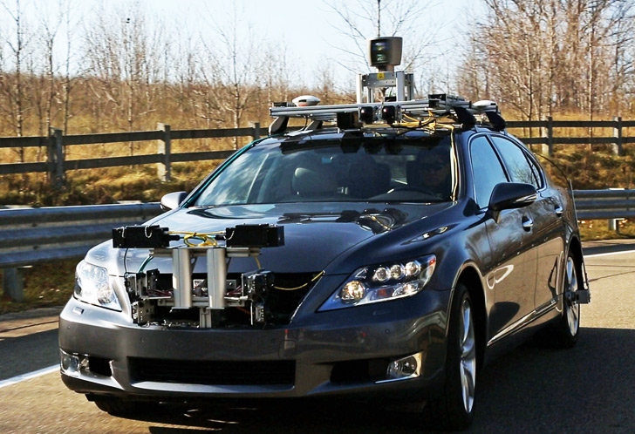
Motivation
Notes:
<number>

Slide 3
System Description
Two cars running in the field
Final System
Simulating the collision scenario with two remote control cars and using a simple lab camera as surveillance camera, send instructions to take control the cars when it’s necessary to avoid collision.
Camera to DSP board
Track the cars using background subtraction and class them with color
Predict the cars location in future
Predict the possibility of collision
Send messages to cars and control their move when necessary to avoid collision and keep them inside boundary

Slide 4
Algorithms: Flow Chart
Video Feed
Collision calculation and response transmission
Background Removal
Trajectory Estimation
Object Identification
Notes:
<number>

Slide 5
Algorithms: Low Level View
Background Subtraction
- Estimate background to identify foreground objects. Used Gaussian model to tag background (Initial training)([4])
Object Identification
- Offline : Used LDA to classify between foreground and cars.
- Online :Explore foreground pixels to distinguish between cars. Used Color statistics.
Notes:
<number>

Slide 6
Algorithms: Low Level View (contd)
Trajectory Estimation/ Retrieval:
- Offline: Kalman filter based path estimation [5][7]
- Online: Predicted position based on car speed and ability to make decisive turn.
Collision Prediction and Response Transmission:
- Thresholding on distance after which collision is not preventable.
- Making appropriate action to avoid collision. Transmission to cars.
Notes:
<number>

Slide 7
Complexity Analysis
Two Part System
(1) Control center, with a real time video feed, DSP and a RF transmitter
(2) Local environment, consisting of an intersection and independent cars with RF receivers
Bottlenecks
- Foreground object detection (background removal)
- Turning decision calculation
- Transmission rate from DSP to car.
Notes:
<number>

Slide 8
Challenges
Accurate background estimation, changing background [4]
Speeding up overall execution.
Distinguishing between the cars.
Turn Decision calculation and response transmission.
Notes:
<number>

Slide 9
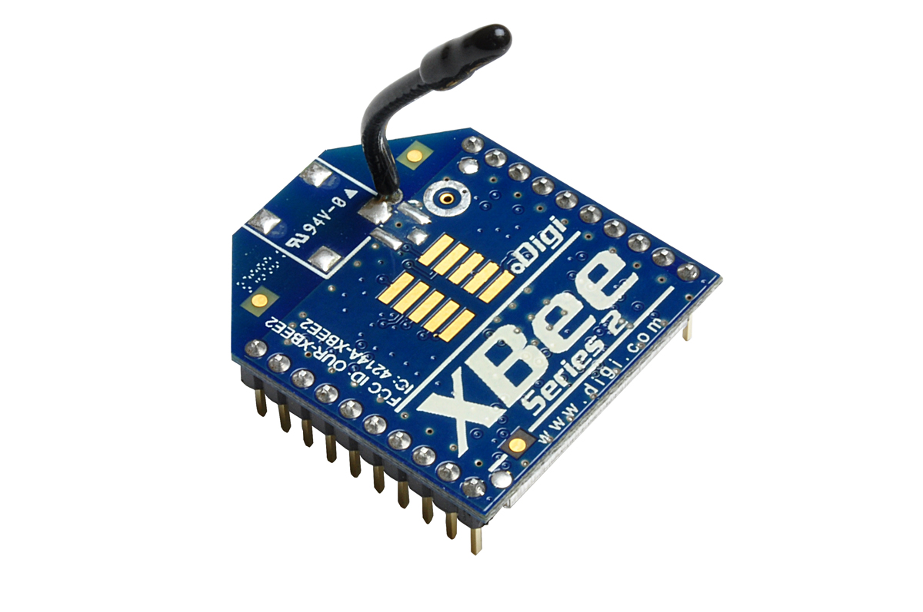
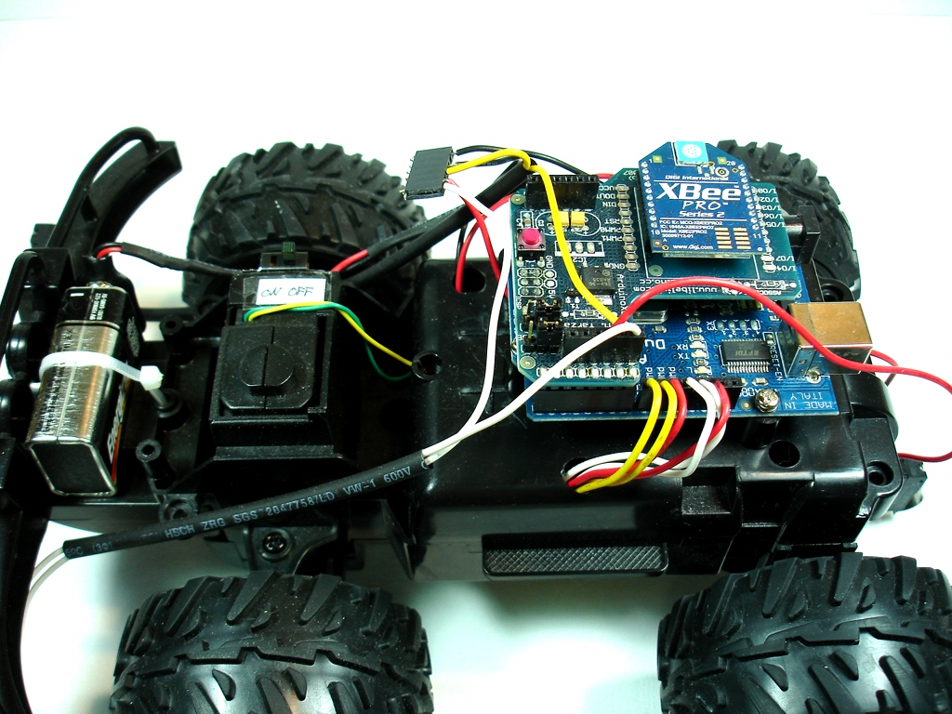
Modeling Tasks
Develop two autonomously driven RC Cars to model the collision system
Have predefined collision path algorithms in place for generating different collision scenarios
Use a communication device like a Xbee to dynamically transmit data from the two cars to the TMS Board
Receive data from the TMS Board and take preventive measures to avoid collision
Notes:
<number>

Slide 10
Final Test Setup
Equipment
TI TMS320C6416 Fixed-Point DSP Board
Overhead Video Camera
Remote-Controlled Cars (2) and RF Transmission Board
Physical Mini-Intersection for Simulation
Simulation
Remote-controlled cars running on a mock intersection, with camera capturing live video of the entire intersection from directly above, fed into the DSP
Movement data of cars and simulated pedestrians overlaid onto live feed
Test scenarios for vehicle-vehicle and pedestrian-vehicle non-collision, near-collision, and collision instances run, with vehicles being corrected by the DSP if a collision is imminent

Slide 11
References
[1] https://www.bloomberg.com/news/articles/2016-09-12/google-car-project-loses-leaders-and-advantage-as-rivals-gain
[2] http://inhabitat.com/lexus-unveils-autonomous-advanced-active-safety-research-vehicle-at-ces-2013/
[3] https://www.newyorkpersonalinjuryattorneysblog.com/2013/08/new_york_accident_prevention_p_1.html
[4] J. Gallego, M. Pardàs, and G. Haro, "Enhanced foreground segmentation and tracking combining Bayesian background, shadow and foreground modeling," Pattern Recognition Letters, vol. 33, no. 12, pp. 1558–1568, Sep. 2012.
[5]. [Online]. Available: http://www.cc.gatech.edu/~ksubrama/files/FPGA_Report.pdf. Accessed: Feb. 13, 2017.
[6]. [Online]. Available: http://www.kev-smith.com/papers/smith-thesis.pdf. Accessed: Feb. 13, 2017.
[7]. S. Kang; J. Paik; A. Koschan; B. Abidi & M. A. Abidi (2003). "Real-time video tracking using PTZ cameras". Proc. SPIE. 5132: 103–111. CiteSeerX 10.1.1.101.4242Freely accessible. doi:10.1117/12.514945.
[8] https://www.youtube.com/watch?v=eMl5u-iENr4
[9] https://www.youtube.com/watch?v=nsHYg3ENgk4
[10 ]http://snakeclamp.com/blog/wp-content/uploads/2015/06/DSLR-overhead-2-reduced.jpg
[11] http://www.ti.com/diagrams/med_tmdsdsk6416_6416_kit_72.jpg
[12] https://i.ytimg.com/vi/7Vrk0xX7cUQ/hqdefault.jpg
[13] https://www.isr.umd.edu/~austin/enes489p/projects2011a/CollisionAvoidance-FinalReport.pdf

Slide 12
Questions?

