Slide 1
EE 660 – Course Project Wearable Computing: Human Activity Recognition
Akash Mukesh Joshi
USC ID: 4703642421

Slide 2
Outline
Introduction – Human Activity Recognition
Dataset Generation
Preprocessing
Classification Techniques
Results
Application & Future Work

Slide 3
Introduction – Human Activity Recognition
Approach - Image Processing and Wearable Sensors
Advantages of Wearable Sensors :
Dynamic Activity data collection
Camera Equipment Hassle
Data Size Management
Using Sensors to identify human activities like standing, sitting, standing up, sitting down and walking.
Accelerometer Locations – Waist, Left Thigh, Right Ankle, Right Arm

Slide 4
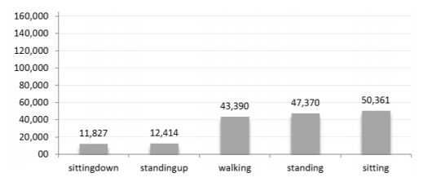
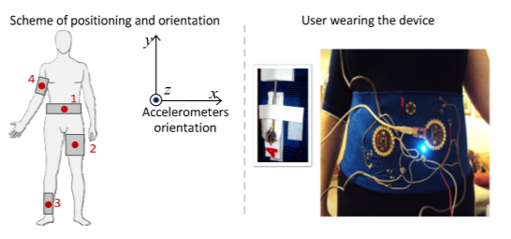
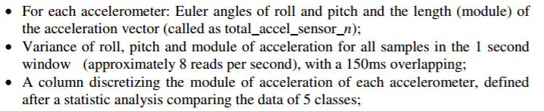
Dataset Generation
4 tri-axial ADXL335 using an ATmega328V microcontroller
Positional Calibration
Collected 165,633 samples – 8 hours – 4 Users

Slide 5
Preprocessing
Random dataset separation
Recasting Features into numerical values
Feature Selection – Correlation Based
Dimensionality Reduction
Outlier Detection and Removal
Normalization
Notes:
The 12 features selected by through this procedure were:
Sensor on the Belt: discretization of the module of acceleration vector, variance of pitch, and variance of roll;
Sensor on the left thigh: module of acceleration vector, discretization, and variance of pitch;
Sensor on the right ankle: variance of pitch, and variance of roll;
Sensor on the right upper-arm: discretization of the module of acceleration vector; From all sensors: average acceleration and standard deviation of acceleration.

Slide 6
Classification
Classifiers : Least Squares and K Nearest Neighbors
Least Squares : Pair-wise, 1000 iterations
K Nearest Neighbors : 5,10,50,100 neighbors
Classification Accuracy
Normalization of dataset - LS Classifier
Less neighbors in KNN Classifier
Application of PCA - 1st 4 components

Slide 7
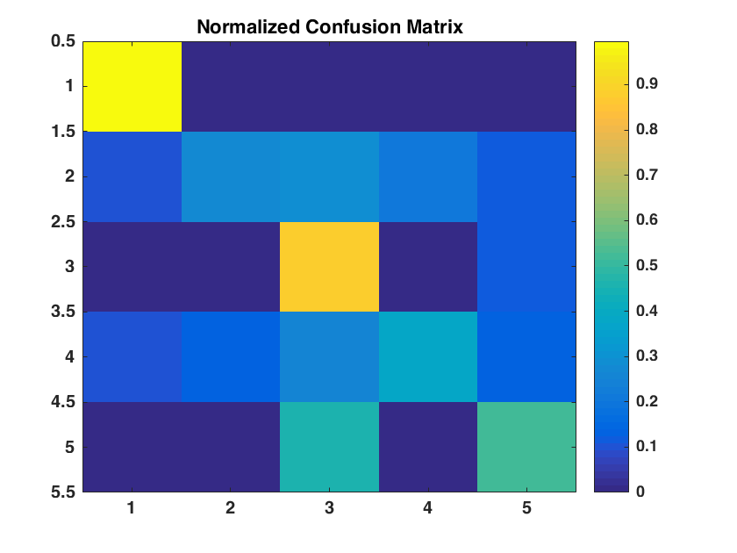
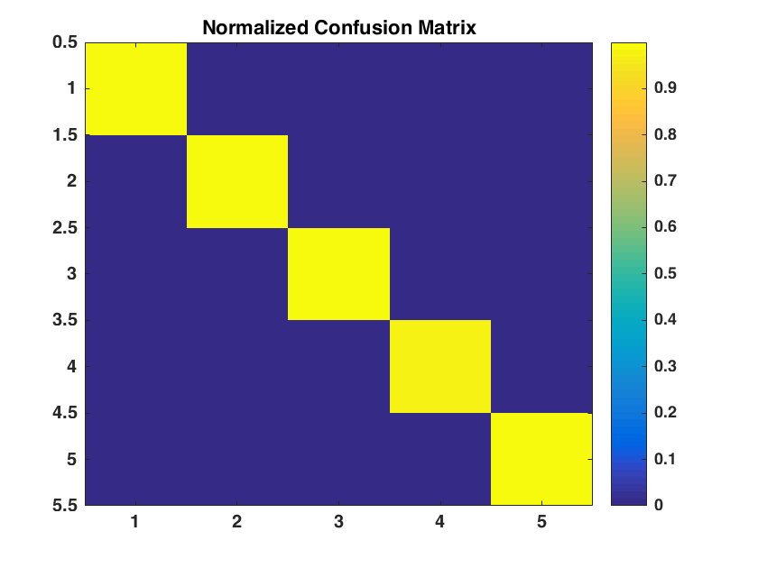
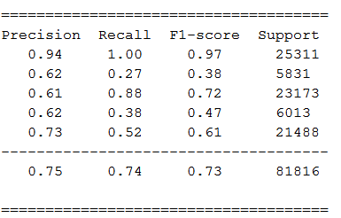
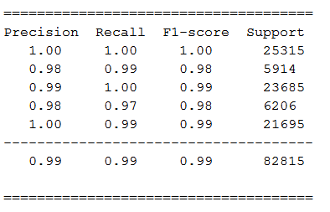
Results
LS Classifier KNN Classifier

Slide 8
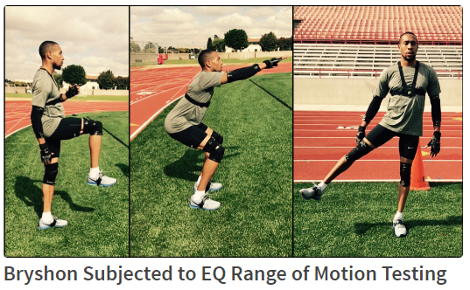
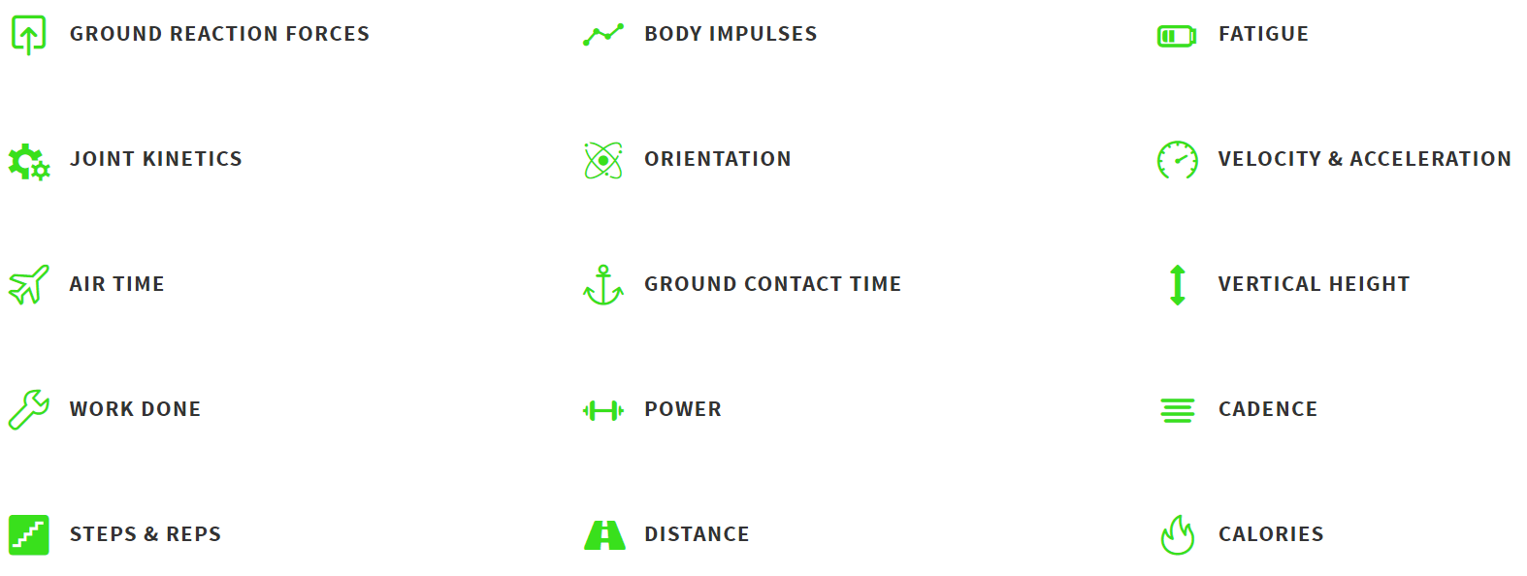
Application & Future Works
Vayu Technology Corp – Equilibrium - USC Based Startup
14 Sensor locations
3D Model Generation of Human Activity
Torch – Embeddable Machine Learning Classification Tool
Increasing the number of classes
Performance Recognition of a particular activity

