Slide 1
A sneak peak into Airbnb
Course: Big Data System Engineering Using Scala
Professor: Robin Hillyard
Team-5: Akash, Tejesh & Vinay

Slide 2
Goals of the project
Building a reactive application that is based on Actor model using Akka framework and Play framework.
Analyze the vibe of the neighborhood from the available listing dataset using Spark.
Suggest user some relevant listings based on his/her past experience or locality preference.

Slide 3
Use case
Because of it’s resilient and scalable design, the application should be responsive during high traffic.
The user will be able to reserve a listing by taking aid from our recommendation system
The super user will have access to a dashboard showcasing the summary of the system.

Slide 4
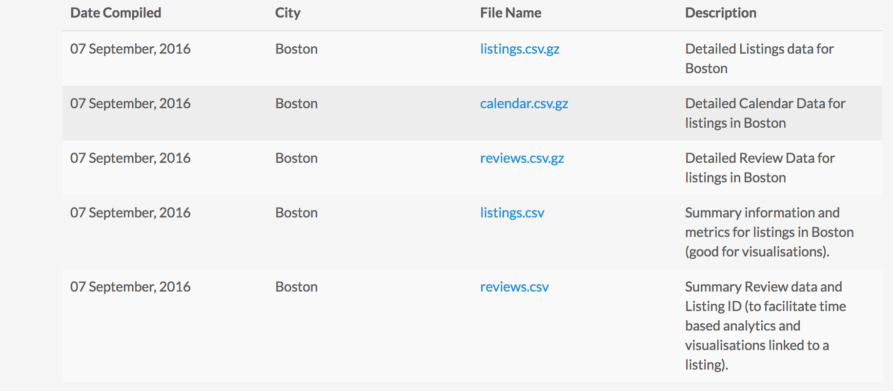
Data sources
The data source we used was taken from http://insideairbnb.com/get-the-data.html which has about 70000 reviews for 4000 listings in Boston.

Slide 5
Methodology
Agile Software Development
Build an reactive application using Play framework and Actor Model
Use of Spark and Spark Mlib to come up with the recommendations for the user

Slide 6
Milestone
Task | Time
Come up with the Prototype for our reactive System | 3/29
Exploring and implementing Play, Actor model and spark and unit tests | 4/15
Integrating Spark and Play | 4/18
Functional and load testing /self acceptance | 4/22

Slide 7
Scala Programming
Everything in Scala ☺
Play
Akka
Spark
Spark MLib

Slide 8
Acceptance Criteria
Application should be scalable enough to handle 2500 requests
Application should be truly reactive

Slide 9
Thank you

