Slide 1
A sneak peak into Airbnb
Course: Big Data System Engineering Using Scala
Professor: Robin Hillyard
Team-5: Akash, Tejesh & Vinay

Slide 2
Goals of the project
Building a reactive application that is based on Actor model using Akka framework and Play framework.
Analyze the vibe of the neighborhood from the available listing dataset
Suggest user some relevant listings based on his/her past experience or locality preference.

Slide 3
What it took to achieve our goal
Play-Framework
Akka
Slick(to help us make async DB calls to blocking DB)
MySQL
Kafka
Spark Streaming
Spark MLlib
HBase
Apache Zookeeper
HDFS
Angular JS
Chart JS

Slide 4
CRAWLER-DOWNLOADER
Data source: http://insideairbnb.com/get-the-data.html
Since there were more then 1000 files that we could download, we built a crawler using Actors that could download all the required files with multiple tries for failed atempts.

Slide 5
Actor system
Actor System
Pool of Login Actor(10)
WebSocket Actor
Kafka manager actor
Consumer Actor
Spark Streaming
Client
Actor
Consumer Thread

Slide 6

Architecture (Part 1)
Client
Login
PLAY
Pool of Login Actor(10)
MySQL
SLICK
Get Dashboard
Futures
HBase
HDFS

Slide 7
Architecture (part ii)
Kafka manager actor
Client
1
PLAY
2
5
WebSocket Actor
3
Spark Streaming Actor
16
Topic - IN
15
7
14
4
Topic - OUT
6
Kafka manager actor
Spark Streaming
Kafka
10
13
6
11
9
8
Consumer Actor
Spark MLib
12
8
Consumer Thread

Slide 8
Insight into airbnb dataset
Performed a few analysis like:
Average price per number of rooms
City trends – When does the city get really busy?
Most active customers
Average price per room type
Stored all these results on HBase.

Slide 9
Airbnb Datasets
Listings.csv – contain 4000 listings of Boston with 94 columns
Reviews.csv – contains around 30000 reviews of people visited a listing, along with ratings to each listings
Cleaned and pre-processed the data using PySpark on Jupyter Notebook on multi-line text.
Joined both csv’s programmatically using Python and obtained the required columns
Obtained 4 important column based on the ALS Algorithm

Slide 10
Spark MLlib
Airbnb listings prediction
Collaborative Filtering
ALS – Alternating Least Square
With the use of Ratings(int, int, double) – inbuilt class of Apache Spark
Clusters with similar interests and ratings

Slide 11
MSE – Mean Squared Error
MSE – Also known as Mean Deviation Error
Measures the average of squares of the errors and deviation
Measure of how close a fitted line is to data points
In layman terms, gives us the difference between estimator and what is estimated.
MSE value should be less than 5. The lower the MSE value the better the recommendation.
We were able to achieve a very good MSE value of approx. 1 and RMSE (Root of MSE) value of 1 as well

Slide 12
Milestone
Task | Time
Come up with the Prototype for our reactive System | 3/29
Exploring and implementing Play, Actor model and spark and unit tests | 4/15
Integrating Spark and Play | 4/18
Functional and load testing /self acceptance | 4/22

Slide 13
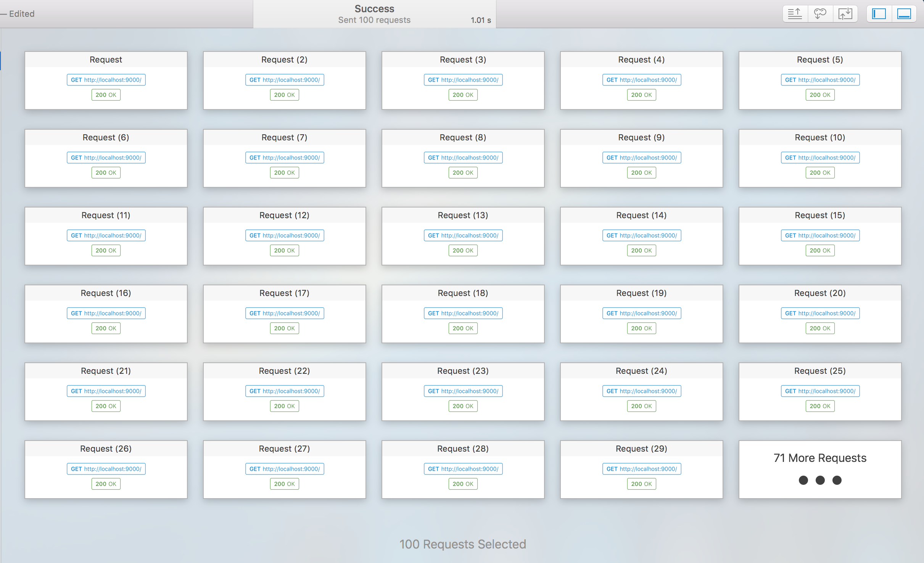
Application could serve upto 100 requests per second

Slide 14
Acceptance Criteria
Application was able to serve up to 100 requests per second.
Provide user with a informative dashboard showing the analytical insights based on the Airbnb listings data.
Recommend listings based on the user preference with MSE value less than 5. Our model is successfully recommending listings to the user with an MSE value of 1.2, which fulfills the criteria easily and serves the purpose of a Recommendation System.

Slide 15
Thank you
Questions?

