Slide 1
HomeMaven A Realtor App
MERN Final Project
(Rutgers Bootcamp Oct 2018 – May 2019)
Developed by:
Nandini, Praisy, Minal and Derek

Slide 2

Features and Functionality
Login and Register Feature
Search House for Sale by Address or Zipcode
Can Save the search house in database.
Can list the saved List. And Pins searched address as Geo Location, has get direction which takes you to googleMap
Displaying real time data using API. Like ATTOM, ESTATED, MapQuest and Google Maps
App is Responsive

Slide 3
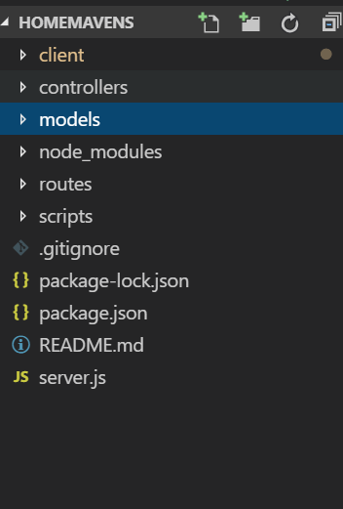
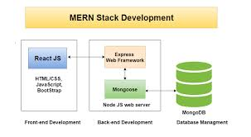
MERN Architecture with MVC Model

Slide 4
Process Flow Chart
User
Login
Main Page
Yes
New User
List the Listing as per Search
With pinned Geo Map
Yes
No
No
Start
Search homes by Address or Zip Code
Register
Existing User
Get stored in database
Click Saved Homes
List the saved Listing from DB

Slide 5
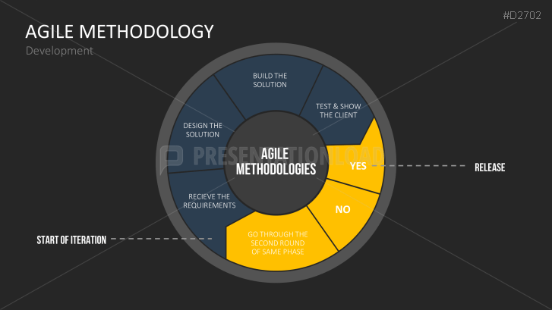
Agile Methodology

Slide 6
Technologies Used
Node
React
MongoDB
Express
Javascript
HTML
CSS
Bootstrap
New Library React Select US State

Slide 7
Thank You

