Slide 1


ADLAKHA MITRA PANDEY PATEL

Slide 2
AGENDA
What is DJANGO?
DJANGO Components
DJANGO Databases
Sites build on DJANGO
How to install DJANGO?
DJANGO Functionality
How to build an App?

Slide 3
What is DJANGO?
Free and open source web application framework written in Python
Simplifies creation of complex, database driven websites
Automate repetitive tasks
Better web apps with less code
Secure apps

Slide 4

DJANGO Components
Think MTV instead of MVC
Models – Django ORM
Templates – Django Template Engine
Views – Python function, Request in Response out

Slide 5




DJANGO Databases

Slide 6






Sites build on DJANGO

Slide 7
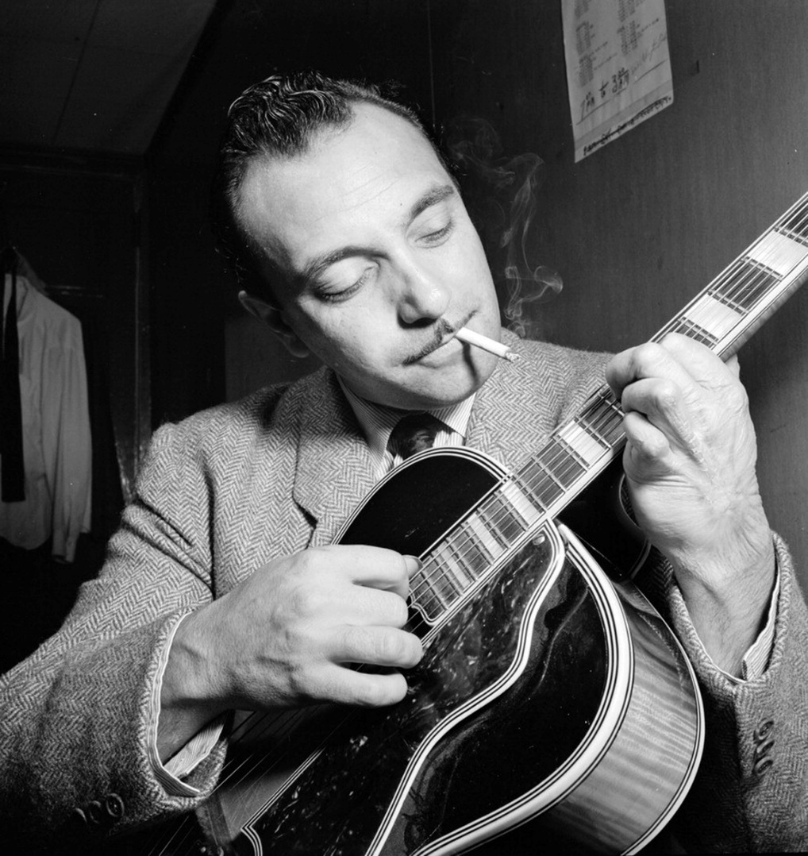
Interesting Facts About django
Django was named after:
Django Reinhardt
Three fingered jazz guitarist
Web programmers at “Lawrence Journal World” newspaper began using python to build applications. -2003
Open sourced – 2005
4.7 million hits/month on website - 2010

Slide 8
Why Django:
Django is python & python is awesome…
Great documentation
Batteries included: ORM Object Relational Mapper, User Authentication, Sessions, Syndication(RSS), Caching, Testing, Templates
Built-in light weight Web Server.
Jython Support

Slide 9
Installation
Prerequisites
Python
PIP for installing Python packages (http://www.pip-installer.org/en/latest/installing.html)
pip install Django==1.7.4
OR https://www.djangoproject.com/download/ - python setup.py install
pip install mysql-python
MySQL on windows https://pypi.python.org/pypi/MySQL-python/1.2.4
Add Python and Django to env path
PYTHONPATH C:\Python27
Path C:\Python27; C:\Python27\Lib\site-packages; C:\Python27\Lib\site-packages\django\bin;
Testing installation
shell> import django; django.get_version();

Slide 10
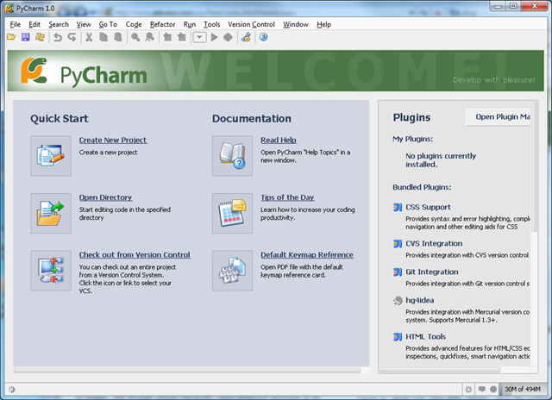
IDE for DJANGO

Slide 11
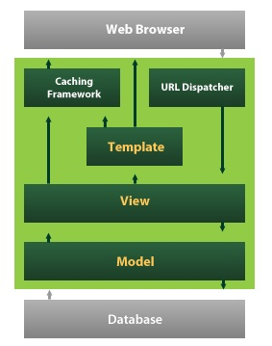
DJANGO Framework

Slide 12
How to build an App?

Slide 13
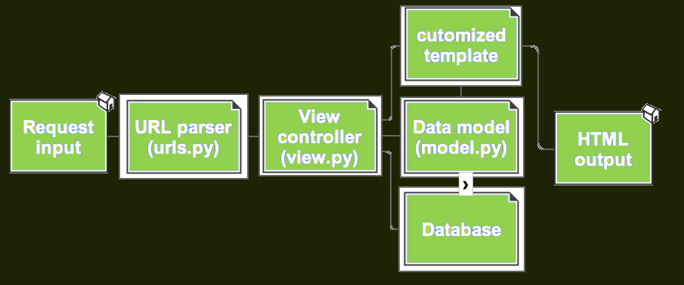
DJANGO Flow

Slide 14
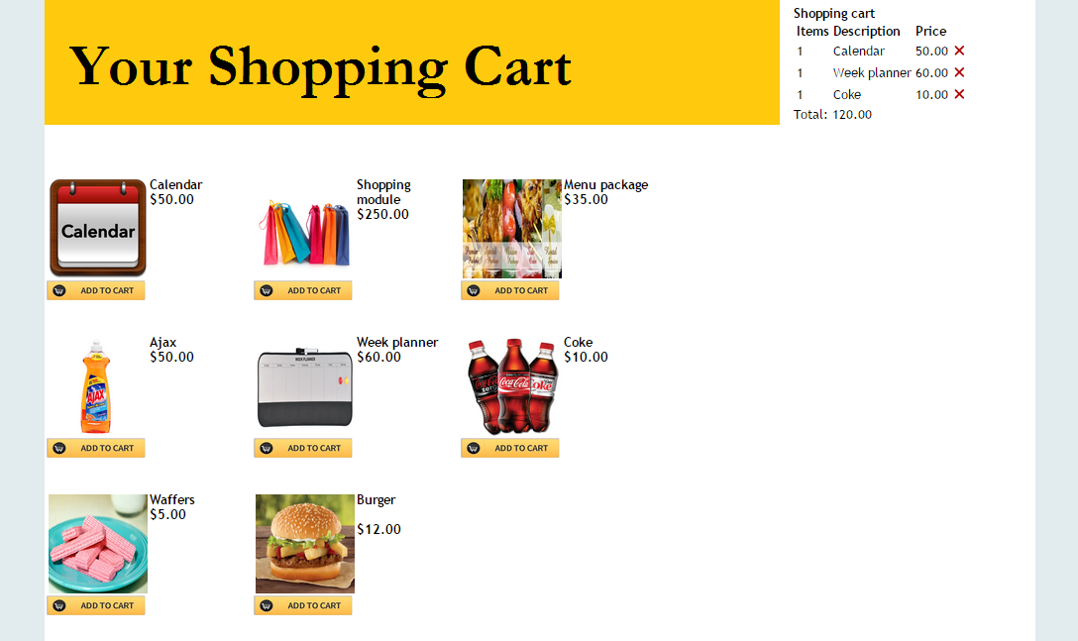
Your Shopping Cart!!

Slide 15
THANK YOU!!

Slide 16
References
https://docs.djangoproject.com/en/1.7/
http://stackoverflow.com/
http://www.erikmitchell.info/2010/09/28/using-django-to-create-complex-sites-simply/
https://docs.python.org/2/tutorial/

