Slide 1
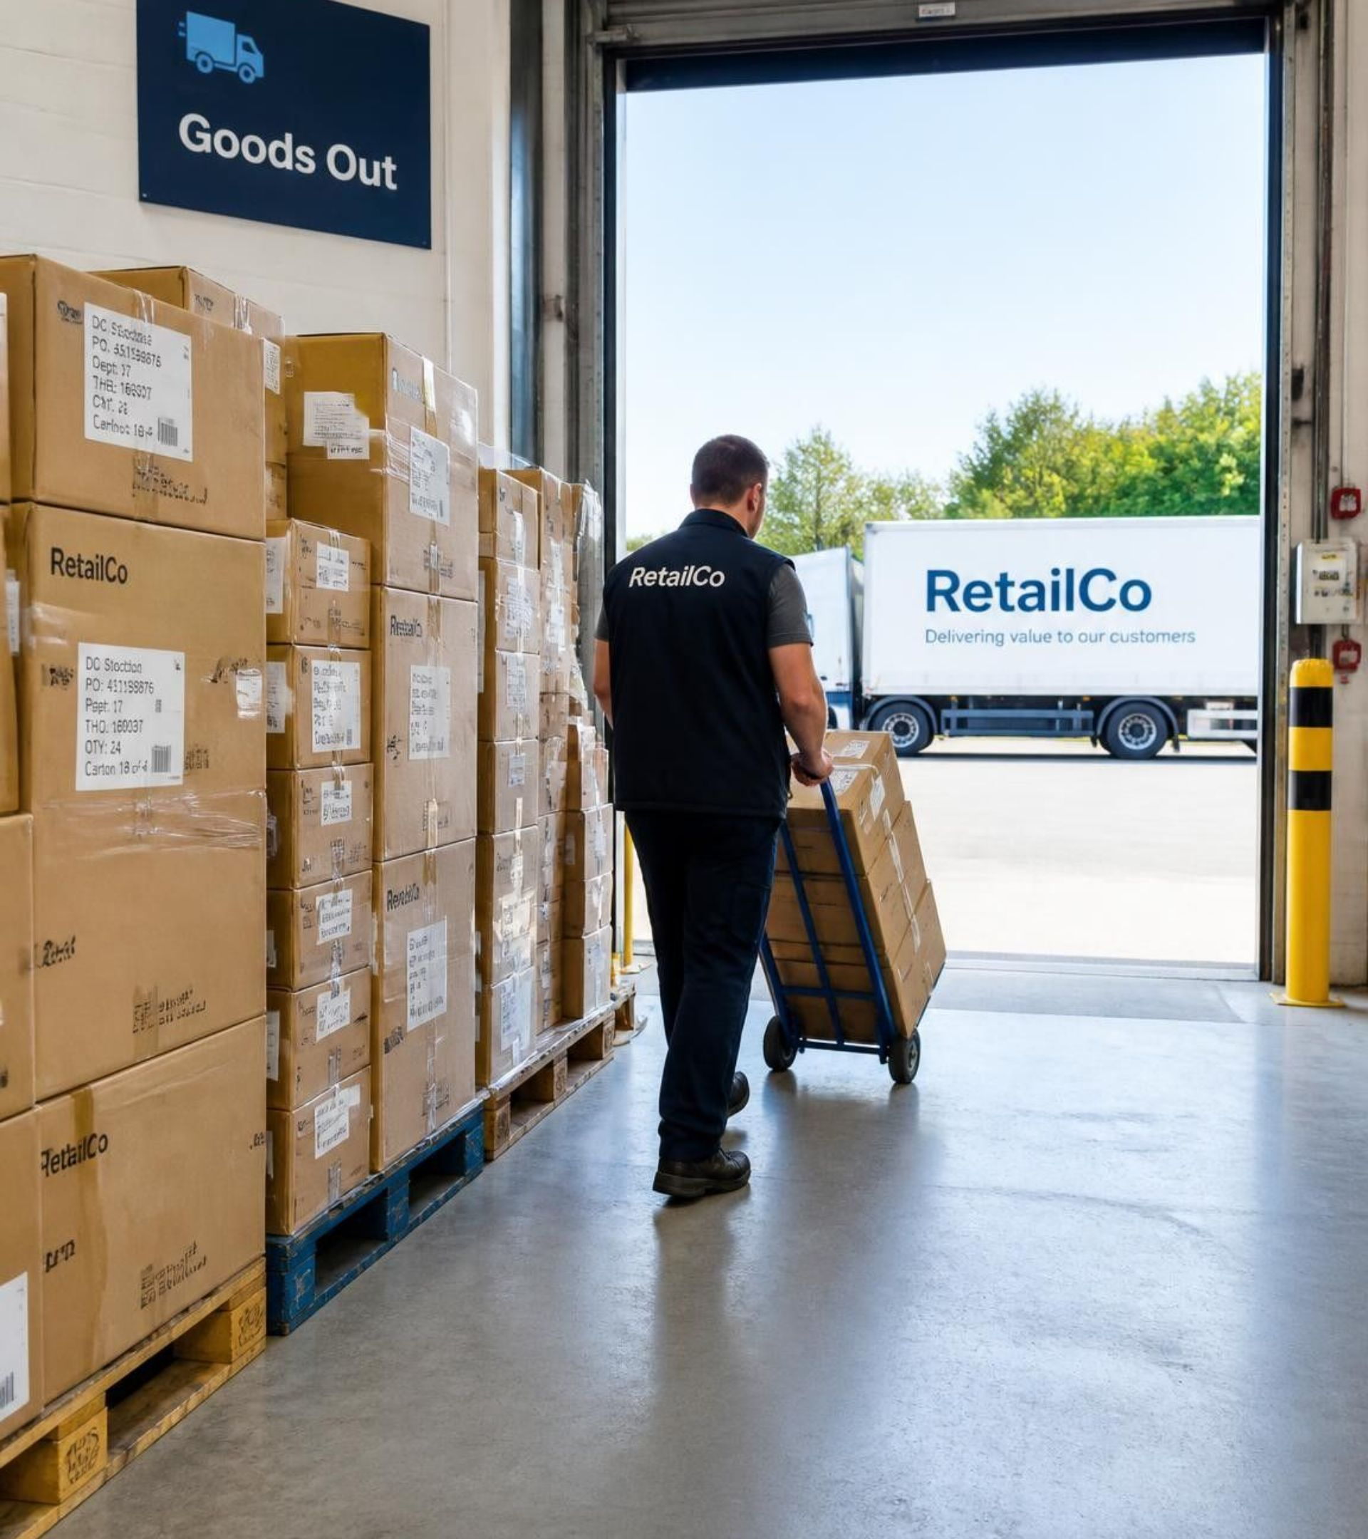
RetailIQ Sales Analytics: Protecting Margin and Cutting Returns
Executive review

Slide 2
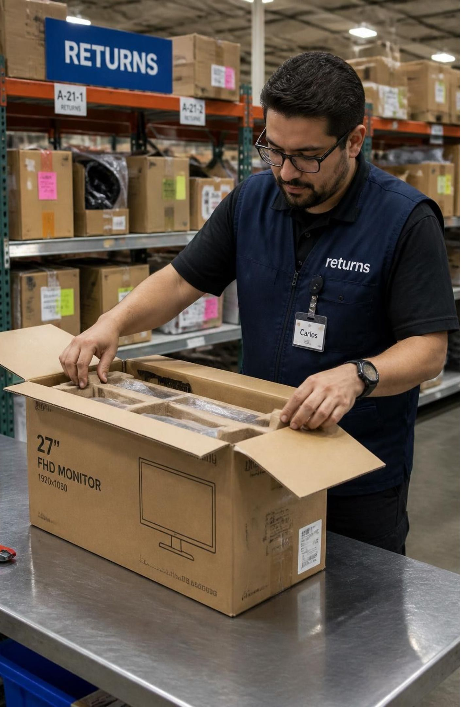
Discounts and returns are eroding profit
3.36% margin at 25% discount vs 27.52% with none; 5,057 unprofitable orders at 20% and 25%
50.1% return rate: 25,026 of 50,000 orders, tying up $1.18B in gross order value
CSAT 3.00 / 5.00 on average
Why now: $2.36B revenue and $403.7M gross profit are billed figures before refunds, overstating performance by about 50%, and Diwali is coming

Slide 3
50,000 orders over 25 months, analyzed at order level
50,000
25 months
transactions in the Kaggle RetailIQ dataset; 20 attributes enriched to 28 fields
July 2024 to July 2026; 50/50 online ($1.176B) and offline ($1.180B)
Excluded
Kept separate
City-level routing (corrupted city-state mapping) and customer lifetime value (non-unique customer IDs)
Gross revenue from net cash realization, because returns are unadjusted

Slide 4
We tested discount depth, trends and channel returns against six targets
Tests
Targets
Discount elasticity: correlation and t-tests across 0% to 25% bands
Trend and channel: monthly revenue by category, Chi-Square on online vs offline returns
Assumptions: gross accounting baseline; synthetic, near-uniform distributions read with caution
Metric | Now to target
Margin | 17.1% to over 20%
Loss-making orders | 5,057 to 0
Average discount | Under 10%
Returns | 50.1% to under 25%
CSAT | 3.00 to over 4.00
AOV | $47,110 to over $55,000

Slide 5
Baseline: $2.36B revenue, 17.14% margin, half of orders returned
Metric | Value
Gross revenue | $2.356B
Gross profit | $403.67M
Blended margin | 17.14%
Return rate | 50.05%
CSAT | 3.003 / 5
Delivery lead time | 3.988 days
Where it concentrates
Mean order $47,110; return rate CI 49.61% to 50.49%
Electronics and Home Appliances: 81.5% of revenue
Monitors 51.61% and Laptops 51.3% return rates

Slide 6
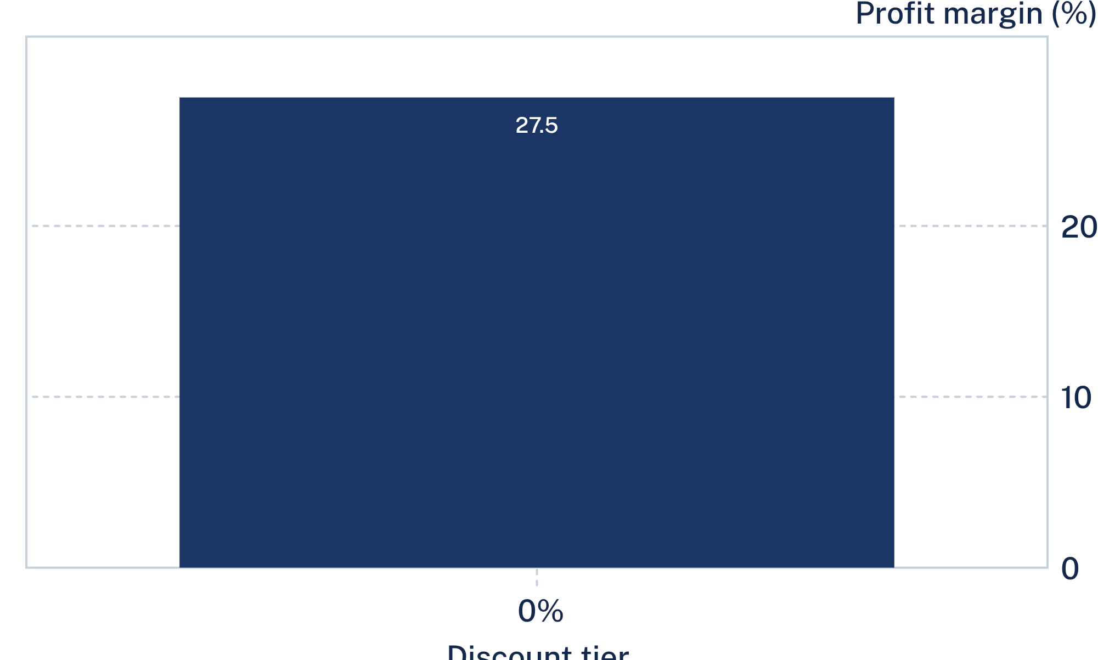
Margin collapses once discounts pass 20%
0%: 27.52% margin, no loss-making orders
1 to 10%: 21.59% margin, no loss-making orders
11 to 20%: 12.18% margin, 1,700 loss-making orders at 20%
21%+: 3.36% margin, 3,357 loss-making orders at 25%

Slide 7
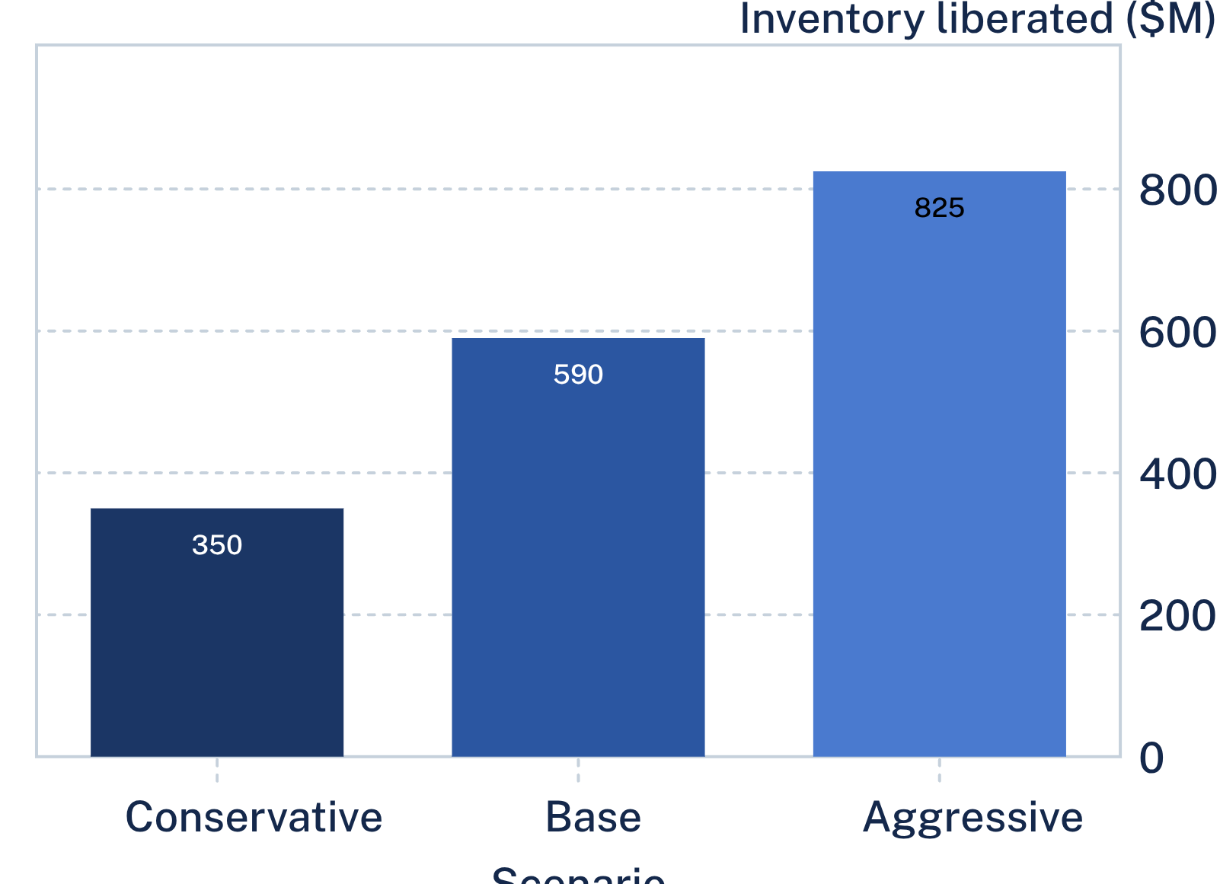
Fixing both could add $100M to $115M in profit and free $590M
$25M+ saved by phasing out 20% and 25% discounts, stopping 5,057 loss-making orders
17.1% to 21.5%+ margin by capping discounts at 10 to 15%
12,500 fewer shipments and 15,000+ handling hours by halving returns
Conservative: +$45M to $60M, $350M freed. Base: +$100M to $115M, $590M freed. Aggressive: +$140M+, $825M freed, margin above 23.5%

Slide 8
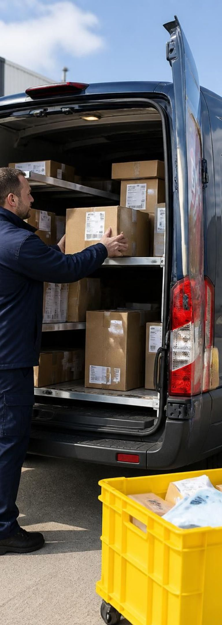
Three initiatives over 90 days
Days 1 to 30: enforce discount guardrails
Days 31 to 60: quality and fulfillment audit
1
2
Remove 20% and 25% codes, cap at 10 to 15%, CCO approval above 15%. Owners: CCO, Head of Pricing. Gate: zero loss-making orders, average discount under 10%
Monitors and Laptops (packaging, listings, delivery). Owners: Operations, QA, CX. Gate: returns under 25%, CSAT over 4.00
Days 61 to 90+: shift spend to Cameras, Air Conditioners, Laptops and launch B2B enterprise tiers
3
Owners: CRO, Digital Marketing, B2B Sales. Gate: margin over 20%, B2B share over 30%, AOV over $55,000

Slide 9

What the data can't tell us, and how we'll close the gaps
Limits
Next
No freight, gateway, CAC or restocking costs
City fields corrupted; customer IDs not unique
Uniform ratings and channel split suggest synthetic data
A/B discount-cap pilots at 5%, 10% and 12%
Reverse logistics cost audit for a true net cash model
Customer identity cleanse to enable cohort and CLV work
Return root-cause sampling on Monitors (51.6%) and Laptops (51.3%)

