Slide 1
Learning Linear Classifiers

Slide 2

Authentication by Secret Questions
Give me your device ID and answer the following questions
10111100
00110010
10001110
00010100
…
TS271828182845
1
0
1
0
…
SERVER
DEVICE

Slide 3


Physically Unclonable Functions
0.50ms
These tiny differences are difficult to predict or clone
0.55ms
Then these could act as the fingerprints for the devices!

Slide 4
Arbiter PUFs
If the top signal reaches the finish line first, the “answer” to this question is 0, else if the bottom signal reaches first, the “answer” is 1
Question: 1011
1
0
1
1
1
?

Slide 5
Arbiter PUFs
If the top signal reaches the finish line first, the “answer” to this question is 0, else if the bottom signal reaches first, the “answer” is 1
Question: 0110
0
1
1
0
0
?

Slide 6
Linear Models
We have $Δ_{63}=w_{0} ⋅x_{0}+w_{1}⋅x_{1}+…+w_{63}⋅x_{63}+β_{63}=w^{⊤}x+b$
where $x_{i}=d_{i}⋅d_{i+1}⋅…⋅d_{63}$ $w_{0}=α_{0}$ $w_{i}=α_{i}+β_{i−1} \left(for i>0\right)$
If $Δ_{63}<0$, upper signal wins and answer is 0
If $Δ_{63}>0$, lower signal wins and answer is 1
Thus, answer is simply $\frac{sign\left(w^{⊤}x+b\right)+1}{2}$
$$w$$
This is nothing but a linear classifier!

Slide 7


The “best” Linear Classifier
It seems infinitely many classifiers perfectly classify the data. Which one should I choose?
Indeed! Such models would be very brittle and might misclassify test data (i.e. predict the wrong class), even those test data which look very similar to train data
It is better to not select a model whose decision boundary passes very close to a training data point

Slide 8
Large Margin Classifiers
Fact: distance of origin from hyperplane $w^{⊤}x+b=0$ is ${\left|b\right|}/{{\left\|w\right\|}_{2}}$
Fact: distance of a point $p$ from this hyperplane is ${\left|w^{⊤}p+b\right|}/{{\left\|w\right\|}_{2}}$
Given train data ${\left\{\left(x^{i},y^{i}\right)\right\}}_{i=1}^{n}$ for a binary classfn problem where $x^{i}∈ℝ^{d}$ and $y^{i}∈\left\{−1,1\right\}$, we want two things from a classifier
Demand 1: classify every point correctly – how to ask this politely?
One way: demand that for all $i=1…n$, $sign\left(w^{⊤}x^{i}+b\right)=y^{i}$
Easier way: demand that for all $i=1…n$, $y^{i}⋅(w^{⊤}x^{i}+b)≥0$
Demand 2: not let any data point come close to the boundary
Demand that $\min_{i=1…n}{{\left|w^{⊤}x^{i}+b\right|}/{{\left\|w\right\|}_{2}}}$ be as large as possible

Slide 9


Support Vector Machines
“
Just a fancy way of saying
Please find me a linear classifier that perfectly classifies the train data while keeping data points as far away from the hyperplane as possible
The mathematical way of writing this request is the following
$\max_{w,b}\left\{\min_{i=1…n}{{\left|w^{⊤}x^{i}+b\right|}/{{\left\|w\right\|}_{2}}}\right\}$
such that $y^{i}⋅(w^{⊤}x^{i}+b)≥0$ for all $i=1…n$
Let us simplify this optimization problem
“
Constraints
Objective
This is known as an optimization problem with an objective and lots of constraints
This looks so complicated, how will I ever find a solution to this optimization problem?

Slide 10
Constrained Optimization 101
Constraints are usually specified using math equations. The set of points that satisfy all the constraints is called the feasible set of the optimization problem
How WE MUST SPEAK TO MS M
How we speak to a human
Objective
Constraints
$\min_{x}{f\left(x\right)}$
such that $p\left(x\right)<0$
and $q\left(x\right)>0$ etc. etc.
I want to find an unknown $x$ that gives me the best value according to this function $f$
Oh! btw, not any $x$ would do! $x$ must satisfy these conditions
All I am saying is, of the values of $x$ that satisfy my conditions, find me the one that gives the best value according to $f$
You optimization problem has no solution since no point satisfies all your constraints ☹
For your specified constraints, the optimal (least) value of $f$ is $9$ and it is achieved at $x=3$
Feasible set is empty!
$\min_{x}{x^{2}}$
s.t. $x≤6$ and $x≥3$
Feasible set is the interval $\left[3,6\right]$
s.t. $x≥6$ and $x≤3$
3 6

Slide 11
Back to SVMs
Assume there do exist params that perfectly classify all train data
Consider one such params $\left(w,b\right)$ which classifies train data perfectly
Now, ${\left|w^{⊤}x^{i}+b\right|}/{{\left\|w\right\|}_{2}}={\left|y^{i}⋅\left(w^{⊤}x^{i}+b\right)\right|}/{{\left\|w\right\|}_{2}}$ as $y^{i}∈\left\{−1,1\right\}$
Thus, geometric margin is same as $\min_{i=1…n}{{\left|y^{i}⋅\left(w^{⊤}x^{i}+b\right)\right|}/{{\left\|w\right\|}_{2}}}=$ $\min_{i=1…n}{{y^{i}⋅\left(w^{⊤}x^{i}+b\right)}/{{\left\|w\right\|}_{2}}}$ since model has perfect classification!
We will use this useful fact to greatly simplify the optimization problem
What if train data is non-linearly separable i.e no linear classifier can perfectly classify it? For example
We will remove this assumption later

Slide 12
Support Vector Machines
Let $i_{0}$ be the data point that comes closest to the hyperplane i.e. $\min_{i=1…n}{y^{i}⋅\left(w^{⊤}x^{i}+b\right)}=y^{i_{0}}⋅\left(w^{⊤}x^{i_{0}}+b\right)$
Recall that all this discussion holds only for a perfect classifier $\left(w,b\right)$
Let $ε=y^{i_{0}}⋅\left(w^{⊤}x^{i_{0}}+b\right)$ and consider $\tilde{w}=w/ε, \tilde{b}=b/ε$
Note this gives us $y^{i}⋅\left({\tilde{w}}^{⊤}x^{i}+\tilde{b}\right)≥1$ for all $i=1…n$ as well as $\min_{i=1…n}{{y^{i}⋅\left({\tilde{w}}^{⊤}x^{i}+\tilde{b}\right)}/{{\left\|\tilde{w}\right\|}_{2}}}=$ $1/{{\left\|\tilde{w}\right\|}_{2}}$ (as $y^{i_{0}}⋅\left({\tilde{w}}^{⊤}x^{i_{0}}+\tilde{b}\right)=1$)
Thus, instead of searching for $\left(w,b\right)$, easier to search for $\left(\tilde{w},\tilde{b}\right)$
$\max_{\tilde{w},\tilde{b}}\left\{1/{{\left\|\tilde{w}\right\|}_{2}}\right\}$
such that $y^{i}⋅({\tilde{w}}^{⊤}x^{i}+\tilde{b})≥1$ for all $i=1…n$
$${}^{2}$$
$$\min_{\tilde{w},\tilde{b}}\left\{{\left\|\tilde{w}\right\|}_{2}\right\}$$

Slide 13

The C-SVM Technique
What prevents me from misusing the slack variables to learn a model that misclassifies every data point?
For linearly separable cases where we suspect a perfect classifier exists
$\min_{\tilde{w},\tilde{b}}{{\frac{1}{2}\left\|\tilde{w}\right\|}_{2}^{2}}$
s.t. $y^{i}⋅({\tilde{w}}^{⊤}x^{i}+\tilde{b})≥1$ for all $i∈\left[n\right]$
If a linear classifier cannot perfectly classify data, then find model using
$\min_{\tilde{w},\tilde{b},\left\{ξ_{i}\right\}}{{\frac{1}{2}\left\|\tilde{w}\right\|}_{2}^{2}+C\sum_{i=1}^{n}{ξ_{i}}}$
s.t. $y^{i}⋅\left({\tilde{w}}^{⊤}x^{i}+\tilde{b}\right)≥1−ξ_{i}$ for all $i∈\left[n\right]$
as well as $ξ_{i}≥0$ for all $i∈\left[n\right]$
The $C$ term prevents you from doing so. If we set $C$ to be a large value (it is a hyper-parameter), then it will penalize solutions that misuse slack too much
Having the constraint $ξ_{i}≥0$ prevents us from misusing slack to artificially inflate the margin
Recall English phrase “cut me some slack”
The $ξ_{i}$ terms are called slack variables. They allow some data points to come close to the hyperplane or be misclassified altogether

Slide 14
From C-SVM to Loss Functions
We can further simplify the previous optimization problem
Note $ξ_{i}$ basically allows us to have $y^{i}⋅\left({\tilde{w}}^{⊤}x^{i}+\tilde{b}\right)<1$ (even $<0$)
Thus, the amount of slack we want is just $ξ_{i}=1−y^{i}⋅\left({\tilde{w}}^{⊤}x^{i}+\tilde{b}\right)$
However, recall that we must also satisfy $ξ_{i}≥0$
Another way of saying that if you already have $y^{i}⋅\left({\tilde{w}}^{⊤}x^{i}+\tilde{b}\right)≥1$, then you don’t need any slack i.e. you should have $ξ_{i}=0$ in this case
Thus, we need only set $ξ_{i}={\left[1−y^{i}⋅\left({\tilde{w}}^{⊤}x^{i}+\tilde{b}\right)\right]}_{+}$
The above is nothing but the popular hinge loss function!
$${\left[x\right]}_{+}=\max\left\{x,0\right\}$$

Slide 15
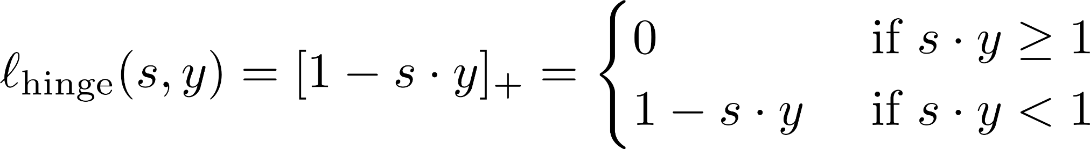

Hinge Loss
Captures how well as a classifier classified a data point
Suppose on a data point $\left(x,y\right), y∈\left\{−1,1\right\}$, a model gives prediction score of $s$ (for a linear model $\left(w,b\right)$, we have $s=w^{⊤}x+b$)
We obviously want $s⋅y≥0$ for correct classification but we also want $s⋅y≫0$ for large margin – hinge loss function captures both
Note that hinge loss not only penalizes misclassification but also correct classification if the data point gets too close to the hyperplane!

Slide 16
Final Form of C-SVM
Recall that the C-SVM optimization finds a model by solving
$\min_{\tilde{w},\tilde{b},\left\{ξ_{i}\right\}}{{\frac{1}{2}\left\|\tilde{w}\right\|}_{2}^{2}+C\sum_{i=1}^{n}{ξ_{i}}}$
s.t. $y^{i}⋅\left({\tilde{w}}^{⊤}x^{i}+\tilde{b}\right)≥1−ξ_{i}$ for all $i∈\left[n\right]$
as well as $ξ_{i}≥0$ for all $i∈\left[n\right]$
Using the previous discussion, we can rewrite the above very simply
$\min_{\tilde{w},\tilde{b} }{{\frac{1}{2}\left\|\tilde{w}\right\|}_{2}^{2}+C\sum_{i=1}^{n}{ℓ_{hinge}\left({\tilde{w}}^{⊤}x^{i}+\tilde{b},y^{i}\right)}}$

Slide 17
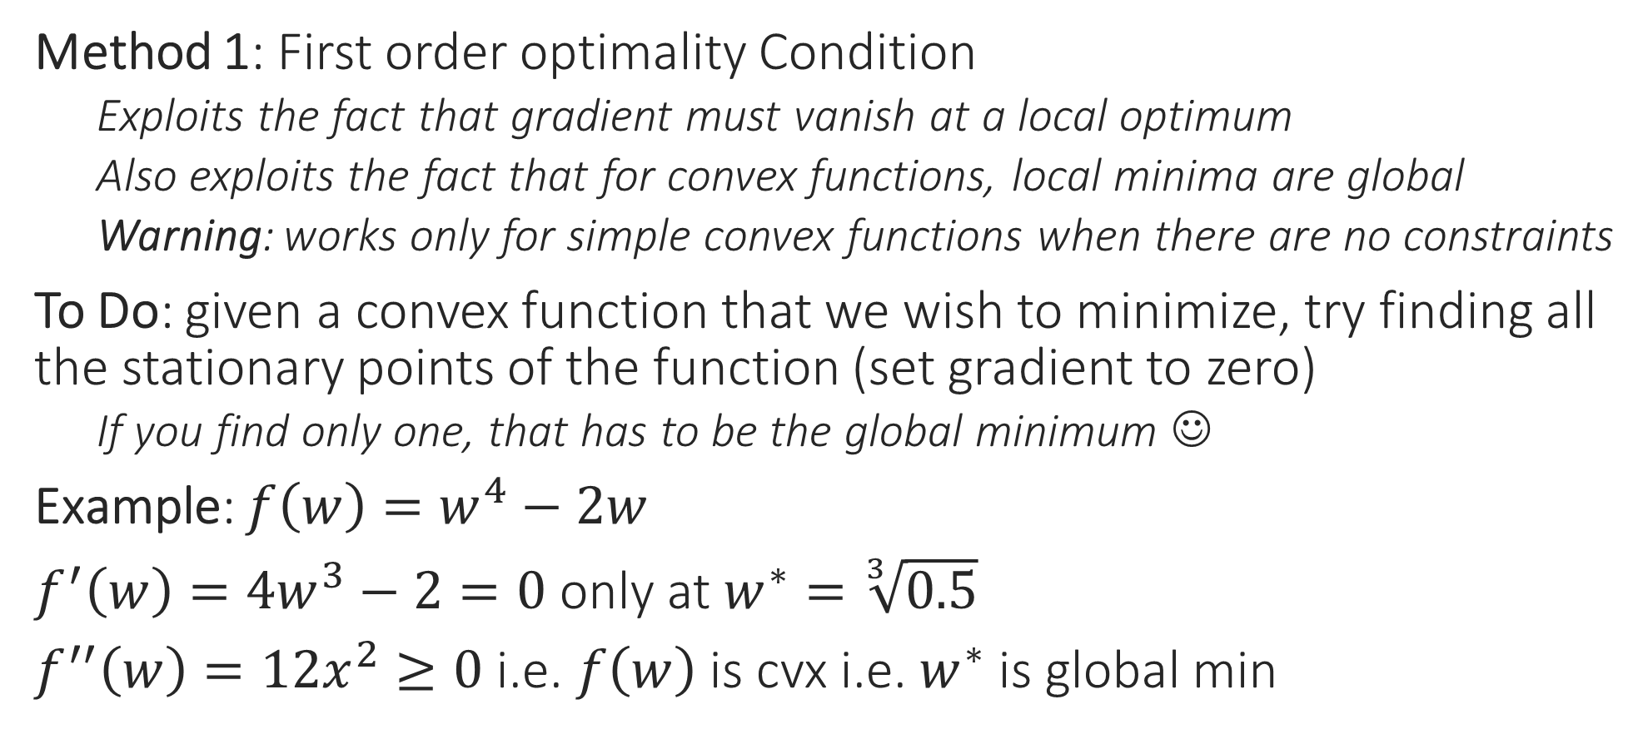
Use Calculus for Optimization
Method 1: First order optimality Condition
Exploits the fact that gradient must vanish at a local optimum
Also exploits the fact that for convex functions, local minima are global
Warning: works only for simple convex functions when there are no constraints
To Do: given a convex function that we wish to minimize, try finding all the stationary points of the function (set gradient to zero)
If you find only one, that has to be the global minimum ☺
Example: $f\left(w\right)=w^{4}−2w$
$f^{′}\left(w\right)=4w^{3}−2=0$ only at $w^{∗}=\sqrt[3]{0.5}$
$f^{′′}\left(w\right)=12x^{2}≥0$ i.e. $f\left(w\right)$ is cvx i.e. $w^{∗}$ is global min

Slide 18


Use Calculus for Optimization
Method 2: Perform (sub)gradient descent
Recall that direction opposite to gradient offers steepest descent
(SUB)GRADIENT DESCENT
Given: obj. func. $f:ℝ^{d}→ℝ$ to minimize
Initialize $w^{0}∈ℝ^{d}$
For $t=0, 1, …$
Obtain a (sub)gradient $g^{t}∈∂f\left(w^{t}\right)$
Choose a step length $η_{t}$
Update $w^{t+1}←w^{t}−η_{t}⋅g^{t}$
Repeat until convergence
How to initialize $w^{0}$?
How to choose $η_{t}$
Often called “step length” or “learning rate”
What is convergence?
How to decide if we have converged?

Slide 19
Gradient Descent (GD)
Choose step length carefully else may overshoot the global minimum even with great initialization
Move opposite to the gradients
Also, initialization may affect result
Our initialization was such that we converged to a local minimum
This time initialization was really nice!
Global minimum
With convex fns, all local minima are global minima and can afford to be less carefull with initialization
Still need to be careful with step lengths otherwise may overshoot global minima

Slide 20



Behind the scenes in GD for SVM
So gradient descent, although a mathematical tool from calculus, actually tries very actively to make the model perform better on all data points
$f\left(w\right)=\frac{1}{2}{\left\|w\right\|}_{2}^{2}+C⋅{\sum_{i=1}^{n}{\left[1−y^{i}⋅w^{⊤}x^{i}\right]}}_{+}$ (ignore bias $b$ for now)
$∇f\left(w\right)=w+C⋅\sum_{i=1}^{n}{g^{i}y^{i}⋅x^{i}}$, where $g^{i}∈∂ℓ_{hinge}\left(y^{i}⋅w^{⊤}x^{i}\right)$
$w^{new}=w−η⋅∇f\left(w\right)=\left(1−η\right)⋅w−ηC⋅\sum_{i=1}^{n}{g^{i}y^{i}⋅x^{i}}$
Assume $n=1$ for a moment for sake of understanding
$w^{new}=\left(1−η\right)⋅w−ηC⋅g^{1}y^{1}⋅x^{1}$
Small $η$: $\left(1−η\right)$ is large $⇒$ do not change $w$ too much!
Large $η$: Feel free to change $w$ as much as the gradient dictates
If $w$ does well on $\left(x^{1},y^{1}\right)$, say $y^{1}⋅w^{⊤}x^{1}>1$, then $g^{1}=0$
If $w$ does badly on $\left(x^{1},y^{1}\right)$, say $y^{1}⋅w^{⊤}x^{1}<0$, then $g^{1}=−1$
$w^{new}=\left(1−η\right)⋅w+ηC⋅y^{1}⋅x^{1}$
$y^{1}⋅{\left(w^{new}\right)}^{⊤}⋅x^{1}={\left(1−η\right)y}^{1}⋅w^{⊤}x^{1}+ηC⋅{\left\|x^{1}\right\|}_{2}^{2}$
No change to $w$ due to the data point $\left(x^{1},y^{1}\right)$
$w^{new}$ may get much better margin on $\left(x^{1},y^{1}\right)$ than $w$

Slide 21

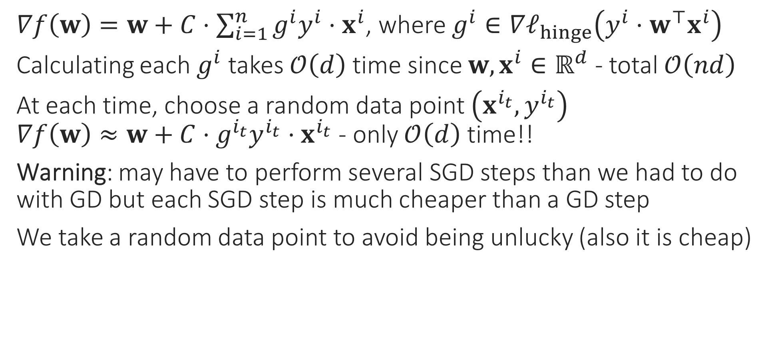
Stochastic Gradient Method
$∇f\left(w\right)=w+C⋅\sum_{i=1}^{n}{g^{i}y^{i}⋅x^{i}}$, where $g^{i}∈∇ℓ_{hinge}\left(y^{i}⋅w^{⊤}x^{i}\right)$
Calculating each $g^{i}$ takes $𝒪\left(d\right)$ time since $w,x^{i}∈ℝ^{d}$ - total $𝒪\left(nd\right)$
At each time, choose a random data point $\left(x^{i_{t}},y^{i_{t}}\right)$ $∇f\left(w\right)≈w+C⋅g^{i_{t}}y^{i_{t}}⋅x^{i_{t}}$ - only $𝒪\left(d\right)$ time!!
Warning: may have to perform several SGD steps than we had to do with GD but each SGD step is much cheaper than a GD step
We take a random data point to avoid being unlucky (also it is cheap)
Do we really need to spend so much time on just one update?
Initially, all we need is a general direction in which to move
Especially in the beginning, when we are far away from the optimum!
No, SGD gives a cheaper way to perform gradient descent

Slide 22
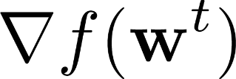
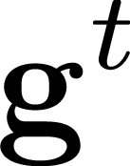
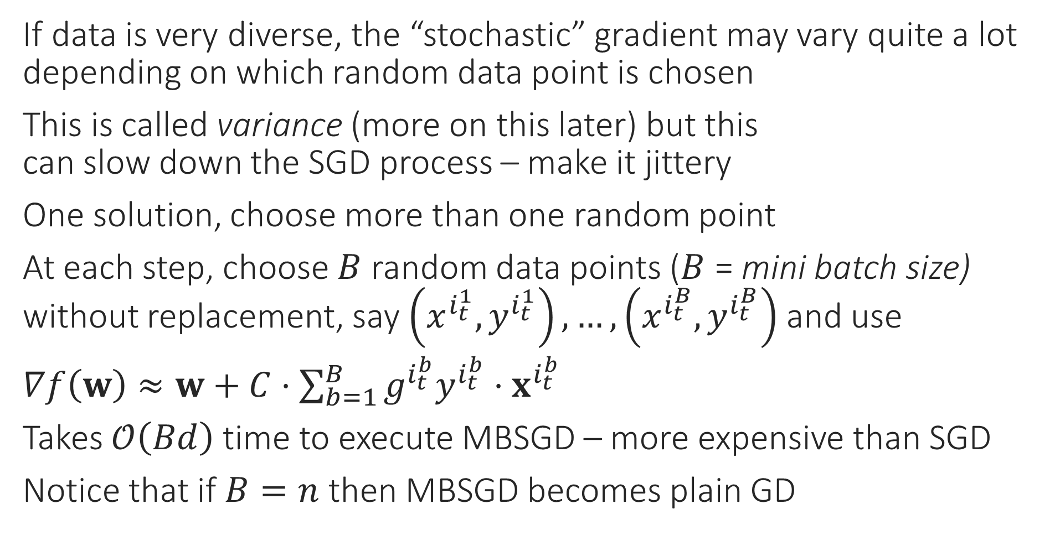
Mini-batch SGD
If data is very diverse, the “stochastic” gradient may vary quite a lot depending on which random data point is chosen
This is called variance (more on this later) but this can slow down the SGD process – make it jittery
One solution, choose more than one random point
At each step, choose $B$ random data points ($B$ = mini batch size) without replacement, say $\left(x^{i_{t}^{1}},y^{i_{t}^{1}}\right),…,\left(x^{i_{t}^{B}},y^{i_{t}^{B}}\right)$ and use
$∇f\left(w\right)≈w+C⋅\sum_{b=1}^{B}{g^{i_{t}^{b}}y^{i_{t}^{b}}⋅x^{i_{t}^{b}}}$
Takes $𝒪\left(Bd\right)$ time to execute MBSGD – more expensive than SGD
Notice that if $B=n$ then MBSGD becomes plain GD

Slide 23


Coordinate Descent
Sometimes we are able to optimize completely along a given variable (even if constraints are there) – called coordinate minimization (CM)
Similar to GD except only one coordinate is changed in a single step
E.g. $\min_{x∈ℝ^{d}}{f\left(x\right)}$ s.t. $x∈𝒞$ with $∇_{j}f\left(x\right)=\frac{∂f}{∂x_{j}}$ as $j$th partial derivative
CCD: choose coordinate cyclically i.e. $j_{t}=1,2,…,d,1,2,…,d,…$
SCD: choose $j_{t}$ randomly
Block CD: choose a small set of coordinates at each $t$ to update
Randperm: permute coordinates randomly and choose them in that order. Once the list is over, choose a new random permutation and start over (very effective)
COORDINATE DESCENT
1. For $t=0,1,…$
Select a coordinate $j_{t}∈\left[d\right]$
Let $u_{j_{t}}^{t+1}←x_{j_{t}}^{t}−η_{t}⋅∇_{j_{t}}f\left(x^{t}\right)$
Let $u_{j}^{t+1}←x_{j}^{t}$ for $j≠j_{t}$
Repeat until convergence

