Slide 1
My first Solver

Slide 2
Constrained Optimization 101
How WE MUST SPEAK TO Melbo
How we speak to a human
Objective
Constraints
$\min_{x}{f\left(x\right)}$
such that $p\left(x\right)<0$
and $q\left(x\right)>0$ etc. etc.
I want to find an unknown $x$ that gives me the best value according to this function $f$
Oh! btw, not any $x$ would do! $x$ must satisfy these conditions
All I am saying is, of the values of $x$ that satisfy my conditions, find me the one that gives the best value according to $f$
$\min_{x}{x^{2}}$
s.t. $x≤6$ and $x≥3$
Feasible set is the interval $\left[3,6\right]$
3 6

Slide 3




Projected Descent Methods
Wait … the projection step itself looks like an optimization problem!
This technique is useful only if $𝒞$ is such that projection step is easy
Technique 1 (Projections):
Undo violations done by GD
Trick: If after descent step, we violate a constraint, go back into the feasible set $𝒞$
Use a “projection step” $Π_{𝒞}\left(x\right)≝\arg{\min_{z∈𝒞}{{\left\|x−z\right\|}_{2}^{2}}}$
PROJECTED GRADIENT DESCENT (PGD)
Given: objective function $f:ℝ^{d}→ℝ$ and feasible set $𝒞⊂ℝ^{d}$
Initialize $w^{0}∈ℝ^{d}$
For $t=0, 1, …$
Get a (sub)gradient $g^{t}∈∂f\left(w^{t}\right)$
Choose a step length $η_{t}$
Update $u^{t+1}←w^{t}−η_{t}⋅g^{t}$
Project $w^{t+1}←Π_{𝒞}\left(u^{t+1}\right)$
Repeat until convergence
The projection step ensures we move as little as possible – this is to avoid undoing the objective value reduction we got out of the descent step
Projections are idempotent i.e., if $x∈𝒞$, then $Π_{𝒞}\left(x\right)=x$
We can easily modify this method to work with SGD, mini-batch SGD, CD, CM
$$𝒞$$

Slide 4
A few useful Projections
Finding the closest point in a set $Π_{𝒞}\left(x\right)=\arg{\min_{z∈𝒞}{{\left\|x−z\right\|}_{2}^{2}}}$
$$𝒞=\left\{z:{\left\|z\right\|}_{2}≤1\right\}$$
$$𝒞=\left\{z:z_{i}≥0\right\}$$
$$Π_{𝒞}\left(x\right)=\left\{\begin{matrix}\begin{matrix} x & if {\left\|x\right\|}_{2}≤1\end{matrix} \\ \begin{matrix}\frac{x}{{\left\|x\right\|}_{2}} & if {\left\|x\right\|}_{2}>1\end{matrix}\end{matrix}\right.$$
$$Π_{𝒞}\left(x\right)=z \\ z_{i}=\left\{\begin{matrix}\begin{matrix}x_{i} & if x_{i}≥0\end{matrix} \\ \begin{matrix}0 & if x_{i}<0\end{matrix}\end{matrix}\right.$$

Slide 5
A few useful Projections
Constraints of the form $x_{i}∈\left[a_{i},b_{i}\right]$ are often call box constraints since the feasible set looks like a box
Finding the closest point in a set $Π_{𝒞}\left(x\right)=\arg{\min_{z∈𝒞}{{\left\|x−z\right\|}_{2}^{2}}}$
$$𝒞=\left\{z:{\left\|z−c\right\|}_{2}≤r\right\}$$
$$𝒞=\left\{z:z_{i}∈\left[a_{i},b_{i}\right]\right\}$$
$$Π_{𝒞}\left(x\right)=\left\{\begin{matrix}\begin{matrix} x & if {\left\|x−c\right\|}_{2}≤r\end{matrix} \\ c+\begin{matrix}\frac{r⋅\left(x−c\right)}{{\left\|x−c\right\|}_{2}} & if {\left\|x−c\right\|}_{2}>r\end{matrix}\end{matrix}\right.$$
$$Π_{𝒞}\left(x\right)=z \\ z_{i}=\left\{\begin{matrix}\begin{matrix}x_{i} & if x_{i}∈\left[a_{i},b_{i}\right]\end{matrix} \\ \begin{matrix}a_{i} & if x_{i}<a_{i}\end{matrix} \\ \begin{matrix}b_{i} & if x_{i}>b_{i}\end{matrix}\end{matrix}\right.$$

Slide 6




Proximal Gradient Descent
Can think of it as a more powerful cousin of projected GD
Many opt problems that come up in ML look like $\min_{w∈ℝ^{d}}{r\left(w\right)+ℓ\left(w\right)}$
In SVM problem, $r\left(w\right)=0.5⋅{\left\|w\right\|}_{2}^{2}$ and $ℓ\left(w\right)=C⋅{\sum_{i=1}^{n}{\left[1−y^{i}⋅w^{⊤}x^{i}\right]}}_{+}$
$ℓ\left(⋅\right)$ is often called the “loss” function and $r\left(⋅\right)$ the “regularizer (more later)
Note that loss depends on model and data but regularizer only on model
The regularizer can even encode constraints e.g. $r_{𝒞}\left(w\right)=\left\{\begin{aligned}0,w∈𝒞 \\ ∞,w∉𝒞\end{aligned}\right.$
Solving $\min_{w∈ℝ^{d}}{r_{𝒞}\left(w\right)+ℓ\left(w\right)}$ is the same as solving $\min_{w∈ℝ^{d}}{ℓ\left(w\right)}$ s.t. $w∈𝒞$
Prox-GD offers a very attractive technique when the regularizer is not a differentiable function (e.g. LASSO in assignment 1)
$$r_{𝒞}$$
$$𝒞$$
Such a function is often called an “indicator function” since it indicates if a point is inside or outside $𝒞$

Slide 7





Proximal Gradient Descent
The intuition behind this definition is that we wish to stay in the proximity of the input $u$, but also lower 𝑟(⋅) value
For any function $r\left(⋅\right)$ and $η>0$ define the proximal function as
$${prox}_{η}\left(u\right)=\arg{\min_{z}\left[r\left(z\right)+\frac{1}{2η}{\left\|z−u\right\|}_{2}^{2}\right]}$$
Nice! So the prox step is trying to lower 𝑟(⋅) value without undoing progress made by gradient step
Indeed – prox GD is very useful for problems where regularizer is non-differentiable
PROXIMAL GRADIENT DESCENT
Given: loss fn $ℓ\left(⋅\right)$ regularizer $r\left(⋅\right)$
Initialize $w^{0}∈ℝ^{d}$
For $t=0, 1, …$
Let $g^{t}∈∂ℓ\left(w^{t}\right)$ and choose $η_{t}$
Let $u^{t+1}←w^{t}−η_{t}⋅g^{t}$
Let $w^{t+1}←prox_{η_{t}}\left(u^{t+1}\right)$
Repeat until convergence
If $r\left(⋅\right)$ is indicator fn of a set $𝒞$, proxGD becomes projected GD ${prox}_{η}\left(u\right)=\arg{\min_{z∈𝓒}{{\left\|u−z\right\|}_{2}}}$
If $r\left(w\right)=\frac{1}{2}⋅{\left\|w\right\|}_{2}^{2}$ then $prox_{η}\left(u\right)=\frac{u}{1+η}$ i.e., scaling
ProxGD very useful in learning sparse models which are offer smaller model size, test times

Slide 8



ProxGD for Sparse Recovery
Consider the LASSO optimization problem (with train data $X∈ℝ^{n×d},y∈ℝ^{n}$) $\min_{w∈ℝ^{d}}{λ⋅{\left\|w\right\|}_{1}+\frac{1}{2n}{\left\|Xw−y\right\|}_{2}^{2}}$
Thus, the proximal operator looks like ${prox}_{η}\left(u\right)=\arg{\min_{z}\left[λ⋅{\left\|z\right\|}_{1}+\frac{1}{2η}{\left\|z−u\right\|}_{2}^{2}\right]}$
Turns out, this has a closed-form solution ${prox}_{η}{\left(u\right)}_{i}=\left\{\begin{matrix}\begin{matrix}u_{i}−ηλ \\ 0 \\ u_{i}+ηλ\end{matrix} & \begin{matrix}u_{i}>ηλ \\ u_{i}∈\left[−ηλ,ηλ\right] \\ u_{i}<−ηλ\end{matrix}\end{matrix}\right.$
Soft Thresholding
$$−ηλ$$
$$ηλ$$

Slide 9


A Tale of Two Methods for Sparse Recovery
Hard thresholding
Soft thresholding
$z^{t}=w^{t}−η⋅ℓ\left(w^{t}\right)$
$w^{t+1}=HT\left(z^{t}\right)$
Solves a constrained problem $\min_{w∈ℝ^{d}}{\frac{1}{2n}{\left\|Xw−y\right\|}_{2}^{2}}$ s.t. ${\left\|w\right\|}_{0}≤s$
Problem being solved is non-convex
Explicitly sets all but top $s$ coordinates of $z^{t}$ (by magnitude) to zero
Super-fast (if used with correction)
$z^{t}=w^{t}−η⋅ℓ\left(w^{t}\right)$
$w^{t+1}=ST\left(z^{t}\right)$
Solves an unconstrained problem $\min_{w∈ℝ^{d}}{λ⋅{\left\|w\right\|}_{1}+\frac{1}{2n}{\left\|Xw−y\right\|}_{2}^{2}}$
Problem being solved is convex
“Shrinks” the coordinates of $z^{t}$ and sets the small magnitude ones to zero
Can be accelerated using NAG (FISTA)

Slide 10






Constrained Optimization
Method 3: Creating a Dual Problem
Suppose we wish to solve $\min_{x∈ℝ^{d}}{f\left(x\right)}+r\left(x\right)$ s.t. $g\left(x\right)≤0$
Trick: sneak this constraint into the objective
Construct a barrier (indicator) fn $r\left(x\right)$ so that $r\left(x\right)=0$ if $g\left(x\right)≤0$ and $r\left(x\right)=∞$ otherwise, and simply solve
Easy to see that both problems have the same solution
One very elegant way to construct such a barrier is the following $r\left(x\right)=\max_{α≥0}{α⋅g\left(x\right)}$
Thus, we want to solve $\min_{x∈ℝ^{d}}\left\{f\left(x\right)+\max_{α≥0}{α⋅g\left(x\right)}\right\}$
Let us see how to handle multiple constraints and equality constraints
Hmm … we still have a constraint here, but a very simple one i.e. $α≥0$
Same as $\min_{x∈ℝ^{d}}\left\{\max_{α≥0} \left\{f\left(x\right)+α⋅g\left(x\right)\right\}\right\}$

Slide 11

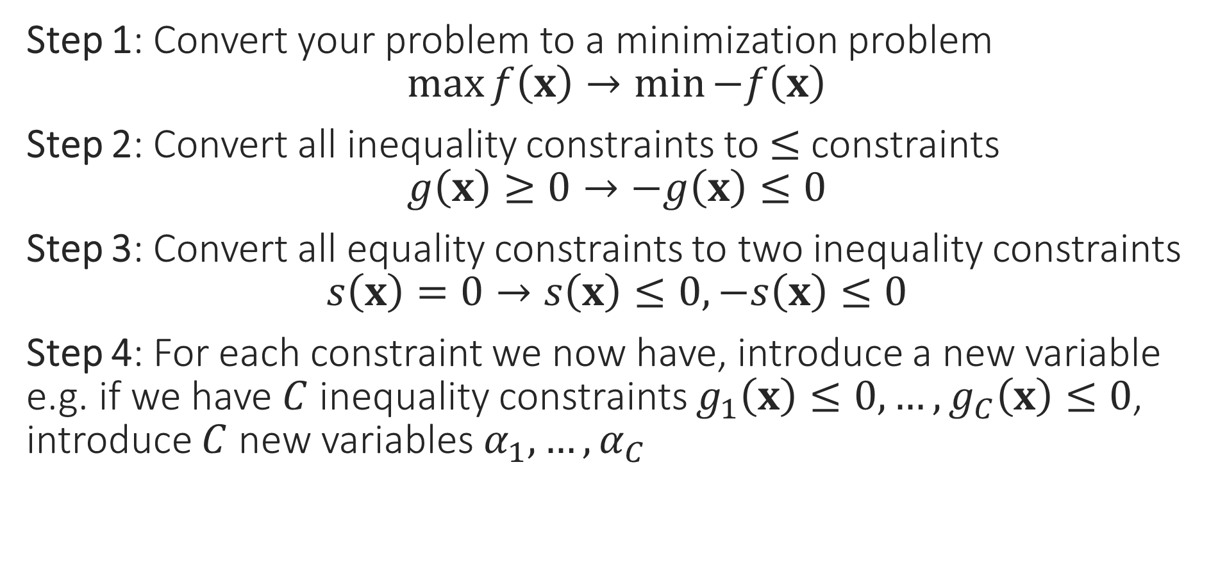
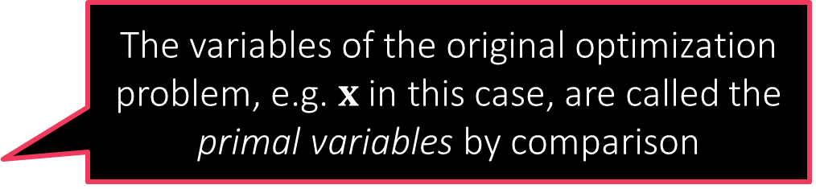
A few Cleanup Steps
Step 1: Convert your problem to a minimization problem $\max{f\left(x\right)}→\min{−f\left(x\right)}$
Step 2: Convert all inequality constraints to $≤$ constraints $g\left(x\right)≥0→−g\left(x\right)≤0$
Step 3: Convert all equality constraints to two inequality constraints $s\left(x\right)=0→s\left(x\right)≤0,−s\left(x\right)≤0$
Step 4: For each constraint we now have, introduce a new variable e.g. if we have $C$ inequality constraints $g_{1}\left(x\right)≤0,…,g_{C}\left(x\right)≤0$, introduce $C$ new variables $α_{1},…,α_{C}$
These new variables are called dual variables or sometimes even called Lagrange multipliers
The variables of the original optimization problem, e.g. $x$in this case, are called the primal variables by comparison

Slide 12

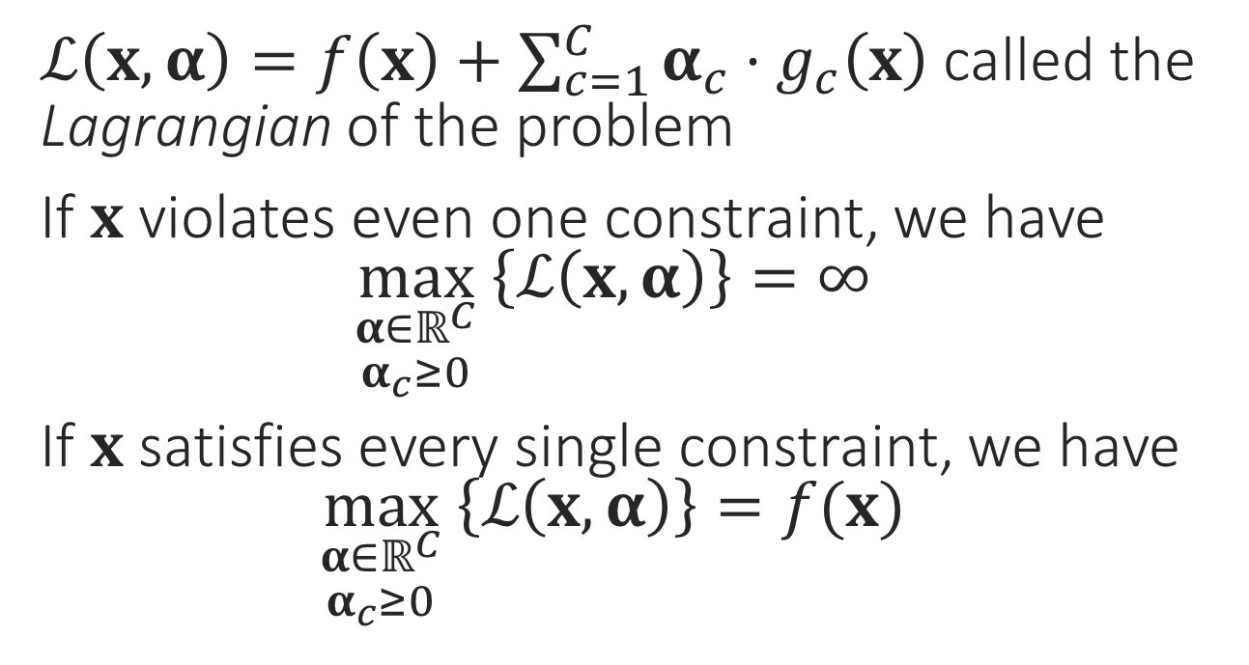

The Lagrangian
$\min_{x}{f\left(x\right)}$
s.t. $g_{1}\left(x\right)≤0$
$g_{2}\left(x\right)≤0$ $$⋮$$ $g_{C}\left(x\right)≤0$
$ℒ\left(x,α\right)=f\left(x\right)+\sum_{c=1}^{C}{α_{c}⋅g_{c}\left(x\right)}$ called the Lagrangian of the problem
If $x$ violates even one constraint, we have $\max_{\begin{aligned}α∈ℝ^{C} \\ α_{c}≥0\end{aligned}} \left\{ℒ\left(x,α\right)\right\}=∞$
If $x$ satisfies every single constraint, we have $\max_{\begin{aligned}α∈ℝ^{C} \\ α_{c}≥0\end{aligned}} \left\{ℒ\left(x,α\right)\right\}=f(x)$
This is just a nice way of rewriting the above problem
$$\min_{x∈ℝ^{d}}\left\{\max_{\begin{aligned}α∈ℝ^{C} \\ α_{c}≥0\end{aligned}} \left\{f\left(x\right)+\sum_{c=1}^{C}{α_{c}⋅g_{c}\left(x\right)}\right\}\right\}$$

Slide 13
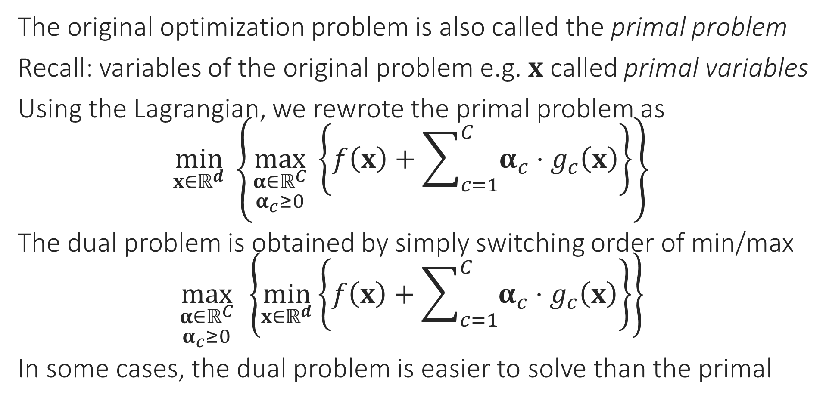
The Dual Problem
The original optimization problem is also called the primal problem
Recall: variables of the original problem e.g. $x$ called primal variables
Using the Lagrangian, we rewrote the primal problem as $\min_{x∈ℝ^{d}}\left\{\max_{\begin{aligned}α∈ℝ^{C} \\ α_{c}≥0\end{aligned}} \left\{f\left(x\right)+\sum_{c=1}^{C}{α_{c}⋅g_{c}\left(x\right)}\right\}\right\}$
The dual problem is obtained by simply switching order of min/max $\max_{\begin{aligned}α∈ℝ^{C} \\ α_{c}≥0\end{aligned}}\left\{\min_{x∈ℝ^{d}}\left\{f\left(x\right)+\sum_{c=1}^{C}{α_{c}⋅g_{c}\left(x\right)}\right\}\right\}$
In some cases, the dual problem is easier to solve than the primal

Slide 14
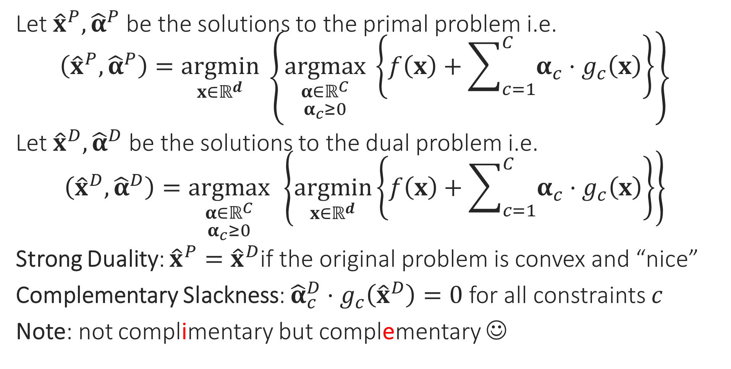
Duality
Let ${\hat{x}}^{P},{\hat{α}}^{P}$ be the solutions to the primal problem i.e. $\left({\hat{x}}^{P},{\hat{α}}^{P}\right)=\underset{x∈ℝ^{d}}{argmin}\left\{\underset{\begin{aligned}α∈ℝ^{C} \\ α_{c}≥0\end{aligned}}{argmax} \left\{f\left(x\right)+\sum_{c=1}^{C}{α_{c}⋅g_{c}\left(x\right)}\right\}\right\}$
Let ${\hat{x}}^{D},{\hat{α}}^{D}$ be the solutions to the dual problem i.e. $\left({\hat{x}}^{D},{\hat{α}}^{D}\right)=\underset{\begin{aligned}α∈ℝ^{C} \\ α_{c}≥0\end{aligned}}{argmax}\left\{\underset{x∈ℝ^{d}}{argmin}\left\{f\left(x\right)+\sum_{c=1}^{C}{α_{c}⋅g_{c}\left(x\right)}\right\}\right\}$
Strong Duality: ${\hat{x}}^{P}={\hat{x}}^{D}$if the original problem is convex and “nice”
Complementary Slackness: ${\hat{α}}_{c}^{D}⋅g_{c}\left({\hat{x}}^{D}\right)=0$ for all constraints $c$
Note: not complimentary but complementary ☺

Slide 15
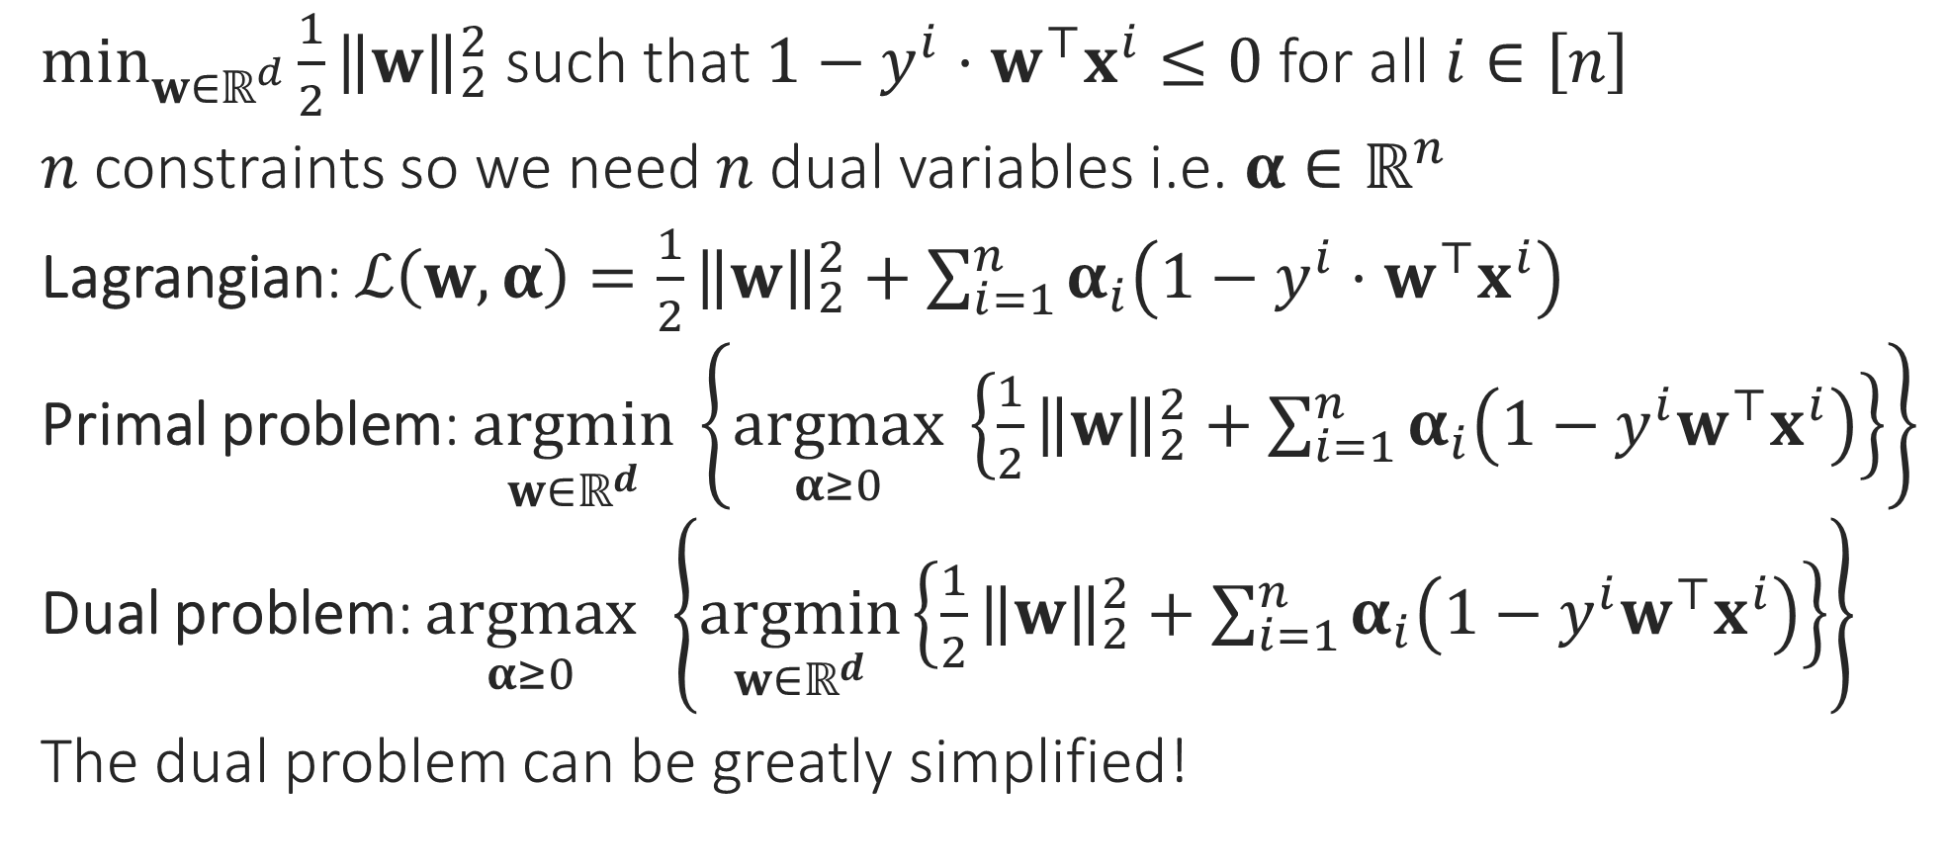
Hard SVM without a bias
$\min_{w∈ℝ^{d}}{\frac{1}{2}{\left\|w\right\|}_{2}^{2}}$ such that $1−y^{i}⋅w^{⊤}x^{i}≤0$ for all $i∈\left[n\right]$
$n$ constraints so we need $n$ dual variables i.e. $α∈ℝ^{n}$
Lagrangian: $ℒ\left(w,α\right)=\frac{1}{2}{\left\|w\right\|}_{2}^{2}+\sum_{i=1}^{n}{α_{i}\left(1−y^{i}⋅w^{⊤}x^{i}\right)}$
Primal problem: $\underset{w∈ℝ^{d}}{argmin}\left\{\underset{α≥0}{argmax} \left\{\frac{1}{2}{\left\|w\right\|}_{2}^{2}+\sum_{i=1}^{n}{α_{i}\left(1−y^{i}w^{⊤}x^{i}\right)}\right\}\right\}$
Dual problem: $\underset{α≥0}{argmax}\left\{\underset{w∈ℝ^{d}}{argmin}\left\{\frac{1}{2}{\left\|w\right\|}_{2}^{2}+\sum_{i=1}^{n}{α_{i}\left(1−y^{i}w^{⊤}x^{i}\right)}\right\}\right\}$
The dual problem can be greatly simplified!

Slide 16
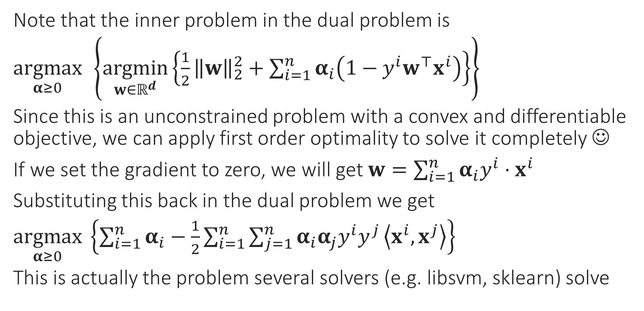

Simplifying the Dual Problem
Once you get optimal values of $α$, use $w=\sum_{i=1}^{n}{α_{i}y^{i}⋅x^{i}}$ to get optimal value of $w$
Note that the inner problem in the dual problem is
$\underset{α≥0}{argmax}\left\{\underset{w∈ℝ^{d}}{argmin}\left\{\frac{1}{2}{\left\|w\right\|}_{2}^{2}+\sum_{i=1}^{n}{α_{i}\left(1−y^{i}w^{⊤}x^{i}\right)}\right\}\right\}$
Since this is an unconstrained problem with a convex and differentiable objective, we can apply first order optimality to solve it completely ☺
If we set the gradient to zero, we will get $w=\sum_{i=1}^{n}{α_{i}y^{i}⋅x^{i}}$
Substituting this back in the dual problem we get
$\underset{α≥0}{argmax} \left\{\sum_{i=1}^{n}{α_{i}}−\frac{1}{2}\sum_{i=1}^{n}{\sum_{j=1}^{n}{α_{i}α_{j}y^{i}y^{j}}\left\langle x^{i},x^{j}\right\rangle }\right\}$
This is actually the problem several solvers (e.g. libsvm, sklearn) solve

Slide 17

Support Vectors
Support Vectors!!
Recall: we have $α_{i}$ for every data point
After solving the dual problem, the data points for which $α_{i}≠0$: Support Vectors
Usually we have $≪n$ support vectors
Recall: complementary slackness tells us that $α_{i}\left(1−y^{i}w^{⊤}x^{i}\right)=0$ i.e. only those data points can become SVs for which $y^{i}w^{⊤}x^{i}=1$ i.e. at margin
The reason these are called support vectors has to do with a mechanical interpretation of these objects – need to look at CSVM to understand that

Slide 18

Dual for CSVM
Similar calculations (see course notes for a derivation) show that if we have a bias term $b$ as well as slack variables, then the dual looks like
$\underset{α∈ℝ^{n}}{argmax} \left\{\sum_{i=1}^{n}{α_{i}}−\frac{1}{2}\sum_{i=1}^{n}{\sum_{j=1}^{n}{α_{i}α_{j}y^{i}y^{j}}\left\langle x^{i},x^{j}\right\rangle }\right\}$ s.t. $α_{i}∈\left[0,C\right]$, and $\sum_{i=1}^{n}{α_{i}}y^{i}=0$
Reason for the name “SVM”: imagine that each data point $i$ is applying a force $α_{i}$ on the hyperplane in the direction $y^{i}$
Then the total force on the hyperplane is equal to zero since $\sum_{i=1}^{n}{α_{i}}y^{i}=0$
Also, the condition $w=\sum_{i=1}^{n}{α_{i}y^{i}⋅x^{i}}$ can be interpreted to mean that the total torque on the hyperplane is zero as well
Thus, support vectors mechanically support the hyperplane (don’t let it shift or rotate around), hence their name ☺

Slide 19
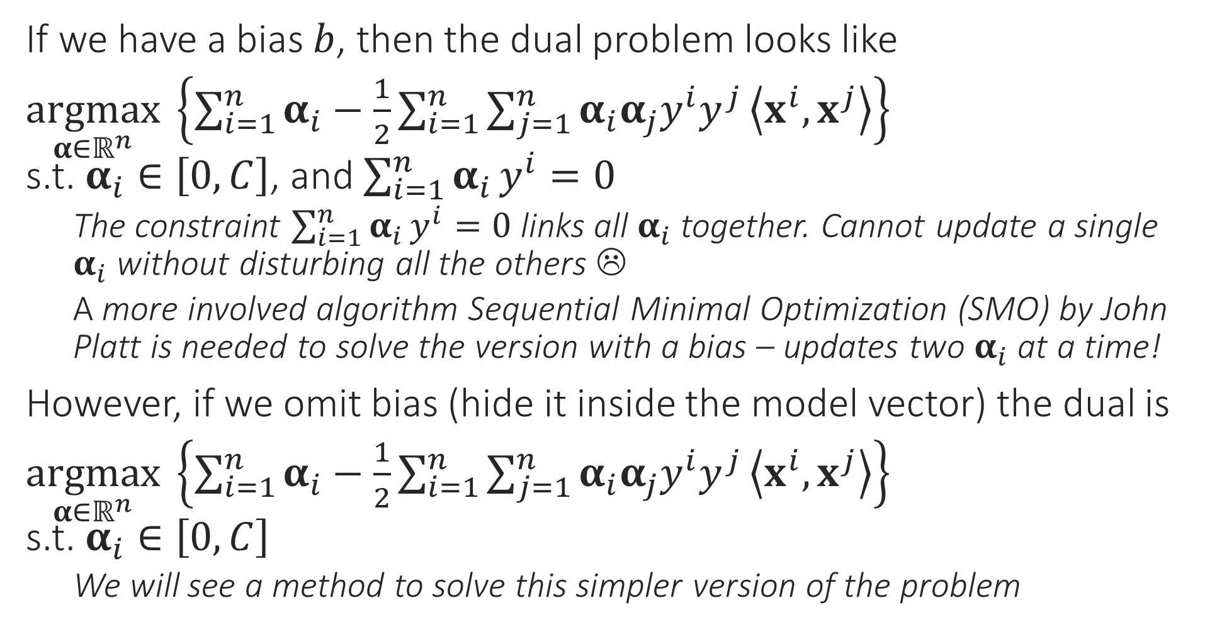
CSVM Dual Problem
If we have a bias $b$, then the dual problem looks like
$\underset{α∈ℝ^{n}}{argmax} \left\{\sum_{i=1}^{n}{α_{i}}−\frac{1}{2}\sum_{i=1}^{n}{\sum_{j=1}^{n}{α_{i}α_{j}y^{i}y^{j}}\left\langle x^{i},x^{j}\right\rangle }\right\}$ s.t. $α_{i}∈\left[0,C\right]$, and $\sum_{i=1}^{n}{α_{i}}y^{i}=0$
The constraint $\sum_{i=1}^{n}{α_{i}}y^{i}=0$ links all $α_{i}$ together. Cannot update a single $α_{i}$ without disturbing all the others ☹
A more involved algorithm Sequential Minimal Optimization (SMO) by John Platt is needed to solve the version with a bias – updates two $α_{i}$ at a time!
However, if we omit bias (hide it inside the model vector) the dual is
$\underset{α∈ℝ^{n}}{argmax} \left\{\sum_{i=1}^{n}{α_{i}}−\frac{1}{2}\sum_{i=1}^{n}{\sum_{j=1}^{n}{α_{i}α_{j}y^{i}y^{j}}\left\langle x^{i},x^{j}\right\rangle }\right\}$ s.t. $α_{i}∈\left[0,C\right]$
We will see a method to solve this simpler version of the problem

Slide 20

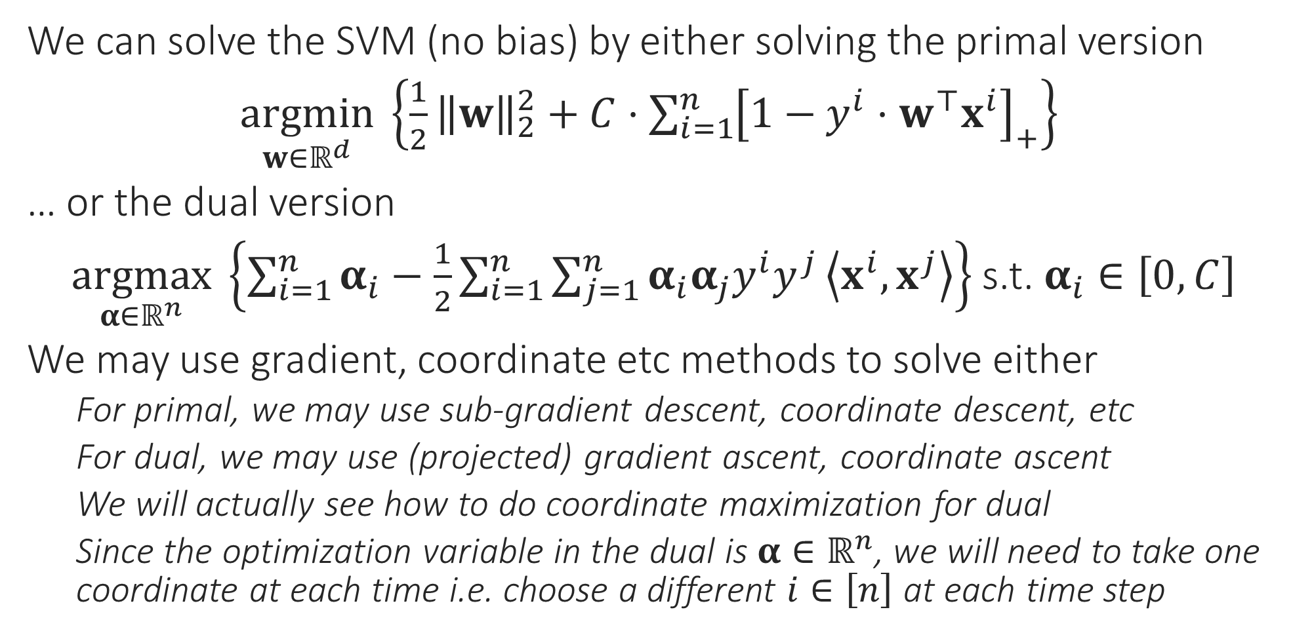
Solvers for the SVM problem
Sub-gradient since the primal objective is convex but non-differentiable
We can solve the SVM (no bias) by either solving the primal version
$\underset{w∈ℝ^{d}}{argmin} \left\{\frac{1}{2}{\left\|w\right\|}_{2}^{2}+C⋅\sum_{i=1}^{n}{{\left[1−y^{i}⋅w^{⊤}x^{i}\right]}_{+}}\right\}$
… or the dual version
$\underset{α∈ℝ^{n}}{argmax} \left\{\sum_{i=1}^{n}{α_{i}}−\frac{1}{2}\sum_{i=1}^{n}{\sum_{j=1}^{n}{α_{i}α_{j}y^{i}y^{j}}\left\langle x^{i},x^{j}\right\rangle }\right\}$ s.t. $α_{i}∈\left[0,C\right]$
We may use gradient, coordinate etc methods to solve either
For primal, we may use sub-gradient descent, coordinate descent, etc
For dual, we may use (projected) gradient ascent, coordinate ascent
We will actually see how to do coordinate maximization for dual
Since the optimization variable in the dual is $α∈ℝ^{n}$, we will need to take one coordinate at each time i.e. choose a different $i∈\left[n\right]$ at each time step
Yes, coordinate ascent in the dual looks a lot like stochastic gradient descent in the primal! Both work with a single data point at a time
Projected since we have a constraint (albeit a simple one) in the dual
Does this mean I need to choose one data point at each time step?

Slide 21
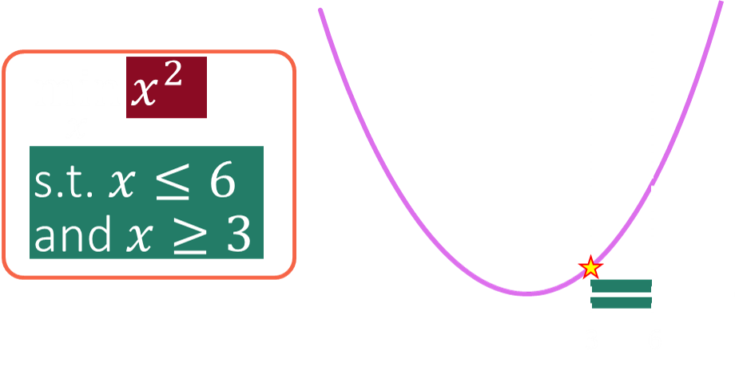

SDCM for the CSVM Problem
Warning: in general, finding an unconstrained solution and doing a projection step does not give a true solution
$\underset{α∈ℝ^{n}}{argmax} \left\{\sum_{i=1}^{n}{α_{i}}−\frac{1}{2}\sum_{i=1}^{n}{\sum_{j=1}^{n}{α_{i}α_{j}y^{i}y^{j}}\left\langle x^{i},x^{j}\right\rangle }\right\}$ s.t. $α_{i}∈\left[0,C\right]$ for all $i∈\left[n\right]$
Concentrating on just the terms that involve $α_{i}$ we get
$\underset{α_{i}∈ℝ}{argmax} \left\{α_{i}−\frac{1}{2}α_{i}^{2}{\left\|x^{i}\right\|}_{2}^{2}−α_{i}y^{i}⋅\sum_{j≠i}{α_{j}y^{j}}\left\langle x^{i},x^{j}\right\rangle \right\}$ s.t. $α_{i}∈\left[0,C\right]$
Renaming $x=α_{i}, q={\left\|x^{i}\right\|}_{2}^{2},p=y^{i}⋅\sum_{j≠i}{α_{j}y^{j}}\left\langle x^{i},x^{j}\right\rangle$, we get
$\arg{\min_{x}{\frac{1}{2}qx^{2}−x(1−p)}}$ s.t. $x∈\left[0,C\right]$
Solution is very simple: find unrestricted minimum i.e. $\tilde{x}=\left(1−p\right)/q$
If $\tilde{x}∈\left[0,C\right]$, solution is $\tilde{x}$ elif $\tilde{x}<0$, solution is $0$, else solution is $C$
Indeed! In this special case, our objective had a nice property called unimodality which is why this trick works – it won’t work in general

Slide 22
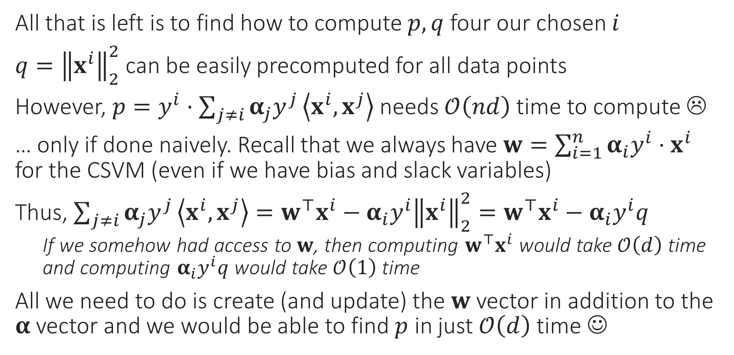
Speeding up SDCM computations
All that is left is to find how to compute $p,q$ four our chosen $i$
$q={\left\|x^{i}\right\|}_{2}^{2}$ can be easily precomputed for all data points
However, $p=y^{i}⋅\sum_{j≠i}{α_{j}y^{j}}\left\langle x^{i},x^{j}\right\rangle$ needs $𝒪\left(nd\right)$ time to compute ☹
… only if done naively. Recall that we always have $w=\sum_{i=1}^{n}{α_{i}y^{i}⋅x^{i}}$ for the CSVM (even if we have bias and slack variables)
Thus, $\sum_{j≠i}{α_{j}y^{j}}\left\langle x^{i},x^{j}\right\rangle =w^{⊤}x^{i}−α_{i}y^{i}{\left\|x^{i}\right\|}_{2}^{2}=w^{⊤}x^{i}−α_{i}y^{i}q$
If we somehow had access to $w$, then computing $w^{⊤}x^{i}$ would take $𝒪\left(d\right)$ time and computing $α_{i}y^{i}q$ would take $𝒪\left(1\right)$ time
All we need to do is create (and update) the $w$ vector in addition to the $α$ vector and we would be able to find $p$ in just $𝒪\left(d\right)$ time ☺

Slide 23


Which Method to Choose?
Can you work out the details on how to implement stochastic primal coordinate descent in $𝒪\left(n\right)$ time per update?
Gradient Methods
Primal Gradient Descent: $𝒪\left(nd\right)$ time per update
Dual Gradient Ascent: $𝒪\left(nd\right)$ time per update
Stochastic Gradient Methods
Stochastic Primal Gradient Descent: $𝒪\left(d\right)$ time per update
Stochastic Dual Gradient Ascent: $𝒪\left(n\right)$ time per update
Coordinate Methods: (take $𝒪\left(nd\right)$ time per update if done naively)
Stochastic Primal Coordinate Descent: $𝒪\left(n\right)$ time per update
Stochastic Dual Coordinate Maximization: $𝒪\left(d\right)$ time per update
Case 1: $n≫d$: use SDCM or SPGD ($𝒪\left(d\right)$ time per update)
Case 2: $d≫n$: use SDGA or SPCD ($𝒪\left(n\right)$ time per update)
Be careful not to get confused with similar sounding terms. Coordinate Ascent takes a small step along one of the coordinates to increase the objective a bit. Coordinate Maximization instead tries to completely maximize the objective along a coordinate
Also be careful that some books/papers may call a method as “Coordinate Ascent” even when it is really doing Coordinate Maximization. The terminology is unfortunately a bit non-standard

Slide 24
Practical Issues with GD Variants
How to initialize?
How to decide convergence?
How to decide step lengths?

Slide 25
How to Initialize?
Initializing close to the global optimum is obviously preferable ☺
Easier said than done. In some applications however, we may have such initialization e.g. someone may have a model they trained on different data
For convex functions, bad initialization may mean slow convergence, but if step lengths are nice then GD should converge eventually
For non-convex functions (e.g. while training deepnets), bad initialization may mean getting stuck at a very bad saddle point
Random restarts most common solution to overcome this problem
For some nice non-convex problems, we do know very good ways to provably initialize close to the global optimum (e.g. collaborative filtering in recommendation systems) – details beyond scope of CS771

Slide 26
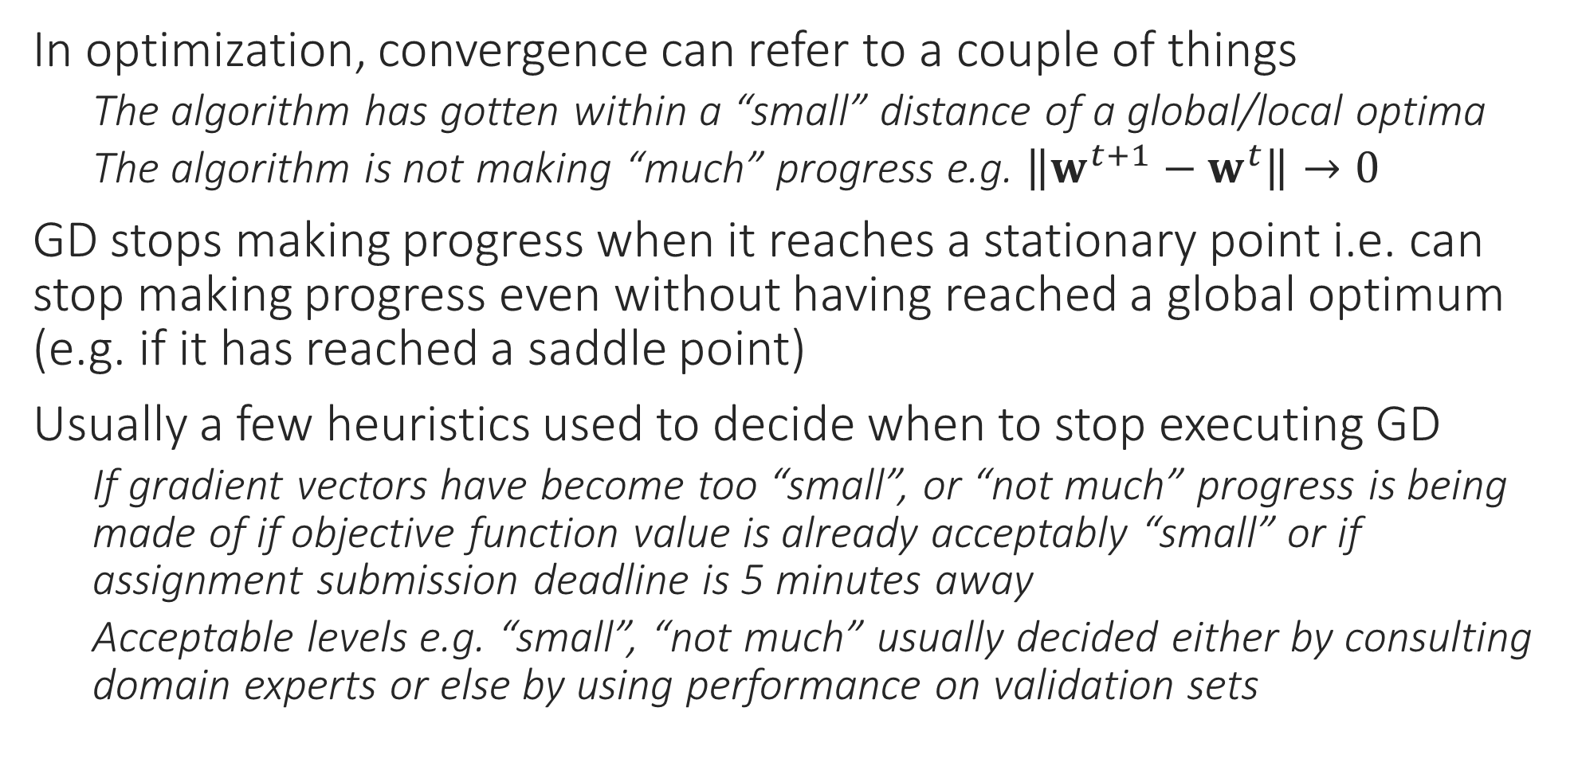
How to decide Convergence?
In optimization, convergence can refer to a couple of things
The algorithm has gotten within a “small” distance of a global/local optima
The algorithm is not making “much” progress e.g. $\left\|w^{t+1}−w^{t}\right\|→0$
GD stops making progress when it reaches a stationary point i.e. can stop making progress even without having reached a global optimum (e.g. if it has reached a saddle point)
Usually a few heuristics used to decide when to stop executing GD
If gradient vectors have become too “small”, or “not much” progress is being made of if objective function value is already acceptably “small” or if assignment submission deadline is 5 minutes away
Acceptable levels e.g. “small”, “not much” usually decided either by consulting domain experts or else by using performance on validation sets

Slide 27
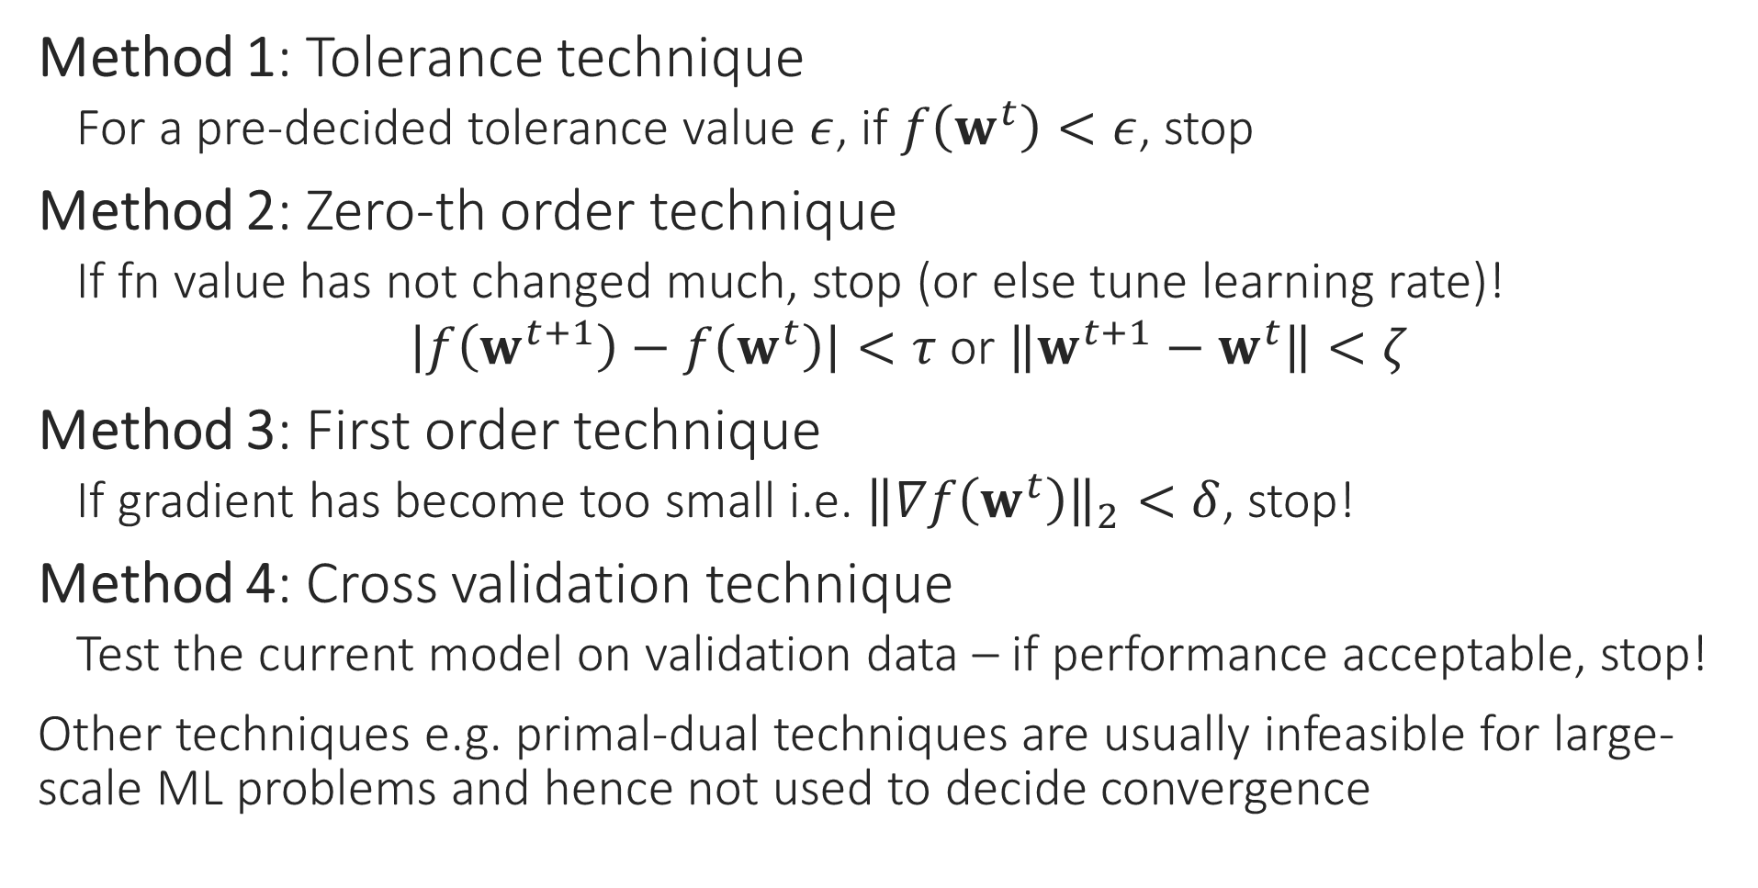
How to detect convergence
Method 1: Tolerance technique
For a pre-decided tolerance value $ε$, if $f\left(w^{t}\right)<ε$, stop
Method 2: Zero-th order technique
If fn value has not changed much, stop (or else tune learning rate)!
$\left|f\left(w^{t+1}\right)−f\left(w^{t}\right)\right|<τ$ or $\left\|w^{t+1}−w^{t}\right\|<ζ$
Method 3: First order technique
If gradient has become too small i.e. ${\left\|∇f\left(w^{t}\right)\right\|}_{2}<δ$, stop!
Method 4: Cross validation technique
Test the current model on validation data – if performance acceptable, stop!
Other techniques e.g. primal-dual techniques are usually infeasible for large-scale ML problems and hence not used to decide convergence

Slide 28
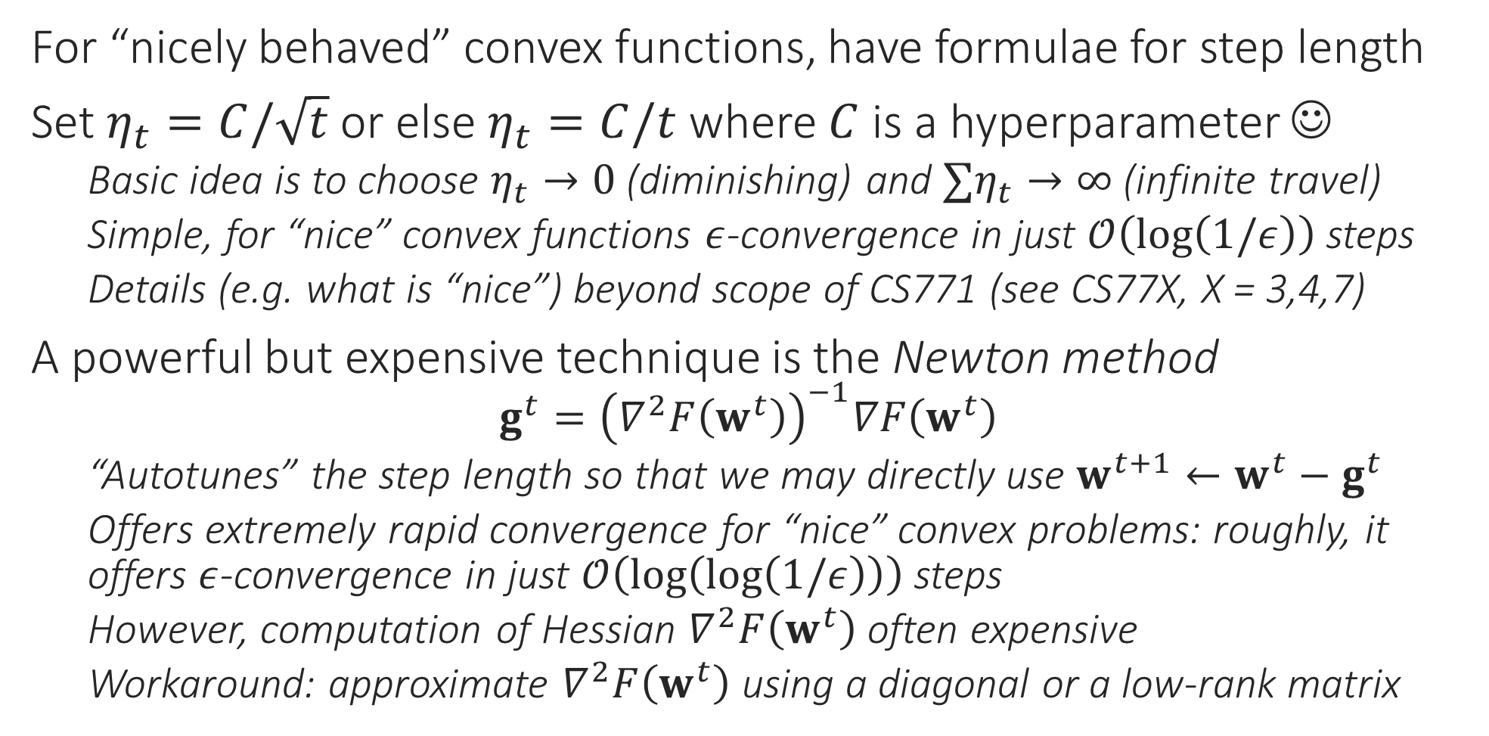
How to choose Step Length?
For “nicely behaved” convex functions, have formulae for step length
Set $η_{t}=C/\sqrt{t}$ or else $η_{t}=C/t$ where $C$ is a hyperparameter ☺
Basic idea is to choose $η_{t}→0$ (diminishing) and $∑η_{t}→∞$ (infinite travel)
Simple, for “nice” convex functions $ε$-convergence in just $𝒪\left(\log\left(1/ε\right)\right)$ steps
Details (e.g. what is “nice”) beyond scope of CS771 (see CS77X, X = 3,4,7)
A powerful but expensive technique is the Newton method
$$g^{t}={\left(∇^{2}F\left(w^{t}\right)\right)}^{−1}∇F\left(w^{t}\right)$$
“Autotunes” the step length so that we may directly use $w^{t+1}←w^{t}−g^{t}$
Offers extremely rapid convergence for “nice” convex problems: roughly, it offers $ε$-convergence in just $𝒪\left(\log\left(\log\left(1/ε\right)\right)\right)$ steps
However, computation of Hessian $∇^{2}F\left(w^{t}\right)$ often expensive
Workaround: approximate $∇^{2}F\left(w^{t}\right)$ using a diagonal or a low-rank matrix

Slide 29

How to choose Step Length?
For not so well-behaved convex functions and non-convex functions, there exist several heuristics – no guarantee they will always work ☹
Line-search Techniques: find the best step length every time $η_{t}=\arg{\min_{η≥0}{f\left(w^{t}−η⋅g^{t}\right)}}$
E.g. Armijo Rule: start by using with a decently large value of $η_{t}$, if objective function value does not reduce sufficiently, then reduce $η_{t}$ and try again
Line search can be expensive as it involves multiple GD steps, fn evaluations
Cheaper “adaptive” techniques exist – these employ several tricks
Use a different step length for each dimension of $w$ (e.g. Adagrad) where $η_{t}$ replaced with a diagonal matrix $E^{t}$ i.e. $w^{t+1}←w^{t}−E^{t}g^{t}$
Use “momentum” methods (e.g. NAG, Adam) which essentially infuses previous gradients into the current gradient

