Slide 1
Decision Trees

Slide 2

Midsem Exam
Jun 18 (Sun), 6PM, L16, L17
Only for registered students (regular + audit)
Assigned seating – announced on Piazza
Open notes (handwritten only)
No mobile phones, tablets etc
Bring your institute ID card
If you don’t bring it, you will have to spend precious time during the exam getting verified separately
Syllabus:
All videos, slides, code linked on the course discussion page (link below) till 16 Jun 2023 (Fri) https://www.cse.iitk.ac.in/users/purushot/courses/ml/2022-23-w/discussion.html
See GitHub for practice questions

Slide 3
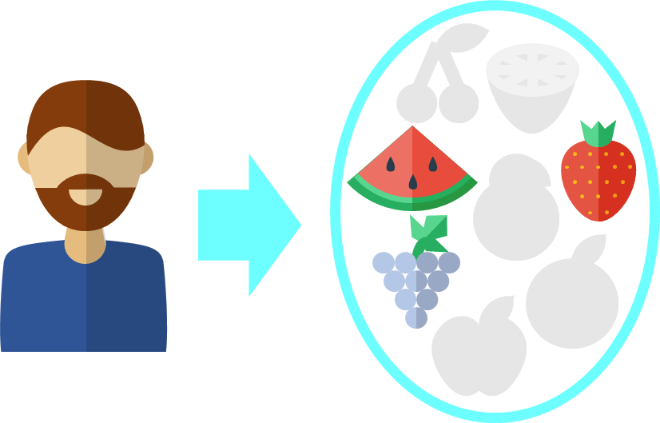
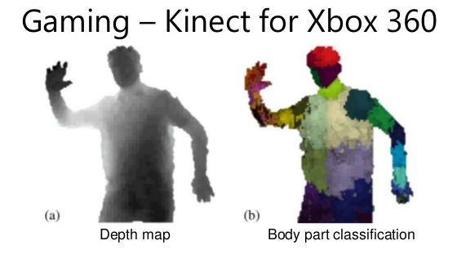
Decision Trees
Recommendation Systems
Can handle non-numeric features easily
Very popular in ML – classification, recsys
Extremely fast at making predictions
Easy to interpret by humans too
Model size can be large
Can give good train perf. but bad test perf. (known as overfitting)

Slide 4



Decision Trees for Classification
Repeatedly partition feature space $ℝ^{d}$
For test data point, find out in which partition does it lie
Can consider assigning the test point, the label of other points in its partition
Can be easily extended to binary, multi-class and multi-label classification problems!
1 2 3 4 5 6 7 8 9 10 11 12
However, if your partitions are fine enough, this will happen very rarely and not hurt performance too much!
1 2 3 4 5 6 7 8 9 10 11 12 13 14
What about points like this? The point might be a green or a red point ☹
Yes, as with all classifiers, decision trees may also get confused at their decision boundaries

Slide 5
Building Decision Trees
Root
Yes
X < 5.5
No
Internal Node
Y > 10.5
Y > 9
1 2 3 4 5 6 7 8 9 10 11 12
Internal Node
X < 11.5
X < 8.5
Internal Node
Y > 2.5
Y > 5.5
1 2 3 4 5 6 7 8 9 10 11 12 13 14
Leaf
X < 12
Leaf
Leaf
Leaf

Slide 6


Decision Trees – all shapes and sizes
This DT is balanced – all leaf nodes are at same depth from the root
The previous DT was very imbalanced and considered bad in general
May prune the tree to make it more shallow as well. Also possible to have DT with more than 2 children per internal node
Imbalanced DTs may
offer very poor
Prediction accuracy
as well as take as long as
kNN to make a prediction.
Imagine a DT which is just a
chain of nodes. With $n$ data points, there would be $𝒪\left(n\right)$ chain: some predictions will take $𝒪\left(n\right)$ time ☹. With a balanced DT, every prediction takes at most $𝒪(\log{n})$ time ☺☺

Slide 7
Regression with Decision Trees
To perform real valued regression, may simply use average score at a leaf node to predict scores for test data points

Slide 8


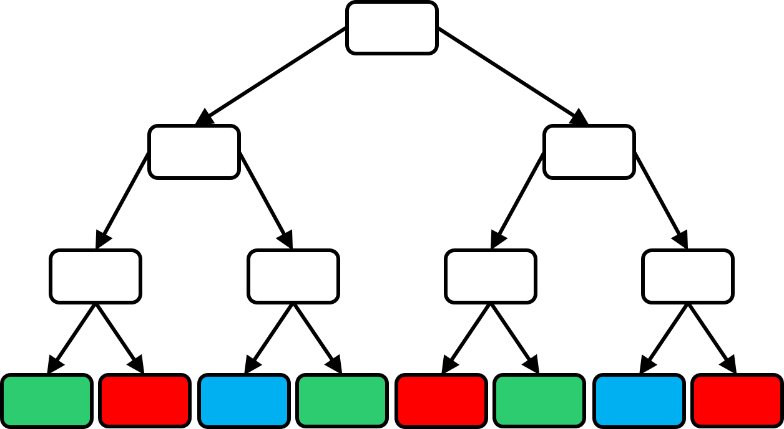
How to learn a DT?
How many children should a node have?
How to send data points to children?
When to stop splitting and make the node a leaf?
What to do at a leaf?
How many trees to train?

Slide 9
What to do at a leaf?
Cheapest thing to do would be to store the majority color (label) at a leaf. A slightly more informative (more expensive as well) thing can be to store how many training points of each color (label) reached that leaf
Can take any (complicated) action at a leaf
Why not call another machine learning algorithm?
For speed, keep leaf action simple
Simplest action – constant prediction
Such a DT will encode a piecewise constant prediction function

Slide 10
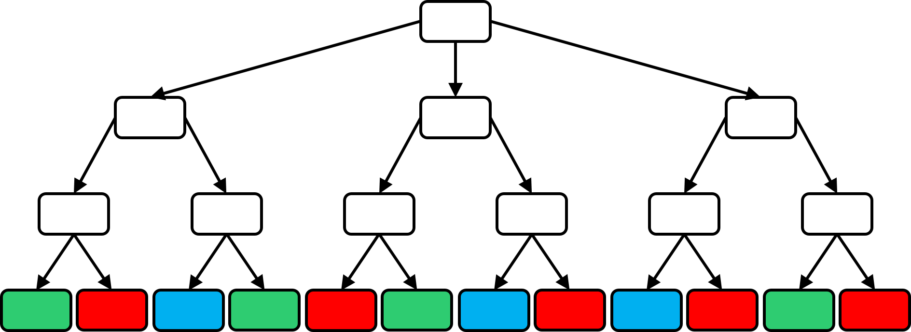



How to split a node into children nodes?
In principle there is no restriction (e.g. can even use a deep net to split a node). However, in practice we use a simple ML algo like linear to split nodes. This is because the usefulness of DTs largely comes from being able to rapidly send a test data point to a leaf
Notice, splitting a node is a classification problem in itself! Binary if two children, multiclass if more than 2 children
Can we use any classification technique to split a node or are there some restrictions?
Oh! So we are using a simple ML technique such as binary classification to learn a DT!

Slide 11



Splitting a Node – some lessons
Various notions of purity exist – entropy and Gini index for classification problems, variance for regression problems
Node splitting algorithm must be fast else DT predictions will be slow
Often people carefully choose just a single feature and split a node based on that e.g. (age $<$ 25 go left, age $≥$ 25 go right)
Such “simple classifiers” are often called decision stumps
Making sure that the split is balanced (e.g. roughly half the data points go left and right) is also important to ensure that the tree is balanced. However, ensuring balance is often tricky
Pure nodes are very convenient. We can make them leaves right away and not have to worry about splitting them ☺
A child node is completely pure if it contains training data of only one class.
How do I decide whether to use age or gender? Even if using age, how do I decide whether to threshold at 25 or 65?
Usually, people go over all available features and all possible thresholds (can be slow if not done cleverly) and choose a feature and a threshold for that feature so that the child nodes that are created are as pure as possible

Slide 12
Purifying Decision Stumps
Purest Horizontal Split
Purest Vertical Split
Left Right
Left Right
Search purest horizontal split by going over all possible thresholds and checking
Two possible splitting directions. Let us choose the one that gives us purer children
Purest vertical split is more pure – use it!

Slide 13
Node splitting via linear classifiers

Slide 14
One Final Recap

Slide 15
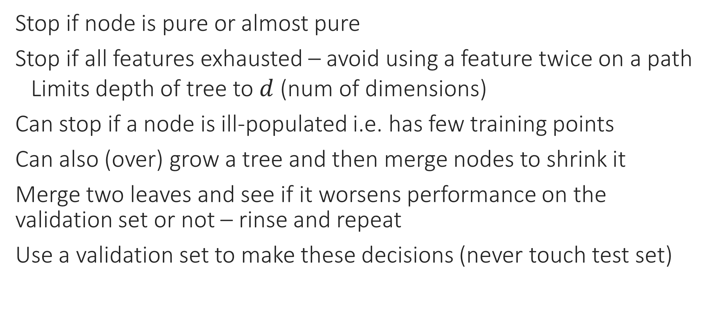
Pruning Strategies
Stop if node is pure or almost pure
Stop if all features exhausted – avoid using a feature twice on a path
Limits depth of tree to $d$ (num of dimensions)
Can stop if a node is ill-populated i.e. has few training points
Can also (over) grow a tree and then merge nodes to shrink it
Merge two leaves and see if it worsens performance on the validation set or not – rinse and repeat
Use a validation set to make these decisions (never touch test set)

Slide 16
Decision Trees - Lessons
Very fast at making predictions (if tree is reasonably balanced)
Can handle discrete data (even non numeric data) as well – e.g. can have a stump as: blood group AB or O go left, else go right
SVM, RR etc have difficulty with such non-numeric and discrete data since difficult to define distance and averages with them (however, there are workarounds to do SVM etc with discrete data as well)
Tons of DT algorithms – both classical (ID3, C4.5) as well as recent (GBDT, LPSR, Parabel) – DTs are versatile and very useful
Reason: DT learning is an NP hard problem ☹
If you think you have a better way of splitting nodes or handling leaf nodes, it might be the next big thing in DT learning ☺

Slide 17
Playing Hangman

Slide 18


Uncertainty
Imagine a language where the letter “#” appears in every word. Guessing # gives us no useful information
To win at hangman, we must ask questions that eliminate wrong answers quickly
4096
2048
2048
1024
1024
1024
1024
10 levels later …
Similarly, very rare letters are not very good either – they will occasionally help us identify the word very quickly but will mostly cause us to make a mistake.
…
1
1
1
1
1
1
1
1
1
1
1
1
1
1
1
1

Slide 19
Uncertainty Reduction – Hangman
amid, baby, back, bake, bike, book, bump, burn, cave, chip, cook, damp, duck, dump, fade, good, have, high, hook, jazz, jump, kick, maid, many, mind, monk, much, must, paid, pain, park, pick, pine, pipe, pond, pony, pump, push, quick, quid, quit, sail, same, save, sight, size, stay, study, stuff, suffer, sway, tail, twin, wage, wake, wall, warn, wave, weak, wear, whip, wife, will, wind, wine, wing, wipe, wise, wish, with, wood, wound, year
Start State
amid
hook
sail
year
Goal States
…
amid, baby, back, bake, bike, book, bump, burn, cave, chip, cook, damp, duck, dump, fade, good, have, high, hook, jazz, jump, kick, maid, many, mind, monk, much, must, paid, pain, park, pick, pine, pipe, pond, pony,
pump, push, quick, quid, quit, sail, same, save, sight, size, stay, study, stuff, suffer, sway, tail, twin, wage, wake, wall, warn, wave, weak, wear, whip, wife, will, wind, wine, wing, wipe, wise, wish, with, wood, wound, year
Good Question
amid
baby, back, bake, bike, book, bump, burn, cave, chip, cook, damp, duck, dump, fade, good, have, high, hook, jazz, jump, kick, maid, many, mind, monk, much, must, paid, pain, park, pick, pine, pipe, pond, pony, pump, push, quick, quid, quit, sail, same, save, sight, size, stay, study, stuff, suffer, sway, tail, twin, wage, wake, wall, warn, wave, weak, wear, whip, wife, will, wind, wine, wing, wipe, wise, wish, with, wood, wound, year
Bad Question

Slide 20
Uncertainty Reduction – Classification
I can see that we wish to go from uncertain start state to goal states where we are certain about a prediction – but how we define a good question is still a big vague
Start State
Goal States
…
Good Question
Bad Question

Slide 21

Entropy is a measure of Uncertainty
Notions of entropy exist for real-valued cases as well but they involve probability density functions so skipping for now
If we have a set of $n$ words, then that set has an entropy of $\log_{2}{n}$
Larger sets have larger entropy and a set with a single word has $0$ entropy
Makes sense since we have no uncertainty if only a single word is possible
More generally, if there is a set $S$ of $n$ elements of $C$ types with $n_{c}$ elements of type $c$, then its entropy is defined as $H\left(S\right)≝−\sum_{c∈\left[C\right]}{\frac{n_{c}}{n}\log_{2}\left(\frac{n_{c}}{n}\right)}=−\sum_{c∈\left[C\right]}{p_{c}\log_{2}{p_{c}}}$
where $p_{c}$ is proportion of elements of type $c$ (or class $c$) in multiclass cases
The earlier example is a special case where each word is its own “type” i.e., there are $C=n$ “types” with $n_{c}=1$ for all $c$
A pure set e.g., $p=\left[0,1,0,0,…,0\right]$ has $0$ entropy whereas a set with same number of elements of each class i.e., $p=\left[\frac{1}{C},\frac{1}{C},…,\frac{1}{C}\right]$ has $\log_{2}{C}$ entropy

Slide 22

What is a good question?
No single criterion – depends on the application
ID3 (iterative dichotomizer 3 by Ross Quinlan) suggests that a good question is one that reduces confusion the most i.e., reduces entropy the most
Suppose asking a question splits a set $S$ into $K$ subsets $S_{1},…,S_{K}$
Note that $S_{i}∩S_{j}=φ$ if $i≠j$ and $\bigcup_{k∈\left[K\right]}{S_{k}}=S$
Let us denote $n_{k}≝\left|S_{k}\right|$ – note that $\sum_{k∈\left[K\right]}{n_{k}}=n≝\left|S\right|$
Then the entropy of this collection of sets is defined to be $\sum_{k∈\left[K\right]}{\frac{n_{k}}{n}⋅H\left(S_{k}\right)}$
Can interpret this as “average” or “weighted” entropy since a $\frac{n_{k}}{n}$fraction of points will land up in the set $S_{k}$ where the entropy is $H\left(S_{k}\right)$

Slide 23
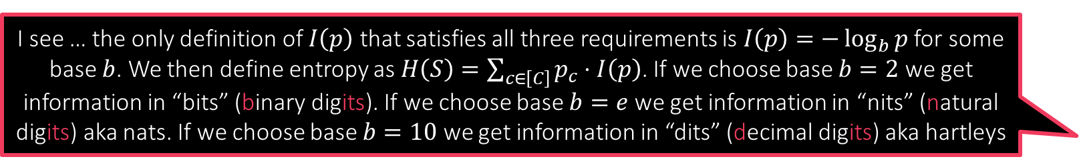

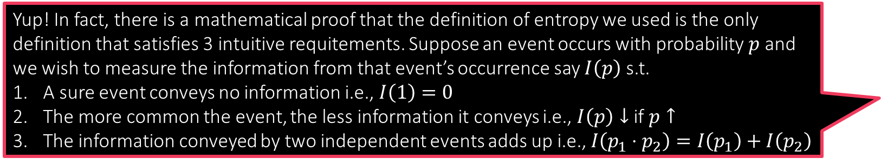
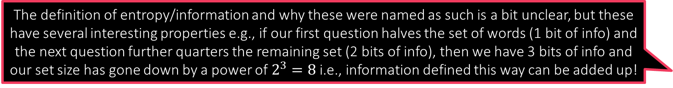
A good question for Hangman
The definition of entropy/information and why these were named as such is a bit unclear, but these have several interesting properties e.g., if our first question halves the set of words (1 bit of info) and the next question further quarters the remaining set (2 bits of info), then we have 3 bits of info and our set size has gone down by a power of $2^{3}=8$ i.e., information defined this way can be added up!
Suppose a question splits a set of 4096 words into (2048, 2048)
Old entropy was $\log_{2}{4096}=12$
New entropy is $\frac{2048}{4096}⋅\log_{2}{2048}+\frac{2048}{4096}⋅\log_{2}{2048}=11$
Entropy reduced by $1$ so we say, we gained $12 – 11 = 1$bit of information
Suppose a question splits the set into (1024, 1024, 1024, 1024)
New entropy is $4⋅\frac{1024}{4096}⋅\log_{2}{1024}=10$
Gained $12−10=2$ bits of information – makes sense – each set is smaller
Suppose a question splits the set into (16, 64, 4016)
New entropy is $\frac{16}{4096}⋅\log_{2}{16}+\frac{64}{4096}⋅\log_{2}{64}+\frac{4016}{4096}⋅\log_{2}{4016}=11.85$
We gained $12−11.85=0.15$ - bits of information ☹
Yup! In fact, there is a mathematical proof that the definition of entropy we used is the only definition that satisfies 3 intuitive requitements. Suppose an event occurs with probability $p$ and we wish to measure the information from that event’s occurrence say $I\left(p\right)$ s.t.
A sure event conveys no information i.e., $I\left(1\right)=0$
The more common the event, the less information it conveys i.e., $I\left(p\right)↓$ if $p↑$
The information conveyed by two independent events adds up i.e., $I\left(p_{1}⋅p_{2}\right)=I\left(p_{1}\right)+I\left(p_{2}\right)$
I see … the only definition of $I\left(p\right)$ that satisfies all three requirements is $I\left(p\right)=−\log_{b}{p}$ for some base $b$. We then define entropy as $H\left(S\right)=\sum_{c∈\left[C\right]}{p_{c}⋅I\left(p\right)}$. If we choose base $b=2$ we get information in “bits” (binary digits). If we choose base $b=e$ we get information in “nits” (natural digits) aka nats. If we choose base $b=10$ we get information in “dits” (decimal digits) aka hartleys

Slide 24

The ID3 Algorithm
Given a test data point, we go down the tree using the splitting criteria till we reach a leaf where we use the leaf action to make our prediction
With $T$ as set of all train points, create a root node $r$ and call train($r,T$)
Train(node $n$, set $S$)
If $S$ is sufficiently pure or sufficiently small, make $n$ a leaf, decide a simple leaf action (e.g., most popular class, label popularity vector, etc.) and return
Else, out of available choices, choose the splitting criteria (e.g. a single feature) that causes maximum information gain i.e., reduces entropy the most
Split $S$ along that criteria to get $S_{1},…,S_{K}$ partition of $S$ (e.g. if that feature takes $K$ distinct values)
Create $K$ child nodes $c_{k},k∈\left[K\right]$ and call train($c_{k},S_{k}$)
There are several augmentations to this algorithm e.g. C4.5, C5.0 that allow handing real-valued features, missing features, boosting etc
Note: ID3 will not ensure a balanced tree but usually balance is decent

Slide 25
Careful use of DTs
DTs can be tweaked to give very high training accuracies
Can badly overfit to training data if grown too large
Choice of decision stumps is critical
PUF problem: a single linear model works
DT will struggle and eventually overfit if we insist that questions used to split the DT nodes use a single feature
However, if we allow node questions to be a general linear model, root node itself can purify the data completely ☺

