Slide 1
Loss and Regularization

Slide 2
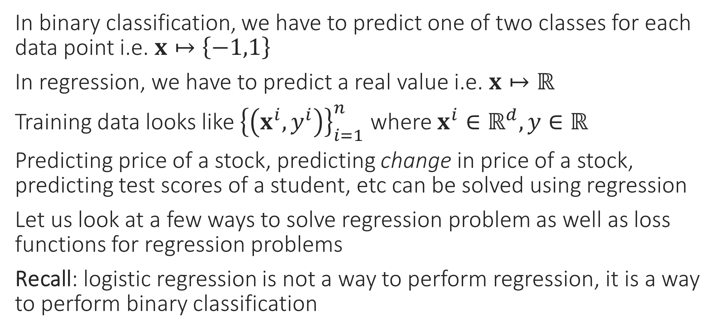
Regression Problems
In binary classification, we have to predict one of two classes for each data point i.e. $x↦\left\{−1,1\right\}$
In regression, we have to predict a real value i.e. $x↦ℝ$
Training data looks like ${\left\{\left(x^{i},y^{i}\right)\right\}}_{i=1}^{n}$ where $x^{i}∈ℝ^{d},y∈ℝ$
Predicting price of a stock, predicting change in price of a stock, predicting test scores of a student, etc can be solved using regression
Let us look at a few ways to solve regression problem as well as loss functions for regression problems
Recall: logistic regression is not a way to perform regression, it is a way to perform binary classification

Slide 3

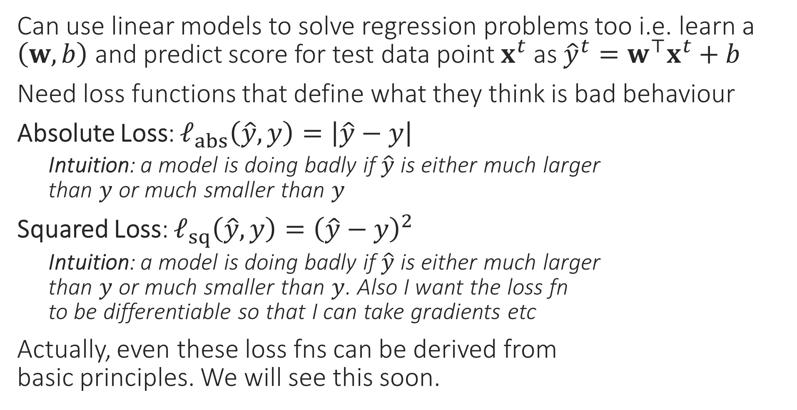
Loss Functions for Regression Problems
Can use linear models to solve regression problems too i.e. learn a $\left(w,b\right)$ and predict score for test data point $x^{t}$ as ${\hat{y}}^{t}=w^{⊤}x^{t}+b$
Need loss functions that define what they think is bad behaviour
Absolute Loss: $ℓ_{abs}\left(\hat{y},y\right)=\left|\hat{y}−y\right|$
Intuition: a model is doing badly if $\hat{y}$ is either much larger than $y$ or much smaller than $y$
Squared Loss: $ℓ_{sq}\left(\hat{y},y\right)={\left(\hat{y}−y\right)}^{2}$
Intuition: a model is doing badly if $\hat{y}$ is either much larger than $y$ or much smaller than $y$. Also I want the loss fn to be differentiable so that I can take gradients etc
Actually, even these loss fns can be derived from basic principles. We will see this soon.

Slide 4

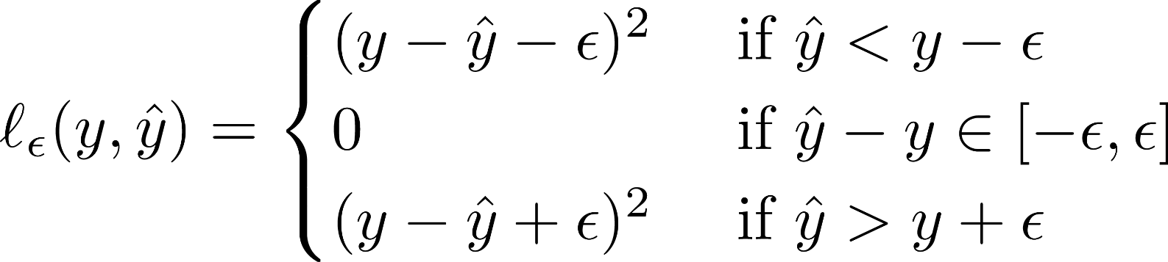
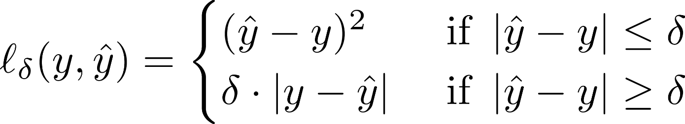

Loss Functions for Regression Problems
Loss functions have to be chosen according to needs of the problem and experience. Eg. Huber loss popular if some data points are corrupted. However, some loss functions are very popular in ML for various reasons e.g. hinge/cross entropy for binary classification, squared for regression
Vapnik’s $ε$-insensitive Loss:
Intuition: if a model is doing slightly badly, don’t penalize it at all, else penalize it as squared loss. Ensure a differentiable fn
Huber Loss:
Intuition: if a model is doing slightly badly, penalize it as squared loss, if doing very badly, penalize it as absolute loss. Also, please ensure a differentiable fn
Indeed, notice that the Huber loss function penalizes large deviations less strictly that the squared loss function (the purple curve is much below the dotted red curve). Doing so may be a good idea in corrupted data settings since it tells the optimizer to not worry too much about corrupted points

Slide 5











Finding good parameters
Age | Highest education (HS, BT, MT, PhD) |  |  |  | Gender (M, F, O) |  |  | True Salary
$$x_{1}$$ | $$x_{2}$$ | $$x_{3}$$ | $$x_{4}$$ | $$x_{5}$$ | $$x_{6}$$ | $$x_{7}$$ | $$x_{8}$$ | $$y$$
45 | 0 | 0 | 1 | 0 | 1 | 0 | 0 | 64475
22 | 0 | 1 | 0 | 0 | 0 | 1 | 0 | 34179
28 | 1 | 0 | 0 | 0 | 1 | 0 | 0 | 34573
34 | 0 | 0 | 1 | 0 | 0 | 1 | 0 | 50882
47 | 1 | 0 | 0 | 0 | 0 | 1 | 0 | 38660
55 | 0 | 0 | 1 | 0 | 1 | 0 | 0 | 71487
49 | 0 | 0 | 0 | 1 | 0 | 1 | 0 | 79430
27 | 0 | 1 | 0 | 0 | 0 | 0 | 1 | 34355
25 | 0 | 1 | 0 | 0 | 1 | 0 | 0 | 43837
We suspect that the following law holds
$\hat{y}=b+d⋅x_{1}+p⋅x_{2}+q⋅x_{3}+r⋅x_{4}+s⋅x_{5}+k⋅x_{6}+l⋅x_{7}+m⋅x_{8}$
Actually, just a linear model $\hat{y}=b+w^{⊤}x$
$x=\left[x_{1},x_{2},x_{3},x_{4},x_{5},x_{6},x_{7},x_{8}\right]$
$w=\left[d,p,q,r,s,k,l,m\right]$
Use average loss to find good params $ℓ\left(w,b\right)≝\frac{1}{n}\sum_{i=1}^{n}{{\left({\hat{y}}^{i}−y^{i}\right)}^{2}}$ $=\frac{1}{n}\sum_{i=1}^{n}{{\left(\left(w^{⊤}x^{i}+b\right)−y^{i}\right)}^{2}}$
$x^{i}=\left[x_{1}^{i},x_{2}^{i},x_{3}^{i},x_{4}^{i},x_{5}^{i},x_{6}^{i},x_{7}^{i},x_{8}^{i}\right]$ is the feature vector for the i-th person in our training set

Slide 6



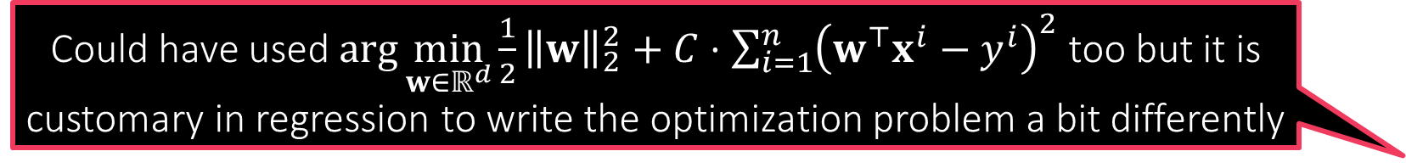
Ridge Regression
Ridge regression uses least squares loss and $L_{2}$ regularization. However the term “least squares regression” is often used to refer to ridge regression ☺
Ignore the bias $b$ for sake of notational simplicity
$\arg{\min_{w∈ℝ^{d}}{\frac{λ}{2}{\left\|w\right\|}_{2}^{2}}+\sum_{i=1}^{n}{{\left(w^{⊤}x^{i}−y^{i}\right)}^{2}}}$
Can rewrite as $\frac{λ}{2}{\left\|w\right\|}_{2}^{2}+{\left\|Xw−y\right\|}_{2}^{2}$with $X∈ℝ^{n×d},y∈ℝ^{n}$
Can apply first order optimality to obtain a solution (convex objective)
Gradient: $λ⋅w+2X^{⊤}\left(Xw−y\right)$ (recall: gradient must be $d×1$)
Gradient must vanish at minimum so we must have
$w={\left(2X^{⊤}X+λ⋅I\right)}^{−1}\left(2X^{⊤}y\right)$
Takes $𝒪\left(d^{3}\right)$ time to invert the matrix – may use faster methods (S)GD
Much faster methods available e.g., conjugate gradient method
Could have used $\arg{\min_{w∈ℝ^{d}}{\frac{1}{2}{\left\|w\right\|}_{2}^{2}}+C⋅\sum_{i=1}^{n}{{\left(w^{⊤}x^{i}−y^{i}\right)}^{2}}}$ too but it is customary in regression to write the optimization problem a bit differently
Even here, we may use dual methods like SDCA (liblinear etc do indeed use them) but yet again, deriving the dual is not as straightforward here since there are no constraints in the original problem
If we want to use fancier loss functions like Vapnik’s loss function, then cannot apply first order optimality, need to use SGD, SDCA etc methods

Slide 7
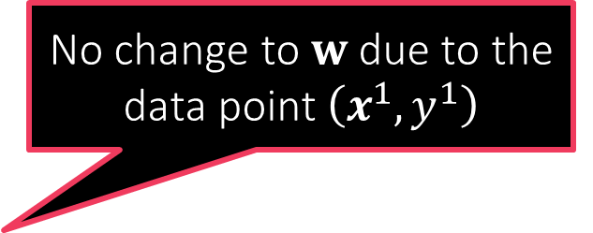
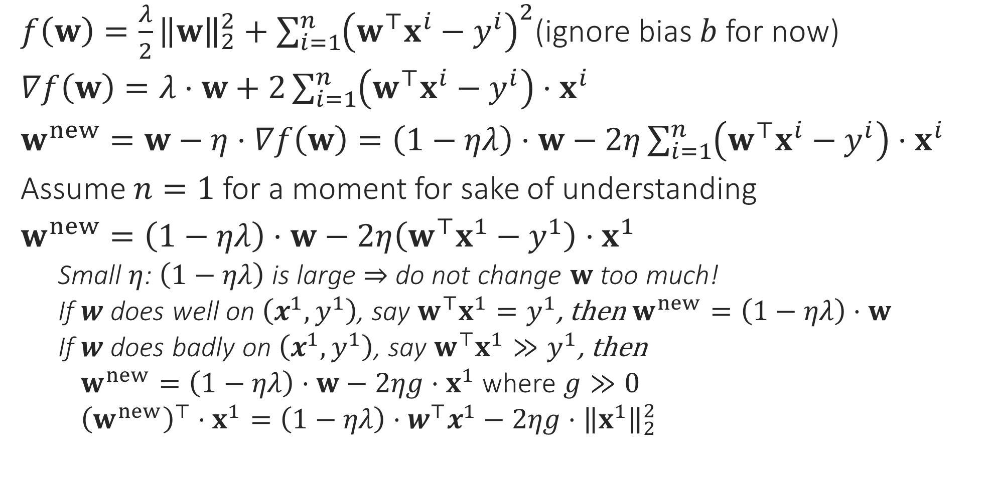
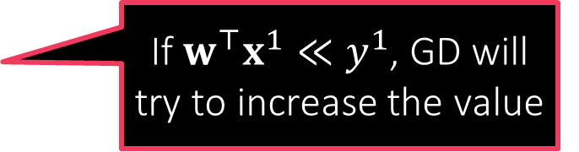
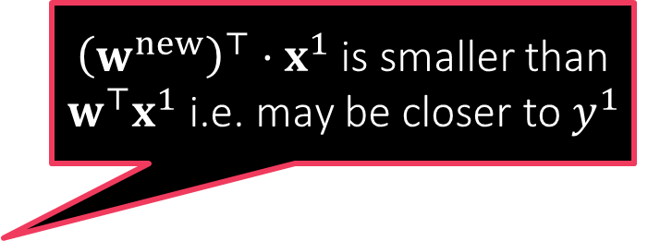
Behind the scenes: GD for Ridge Regression
$f\left(w\right)=\frac{λ}{2}{\left\|w\right\|}_{2}^{2}+\sum_{i=1}^{n}{{\left(w^{⊤}x^{i}−y^{i}\right)}^{2}}$(ignore bias $b$ for now)
$∇f\left(w\right)=λ⋅w+2\sum_{i=1}^{n}{\left(w^{⊤}x^{i}−y^{i}\right)⋅x^{i}}$
$w^{new}=w−η⋅∇f\left(w\right)=\left(1−ηλ\right)⋅w−2η\sum_{i=1}^{n}{\left(w^{⊤}x^{i}−y^{i}\right)⋅x^{i}}$
Assume $n=1$ for a moment for sake of understanding
$w^{new}=\left(1−ηλ\right)⋅w−2η\left(w^{⊤}x^{1}−y^{1}\right)⋅x^{1}$
Small $η$: $\left(1−ηλ\right)$ is large $⇒$ do not change $w$ too much!
If $w$ does well on $\left(x^{1},y^{1}\right)$, say $w^{⊤}x^{1}=y^{1}$, then $w^{new}=\left(1−ηλ\right)⋅w$
If $w$ does badly on $\left(x^{1},y^{1}\right)$, say $w^{⊤}x^{1}≫y^{1}$, then
$w^{new}=\left(1−ηλ\right)⋅w−2ηg⋅x^{1}$ where $g≫0$
${\left(w^{new}\right)}^{⊤}⋅x^{1}=\left(1−ηλ\right)⋅w^{⊤}x^{1}−2ηg⋅{\left\|x^{1}\right\|}_{2}^{2}$
GD and other optimization techniques merely try to obtain models that obey the rules of good behaviour as encoded in the loss function
No change to $w$ due to the data point $\left(x^{1},y^{1}\right)$
${\left(w^{new}\right)}^{⊤}⋅x^{1}$ is smaller than $w^{⊤}x^{1}$ i.e. may be closer to $y^{1}$
If $w^{⊤}x^{1}≪y^{1}$, GD will try to increase the value

Slide 8

Regularization
Makes sense since regularization is supposed to protect us from data issues
An umbrella term used in ML to describe a whole family of steps taken to prevent ML algos from suffering from problems in data
These help ML algos offer stable behaviour even if data misbehaves
In an ideal world where data is perfectly clean and there is plenty of data available, there would be no need for any regularization!
How to do regularization is often decided without looking at data
However, regularization usually involves its own hyperparameters that need to be tuned using data itself (using validation techniques)
In general, regularization techniques prevent the model from just blindly doing well on data (since data cannot be trusted)
Frequently, regularization can also make the optimization problem well-posed and the solution unique – this helps optimizers (SGD etc) immensely
So regularization can be somewhat data dependent

Slide 9

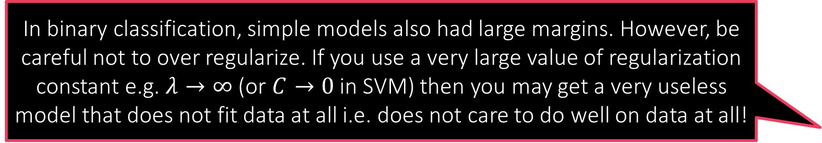
Regularization by adding a regularizer
A regularizer essentially tells the optimizer to not just blindly return a model that does well on data (according to the loss function), but rather return a model that does well and is simple. The L2 regularizer defines simplicity using the L2 norm (or Euclidean length). A model is simple if it has small L2 norm
$f\left(w\right)=\frac{1}{2}{\left\|w\right\|}_{2}^{2}+C⋅{\sum_{i=1}^{n}{\left[1−y^{i}⋅w^{⊤}x^{i}\right]}}_{+}$
$f\left(w\right)=\frac{λ}{2}{\left\|w\right\|}_{2}^{2}+\sum_{i=1}^{n}{{\left(w^{⊤}x^{i}−y^{i}\right)}^{2}}$
The ${\left\|w\right\|}_{2}^{2}$ term above is called the L2 regularizer (or the squared L2 regularizer if we want to be very specific)
In binary classification settings, we saw that this regularizer encourages a large margin
In regression settings it ensures uniqueness of solution
Recall that the closed form solution is $w={\left(2X^{⊤}X+λ⋅I\right)}^{−1}\left(2X^{⊤}y\right)$
If $X^{⊤}X$ is non-invertible then we have infinitely many solutions if $λ=0$
Having $λ>0$ ensures unique solution no matter what the data
In binary classification, simple models also had large margins. However, be careful not to over regularize. If you use a very large value of regularization constant e.g. $λ→∞$ (or $C→0$ in SVM) then you may get a very useless model that does not fit data at all i.e. does not care to do well on data at all!
The key is moderation. Usually regularization constants are chosen using validation. Other important considerations include: how noisy do we expect data to be and how much data do we have. Rule of thumb: as you have more and more data, you can safely afford to regularize less and less

Slide 10

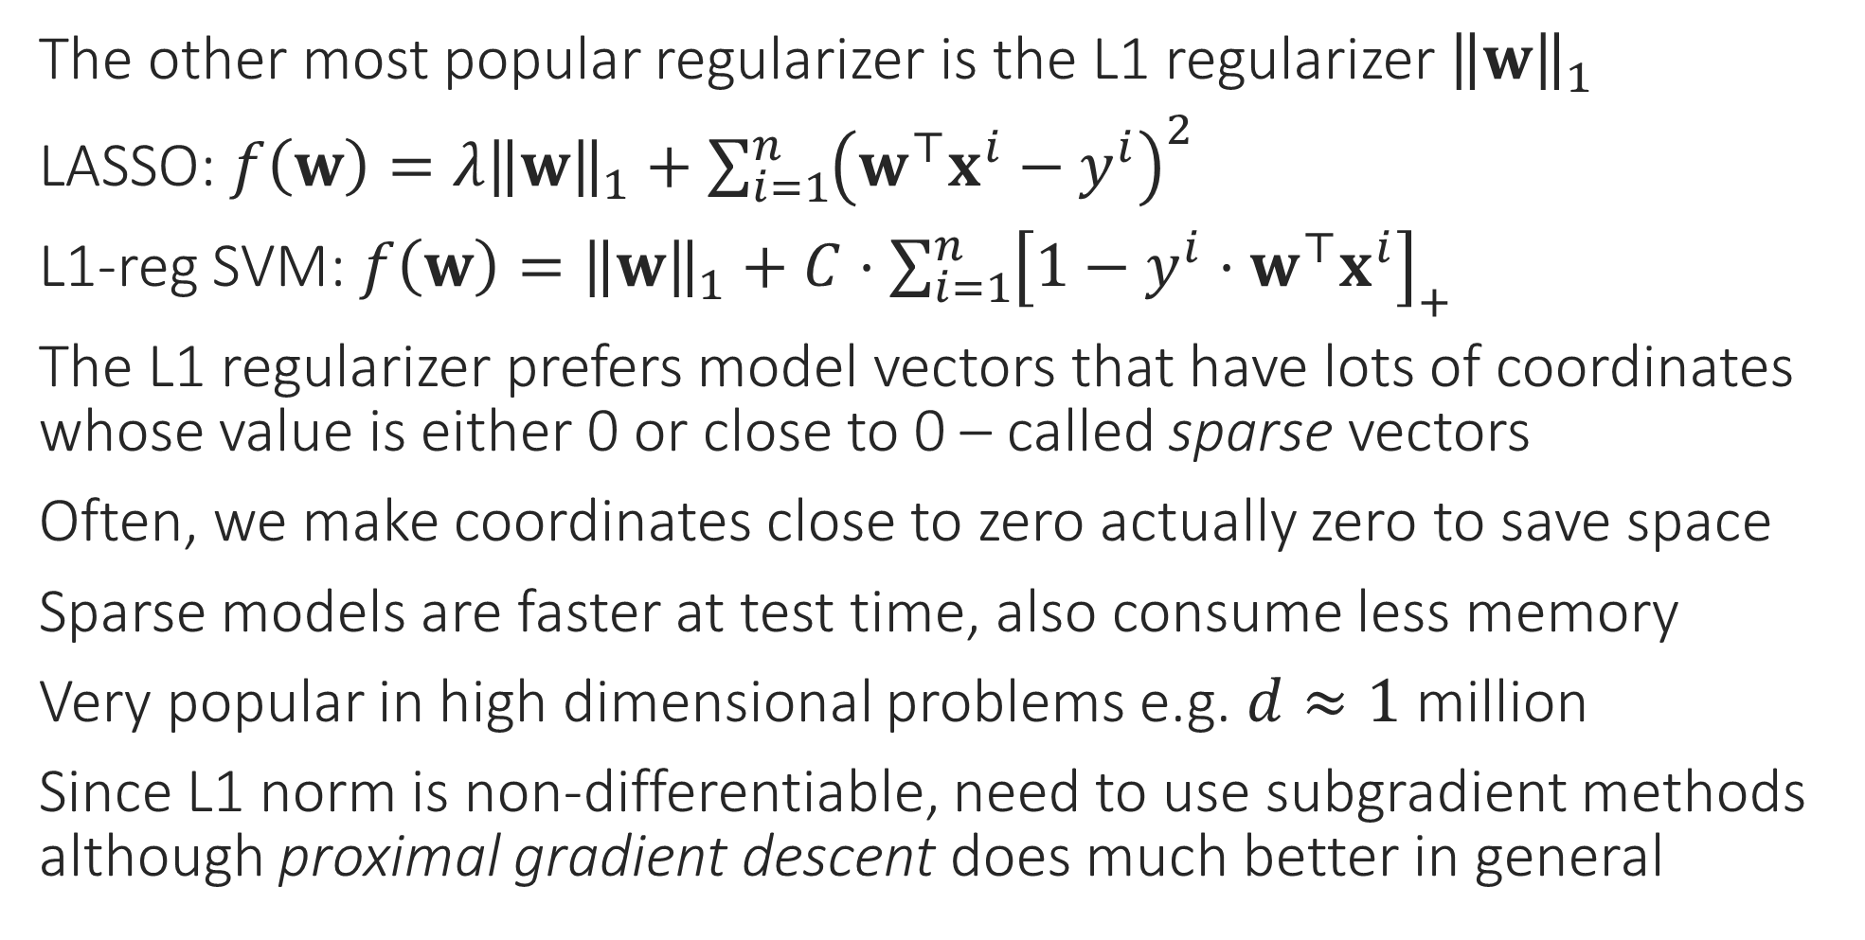
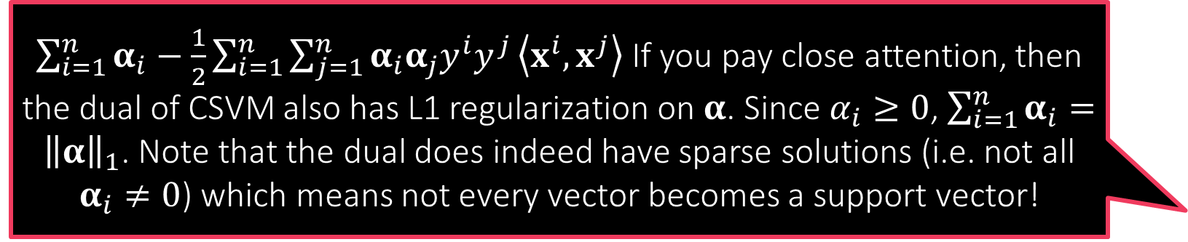
Other popular regularizers
$\sum_{i=1}^{n}{α_{i}}−\frac{1}{2}\sum_{i=1}^{n}{\sum_{j=1}^{n}{α_{i}α_{j}y^{i}y^{j}}\left\langle x^{i},x^{j}\right\rangle }$ If you pay close attention, then the dual of CSVM also has L1 regularization on $α$. Since $α_{i}≥0$, $\sum_{i=1}^{n}{α_{i}}={\left\|α\right\|}_{1}$. Note that the dual does indeed have sparse solutions (i.e. not all $α_{i}≠0$) which means not every vector becomes a support vector!
The other most popular regularizer is the L1 regularizer ${\left\|w\right\|}_{1}$
LASSO: $f\left(w\right)=λ{\left\|w\right\|}_{1}+\sum_{i=1}^{n}{{\left(w^{⊤}x^{i}−y^{i}\right)}^{2}}$
L1-reg SVM: $f\left(w\right)={\left\|w\right\|}_{1}+C⋅{\sum_{i=1}^{n}{\left[1−y^{i}⋅w^{⊤}x^{i}\right]}}_{+}$
The L1 regularizer prefers model vectors that have lots of coordinates whose value is either 0 or close to 0 – called sparse vectors
Often, we make coordinates close to zero actually zero to save space
Sparse models are faster at test time, also consume less memory
Very popular in high dimensional problems e.g. $d≈1$ million
Since L1 norm is non-differentiable, need to use subgradient methods although proximal gradient descent does much better in general

Slide 11
Regularization by Early Stopping
Sometimes, ML practitioners stop an optimizer well before it has solved the optimization problem fully – sometimes due to timeout but sometimes deliberately
Note that this automatically prevents the model from fitting the data too closely (this is good if the data was noisy or had outliers)
This often happens implicitly with complex optimization problems e.g. training deep networks where the person training the network gets tired and gives up training – gets some regularization for free ☺
Be careful not to misuse this – if you stop too early, you may just get an overregularized model that does not fit data at all i.e. does not do well on data at all!

Slide 12
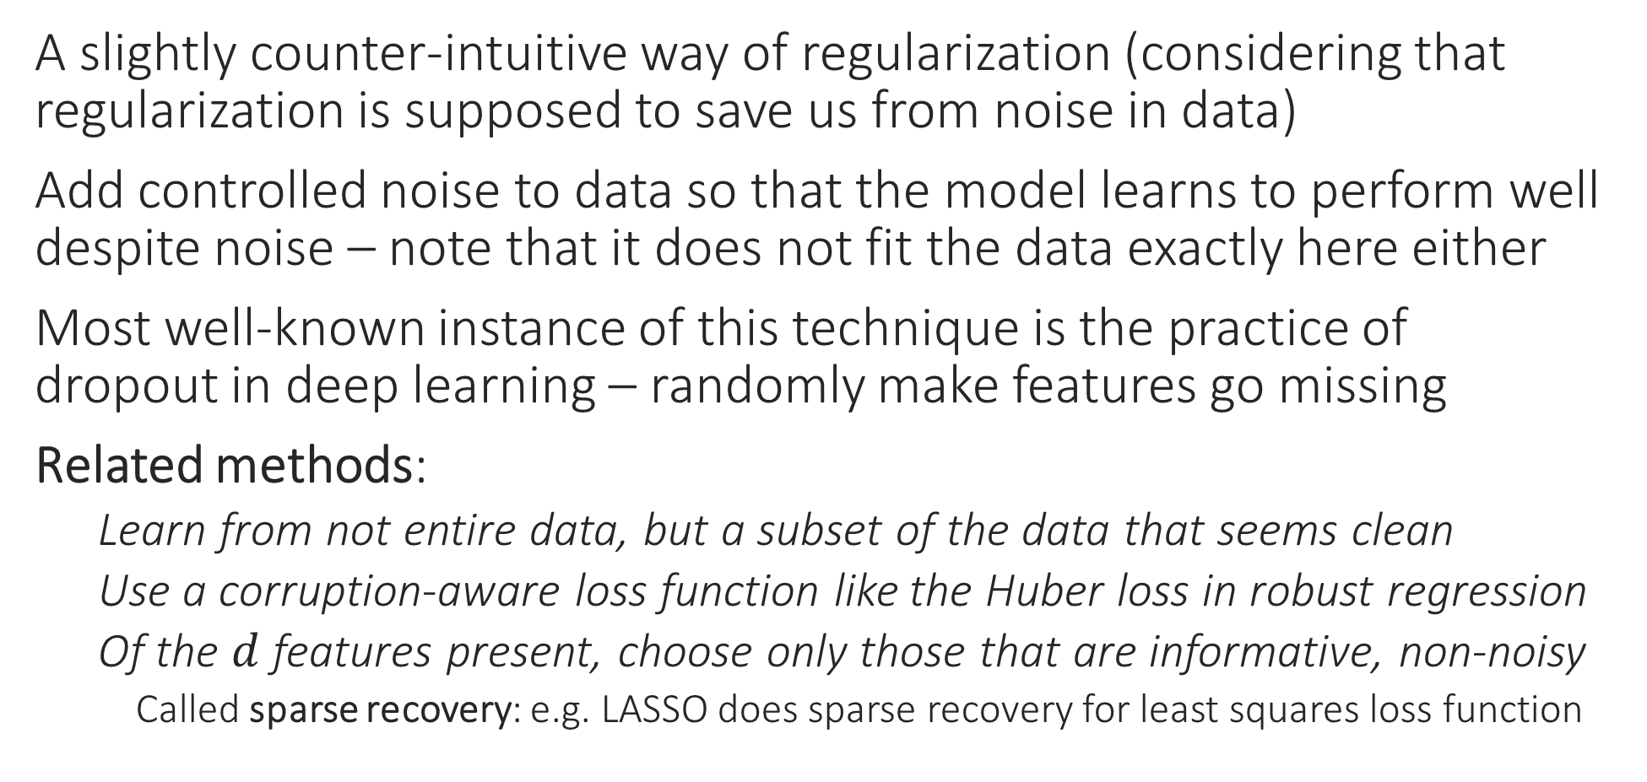
Regularization by adding noise
A slightly counter-intuitive way of regularization (considering that regularization is supposed to save us from noise in data)
Add controlled noise to data so that the model learns to perform well despite noise – note that it does not fit the data exactly here either
Most well-known instance of this technique is the practice of dropout in deep learning – randomly make features go missing
Related methods:
Learn from not entire data, but a subset of the data that seems clean
Use a corruption-aware loss function like the Huber loss in robust regression
Of the $d$ features present, choose only those that are informative, non-noisy
Called sparse recovery: e.g. LASSO does sparse recovery for least squares loss function

Slide 13

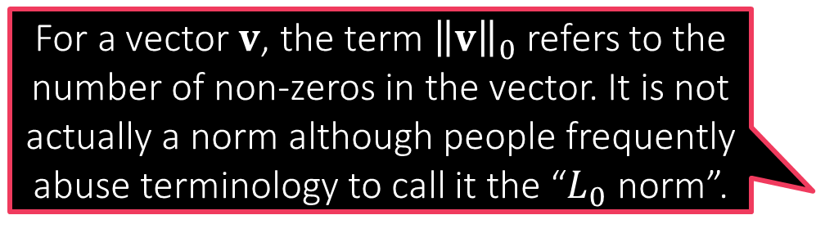
Other forms of regularization
For a vector $v$, the term ${\left\|v\right\|}_{0}$ refers to the number of non-zeros in the vector. It is not actually a norm although people frequently abuse terminology to call it the “$L_{0}$ norm”.
Regularization by imposing convex constraints $\arg{\min_{w∈ℝ^{d}}{{\left\|Xw−y\right\|}_{2}^{2}}}$ $s.t.{\left\|w\right\|}_{2}^{2}≤R^{2}$
The constraint set (feasible set) is a convex set here (an $L_{2}$ ball)
Regularization by imposing non-convex constraints $\arg{\min_{w∈ℝ^{d}}{{\left\|Xw−y\right\|}_{2}^{2}}}$ $s.t.{\left\|w\right\|}_{0}≤s$
Forcing us to choose only $s≪d$ features to solve the problem
Called “sparse recovery” – related to compressed sensing
The feasible set is a non-convex set here

Slide 14
Multiclass Learning

Slide 15

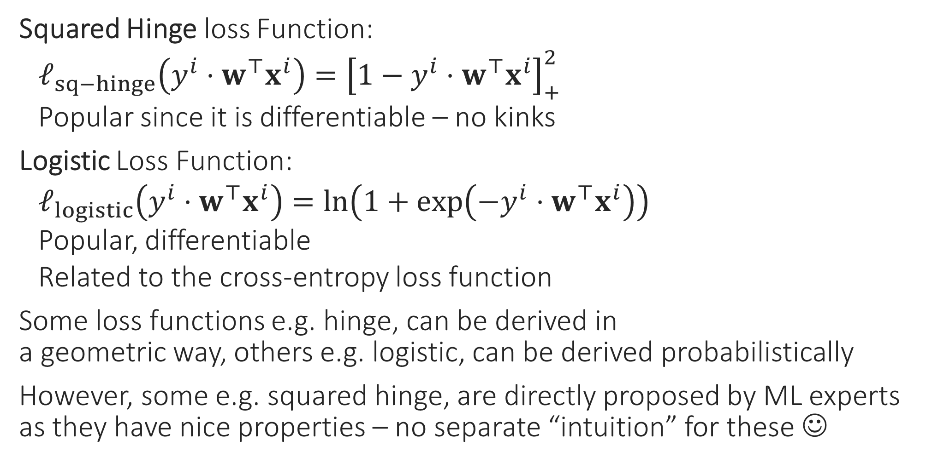
Classification Loss Functions
Squared Hinge loss Function:
$ℓ_{sq−hinge}\left(y^{i}⋅w^{⊤}x^{i}\right)={\left[1−y^{i}⋅w^{⊤}x^{i}\right]}_{+}^{2}$
Popular since it is differentiable – no kinks
Logistic Loss Function:
$ℓ_{logistic}\left(y^{i}⋅w^{⊤}x^{i}\right)=\ln\left(1+\exp\left(−y^{i}⋅w^{⊤}x^{i}\right)\right)$
Popular, differentiable
Related to the cross-entropy loss function
Some loss functions e.g. hinge, can be derived in a geometric way, others e.g. logistic, can be derived probabilistically
However, some e.g. squared hinge, are directly proposed by ML experts as they have nice properties – no separate “intuition” for these ☺

Slide 16

Multiclass Classification
Sometimes aka multiclassification
Can be solved using linear models too!
Trick is to reduce to binary classification
If there are $C$ classes, then train $C$ linear models, each trained to identify one class
E.g. $C=3$ {dog, horse, fish}. Train model1 to say yes to dog images but no to horse and no to fish images, similarly model2, 3
Called the OVA method (one-vs-all)
At test time, just ask all three models and hope that only one of them says yes ☺

Slide 17
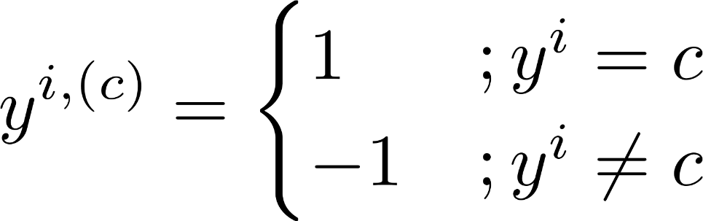
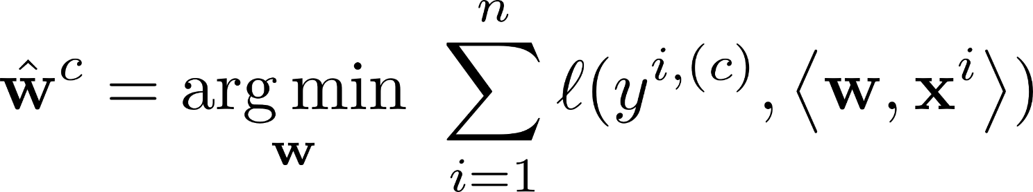
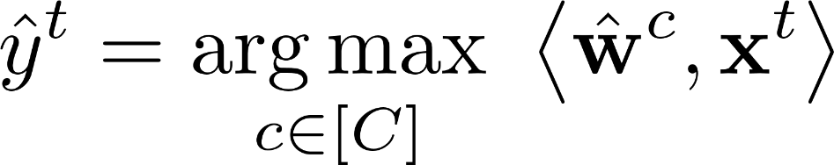
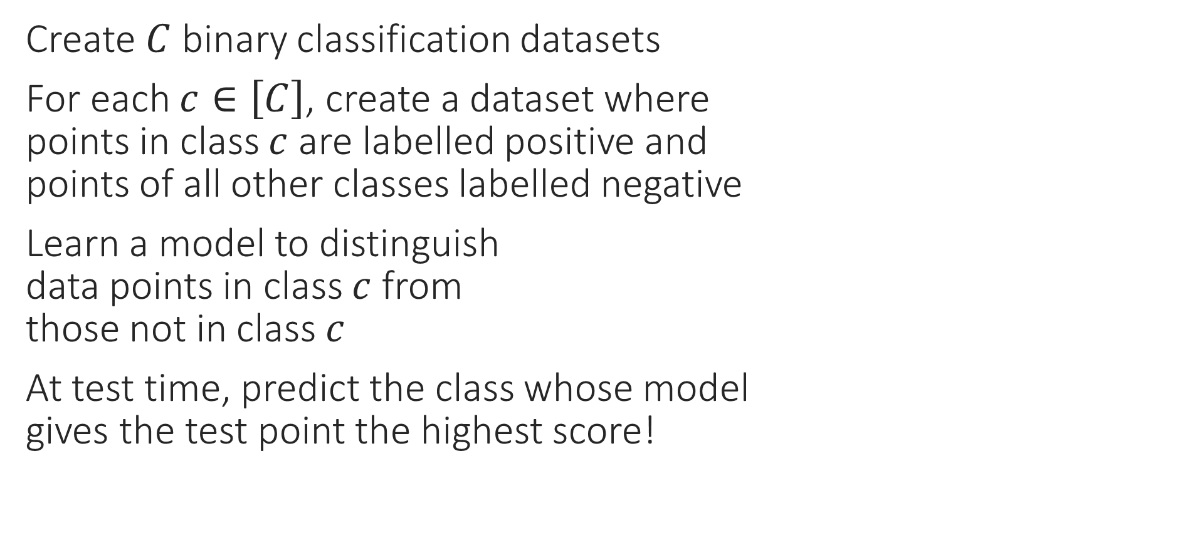

OVA – Reduce to $C$ binary problems
Create $C$ binary classification datasets
For each $c∈\left[C\right]$, create a dataset where points in class $c$ are labelled positive and points of all other classes labelled negative
Learn a model to distinguish data points in class $c$ from those not in class $c$
At test time, predict the class whose model gives the test point the highest score!

Slide 18
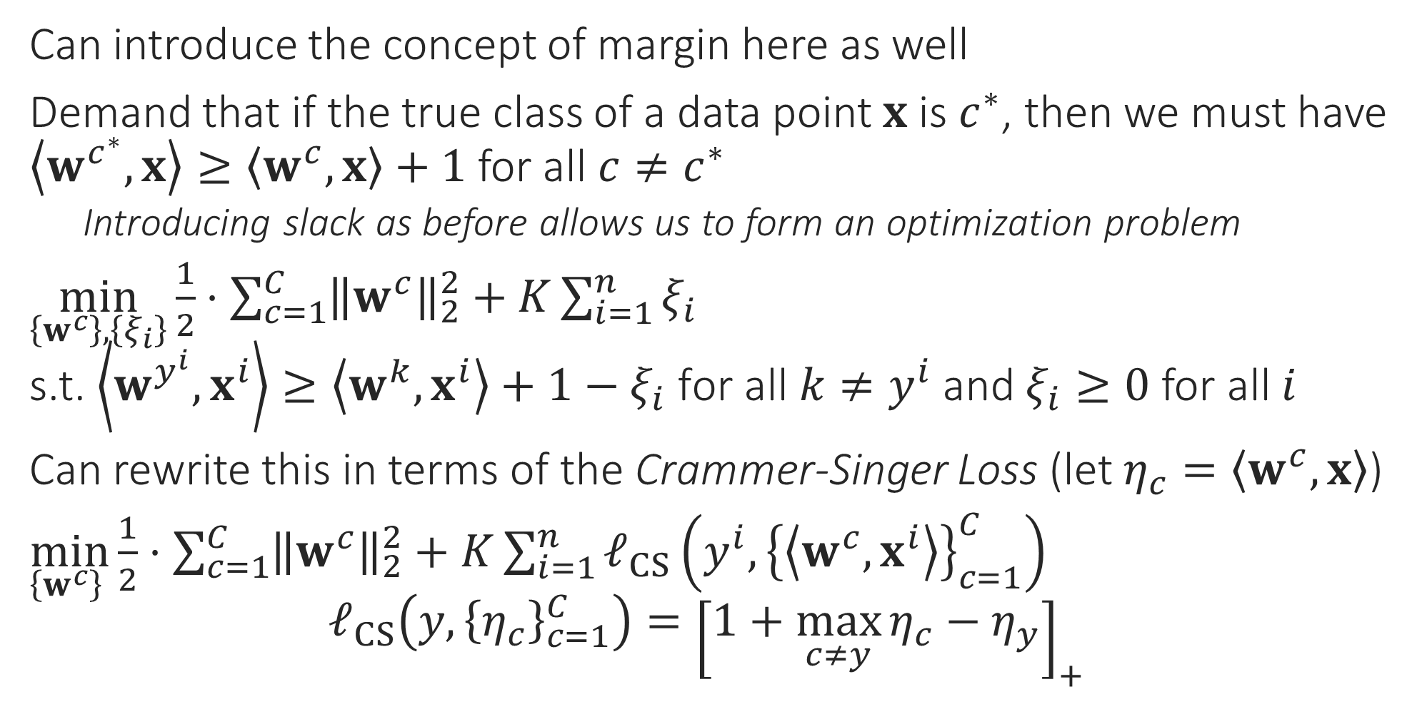

OVA – Learn the $C$ models together
Can introduce the concept of margin here as well
Demand that if the true class of a data point $x$ is $c^{∗}$, then we must have $\left\langle w^{c^{∗}},x\right\rangle ≥\left\langle w^{c},x\right\rangle +1$ for all $c≠c^{∗}$
Introducing slack as before allows us to form an optimization problem
$\min_{\left\{w^{c}\right\},\left\{ξ_{i}\right\}}{\frac{1}{2}⋅\sum_{c=1}^{C}{{\left\|w^{c}\right\|}_{2}^{2}}}+K\sum_{i=1}^{n}{ξ_{i}}$ s.t. $\left\langle w^{y^{i}},x^{i}\right\rangle ≥\left\langle w^{k},x^{i}\right\rangle +1−ξ_{i} \text{for} \text{all} k≠y^{i}$ and $ξ_{i}≥0$ for all $i$
Can rewrite this in terms of the Crammer-Singer Loss (let $η_{c}=\left\langle w^{c},x\right\rangle$)
$\min_{\left\{w^{c}\right\} }{\frac{1}{2}⋅\sum_{c=1}^{C}{{\left\|w^{c}\right\|}_{2}^{2}}}+K\sum_{i=1}^{n}{ℓ_{CS}\left(y^{i},{\left\{\left\langle w^{c},x^{i}\right\rangle \right\}}_{c=1}^{C}\right)}$ $ℓ_{CS}\left(y,{\left\{η_{c}\right\}}_{c=1}^{C}\right)={\left[1+\max_{c≠y}{η_{c}}−η_{y}\right]}_{+}$

Slide 19
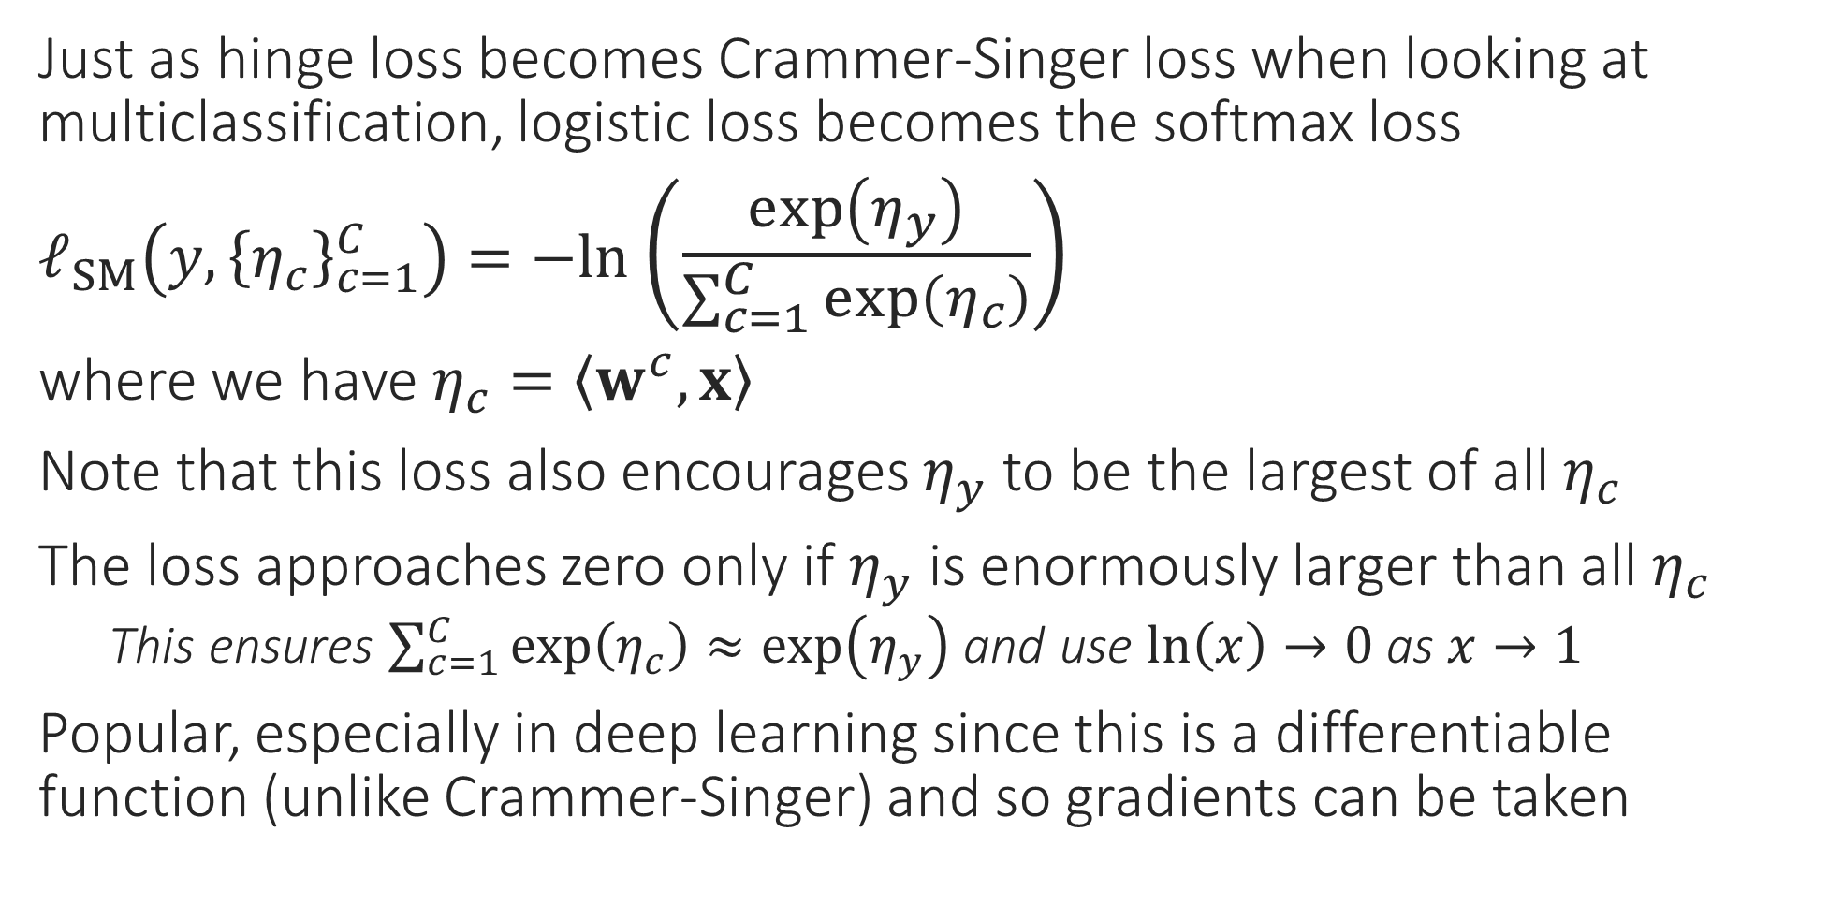
OVA via Softmax
Just as hinge loss becomes Crammer-Singer loss when looking at multiclassification, logistic loss becomes the softmax loss
$ℓ_{SM}\left(y,{\left\{η_{c}\right\}}_{c=1}^{C}\right)=−ln$ $\left(\frac{\exp\left(η_{y}\right)}{\sum_{c=1}^{C}{\exp\left(η_{c}\right)}}\right)$
where we have $η_{c}=\left\langle w^{c},x\right\rangle$
Note that this loss also encourages $η_{y}$ to be the largest of all $η_{c}$
The loss approaches zero only if $η_{y}$ is enormously larger than all $η_{c}$
This ensures $\sum_{c=1}^{C}{\exp\left(η_{c}\right)}≈\exp\left(η_{y}\right)$ and use $\ln\left(x\right)→0$ as $x→1$
Popular, especially in deep learning since this is a differentiable function (unlike Crammer-Singer) and so gradients can be taken

Slide 20

Multiclassification – popular techniques
OVA: convert multiclassification into several binary problems
Can be slow if $C≫1$ but ways exist to speed things up
Crammer Singer present in liblinear, sklearn. Softmax popular in deep learning
Output Codes: convert multiclassification into regression problems
Represent each class $c∈\left[C\right]$ using a $k$-dim vector $v_{c}∈ℝ^{k}$.
Solve $k$ regression problems on the data, essentially trying to predict $v_{1}$ for data points that belong to class 1, $v_{2}$ for data points that belong to class 2 etc
At test time, predict $k$ numbers for the test point, think of this as a $k$-dim vector and see if this vector is closest to $v_{1}$ or $v_{2}$ or etc …
Want $k$ to be small for sake of speed but cannot have very small $k$. The whole purpose of having $k>1$ is to account for regression mistakes
Decision Trees: very popular especially if number of classes $C≫1$

Slide 21

Multiclass via DT
Recall that if a node $S$ contains $n$ data points of $C$ possible classes with $n_{c}$ data points of class $c$ (with $\sum_{c∈\left[C\right]}{n_{c}}=n$), then the entropy of this node can be computed as is defined as $H\left(S\right)≝−\sum_{c∈\left[C\right]}{\frac{n_{c}}{n}\log_{2}\left(\frac{n_{c}}{n}\right)}=−\sum_{c∈\left[C\right]}{p_{c}\log_{2}{p_{c}}}$
where $p_{c}≝\frac{n_{c}}{n}$ is proportion of elements of class $c$
If we split $S$ into $K$ subsets $S_{1},…,S_{K}$ s.t. $\left|S_{k}\right|≝m_{k}$, $\sum_{k∈\left[K\right]}{m_{k}}=n$ then the entropy of this collection of children nodes is defined as $\sum_{k∈\left[K\right]}{\frac{m_{k}}{n}⋅H\left(S_{k}\right)}$
ID3 chooses split that minimizes entropy of the child node collection

