Slide 1
IIIT Lucknow
Capstone Project on
Fire Detection using Surveillance camera on Roads
( Codes )
Submitted by - Akash Papnai,
Vipul Chandra
Submitted to - Dr. Deepak Singh

Slide 2
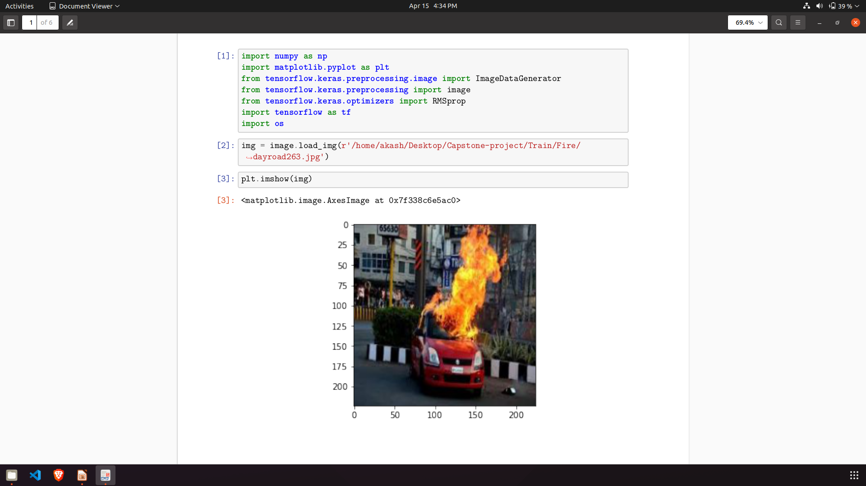
Importing necessary libraries

Slide 3
Sample Image

Slide 4
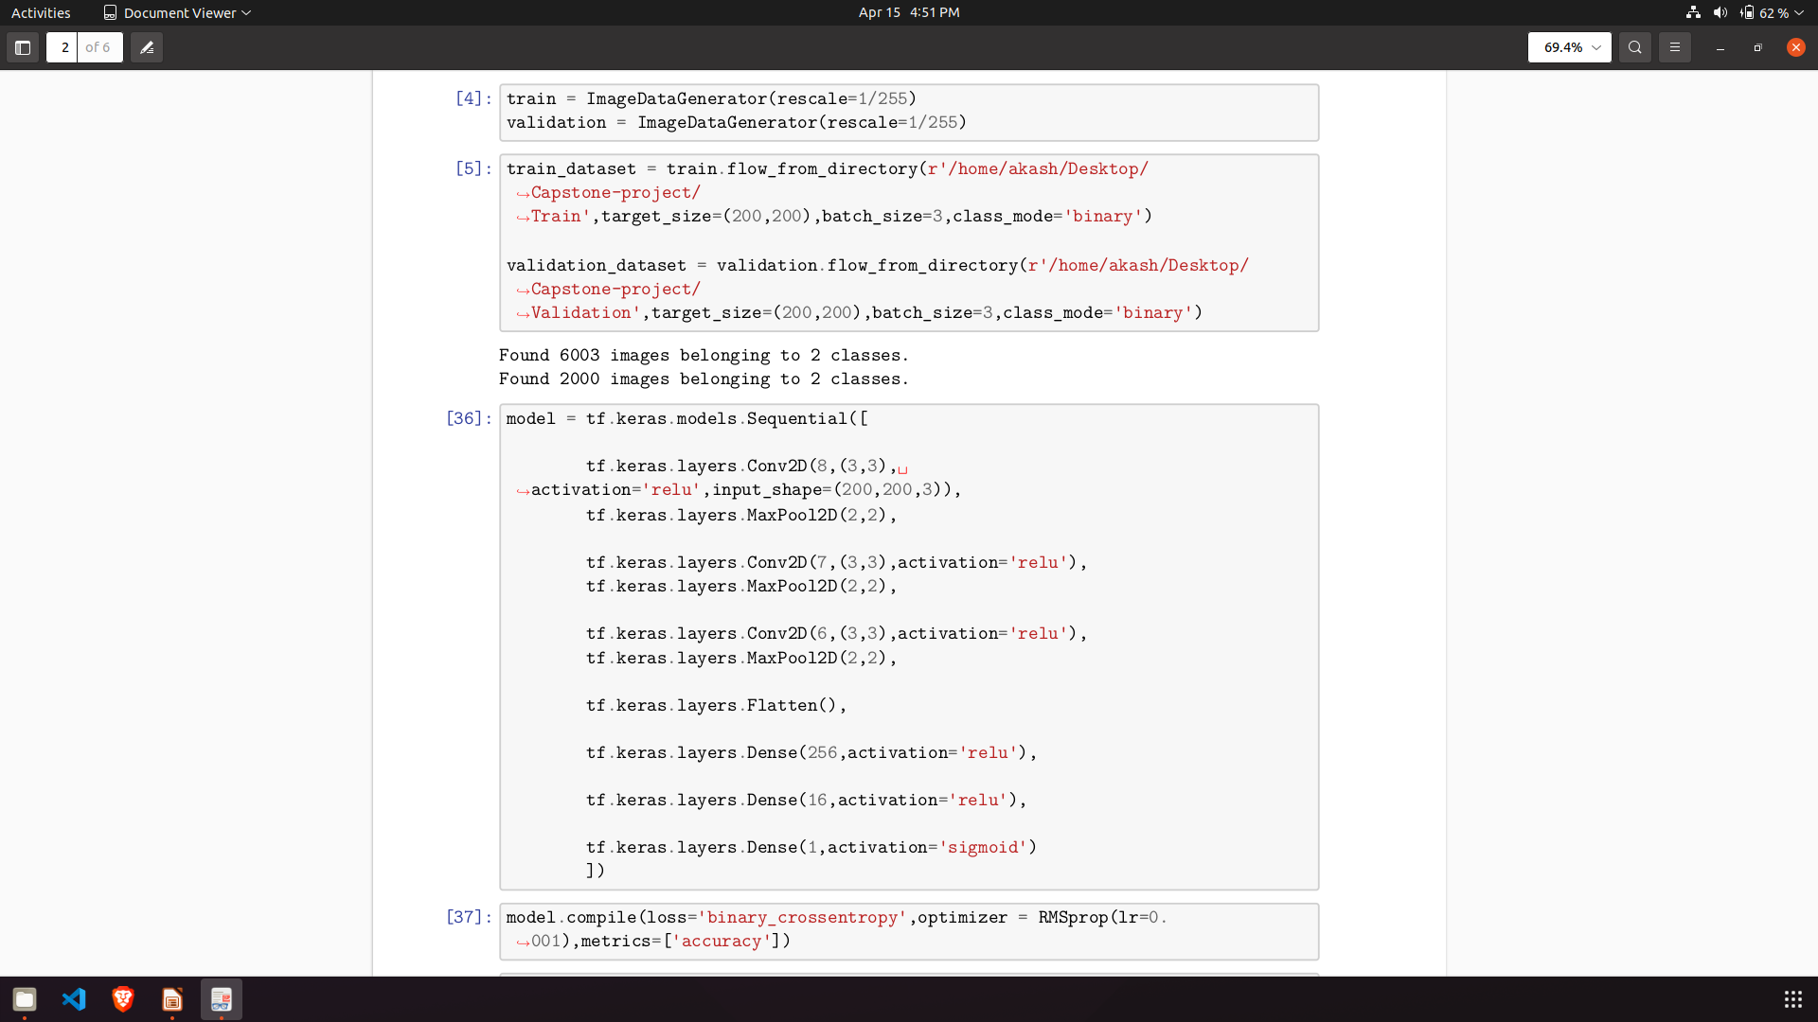
Importing data

Slide 5
Adding Convolutional Layers

Slide 6
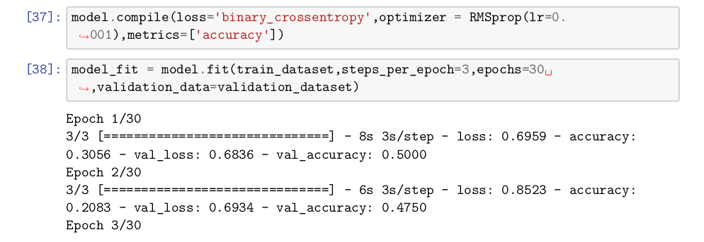
Training the Model

Slide 7
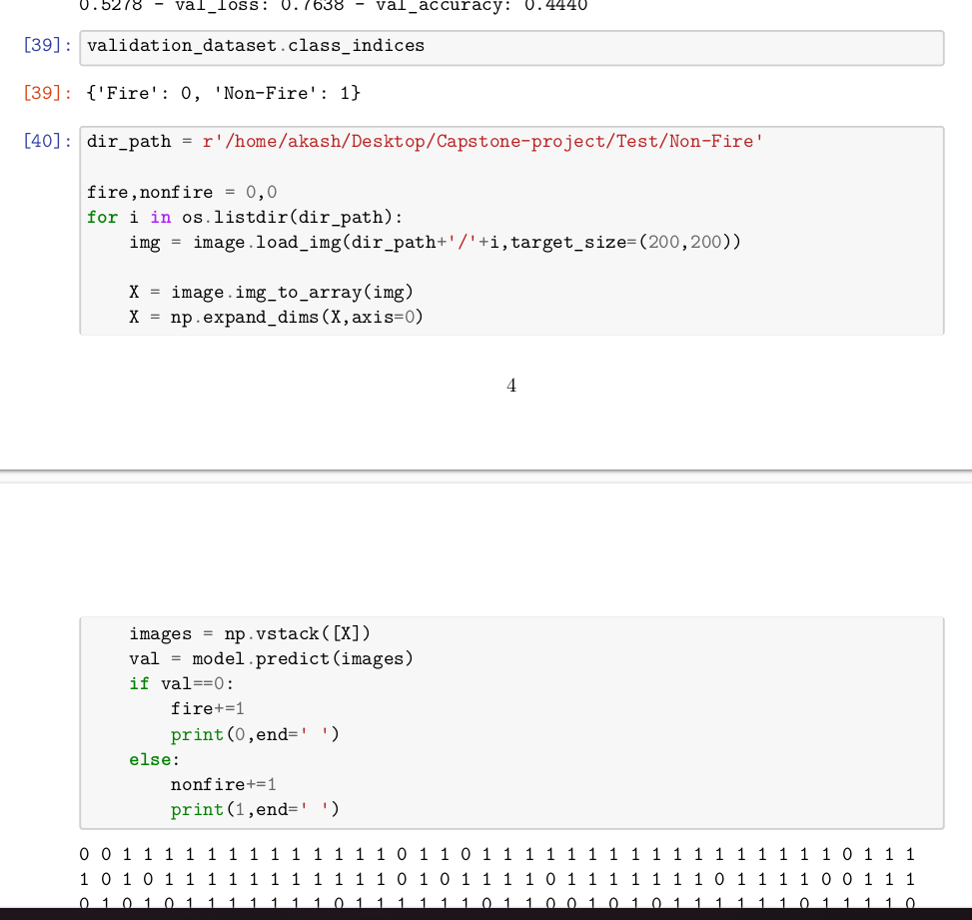
Testing the trained model

Slide 8
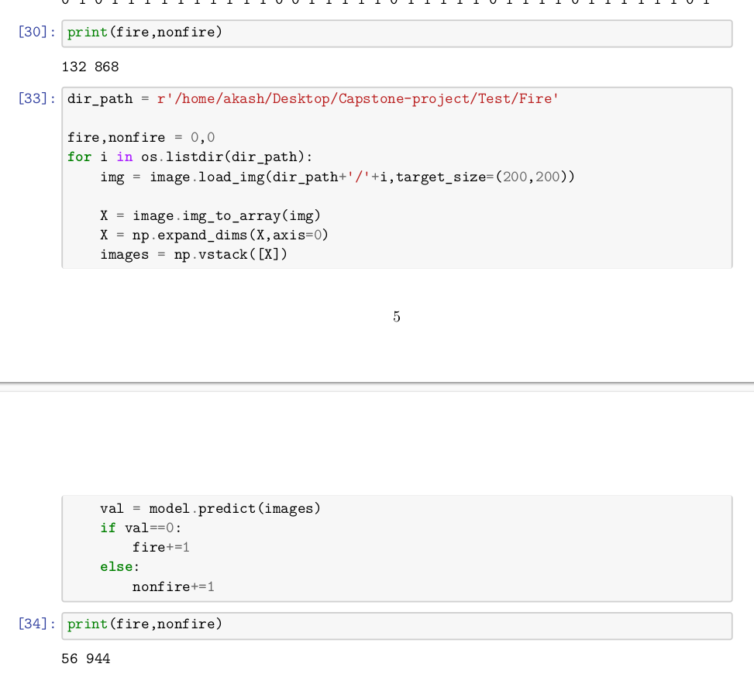
Results

Slide 9
THANK YOU

