Slide 1
Automotive Pricing Analysis & Market Drivers

Slide 2
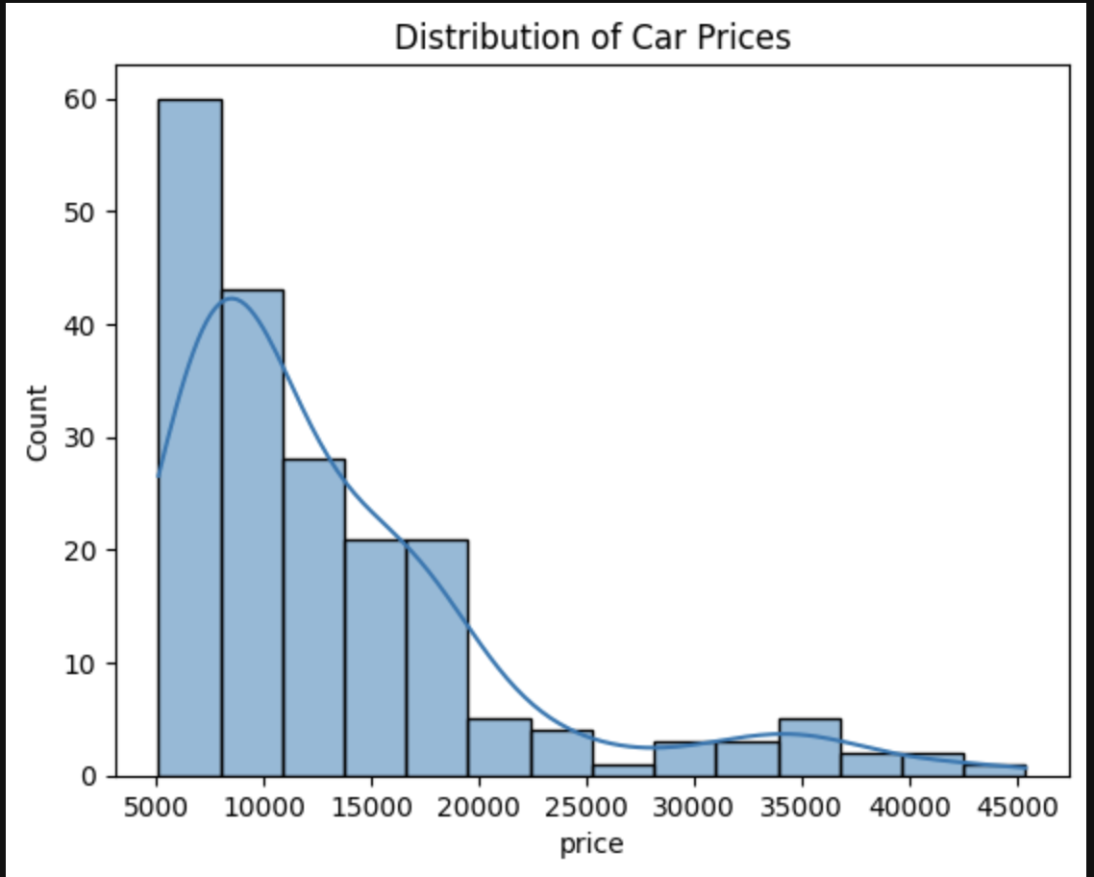

Slide 3
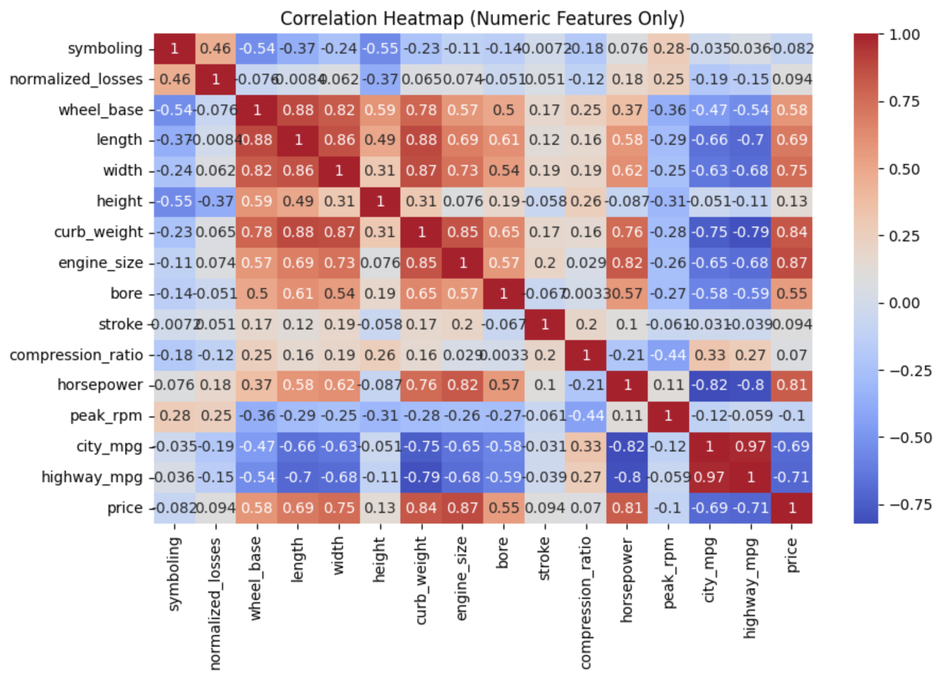

Slide 4
