Slide 1


Slide 2
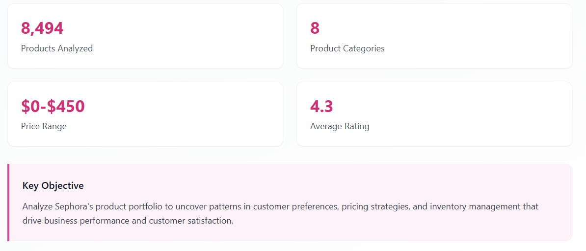
Executive Summary

Slide 3

Phase 1

Slide 4
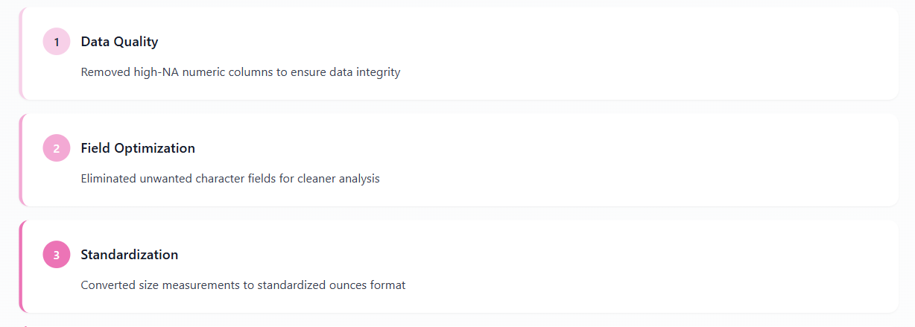
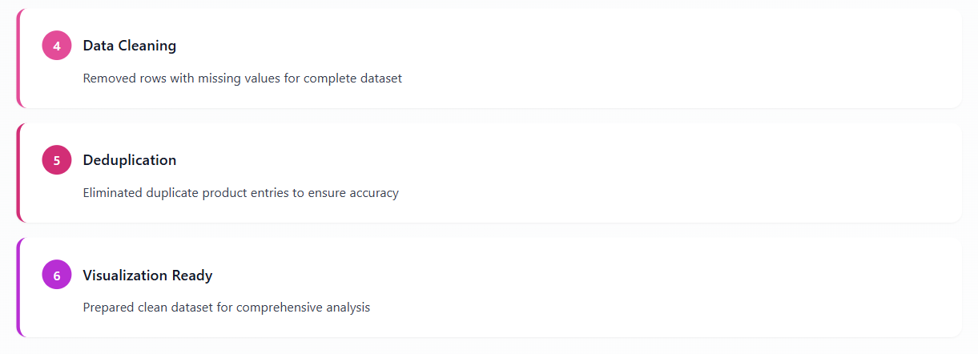
Data Preparation & Cleaning

Slide 5
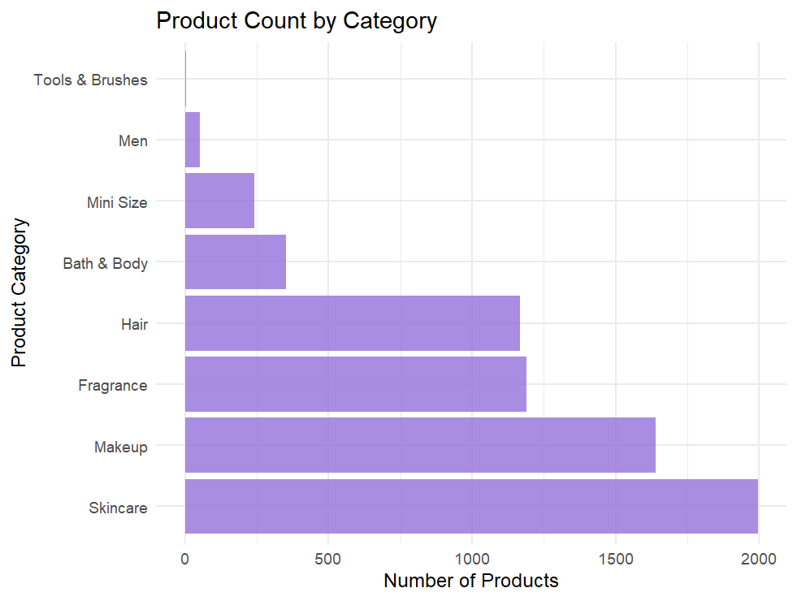

Product Portfolio Distribution

Slide 6
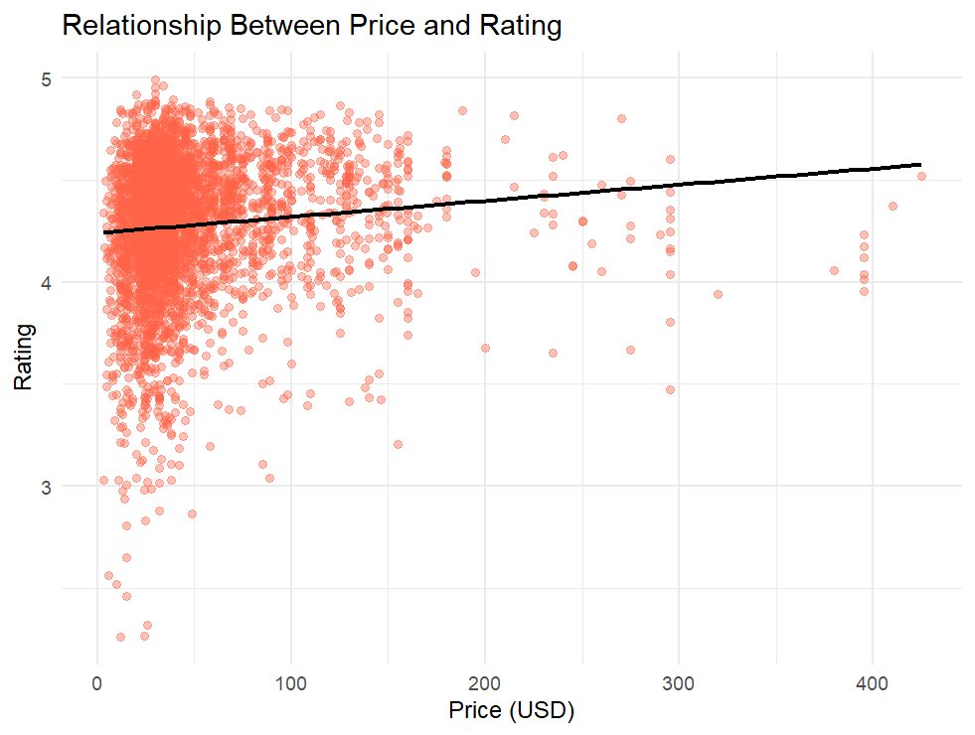

Price vs Customer Satisfaction

Slide 7
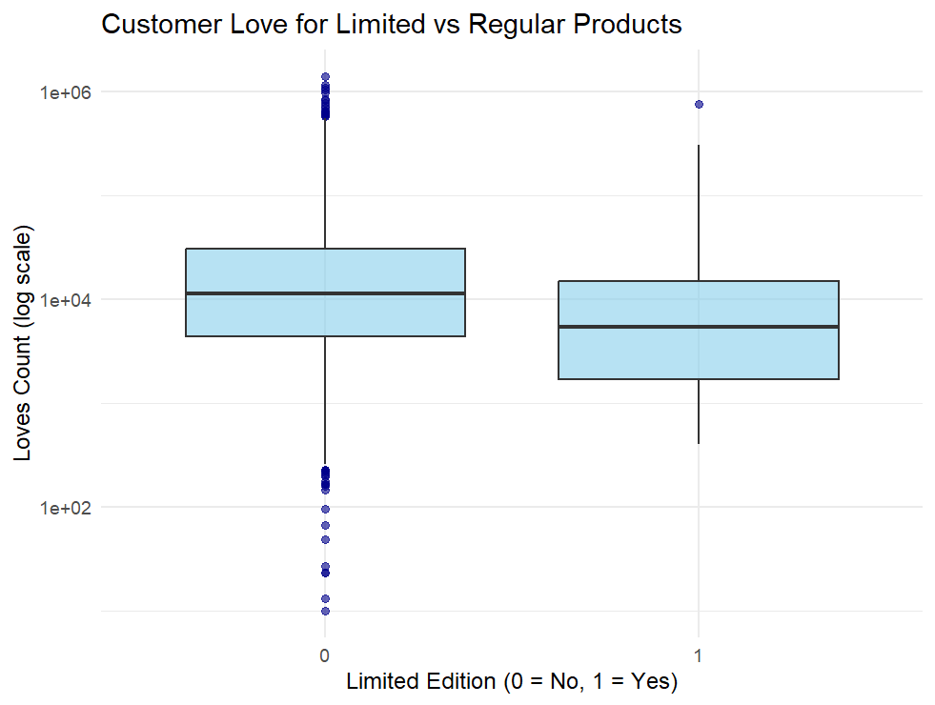
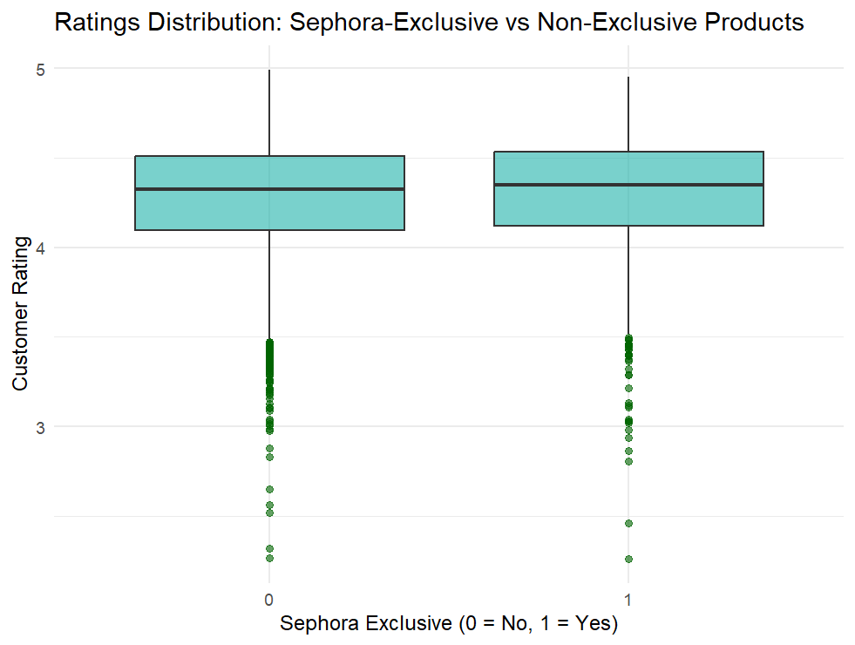

Exclusivity Impact on Ratings

Slide 8
Phase 2

Slide 9
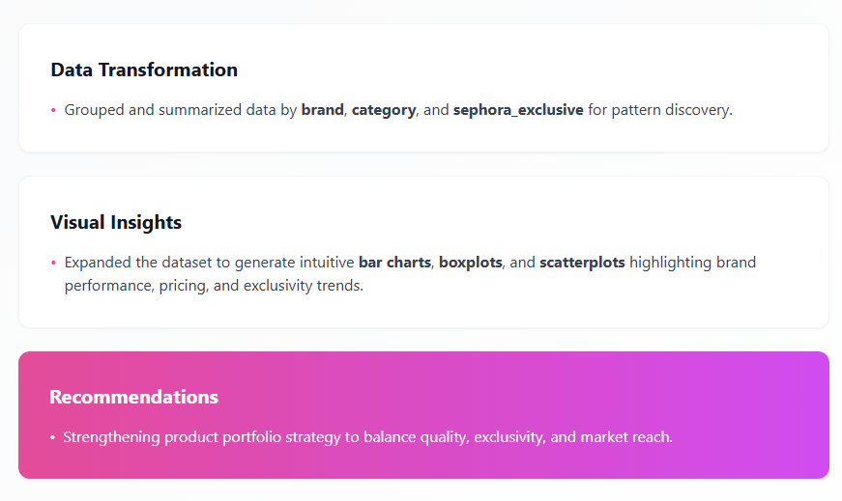
Data Exploration

Slide 10
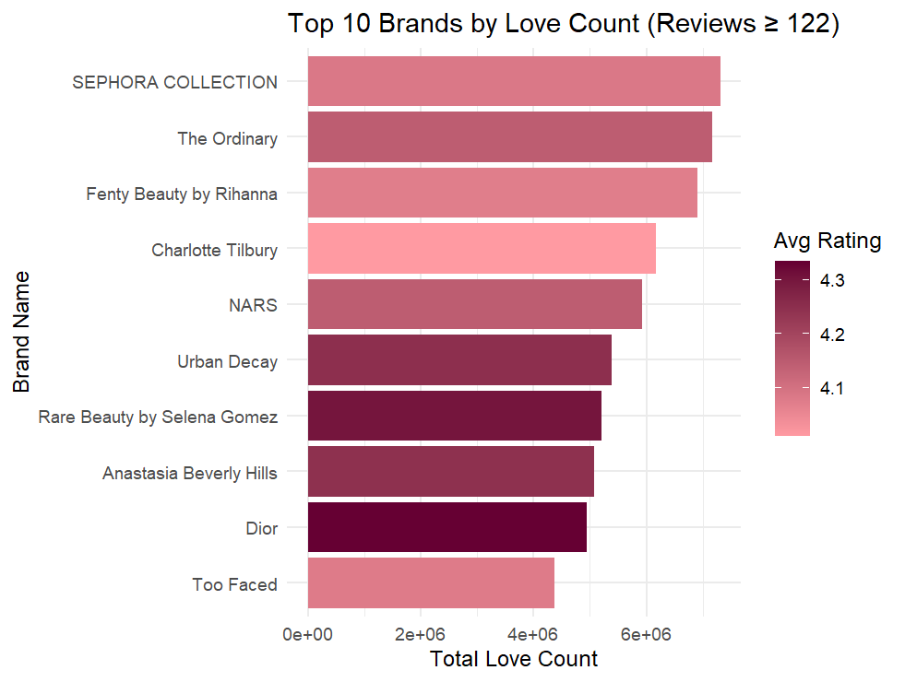

Top Performing Brands

Slide 11
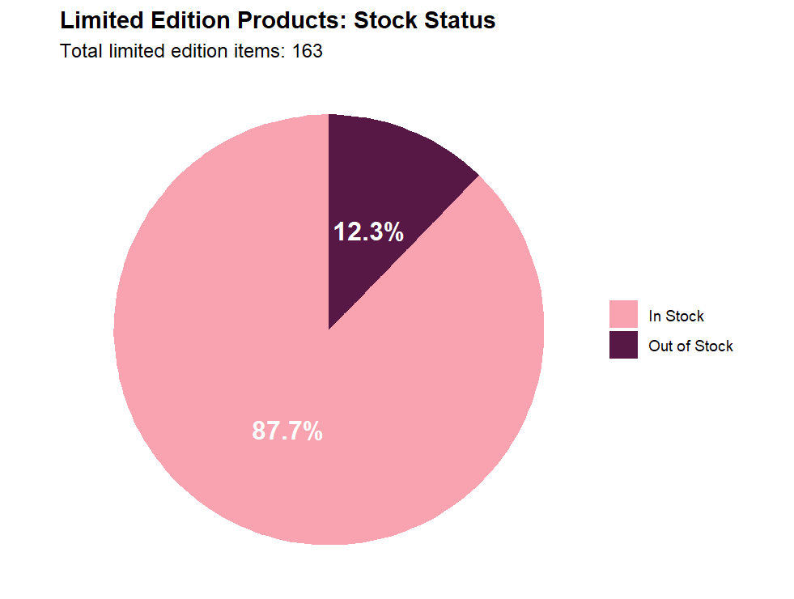
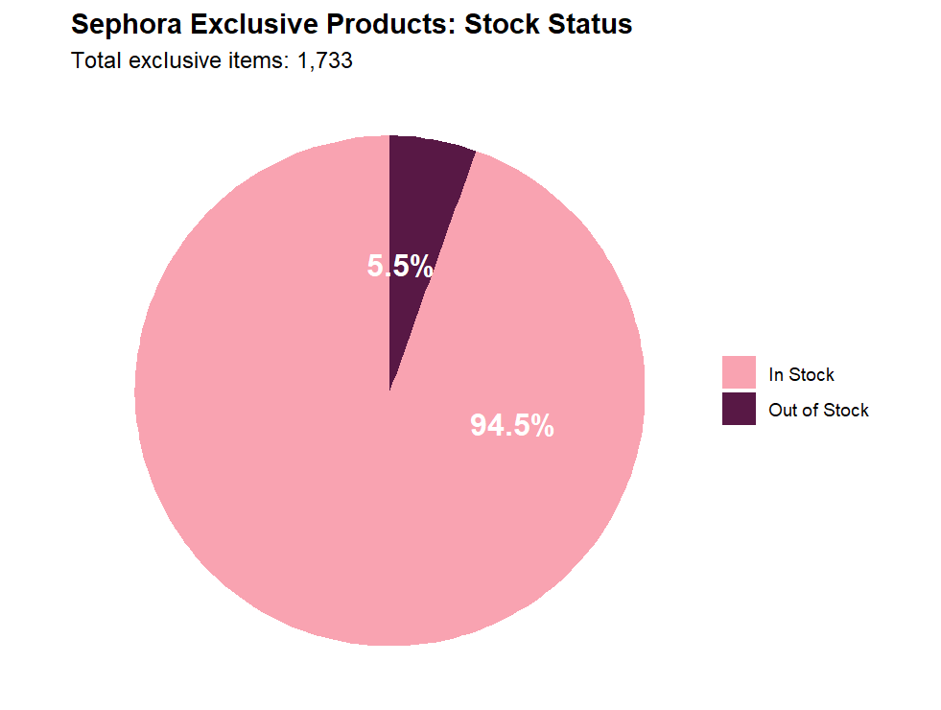

Inventory Management Insights

Slide 12
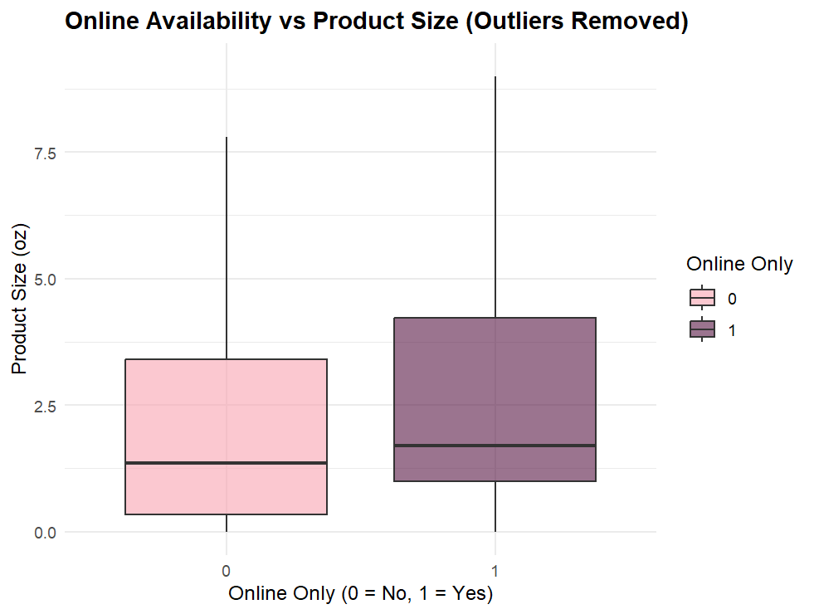

Digital Shopping Preferences

Slide 13
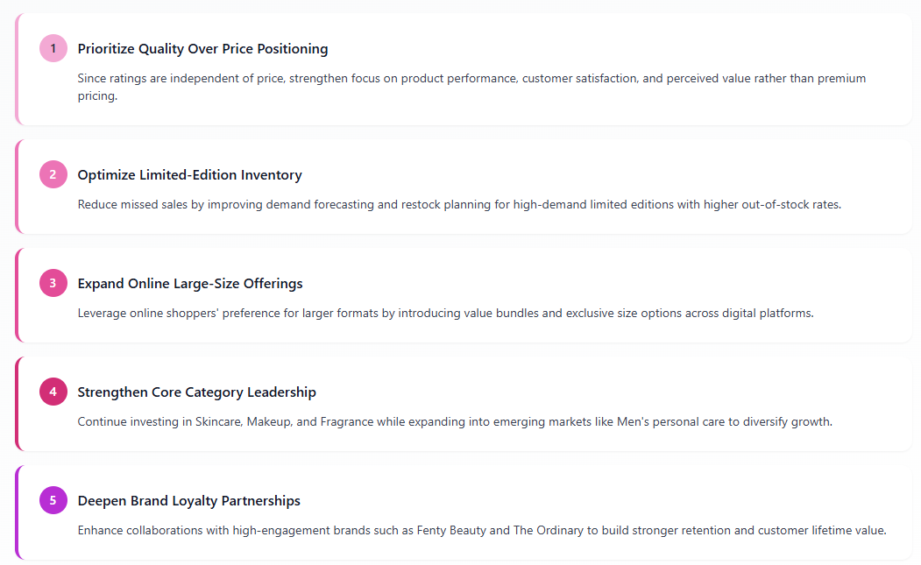
Strategic Recommendations

Slide 14


