Slide 1

Data Analysis of Disney+Hotstar

Slide 2
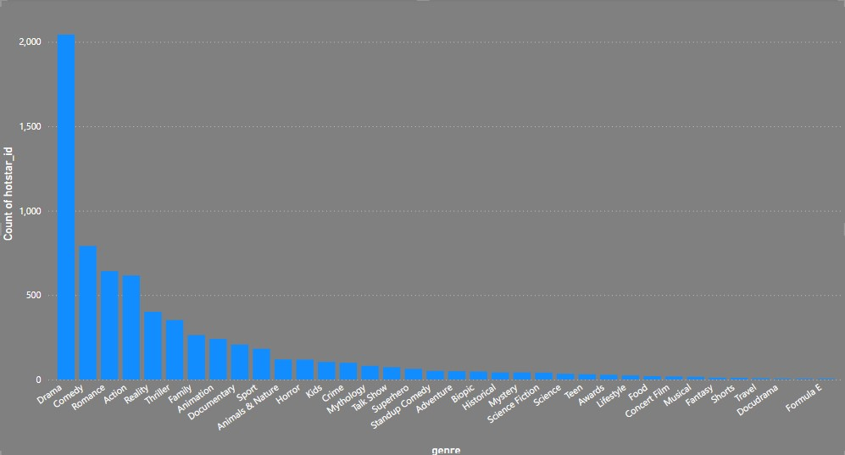
Distribution of Movies by Genre
Stacked Column Chart Of Movie count & Genre
From the above chart we can find the count of movies for each genre
In that more movies released in drama genre
Less more released in docudrama genre

Slide 3
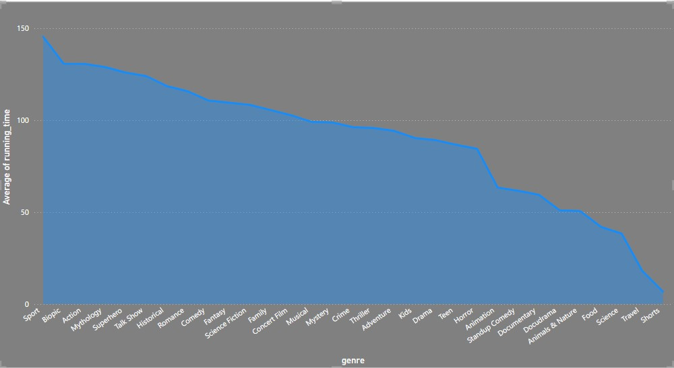
Average Running Time by Genre
Area Chart Of Running time & Genre
From the above chart we can find the average of running time for each genre
In that sports genre has more running time
Shorts genre has less running time

Slide 4
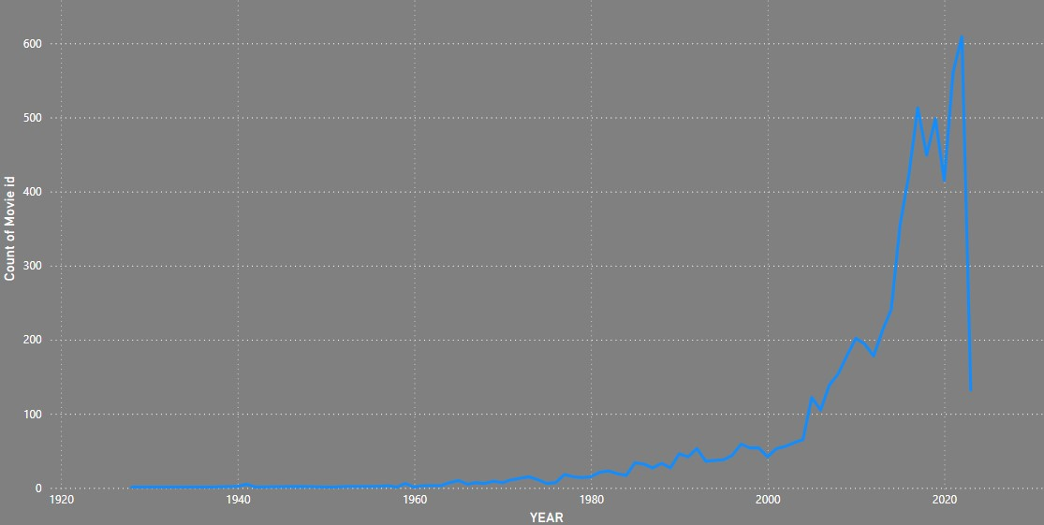
Movies Released Each Year
Line Chart Of Movie count & Genre
From the above line chart we can find the number of movies released each year.
In that more movie released in 2023 (609 movies).
Less movies released in 1960.

Slide 5
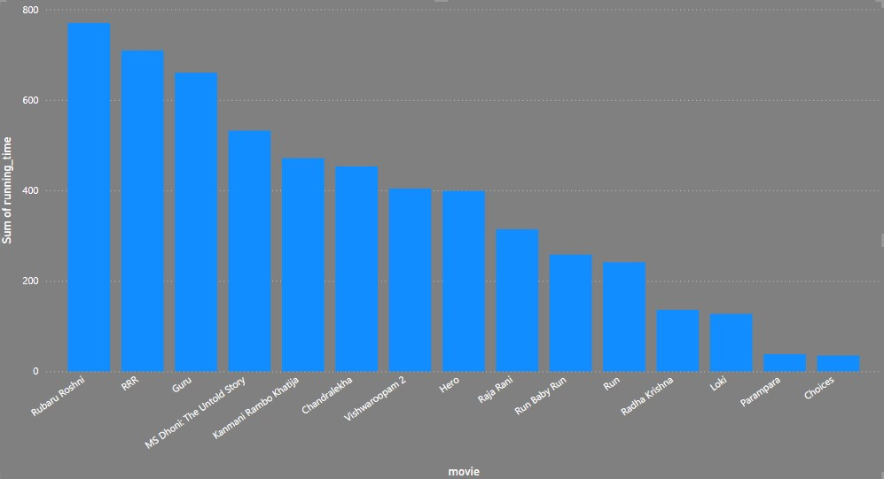
Top 10 Longest Movies
Stacked bar Chart of sum of Running time & Movies
From the above bar chat we can identify the top 10 longest movies based on running time.

Slide 6
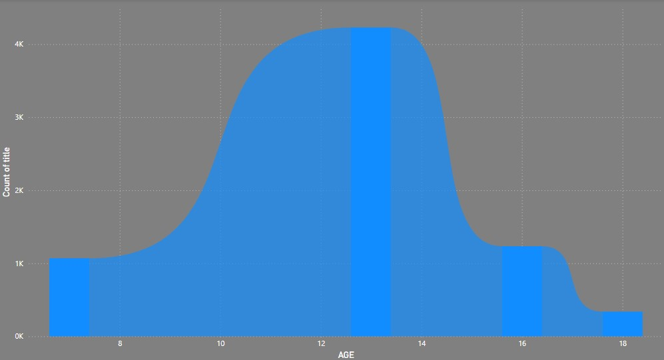
Movies by Age Rating
Ribbon Chart Of Movie & Age
From the above Ribbon chart we can see the distribution of movies by age rating.
In that people age between 12 to 14 are high .
People age above 18 are less .

Slide 7
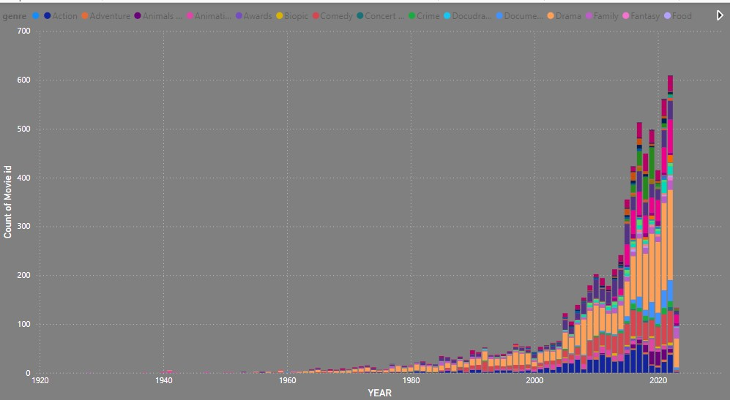
Count of Movies by Year and Genre
Stacked Column Chart Of Movie count & Genre
The stacked column chart shows the count of movies for each genre over the years
On looking on 2023 release 58 movies are from drama and 3 from comedy and sports each

Slide 8
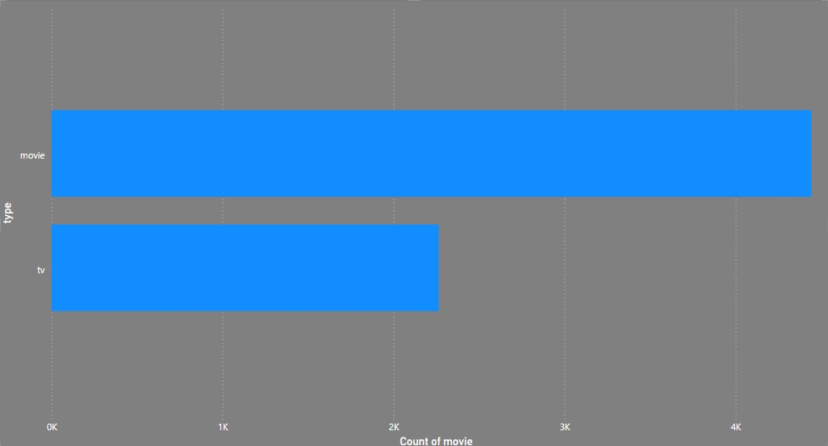
Most Common Movie Types
Clustered Bar Chart Of Movie count & Genre
From the above bar we can find the number of movies for each type In that
In that movies are high with 4443 .
And tv shows with 2264.

Slide 9
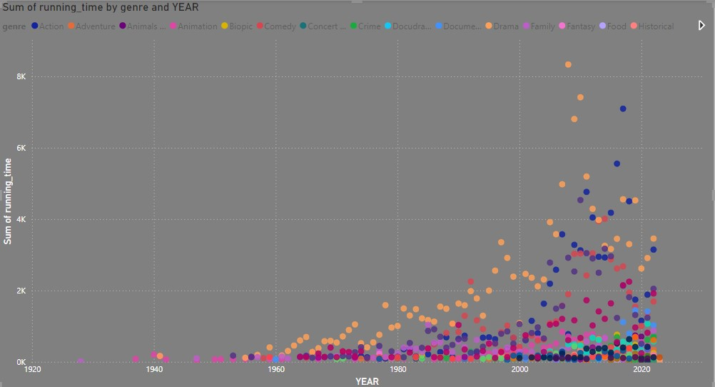
Correlation Between Running Time and Year
Scatter plot of Running time and year
scatter plot will explore the relationship between the running time of movies and their release year.

Slide 10
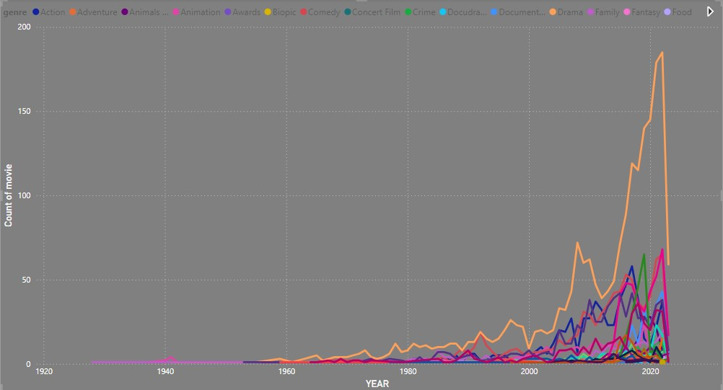
Genre Popularity Over Time
Line chart of Movie, Year and Genre
line chart to show how the popularity of different genres has changed over time.
Where popularity of drama genre were dramatically changed
In 1941 drama has less popularity (1) but in 2021 more movies were released in drama genre(179).

Slide 11
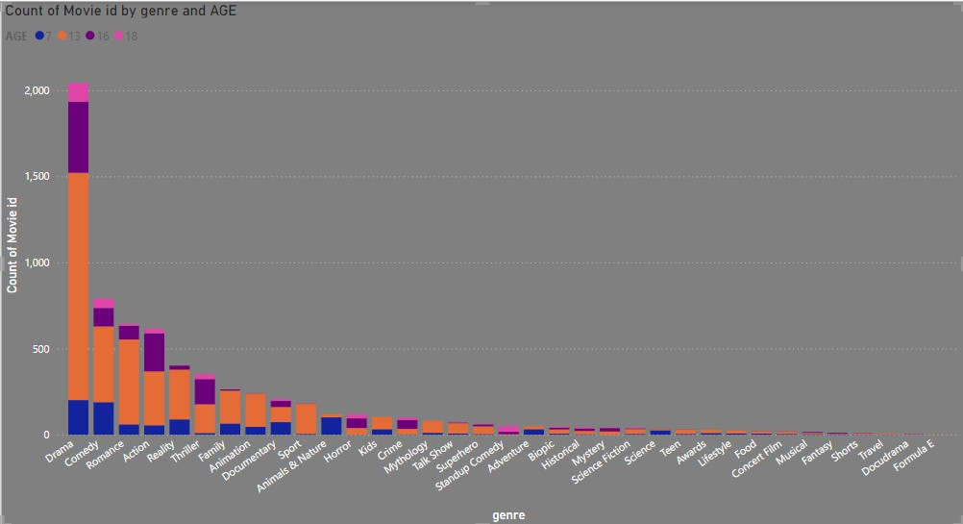
Movies by Genre and Age Rating
Stacked Column Chart Of Movie count & Genre with Age
Stacked column chart show the count of movies for each combination of genre and age rating.

Slide 12
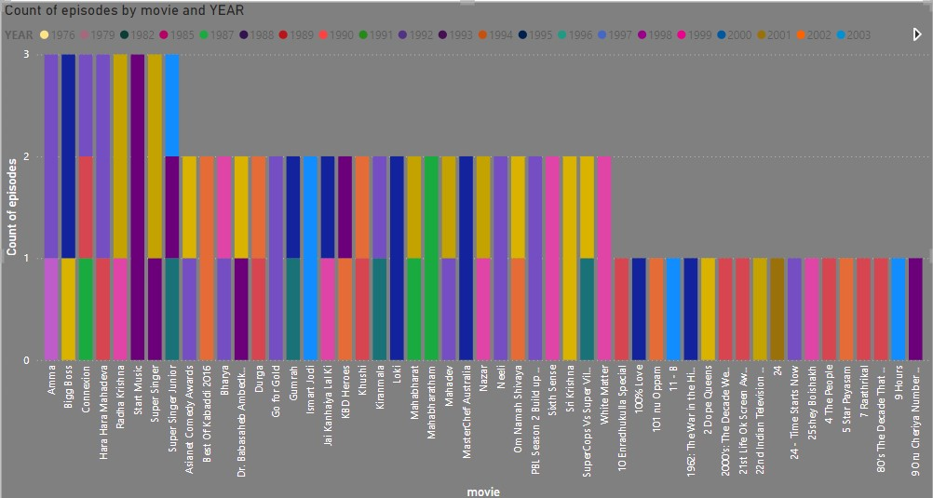
Movies with Maximum Episodes
Stacked Column of episodes & movie with year
The stacked column chart shows the movies with maximum number of episodes.
In movie name AMMA has more episodes (3)

Slide 13
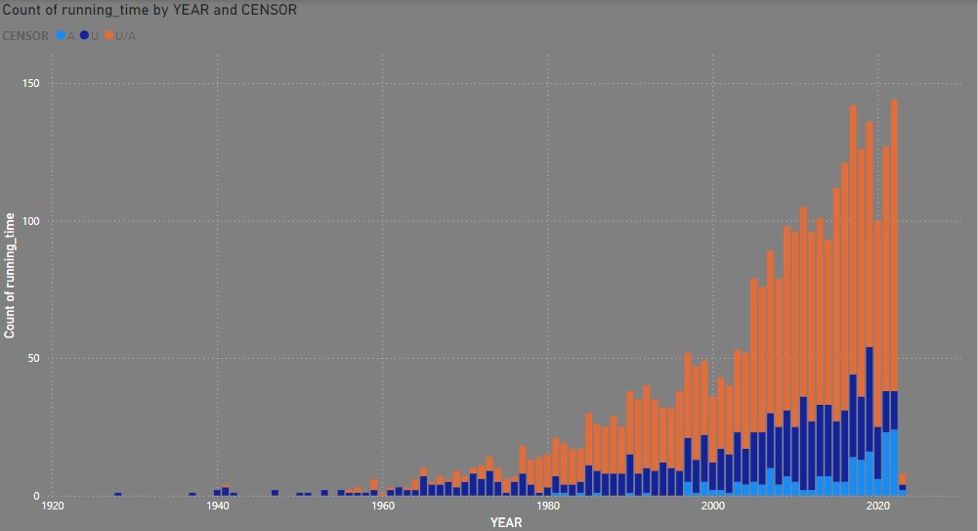
Distribution of running time
Scatter plot of Running time & year with censor
The above stacked column chat shows the distribution of running times for all movies with their censor certificates .

Slide 14
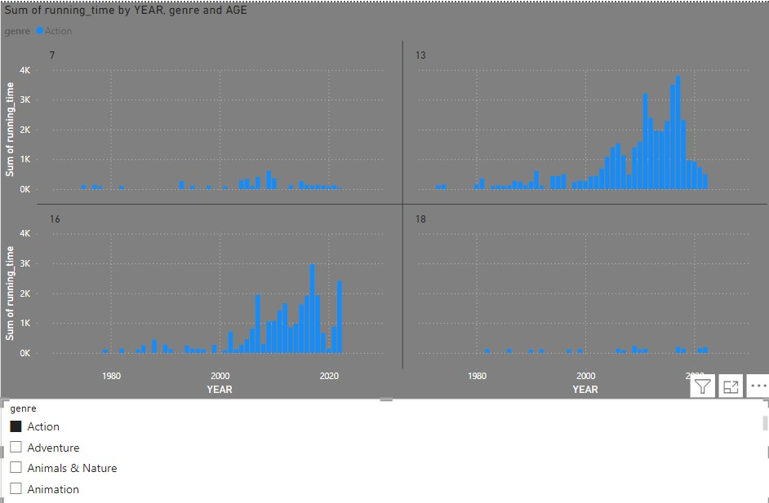
Analysis of Action Genre
Stacked column chart of Running time with Year, Genre and Age
The stacked column chart shows the analyze of action genre with various attributes .

Slide 15
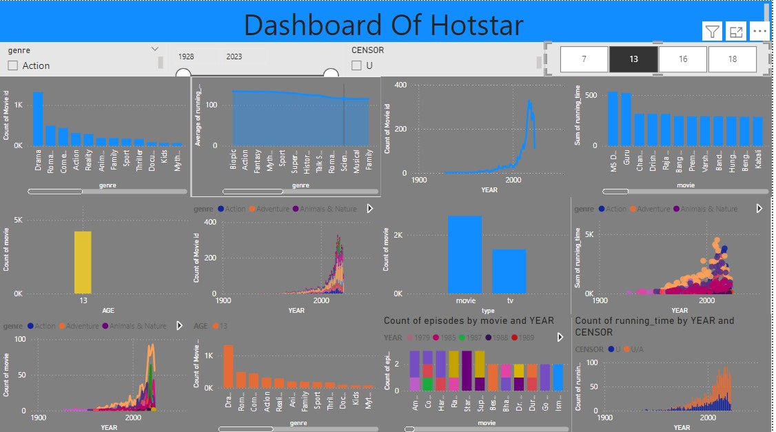
Dashboard of Disney+hotstar

Slide 16
Thank you

