Slide 1
Resource report EECS 597
GloVe: Global Vectors for Word Representation

Slide 2
How do we generally represent a word ?
In vector space, we generally represent word as “one hot vectors”
Possible problems with this representation:
Dimensionality: Speech: 20K, Oxford dictionary: 180K
No information gain about similarity between terms: King and queen; frog and frogs
Rework on addition of new words
If we have ten words in our vocabulary then their ‘one-hot’ representation is
King = [0 0 0 0 0 0 0 1 0 0 ]

Slide 3
Solution
Co-occurrence matrix: is the frequency matrix of word combinations in a given window size occurring in a document/corpus
Example:
The words around ‘economy’ tell us more about ‘economy’ then its one-hot vector representation
“You shall know a word by the company it keeps”
- J.R. Firth
While the overall economy looks strong, economists say there are good reasons that…
When the economy entered recession, the workhouse conditions had to worsened…

Slide 4
Co-occurrence matrix – one word window ex.
Corpus :
What are you studying?
I am studying NLP
I like NLP
Problem solved: Similarity between terms
Problem left: Dimensionality reduction; rework on addition of terms
 | What | Are | You | Studying | I | am | NLP | like
What | 0 | 1 | 0 | 0 | 0 | 0 | 0 | 0
Are | 1 | 0 | 1 | 0 | 0 | 0 | 0 | 0
You | 0 | 1 | 0 | 1 | 0 | 0 | 0 | 0
Studying | 0 | 0 | 1 | 0 | 0 | 1 | 1 | 0
I | 0 | 0 | 0 | 0 | 0 | 1 | 0 | 1
am | 0 | 0 | 0 | 0 | 1 | 0 | 0 | 0
NLP | 0 | 0 | 0 | 1 | 0 | 0 | 0 | 1
like | 0 | 0 | 0 | 0 | 1 | 0 | 0 | 0

Slide 5
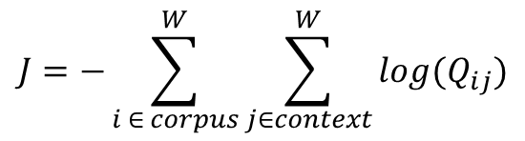
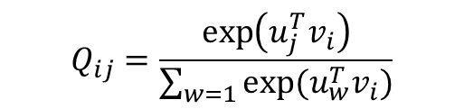
Solution to dimensionality reduction
SVD
Computationally expensive
Rework on addition of new words
Word2Vec
Predict words in a given window of every ‘center’ word
Probability that word j appears in the context window of word i:
Minimize the global cross-entropy loss
Drawbacks:
Normalizing Q is an expensive task
$$Q_{ij}=\frac{\exp\left(u_{j}^{T}v_{i}\right)}{\sum_{w=1}{exp⁡(u_{w}^{T}v_{i})}}$$
$$J=−\sum_{i ∈ corpus}^{W}{\sum_{j∈context}^{W}{log{(Q}_{ij})}}$$

Slide 6
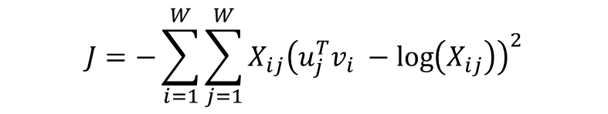
GloVe
Changed the objective function to:
Advantages:
Training only on the non-zero elements of the co-occurrence matrix
Scalable to huge corpus
Produces vector subspace with meaningful sub-structures
Faster to train in comparison to word2Vec
Outperforms word2vec on the word analogy task, given the same hyperparamters
Usage:
Plug in & play: Download trained word vectors from http://nlp.stanford.edu/projects/glove/
Various options available:
Dataset used for pre-training the word vectors (Wikipedia 2014; Common crawl; twitter)
Dimension of the word vectors (25d; 50d; 100d; 200d; 300d)
$$J=−\sum_{i=1}^{W}{\sum_{j=1}^{W}{X_{ij}{\left(u_{j}^{T}v_{i} −\log\left(X_{ij}\right)\right)}^{2}}}$$

Slide 7
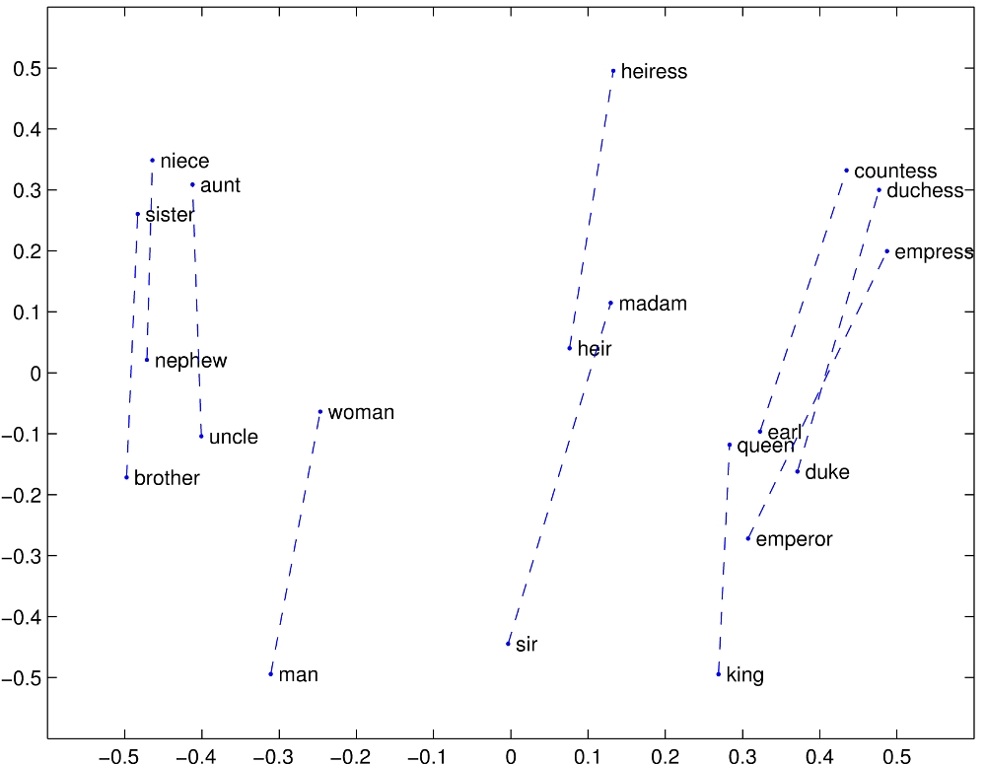
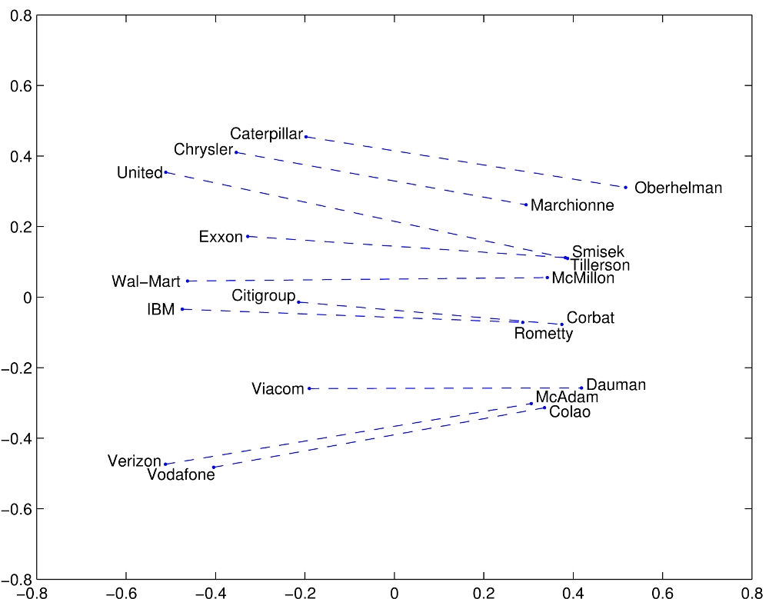
GloVe Visualisations: word vector analogies
The dimension of all the word vectors is reduced to 2 for visualisation
a:b :: c: ?
Brother:sister :: uncle:?
*These images are taken from http://nlp.stanford.edu/projects/glove/

Slide 8
GloVe vs. other techniques
*Source: http://nlp.stanford.edu/pubs/glove.pdf

