Slide 1
Project Details
Problem statement Title :Help Accident
Problem Statement Type :Student innovation
Team Name :Amigos_2020
Team Leader Name :R.Akash
Category :Software
College Code :VMEG

Slide 2
ABOUT
Ever wondered if you can do something about saving lives.....and it doesn't have to require any initiative but only a little help whenever necessary.
Passing through his daily schedule, an individual might come across something really heart wrenching.....an accident.....We aim to serve this purpose so that one could be free from the regret "I coundn't help..".

Slide 3
The Idea..
It is well known of the situation in the hospitals that a victim is not given proper medical attention until the completion of the required formalities...being specific....Money..It is therefore required for the family to arrive at the hospital and fulfil the required formalities.
A recent survey justifies the situation...50% of the accidents are being Fatal only due to the delay of medical attention.This is quite considerable which is to be worked on.

Slide 4
How simple is this going to be ?
Well.. all you have to do is message the vehicle's(met with accident) registration number to a predetermined number(also provided as a default saved contact) in order to generate SMS alerts to nearby ambulance services and the vehicle holder's family members which is considered necessary for the medical formalities to proceed.

Slide 5
We also include...ML concepts..
Most of the accidents occur during nights.Here we use Surveillance cameras to help out victim(who met with accident).We already have the technology to detect vehicle registered number while in travel.
Using Machine Learning ,we train the Surveillance cameras with similar sample images of accidents.By which,Surveillance cameras automatically detect vehicle registered number and generates SMS alert and Location to nearby ambulance services and the vehicle holder's family members .

Slide 6
Requirements specification
We plan to make this service impeccably simple and ensure availabilty to every individual trying to help.
Every mobile phone(doesn't have to be a smartphone) user has access to this service through basic SMS services typically available from any mobile phone till date.
Primarily this service would require the updation of database for the phone numbers of the the family through various means.

Slide 7
Cost estimations
This service is certain to be very inexpensive as it would only require a web server to recieve and send message alerts and an SMS service provider(many to choose from) to which the costs can be negotiated when incorporated at a higher level of use and are also likely to subsidize the service..

Slide 8
Technology Stack :-
Hyper Text Markup Language(HTML)
Cascading Style Sheets(CSS)
PHP
Java Script(JS)
MySql
ML concepts(Python)

Slide 9
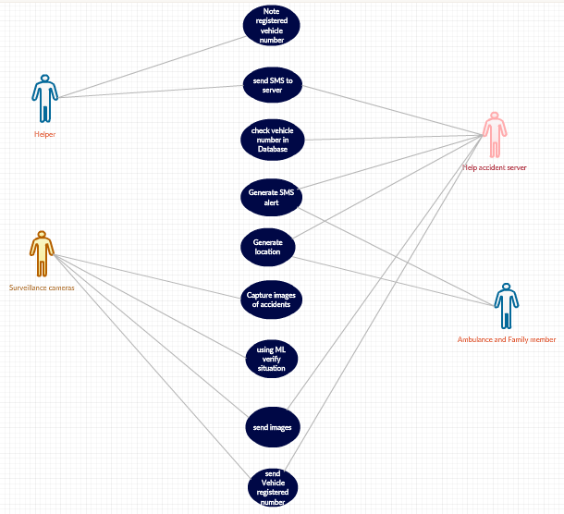
UML for Basic features:

