Slide 1



Workforce Analytics & Utilization Dashboard
Business Intelligence Case Study
Tools Used:
Power BI | Python | DAX | Data Analytics
Prepared By:
Akash Kumar

Slide 2
Business Problem Statement
Business Context
Organizations often struggle to monitor workforce productivity, employee utilization, overtime trends and workforce health across departments.
Lack of centralized workforce analytics can lead to operational inefficiencies, burnout risks and poor resource planning.
Key Challenges
Limited visibility into workforce utilization
Difficulty identifying overutilized and underutilized teams
Lack of proactive attrition and burnout indicators
Inefficient workforce allocation and planning
Inability to track productivity trends over time
Project Objective
Build an interactive workforce analytics solution to monitor productivity, utilization, employee health, and operational efficiency through KPI-driven dashboards and business insights.

Slide 3
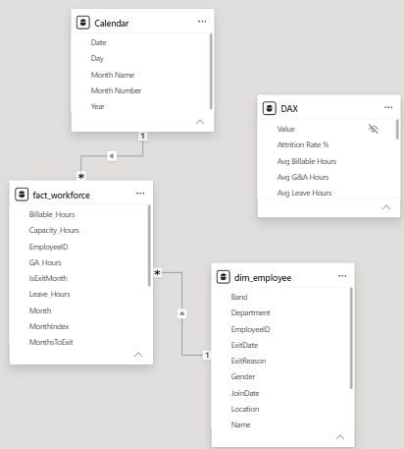
Dataset Overview
Dataset Summary
Workforce dataset representing approximately 10,000 employees.
Historical workforce activity spanning 2 years
Employee master data combined with monthly utilization records
Dataset designed to simulate enterprise workforce operations
Key Workforce Metrics
Billable Hours, Non-Billable Hours, Leave Hours, G&A Hours, Overtime Hours, Utilization %, Performance Rating, Attrition Risk Indicators and so on.
Data Model
The solution follows a star schema model consisting of:
Employee Master Dimension Table
Monthly Workforce Fact Table
Date Dimension Table
Note: Relationships were established to support time intelligence and KPI-driven analytics.

Slide 4
Project Approach & Architecture
Project workflow
1. Data Collection & Integration
2. Exploratory Data Analysis using Python
3. Data Modelling & KPI Development in Power BI
4. Dashboard Design & Interactive Reporting
5. Business Insight Generation & Recommendations
Tools & Technologies
Python & Pandas → Exploratory Data Analysis
Matplotlib → Trend & Statistical Visualization
Power BI → Dashboarding & Business Intelligence
DAX → KPI Calculations & Time Intelligence
Star Schema Modeling → Scalable Analytical Structure
Raw Data
Python EDA
PBI Model
DAX KPIs
Visualization
Business Insights

Slide 5
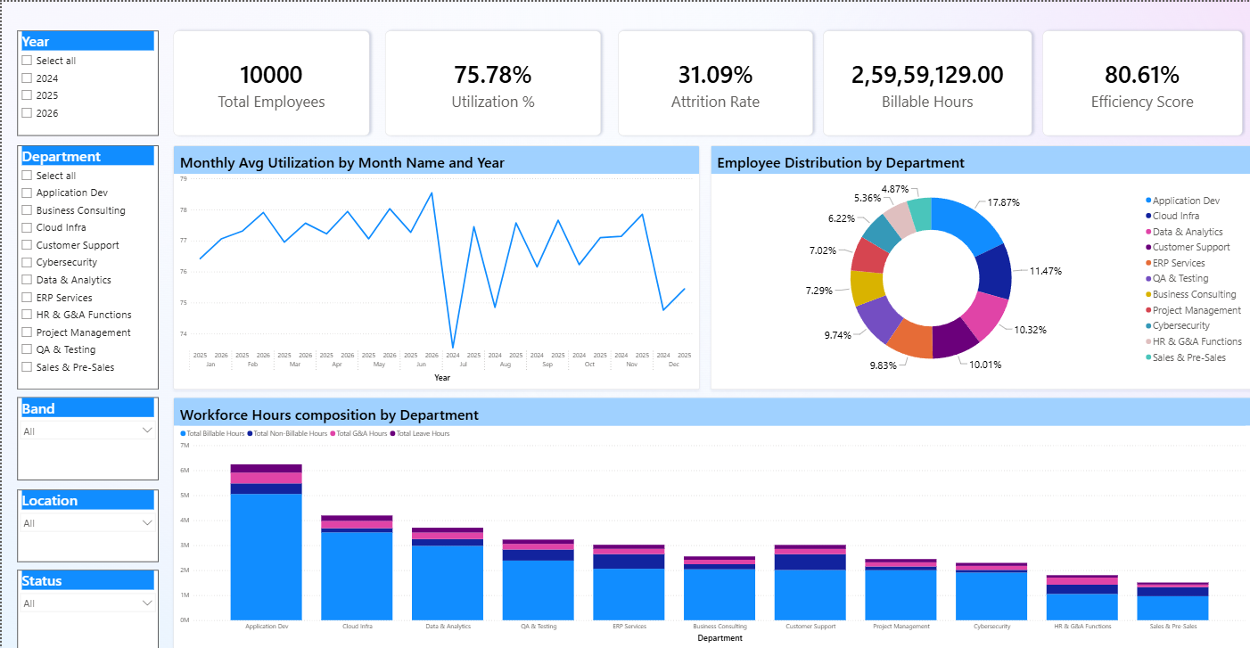
Executive Dashboard
Key Executive KPIs
Workforce Utilization Monitoring
Billable vs Non-Billable Analysis
Overtime & Productivity Tracking
Workforce Capacity Visibility
Department-Level Performance Insights
Interactive Time-Based Trend Analysis
Business Value Delivered
The dashboard enables leadership teams to monitor workforce productivity, identify operational inefficiencies and proactively manage workforce performance.

Slide 6
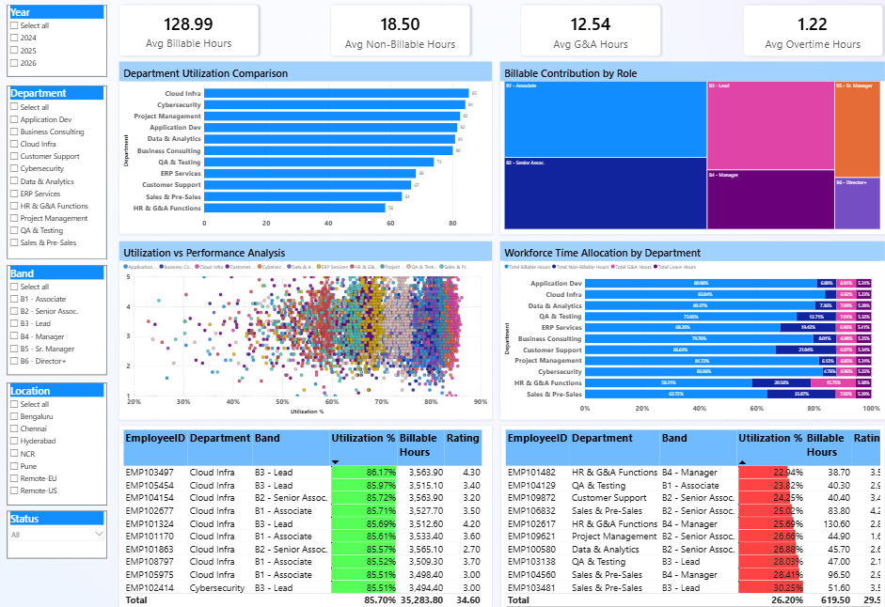
Productivity Analytics
Key Productivity Insights
Significant utilization variation observed across departments
Top-performing teams demonstrated consistently high billable contribution
Certain business units showed lower utilization efficiency, indicating resource optimization opportunities
Overtime concentration identified in highly utilized operational teams
Productivity trends highlighted workforce allocation imbalance
Analytical Focus Areas
Top N / Bottom N Department Analysis
Workforce Utilization Monitoring
Overtime Impact Assessment
Billable Efficiency Tracking
Department-Level Trend Comparison

Slide 7
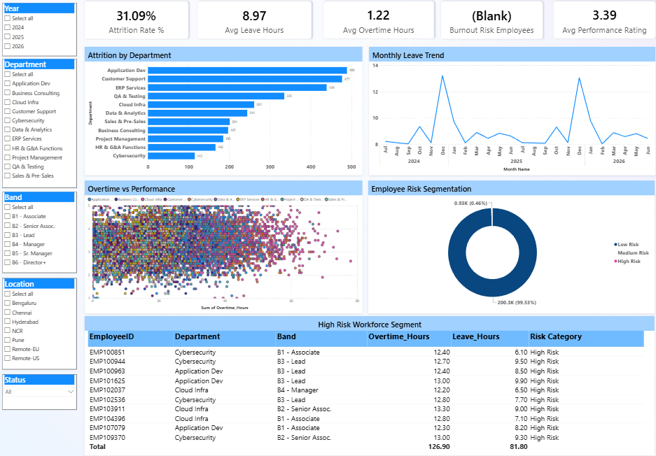
Attrition & Workforce Health
Key Workforce Health Insights
Elevated overtime patterns identified across highly utilized teams
Increased leave trends may indicate workforce fatigue concentration
Certain employee groups demonstrated higher attrition risk indicators
Workforce health metrics revealed potential operational pressure zones
Sustained overtime exposure may negatively impact long-term productivity
Business Impact
The analysis enables proactive workforce management by helping leadership identify burnout risks, optimize workforce planning, and improve employee retention strategies.

Slide 8
Key Business Insights
Workforce Utilization
High variation in workforce utilization was observed across departments, indicating workload imbalance and resource optimization opportunities.
Productivity Trends
Top-performing departments consistently demonstrated higher billable contribution and stronger utilization efficiency compared to underperforming business units.
Workforce Health
Sustained overtime exposure combined with elevated leave trends suggested potential burnout concentration within highly utilized employee groups.
Strategic Risk Indicators
Attrition indicators and workforce imbalance patterns highlighted the need for proactive workforce planning, capacity optimization, and employee retention initiatives.

Slide 9
Strategic Recommendations
Optimize Workforce Allocation
Rebalance workload distribution across departments to reduce utilization imbalance and improve operational efficiency.
Monitor High Overtime Exposure
Implement proactive monitoring for employee groups with sustained overtime concentration to reduce burnout risk.
Strengthen Employee Retention
Introduce workforce wellness and employee engagement initiatives for high-risk operational teams.
Enhance Workforce Intelligence
Leverage KPI-driven dashboards for continuous workforce monitoring, capacity planning, and leadership decision support.

Slide 10
Future Enhancements
• Predictive Attrition Modeling using Machine Learning
• Workforce Demand Forecasting & Capacity Planning
• Real-Time Data Integration using Cloud Pipelines
• Advanced Employee Sentiment & Engagement Analytics
• AI-Driven Workforce Risk Scoring
• Automated Executive Reporting & Alerts
Project Outcome
The project successfully demonstrated how workforce analytics and business intelligence can support data-driven decision making, operational efficiency, and proactive workforce management.
Thank You

