Slide 1

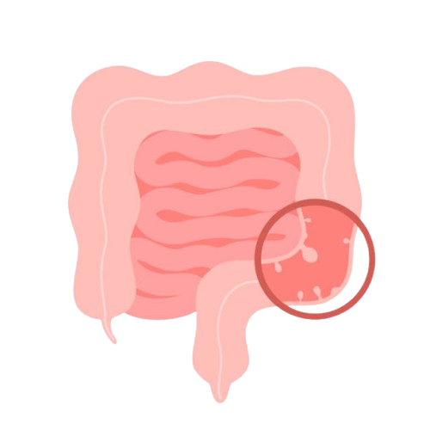
Colon Cancer Detection
Akash Raj (229301533, VI-CSE)
Sainyam Acharya(229301524, VI-CSE)
Manipal University Jaipur
Guide: Dr. Satyabrata Roy
February 2025

Slide 2

Problem Statement
Develop a detection model using YOLO for polyp detection and DenseNet for feature extraction, improving early colon cancer detection with higher accuracy, speed, and reliability.

Slide 3
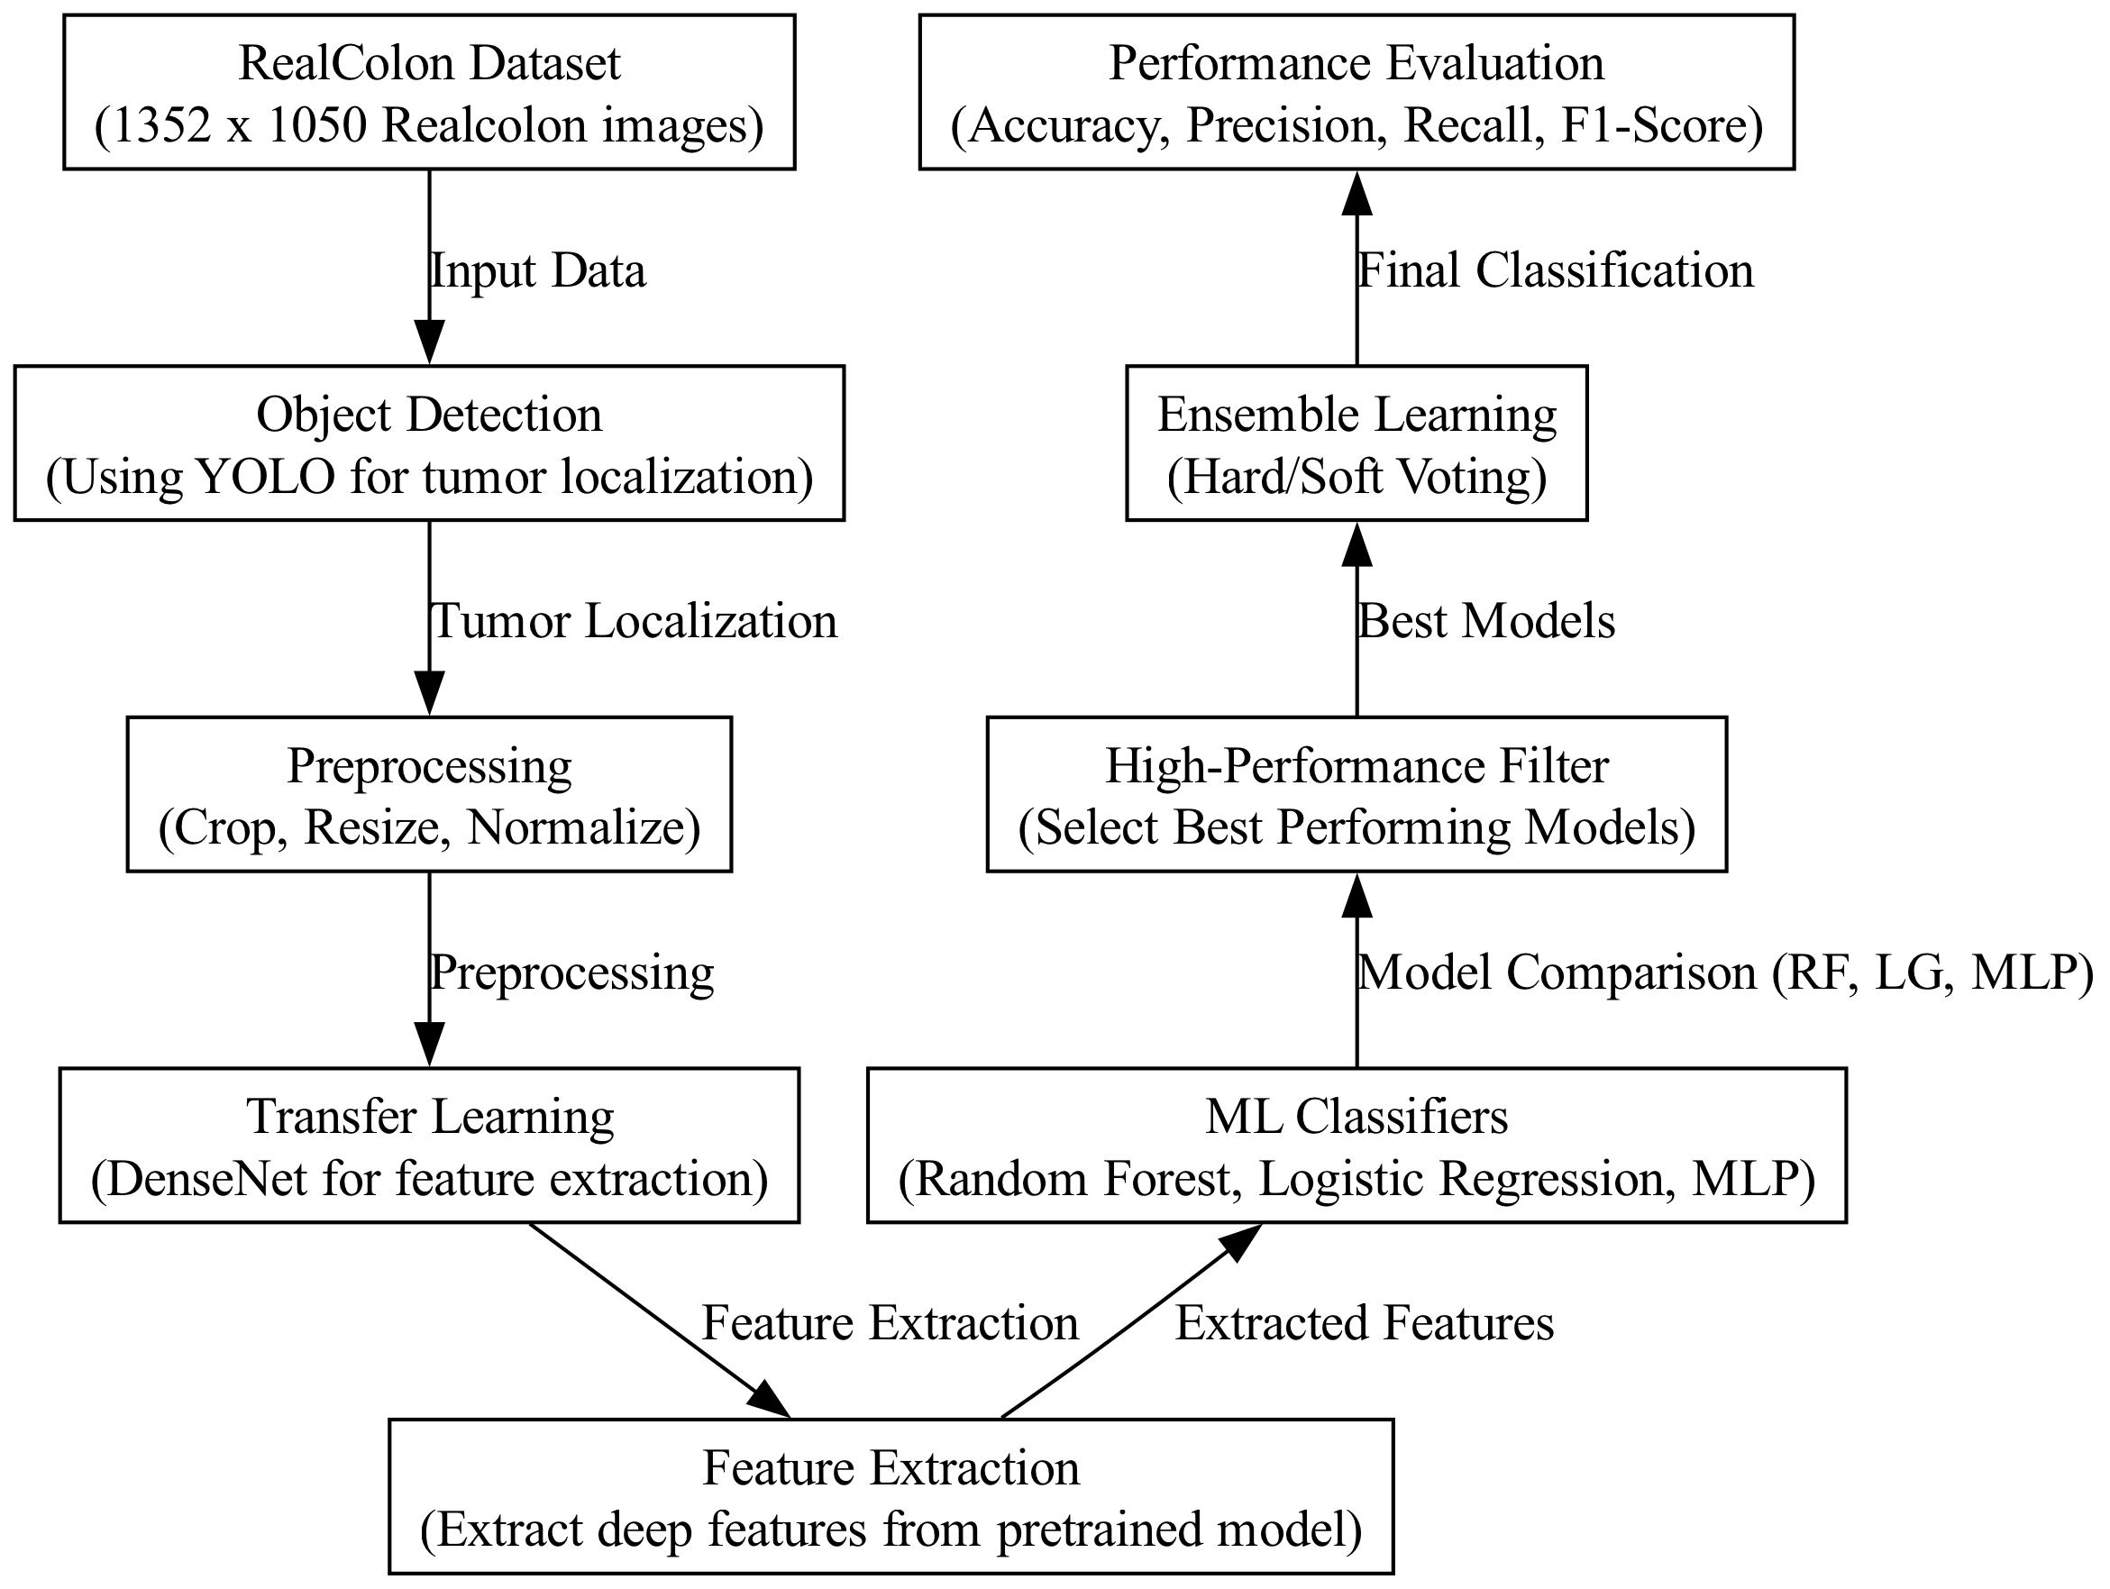
Flowchart

Slide 4
Flowchart

Slide 5
Dataset - Realcolon
Overview
60 Colonoscopy recordings from 4 clinical studies (001-004)
2.75M frames (2757723 total frames)
Resolution: 1352 x 1050
Total Size: 880.78 GB
Research Institution(s) - Cosmo Intelligent Medical Devices
https://doi.org/10.1038/s41597-024-03359-0

Slide 6
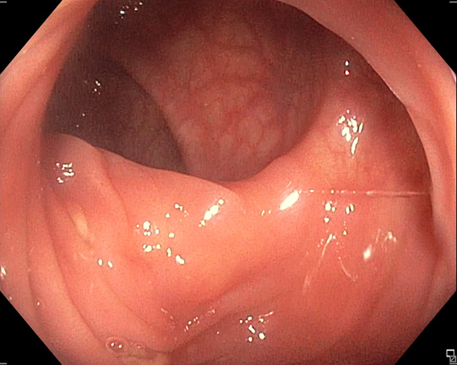
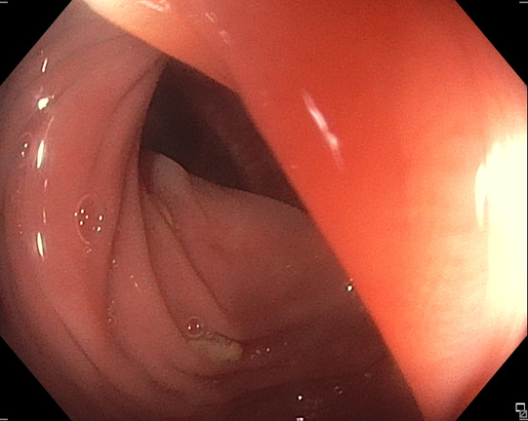
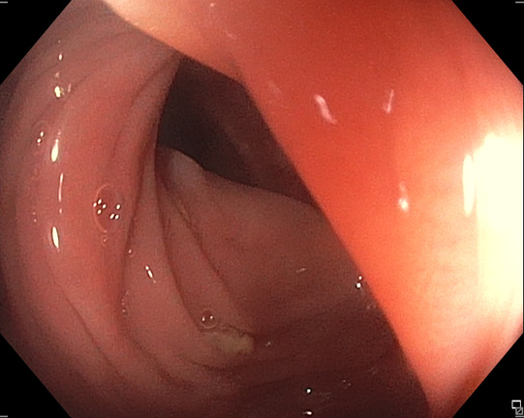
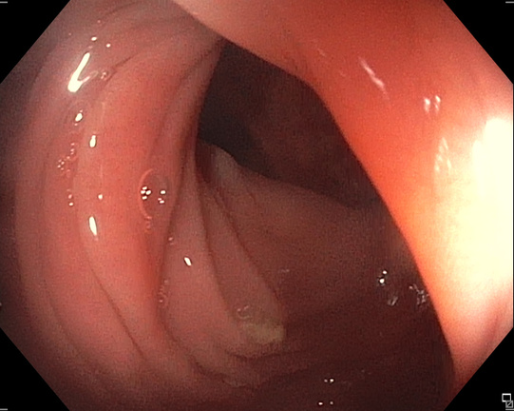
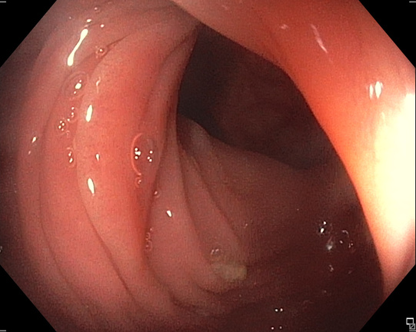
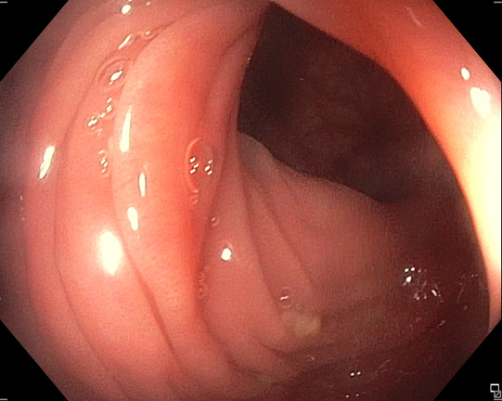
Dataset - Preview
Continous Video Frames (2.75 M)

Slide 7
Flowchart

Slide 8
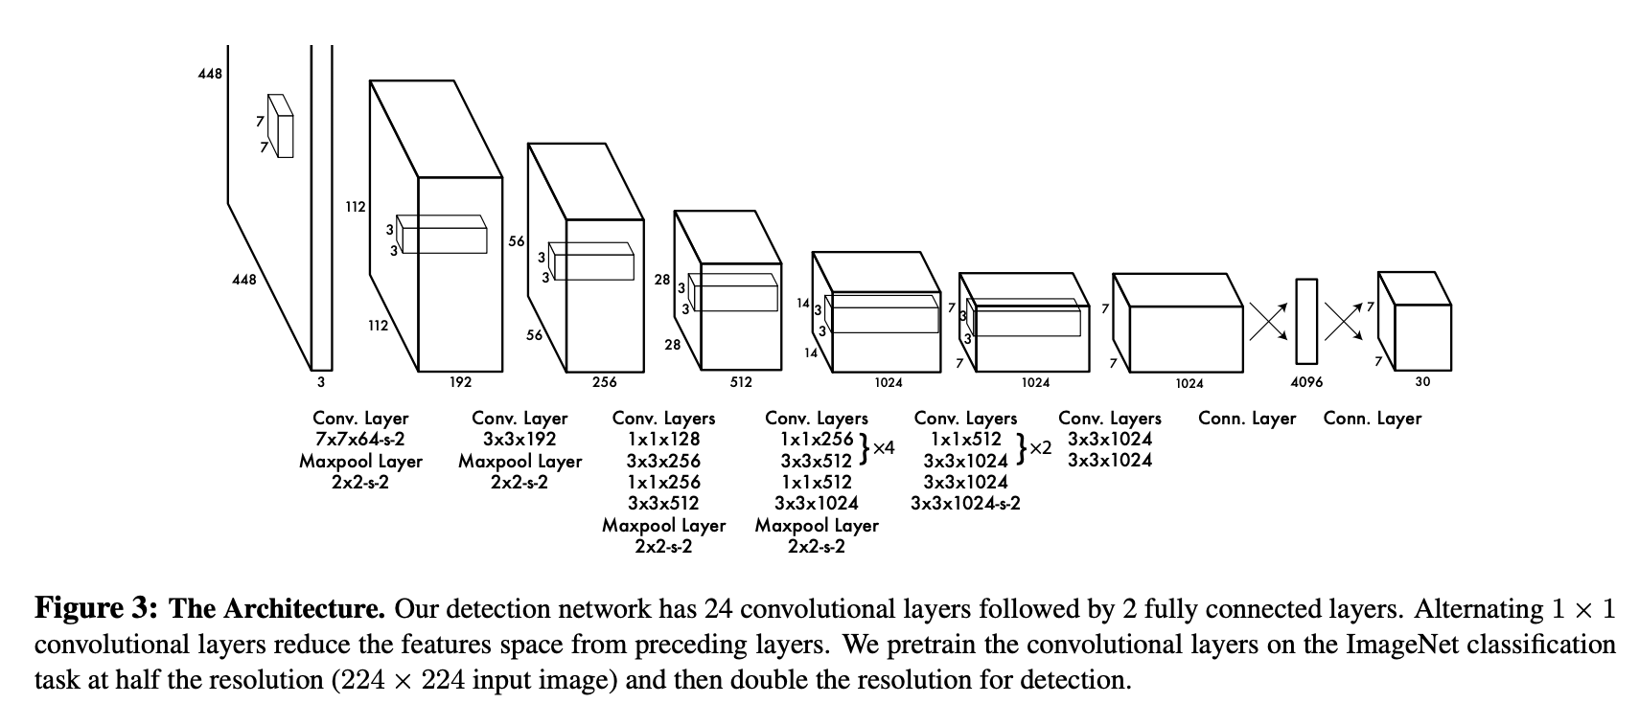
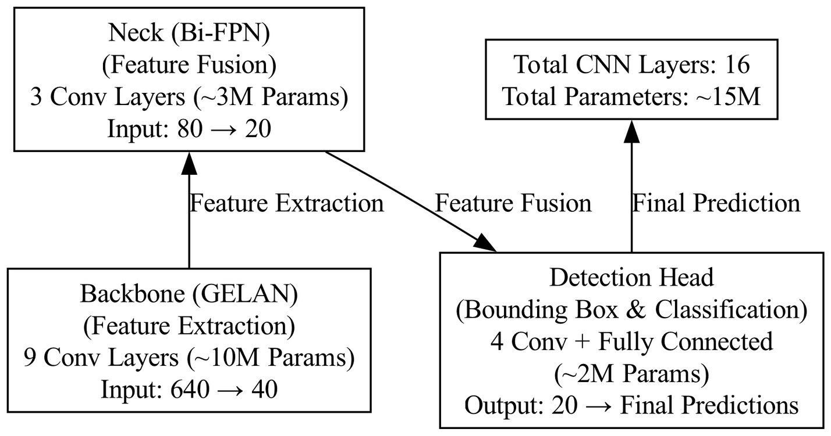
YOLO

Slide 9
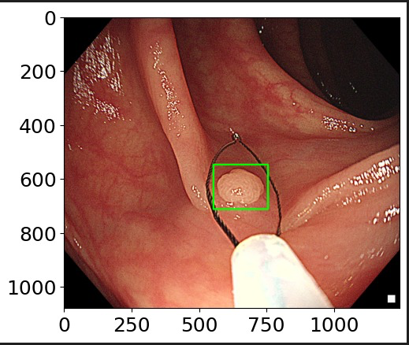
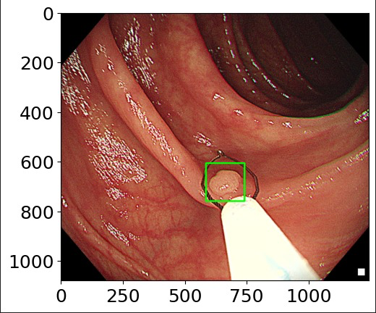
YOLO

Slide 10
Flowchart

Slide 11
Preprocessing
Cropping: Remove unnecessary regions to focus on the tumor.
Resizing: Standardize image dimensions for uniform input.
Normalization: Scale pixel values for better model performance.
Why is it Important?
Enhances image quality for deep learning models.
Reduces noise and improves feature extraction.
Standardizes data for efficient training.

Slide 12
Flowchart

Slide 13
Transfer Learning
Taking pretrained model and customize for Polyps
Gives better result
Using DenseNet
Accuracy (Medical Images)
Computational Efficient

Slide 14
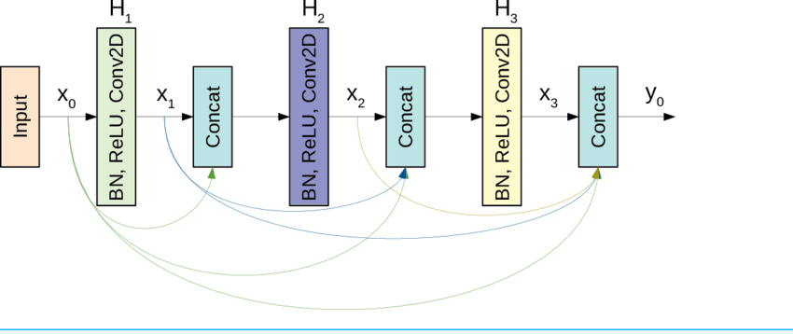
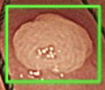
Transfer Learning (DenseNet)

Slide 15
Flowchart (Remaining Work )

Slide 16
CONCLUSION
The proposed workflow ensures an efficient Cancer detection system.
YOLO detects polyps, focusing on tumor-affected regions.
Preprocessing reduces computational load by removing irrelevant parts.
DenseNet extracts deep features, improving classification accuracy.
ML classifiers & ensemble learning optimize performance.
A structured approach enhances efficiency, accuracy, and clinical applicability.

Slide 17
DenseNet Architecture
Cropping: Remove unnecessary regions to focus on the tumor.
Resizing: Standardize image dimensions for uniform input.
Normalization: Scale pixel values for better model performance.
Question ?

Slide 18
DenseNet Architecture
Cropping: Remove unnecessary regions to focus on the tumor.
Resizing: Standardize image dimensions for uniform input.
Normalization: Scale pixel values for better model performance.
Thank You

