Slide 1
Milestone 2 Progress Report
Real-Time Human Activity Classification Using CNN and LSTM/Transformer
Akash Rana

Slide 2
1. Where I Am
Implemented first version using ConvLSTM2D layers
Model runs successfully but needs optimization
Currently improving architecture and performance

Slide 3
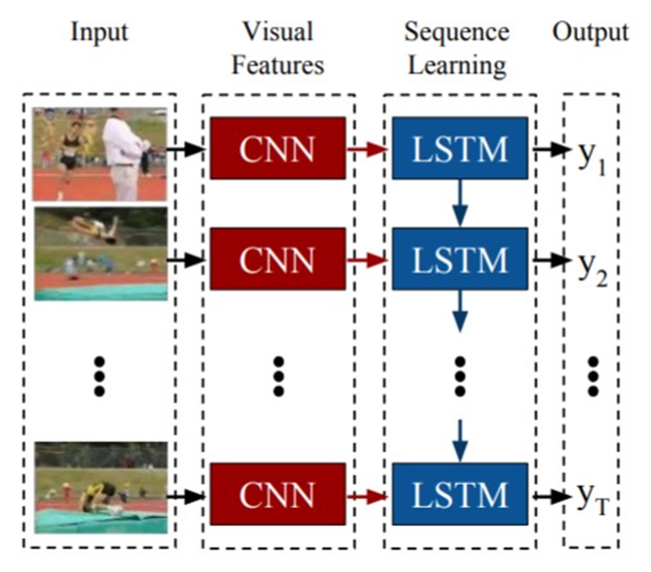

Slide 4
2. What I’ve Done So Far
Built ConvLSTM model for spatiotemporal learning
Integrated MaxPooling3D, TimeDistributed, Flatten, and Dense layers
Verified model structure and output
Began identifying and addressing performance issues

Slide 5
Model Architecture Summary
4 ConvLSTM2D layers with pooling and dense output
Output shape before dense layer: (None, 2880)
Dense layer outputs 4 activity classes
Total Parameters: 44,524

Slide 6
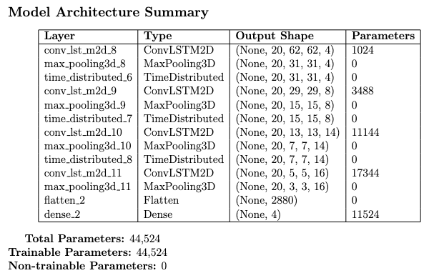

Slide 7
3. What I’ve Learned
ConvLSTM handles spatiotemporal data well
Requires significant computation resources
Learned importance of shape consistency
Realized modular approaches may be more efficient

Slide 8
4. Difficulties
Limited hardware for training deep models
Complex tuning of ConvLSTM architecture
Suboptimal initial performance
Long training times limiting experimentation

Slide 9
5. Future Plans
Explore LRCN approach (CNN + LSTM)
Try separate CNN and LSTM training
Use pretrained CNNs (e.g., ResNet, MobileNet)
Optimize for real-time inference and accuracy

Slide 10
6. Changes from Proposal
May Shift from ConvLSTM-first to modular CNN+LSTM
Transformer model postponed due to complexity
Focus now on efficiency, modularity, and scalability
Prioritizing models compatible with transfer learning

