Slide 1
Milestone 2: Hidden Markov Model for Smart Homes
Progress Report by Akash Rana

Slide 2
Overview
Goal: Build and apply an HMM from scratch
Application: Smart home activity recognition
Focus: Progress, challenges, future steps

Slide 3
HMM Implementation
Implemented Core Algorithms:
Forward-Backward
Baum-Welch
Viterbi
Result: Full HMM pipeline from initialization to decoding

Slide 4
Key Learnings
Transition, emission, and initial probabilities jointly model activity
Importance of structuring observation space (sensor data → activity)
Interdependence of HMM components for accurate inference

Slide 5
Dataset Challenges
Issue: Real-world data sourcing
Solution: CASA dataset selected
Next Steps: Preprocessing for consistent sensor events and valid time windows

Slide 6
Data Progress
Validation: Dummy data used for testing
Current Status: Real-world trials started, further cleanup needed
Need: Feature engineering aligned with smart home context

Slide 7
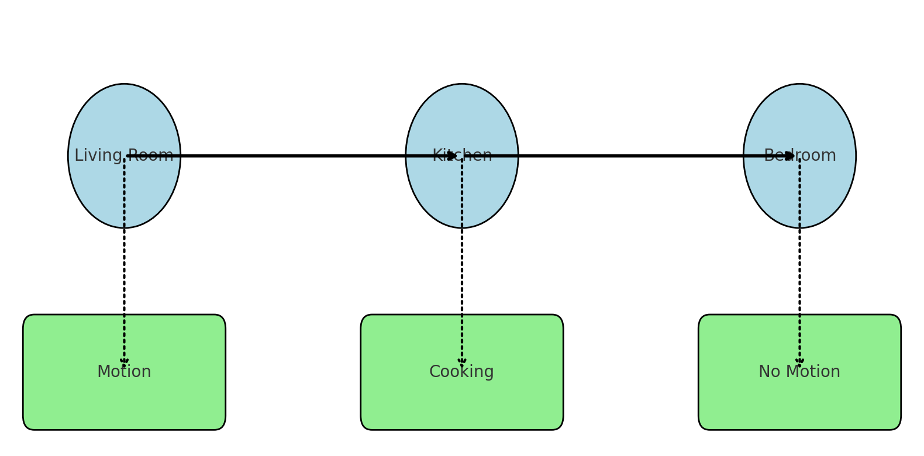
Hidden Markov Model

Slide 8
HMM Theory - Smart Home Mapping
HMM Element | Smart Home Meaning
-------------|---------------------
Hidden States (S) | Actual locations (e.g., kitchen)
Observations (O) | Sensor activities (e.g., motion)
Transition Prob. (A) | Move between locations
Emission Prob. (B) | Sensor reading given location
Initial Prob. (π) | Start location

Slide 9
Joint Probability Example
Given:
O = {Motion, Cooking, No Motion}
S = {Living Room, Kitchen, Bedroom}
Joint Probability:
P(O, S) = P(S1) × P(O1|S1) × P(S2|S1) × ...

Slide 10
Forward & Backward Algorithm
Forward (α): Likelihood up to time t
Backward (β): Likelihood after time t
Use: Combined for posterior inference

Slide 11
Expectation & Re-estimation
Posterior Prob (γ): Probability of state i at time t
Transition Prob (ξ): Probability of moving from i → j
Update Rules (Baum-Welch):
- π, A, B updated iteratively using γ and ξ

Slide 12
Viterbi Algorithm
Goal: Most probable sequence of hidden states
Approach:
- Recursively track max probability path
- Backtrack to decode final sequence

Slide 13
Future Plans
Train HMM on real-world data
Evaluate predictions vs. actual movements
Introduce Bayesian Networks (context-aware refinement)
Optimize parameters (e.g., smoothing, # of states)

Slide 14
Conclusion
Solid progress on HMM theory & implementation
Real-world integration in progress
Future work will focus on data refinement & predictive accuracy by implementing Bayesian Network

