Slide 1
Predictive Movement Modeling Using HMMs and DBNs Enhancing Automation Through Context-Aware Prediction -Akash Rana
Notes:
Good morning, everyone. Today, I'm going to talk about scaling laws for language model performance. This presentation is based on a research paper that explores how the performance of language models changes as we increase the model size, dataset size, and the amount of compute used for training.

Slide 2
Introduction & Motivation
Problem:
Smart homes require proactive automation (lighting, security, energy efficiency).
Challenges:
Complex user behavior, irregular routines, and periodic patterns.
Solution:
Predict user movements to enable context-aware automation.
Impact:
Energy savings, enhanced security, elderly care support.
Notes:
Good morning, everyone. Today, I'm going to talk about scaling laws for language model performance. This presentation is based on a research paper that explores how the performance of language models changes as we increase the model size, dataset size, and the amount of compute used for training.

Slide 3
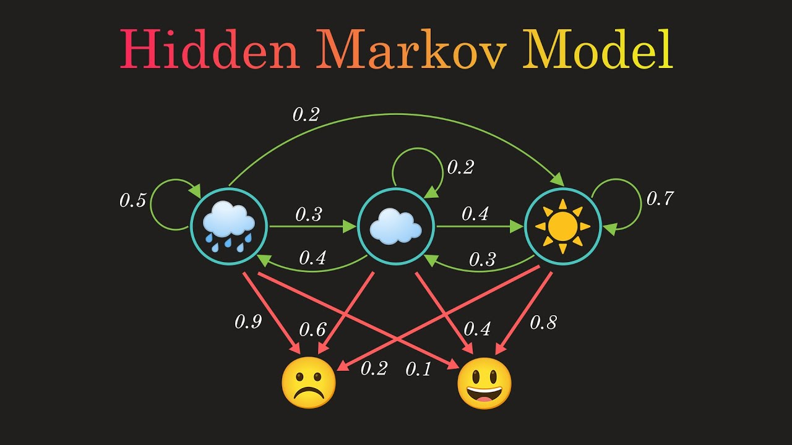
Objective
Goal:
Predict a user’s next location in a smart home using historical sensor data and contextual features (e.g., time of day).
Key Focus:
Hybrid model combining Hidden Markov Models (temporal patterns) and Dynamic Bayesian Networks (contextual dependencies).
Notes:
Good morning, everyone. Today, I'm going to talk about scaling laws for language model performance. This presentation is based on a research paper that explores how the performance of language models changes as we increase the model size, dataset size, and the amount of compute used for training.

Slide 4
Why HMMs and DBNs?
HMMs:
Ideal for temporal sequences (e.g., room transitions).
Computationally efficient, interpretable.
DBNs:
Extend HMMs by integrating context (time of day, habits).
Better accuracy for periodic routines.
Comparison with Alternatives:
LSTMs/GRUs require more data; HMMs/DBNs balance efficiency and accuracy.
Notes:
Good morning, everyone. Today, I'm going to talk about scaling laws for language model performance. This presentation is based on a research paper that explores how the performance of language models changes as we increase the model size, dataset size, and the amount of compute used for training.

Slide 5
Dataset & Preprocessing
Dataset: CASAS Aruba
Motion sensor activations (e.g., "Bedroom," "Kitchen").
Temporal sequences with ground-truth labels.
Preprocessing Steps:
Split data into training (70%) and testing (30%).
Map sensor IDs to room labels.
Add time-of-day context (morning/afternoon/night).
Notes:
Good morning, everyone. Today, I'm going to talk about scaling laws for language model performance. This presentation is based on a research paper that explores how the performance of language models changes as we increase the model size, dataset size, and the amount of compute used for training.

Slide 6
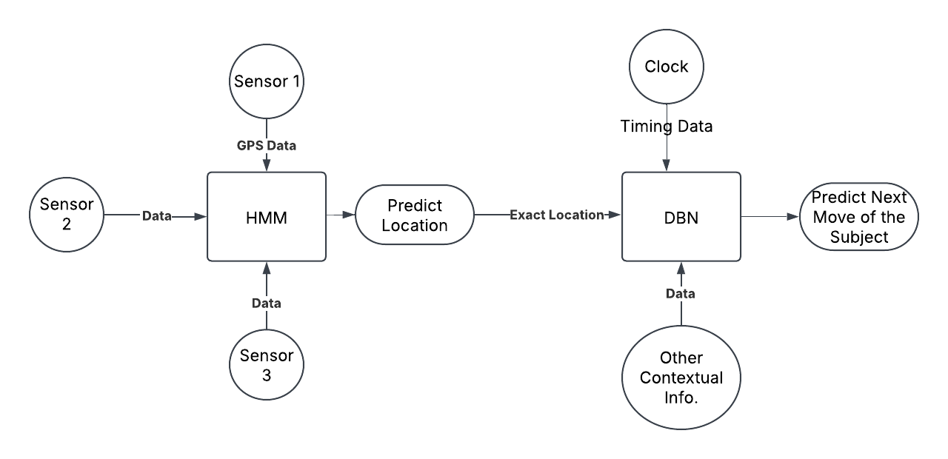
Model Design
Hybrid Architecture:
HMM Layer: Predicts room transitions using Viterbi algorithm.
DBN Layer: Refines predictions with time-of-day context via particle filtering.
Integration:
HMM output feeds into DBN as contextual input.
Visual: Flowchart showing HMM → DBN interaction.
Notes:
Good morning, everyone. Today, I'm going to talk about scaling laws for language model performance. This presentation is based on a research paper that explores how the performance of language models changes as we increase the model size, dataset size, and the amount of compute used for training.

Slide 7
Workflow Overview
Data Collection: CASAS Aruba dataset.
Feature Engineering: Room labels + time bins.
Model Training:
HMM: Baum-Welch algorithm.
DBN: Particle filtering with HMM context.
Evaluation: Accuracy, F1-score, confusion matrices.
Deployment: Real-time integration with smart home systems.
Notes:
Good morning, everyone. Today, I'm going to talk about scaling laws for language model performance. This presentation is based on a research paper that explores how the performance of language models changes as we increase the model size, dataset size, and the amount of compute used for training.

Slide 8
Evaluation Metrics
Accuracy: % of correct room predictions.
Precision/Recall: Per-room performance.
Transition Confusion Matrix: Common errors (e.g., Living Room vs. Dining Room).
Prediction Lead Time: Steps ahead forecasted accurately.
Visual: Comparison table (HMM vs. DBN expected accuracy).
Notes:
Good morning, everyone. Today, I'm going to talk about scaling laws for language model performance. This presentation is based on a research paper that explores how the performance of language models changes as we increase the model size, dataset size, and the amount of compute used for training.

Slide 9
Expected Results
HMM Baseline: ~80–85% accuracy.
DBN Improvement: ~85–90% accuracy (better time-context handling).
Visual: Bar chart showing accuracy gains.
Notes:
Good morning, everyone. Today, I'm going to talk about scaling laws for language model performance. This presentation is based on a research paper that explores how the performance of language models changes as we increase the model size, dataset size, and the amount of compute used for training.

Slide 10
Challenges & Solutions
Data Sparsity:
Solution: Laplace smoothing, synthetic sequences.
Overfitting in HMMs:
Solution: Regularization (AIC/BIC).
Temporal Alignment:
Solution: Time discretization (e.g., 6 AM–9 AM = "morning").
Notes:
Good morning, everyone. Today, I'm going to talk about scaling laws for language model performance. This presentation is based on a research paper that explores how the performance of language models changes as we increase the model size, dataset size, and the amount of compute used for training.

Slide 11
Conclusion
Outcome:
Robust model for room transition prediction.
Foundation for real-time smart home automation.
Future Work:
Actuator integration (lights, HVAC).
Expand to multi-user environments.
Notes:
Good morning, everyone. Today, I'm going to talk about scaling laws for language model performance. This presentation is based on a research paper that explores how the performance of language models changes as we increase the model size, dataset size, and the amount of compute used for training.

Slide 12
Thank You

