Slide 1
01
RESUME ANALYZER AI
A Smart AI Tool to Read and Search Resumes
for HR and Recruitment
AI Powered
Smart Search
Easy to Use
HR Tech
Smart HR Assistant

Slide 2
2. Project Overview
Resume Analyzer AI is a state-of-the-art web application designed to significantly reduce the time HR professionals spend evaluating candidates.
Our smart AI platform helps recruiters save time. You can:
▸ Upload many resumes at once and let the system read them.
▸ Ask questions about candidates like you're chatting with a human.
▸ Quickly find the best people for the job based on their skills and experience.
⏱ Fast
🔍 Smart
🔒 Private
🤖 AI-Powered
Reads instantly
Understands context
Your data is safe
Smart Answers

Slide 3
3. How It's Built (Simple View)
🔐 Secure Login
📄 Document Reader
Keeps everything safe so only authorized HR managers can see the resumes.
Opens PDFs and Word docs, reads the text, and remembers who it belongs to.
🧠 Smart Memory
🖥 Easy-to-use Dashboard
Stores knowledge in a way the AI can quickly search through to answer your questions.
A friendly website that's simple to navigate and remembers what you're working on.

Slide 4
4. System Overview
How information flows from you to the AI and back
[Image could not be loaded]
A simple view of how the website talks to the Brain (AI) to get your answers.

Slide 5
5. System Components
The main building blocks: System, Document Reader, Memory, and AI
[Image could not be loaded]
How different parts of the system work together to help you.

Slide 6
6. How You Use It (Step-by-Step)
The typical flow from uploading a resume to getting an answer
[Image could not be loaded]
A visual guide of a typical task on the website.

Slide 7
7. What You Can Do
The main features available to HR users
[Image could not be loaded]
A quick look at the main actions you can perform on the platform.

Slide 8
8. How We Store Your Data
The platform saves your progress securely on the server so you can resume work anytime without losing data.
Working Sessions
Saved Resumes
Chat History
id
Unique ID
id
Unique ID
id
Unique ID
hr_username
Who is logged in
↑ Link
session_id
Link to Session
↑ Link
session_id
Link to Session
session_name
Chat name
filename
Name of file
role
User or AI
created_at
Date & Time
file_path
Where it is stored
content
Message Text
timestamp
Date & Time

Slide 9
9. The Website Interface
▸ Beautiful Design: Looks modern and professional, similar to your favorite top-tier apps.
▸ Smooth Experience: Drag and drop resumes and switch between modes without waiting for the page to reload.
▸ Neat Text Formatting: Makes the answers from the AI easy to read with bullet points and bold text.
▸ Lightning Fast: Built to be incredibly quick when navigating the platform.
▸ Remembers Your Work: All your uploaded resumes and chat history are saved automatically.

Slide 10
10. Behind the Scenes (The Server)
▸ The Traffic Cop: Directs your clicks securely to the right places.
▸ File Reader: Easily opens and understands both PDF and Word document formats.
▸ Data Separation: Keeps each HR user's uploaded resumes separate and secure.
▸ Reliable Storage: Saves important data so nothing gets lost if your computer shuts down.
▸ Strong Security: Ensures no one else can sneak into your private data.

Slide 11
11. How the Smart AI Works
Our AI is designed to be truthful: it looks for answers strictly within the resumes you uploaded, preventing 'made-up' facts.
1
READING
2
SEARCHING
3
ANSWERING
The system reads every uploaded resume carefully and organizes the details so it's easy to search later.
You ask a question like "Who knows Python?" – and the system quickly grabs only the resumes that match.
The AI looks at the matches and gives you a simple, direct answer, and tells you exactly which resume it got it from.
→
→

Slide 12
12. Technology We Use (Simplified)
Frontend
Backend Framework
Website / Look & Feel (HTML, CSS, JavaScript)
Server / Traffic Controller (Python, Flask)
Database
NLP / Embeddings
Secure Saving (SQLite)
AI Smart Search (sentence-transformers)
LLM Pipeline
Doc Processing
Answering Engine (HuggingFace AI)
PDF and Word Readers (PyPDF2, python-docx)

Slide 13
13. Why This Platform Helps You
⏱ Saves You Hours
🎯 Fair Choice
Instead of reading dozens of resumes manually, the system does it for you instantly.
Focuses purely on the candidate's actual skills listed in their resume, removing biases.
🔒 Keeps Data Safe
💾 Pick Up Later
Your resumes are safe and locked down so only you can see your data.
You can log off, and when you return, all your resumes and chats will still be there.
✨ Easy and Beautiful
It is fast, responsive, and as simple to use as your favorite modern apps.

Slide 14
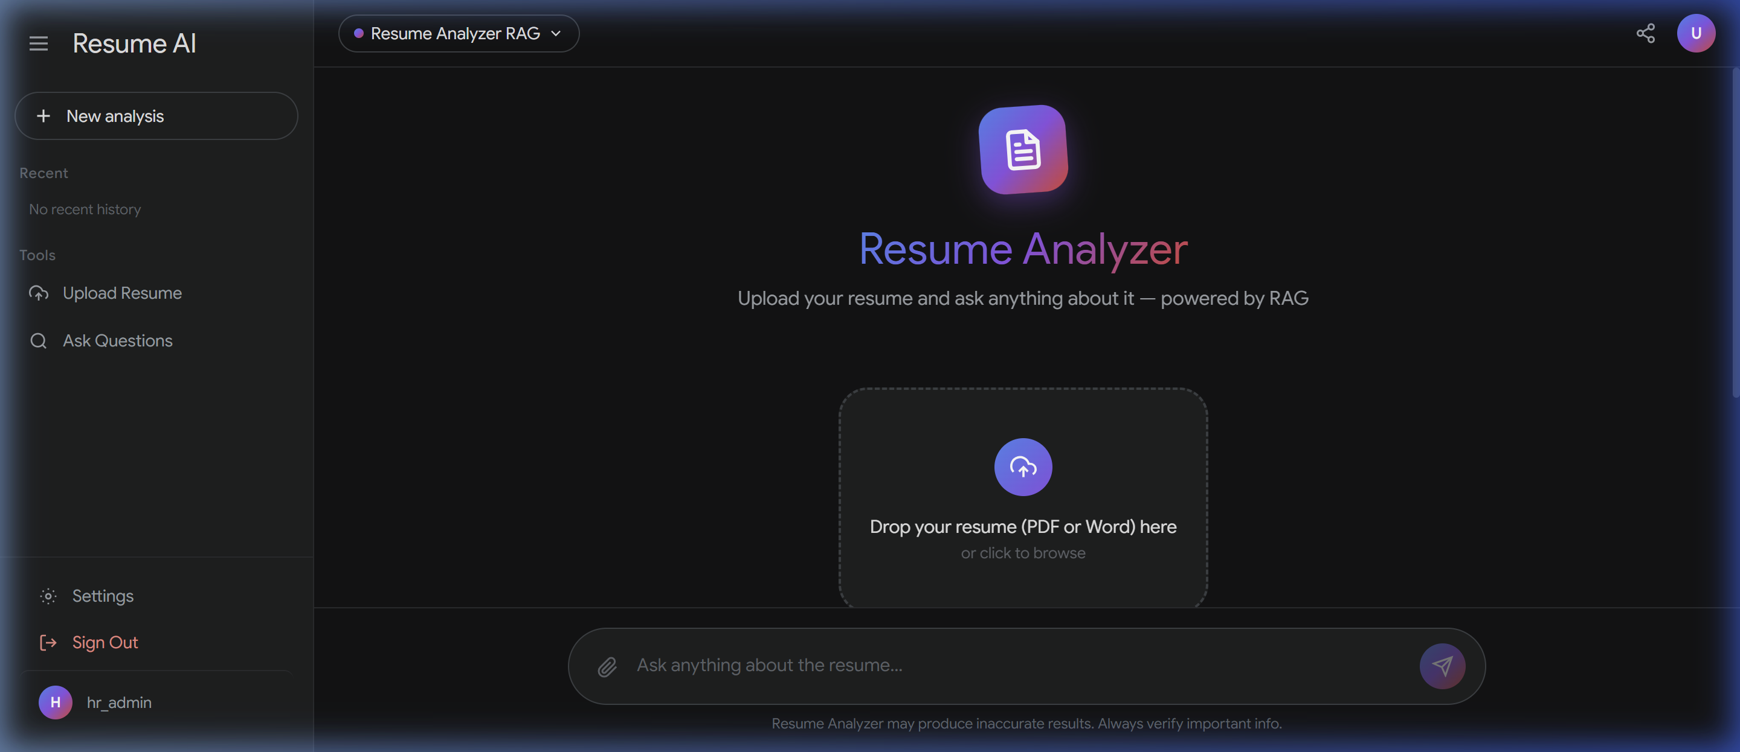
14. A Look at the Website: Main View
Clear options to look at one resume, many resumes, or see your past work.
A modern and clean screen that greets you when you log in.

Slide 15
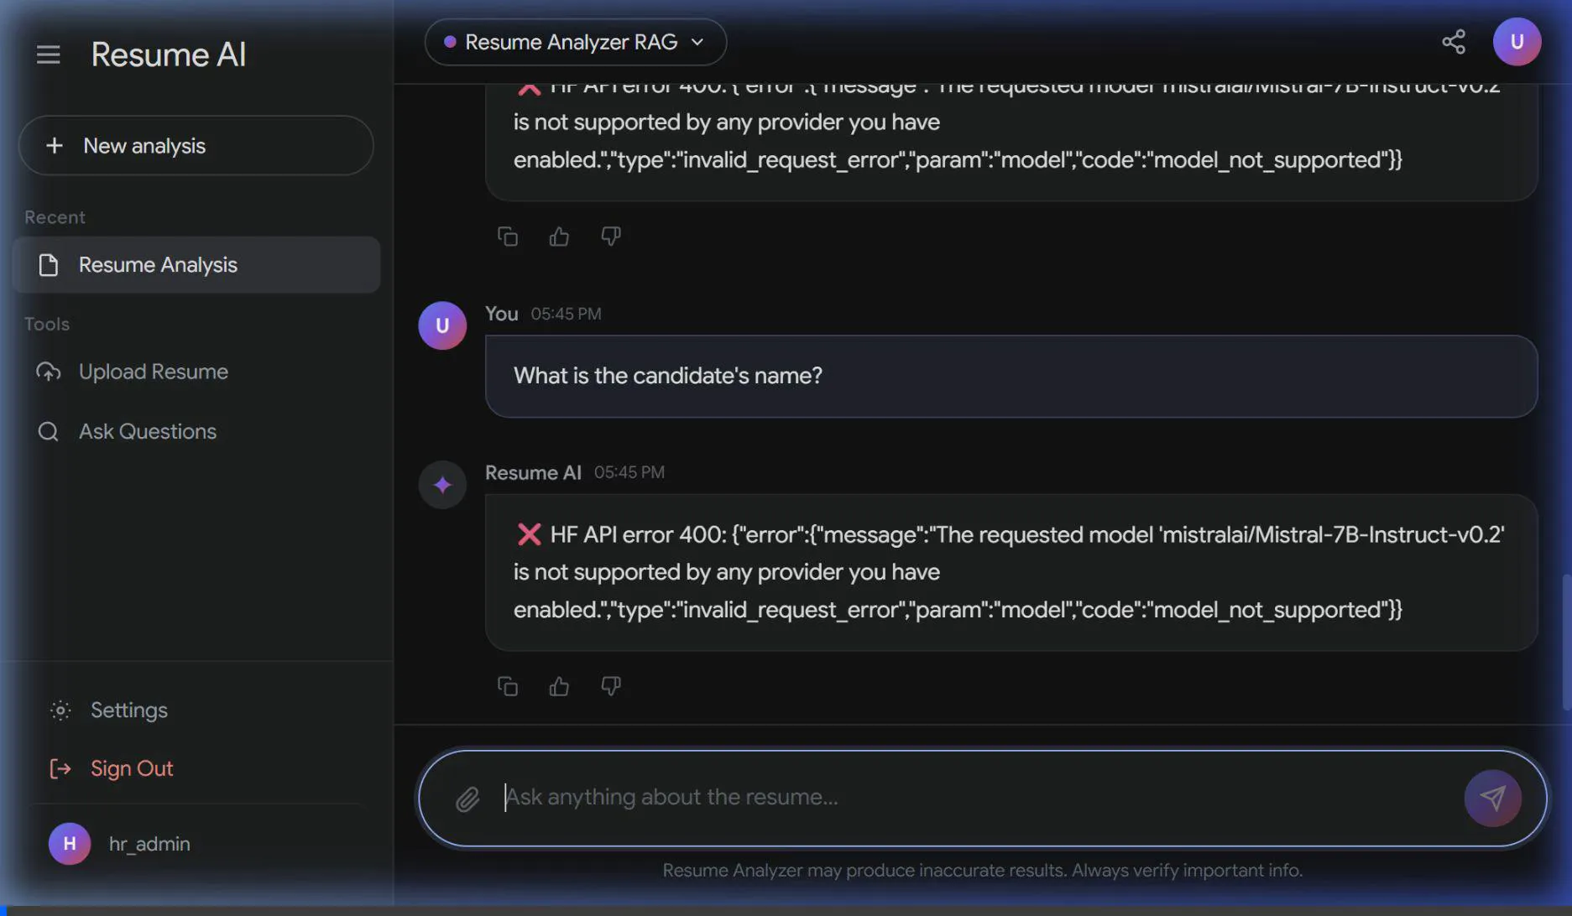
15. A Look at the Website: Asking Questions
Chatting with the AI to get answers from the uploaded resumes.
The AI gives easy-to-read answers and clearly shows which file it read.

Slide 16
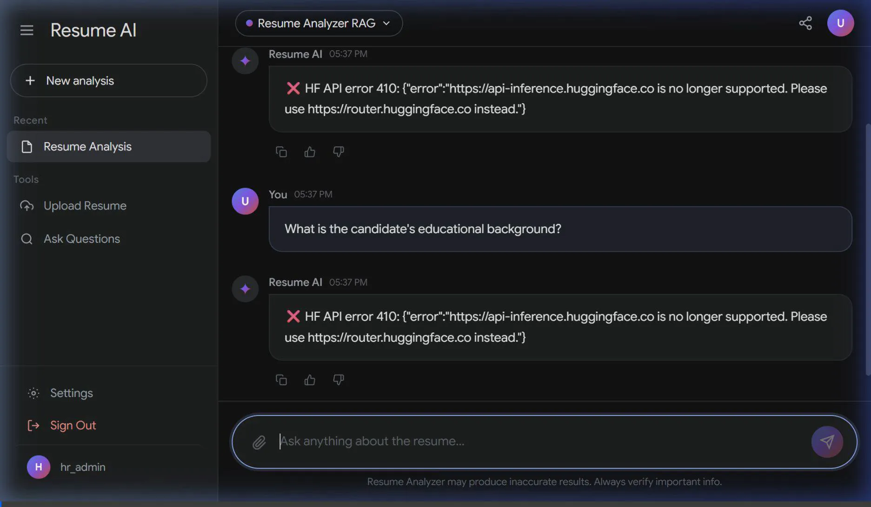
16. A Look at the Website: Finding the Best Match
Easily filter candidates by specific skills and years of experience.
Use simple controls to narrow down exactly who you are looking for.

Slide 17
Thank You
HR Assistant — Making Recruitment Easier with AI
Smart AI
Fast
Secure Saving
Easy Chat
Automated
HR Tech

