Slide 1

Car accident severity prediction
Akash Rode

Slide 2
Table OF Content
Introduction
Data Understanding
Balancing Data Set
Methodology
KNN Algorithm
Decision Algorithm
Result and Analysis

Slide 3

Introduction
Objective to lessen the frequency of car collision.
To find out the best suitable algorithm for prediction of severity of an accident.
Severity factors to be consider :
Weather condition, Road Condition, Light Condition.
With the help of ML model severity of the accident can be predicted.

Slide 4

Data Understanding
Attributes responsible for collision: Weather condition, Light condition, Road Condition etc.
Important variable to be consider is ‘SEVERITYCODE’,
SEVERITYCODE is considered as dependent variable.
All the attributes are referred as independent variable.
‘SEVERITYCODE 1-> Property Damage Only Collision’ & ‘SEVERITYCODE 2 -> Injury Collision’.

Slide 5

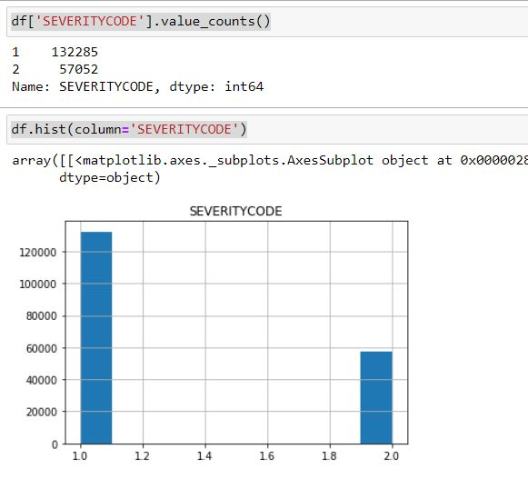
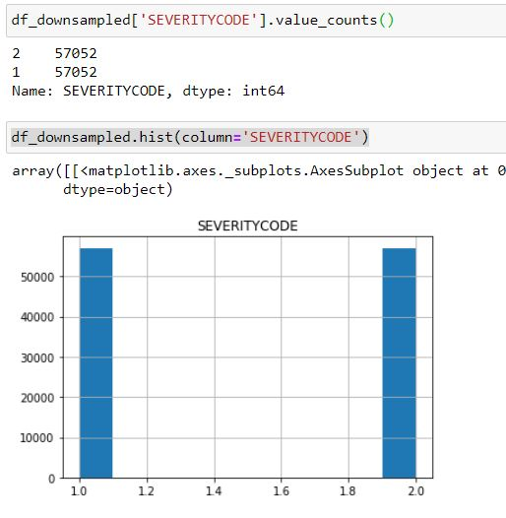
Balancing Data Set
1) Imbalanced Data
Balanced Data

Slide 6

Balancing Data Set
Explaination:
Output of class 2 is 57052.
Output of class 1 is 132285.
70% of output is biased towards class 1.
Random down sampling is necessary in order to balance the data set,
Model which contain output as class 1 will be down sampled.

Slide 7
Methodology
As the data set is well labelled we can use Supervised Machine Learning technique.
Our predictor value contains binary data i.e. 1 & 2 ( Two outcomes only )
We can use K - Nearest Neighbour Algorithm, Decision Tree algorithm, Logistic model, etc.
For this project we are using K nearest Neighbour algorithm & Decision Tree algorithm.

Slide 8

K Nearest Neighbour (KNN) algorithm
It is one of most basic and essential algorithm in ML.
Belongs to the supervised learning domain
Finds intense application in pattern recognition, data mining and intrusion detection.
It assumes that similar things exist in close proximity.

Slide 9
Decision Tree algorithm
It is one of the most powerful and popular algorithm.
It falls under the category of supervised learning algorithms.
It works for both continuous as well as categorical output variables.
This is constructed via an algorithmic approach that identifies ways to split a data set based on different conditions.
It is one of the most widely used and practical methods for supervised learning.
It is a non-parametric supervised learning method for classification problems.

Slide 10
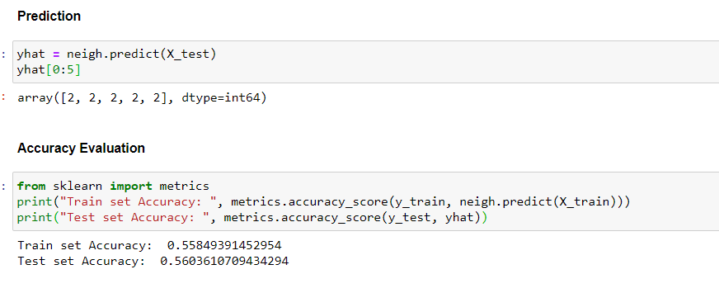
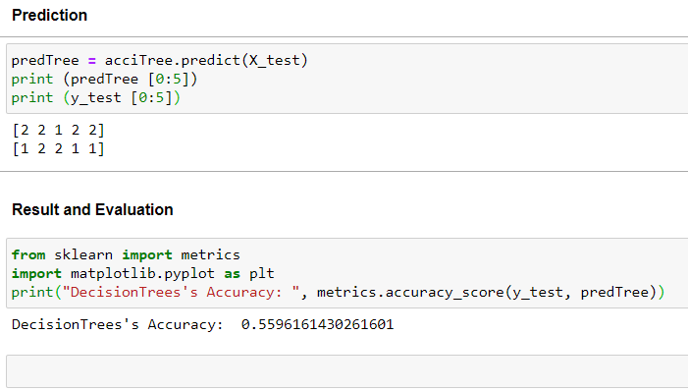

Result and Analysis
1) KNN Algorithm
2) Decesion Tree Algorithm

Slide 11
Thank you

