Slide 1
MBA (IT & SYSTEMS) · LIVE CLASSROOM DEMONSTRATION · JUNE 2026
AI Dynamic Pricing &
Revenue Management Simulator
Turning revenue-management theory into a decision you can watch happen —
pricing mathematics, a simulated customer market, and an AI that explains every call.
CASE SETTING
The Grand Horizon Palace, Mumbai · 100 rooms · single room type · base rate ₹5,000 · currency INR

Slide 2
THE PROBLEM
Why hotel pricing is hard
02 / 12
A hotel room is perishable inventory on fixed capacity: tonight's unsold room is worth ₹0 at midnight, yet the hotel cannot add a floor because a concert came to town. That tension is revenue management.
Demand uncertainty
Only a forecast with a band around it. Pricing for the average empties the hotel in bad weeks.
Time pressure
Willingness to pay shifts as arrival nears — leisure books early on price, business books late on availability.
Competitor pressure
Rates are public. A rival can cut 40% overnight and reshape the conversion curve instantly.
Cost & reputation floors
Below variable cost every sale loses money; far above the market, the brand takes the damage.
RevPAR = Occupancy × ADR Expected revenue = Price × Expected bookings at that price
Because bookings fall as price rises, expected revenue is a curve with a peak, not a line. The simulator makes that peak visible — and shows how far it moves when one condition changes.
The Grand Horizon Palace · AI Dynamic Pricing & Revenue Management Simulator

Slide 3
SOLUTION OVERVIEW
One screen, four zones
03 / 12
A single dashboard so the presenter never navigates away from the decision — three visible zones plus a compliance view.
ZONE 1 — Manager panel
Five sliders, season selector, event switch and four one-click shock presets. Sets up the night, or fires a preset to change the world instantly.
ZONE 2 — Recommendation & analytics
Recommended rate, multiplier chain, 14-day forecast, booking pace, the Monte Carlo distribution and the comparison table.
ZONE 3 — Guardrails & AI
Ethical/policy flags plus the Gemini 3 Flash rationale that streams in word by word — the model can be challenged live.
ZONE 4 — Warning audit log
A timestamped server-side record of every flag ever raised. Answers: can you prove what the system flagged, and when?
Set scenario → optimize → simulate ×500 → evaluate guardrails → AI explains → accept / override & save
The Grand Horizon Palace · AI Dynamic Pricing & Revenue Management Simulator

Slide 4
THE ENGINE
How the price is decided — no black box
04 / 12
Formula price = BaseRate × Season × Demand × Scarcity × Competitor × LeadTime × Event
1 · Multiplier chain
Base ₹5,000 adjusted by seven independent factors, each answering one business question.
Demand damped: only 40% of the movement passes to price, capped at 1.40.
Scarcity convex: the last rooms move the rate sharply, the first barely at all.
2 · Revenue-max search
Grid ±30% around the formula price in ₹50 steps.
argmax Price × expected bookings — the money-maximising rate, not the highest legal one.
Constraint: must fill ≥75% of remaining rooms.
3 · Hard rules
Floor / ceiling: 0.2× to 3.0× base (₹1,000–₹15,000).
Cost floor: ₹1,200 variable cost per occupied room.
Below that raises a warning — an empty room becomes a loss-making one.
Recommended price = argmax over candidates ( Price × Expected bookings at that price )
The key idea: the recommendation is where the rate-vs-volume trade-off makes the most money. Raising further is rejected by the optimizer itself — not by a policy.
The Grand Horizon Palace · AI Dynamic Pricing & Revenue Management Simulator

Slide 5
WORKED EXAMPLE
“Concert in Town” — reproducible live
05 / 12
Scenario
Demand 175 market 75% hotter than normal
35 rooms left two-thirds already sold · 5 days out
Competitor ₹8,200 market already repriced · event on
WHY THE HIGHER RATE WINS
Current ₹5,000
Rec ₹12,412
Leisure conversion
93.3%
31.4%
Business conversion
87.9%
52.4%
₹5,000 ×1.00 ×1.30 ×1.211 ×1.192 ×1.08 ×1.20
Expected bookings
35.0
35.0
Formula price ₹12,160 → recommended ₹12,412
with only 35 rooms left, the hotel still sells out at the higher rate.
Expected revenue
₹1.75 L
₹4.34 L
Teaching point: conversion collapses, yet only 35 bookings are needed — so the rate rise is correct.
The Grand Horizon Palace · AI Dynamic Pricing & Revenue Management Simulator

Slide 6
THE MARKET
How customers are modelled
06 / 12
Two segments, because one “average guest” hides the most interesting behaviour in hotel pricing.
Leisure · 60% of demand
Sensitivity k ≈ 4.5 a cliff — a 20% premium destroys most bookings
Books early compares hotels, walks when the rate beats the market reference
Business · 40% of demand
Sensitivity k ≈ 1.8 a slope — the same premium costs few bookings
Books late needs a room on a date; hardens to k≈1.2 inside three days
Conversion(P) = 2·Baseline ÷ ( 1 + exp( k·(P÷Reference − 1) ) ) bounded 2%–95%
Reference = (0.5·Competitor + 0.5·Base) × 1.15 × SeasonDemand × Event × Scarcity × Urgency
The single parameter k is what makes business demand profitable to price into and leisure demand dangerous to price into.
The Grand Horizon Palace · AI Dynamic Pricing & Revenue Management Simulator

Slide 7
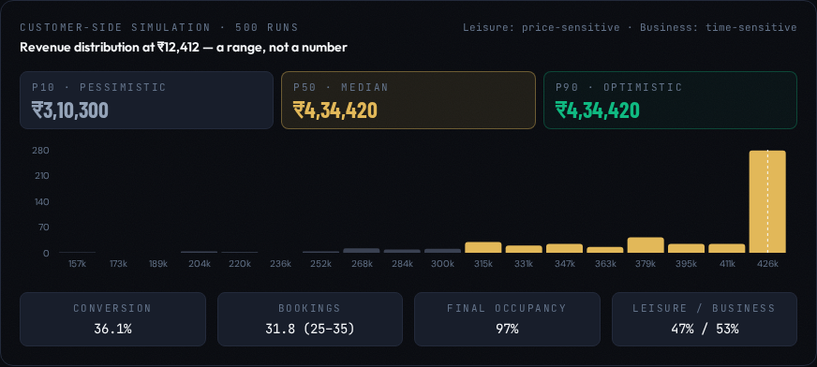
CONFIDENCE
The Monte Carlo simulation — 500 runs
07 / 12
One revenue number implies a certainty that does not exist. So the night is run 500 times with random variation.
What varies each run
Demand volume Poisson arrivals × log-normal noise
Conversion perturbed ±12% around the curve
Booking outcome each guest a binomial book / no-book
Capacity capped at rooms actually available
500-run revenue distribution with P10 / P50 / P90 markers
Reading the output (worked example)
P10 / P50 / P90 ₹3.10 L · ₹4.34 L · ₹4.34 L
P10=P90 signature of a capacity-constrained, sell-out night
Sell-out probability 51% the honest answer to “will this work?”
The Grand Horizon Palace · AI Dynamic Pricing & Revenue Management Simulator

Slide 8
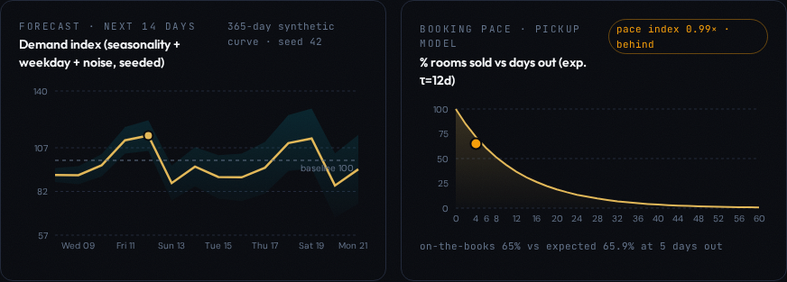
TIMING
Forecasting & booking pace
08 / 12
14-day demand forecast
Seasonal wave × day-of-week + noise 365 seeded days projected forward
The band widens ~1.2 pts/day out a forecast is a cone, not a line — decisions 14 days out deserve less conviction
Booking pace · pickup model
Expected share = 100·e^(−Days÷12)
Pace index = Actual ÷ Expected
> 1.1 ahead of pace sell faster — hold or push the rate
~ 1.0 on the books the rate is roughly right
< 0.9 behind pace cut the rate or add promotion
14-day forecast cone (left) and the pickup pace curve (right)
The Grand Horizon Palace · AI Dynamic Pricing & Revenue Management Simulator

Slide 9
RESPONSIBILITY
Ethical & policy guardrails
09 / 12
SURGE
Rate > 2.5× base
→ Cap at 2.5× or add value to justify the premium
BELOW COST
Rate < ₹1,200 cost
→ Hold at the cost floor, accept lower occupancy
FAIRNESS
Segment rates differ >50%
→ Use fenced rates, not segment-based pricing
PARITY
Rate > 40% over competitor
→ Monitor pickup, step down in ₹250 increments
Flag, do not block
The system never refuses to show a price. It shows the price, shows the flag, and leaves the call to a named human.
• A hard block hides the trade-off the manager needs to see.
• Accountability requires a decision-maker, not an algorithm.
The audit log = the compliance answer
Every flag is written to the database with the rate, full scenario and a timestamp.
Replayed newest-first with running totals — “what did you warn me about, and when?” has a documented answer.
Screen-only deliberately excluded from the printable strategy sheet.
The Grand Horizon Palace · AI Dynamic Pricing & Revenue Management Simulator

Slide 10
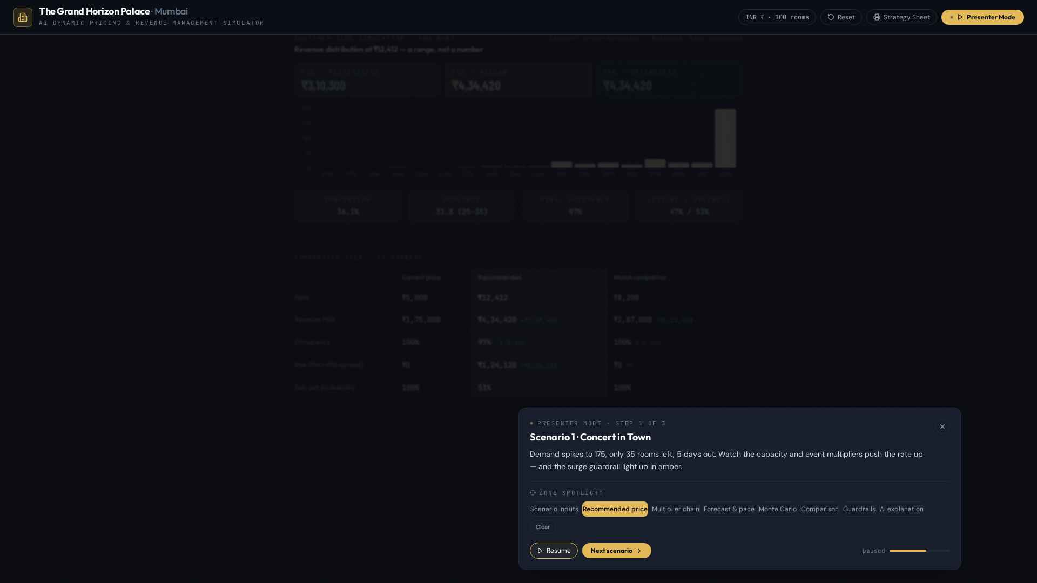
EXPLANATION & DELIVERY
The AI layer + Presenter Mode
10 / 12
Gemini 3 Flash explains the number
Sent: a compact numerical brief — scenario, recommendation, multipliers, Monte Carlo summary, flags. No free text, no guest data.
Returns: Why this price · three specific risks · an alternative strategy — as a senior RM would brief the room.
Presenter Mode
Three shock scenarios 20-second auto-advance, pause & manual step, scripted narration
Concert · Competitor −40% · Off-season each with its own teaching point
Zone spotlight dims every panel except the one being discussed
Three decisions that matter live
Caching same scenario returns instantly, no re-spend
Streaming reveal word-by-word so the room reads at your pace
Deterministic fallback the panel is never blank if the network drops
The Grand Horizon Palace · AI Dynamic Pricing & Revenue Management Simulator
Presenter Mode: the recommendation spotlighted, the rest dimmed

Slide 11
THE TEAM
Contributions
11 / 12
Eight members, one system — each owning a real part of the build.
1
Member 1
Pricing Optimizer & Multiplier Chain
Seven-factor chain + bounded revenue-max search
2
Member 2
Customer Demand Model
Two-segment logistic price-response & reference price
3
Member 3
Monte Carlo Simulation Engine
500-run Poisson × binomial revenue distribution
4
Member 4
Forecasting & Booking Pace
14-day seeded forecast cone + pickup pace index
5
Member 5
Ethical Guardrails & Audit Log
Surge / cost / fairness / parity flags + compliance trail
6
Member 6
AI Explanation Layer
Gemini 3 Flash brief, caching, streaming & fallback
7
Member 7
Frontend, UI & Presenter Mode
React dashboard, zone spotlight, strategy sheet
8
Member 8
Documentation & Project Report
Word report, this deck & the demo script
The Grand Horizon Palace · AI Dynamic Pricing & Revenue Management Simulator

Slide 12
MBA (IT & SYSTEMS) · REVENUE MANAGEMENT
Thank you.
Questions, challenges and “what if we changed this slider?” are the point.
The Grand Horizon Palace, Mumbai · AI Dynamic Pricing & Revenue Management Simulator

