Slide 1
Alarm System using Proximity Sensor
Prepared by:
Sneha Dipankar Roy
Akash Rajendra Ventekar
Prepared for:
Dr. Feng Zhu

Slide 2
Agenda
Introduction
Android Client
Android Server
Results
References

Slide 3
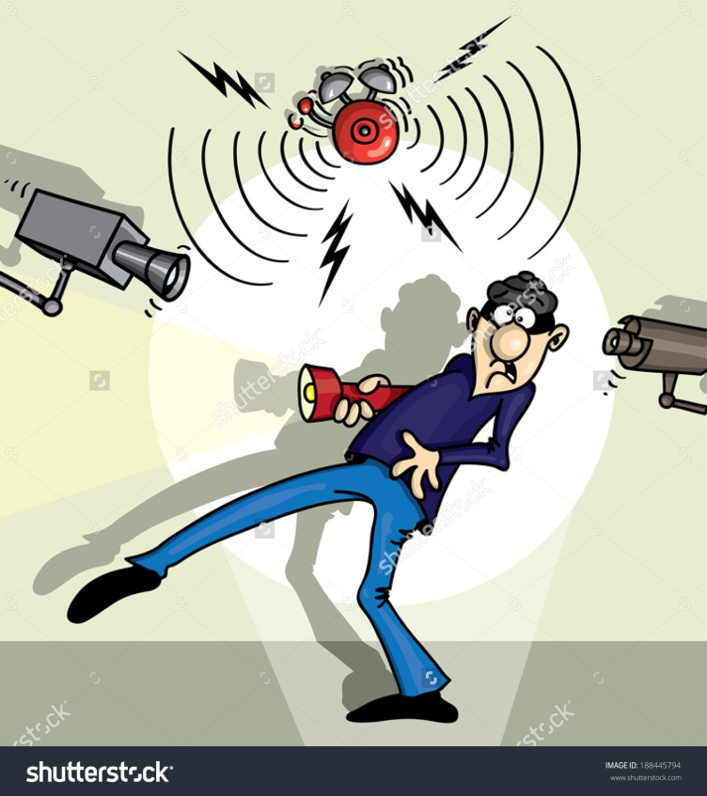
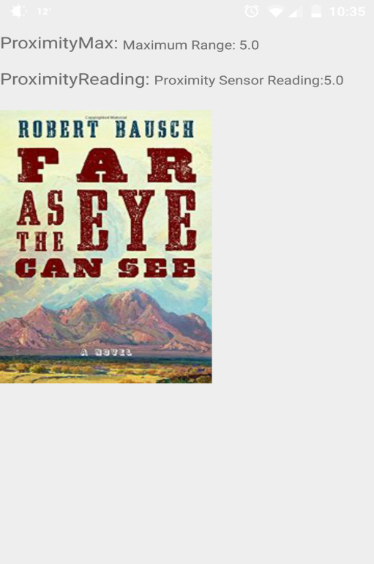
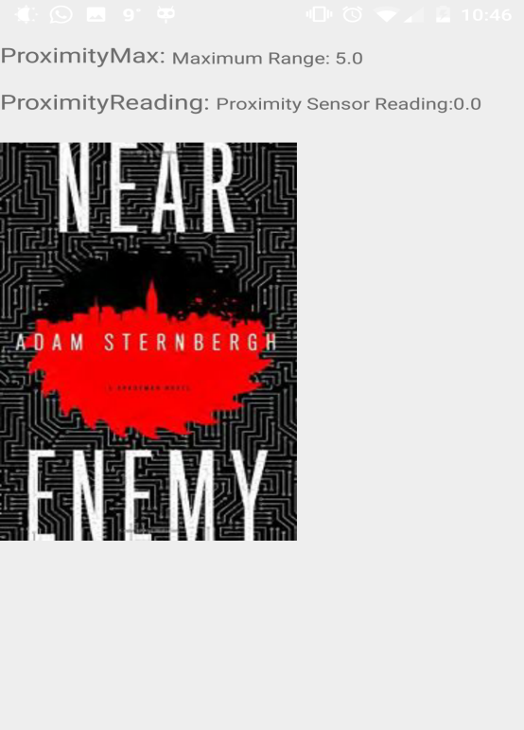
Introduction
Alarm System?
Applications
Which sensor?
Notes:
An alarm system is a system designed to detect intrusion – unauthorized entry – into a building or area.
Can be used in residential, commercial, industrial and military purposes against burglary or property damage as well as personal protection.
There are car alarms too to protect vehicles and their contents.
We will be using proximity sensor to detect the presence of any object around the device.

Slide 4

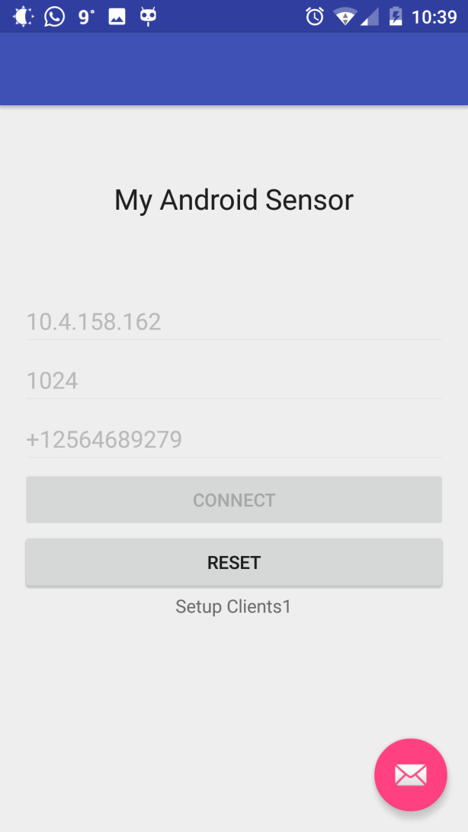
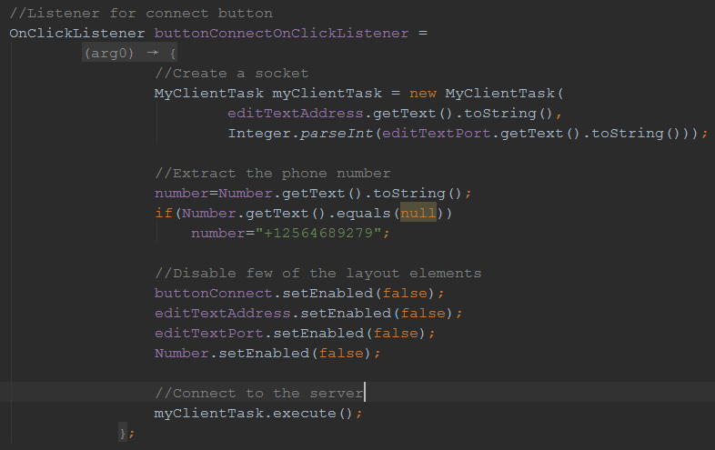
Android Client

Slide 5
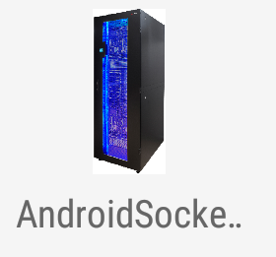
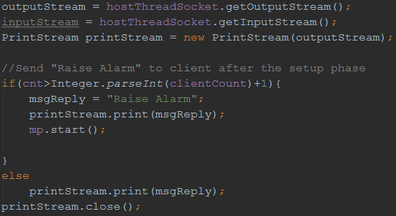
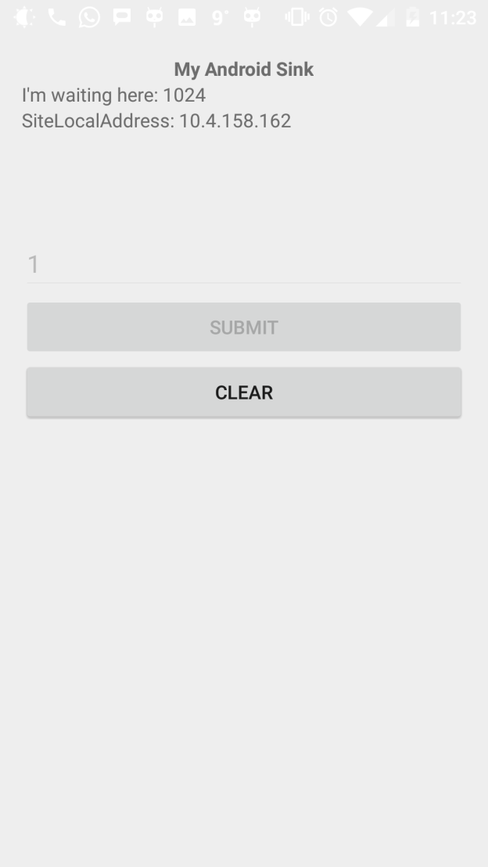
Android Server

Slide 6
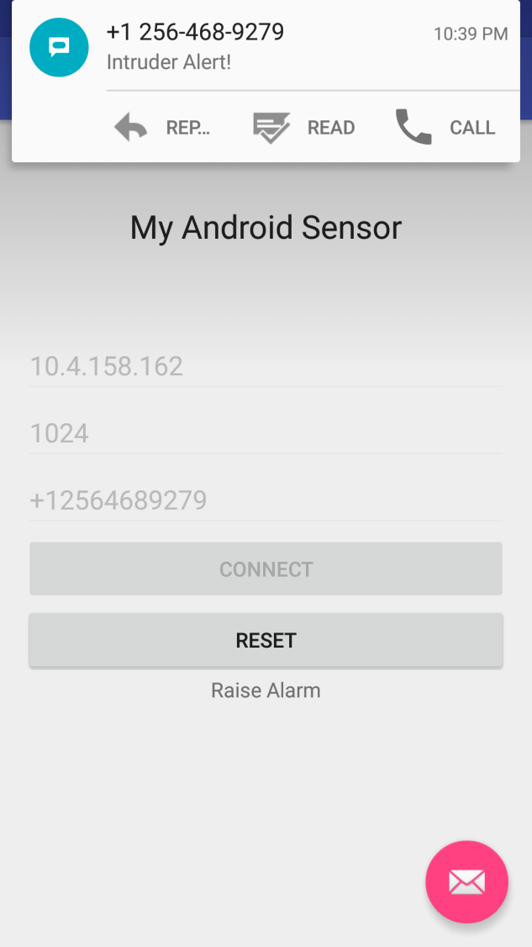
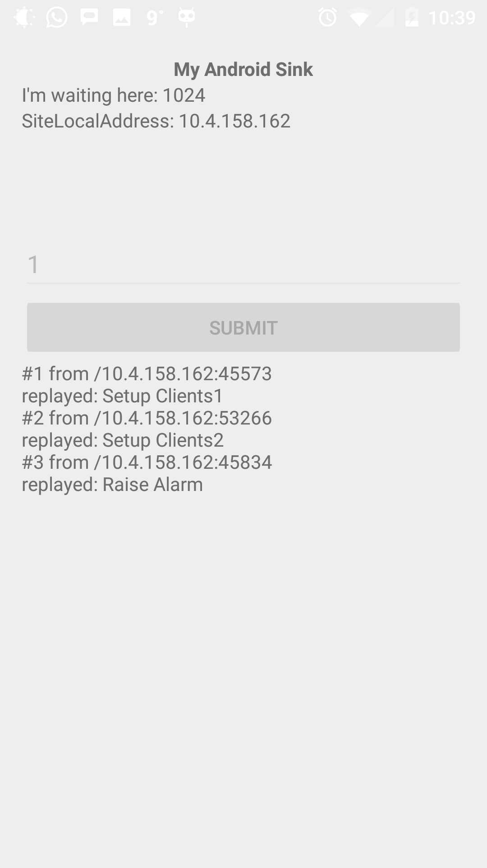
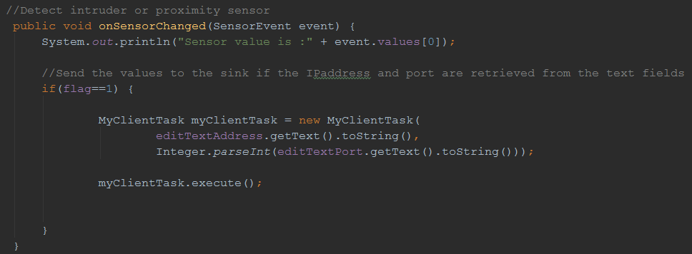
Results

Slide 7
References
http://androidbite.blogspot.com/2013/05/android-proximity-sensor-example.html
http://stackoverflow.com/questions/22953671/how-to-controlandroid-proximity-sensor
http://androidsrc.net/android-client-server-using-sockets-client-implementation/
http://androidsrc.net/android-client-server-using-sockets-server-implementation/

Slide 8
???

Slide 9
Thank You

