Slide 1

A HackSC Project 2020
William Chang
Ryan Li
Justin Nakama
Akash Sareen

Slide 2



Slide 3
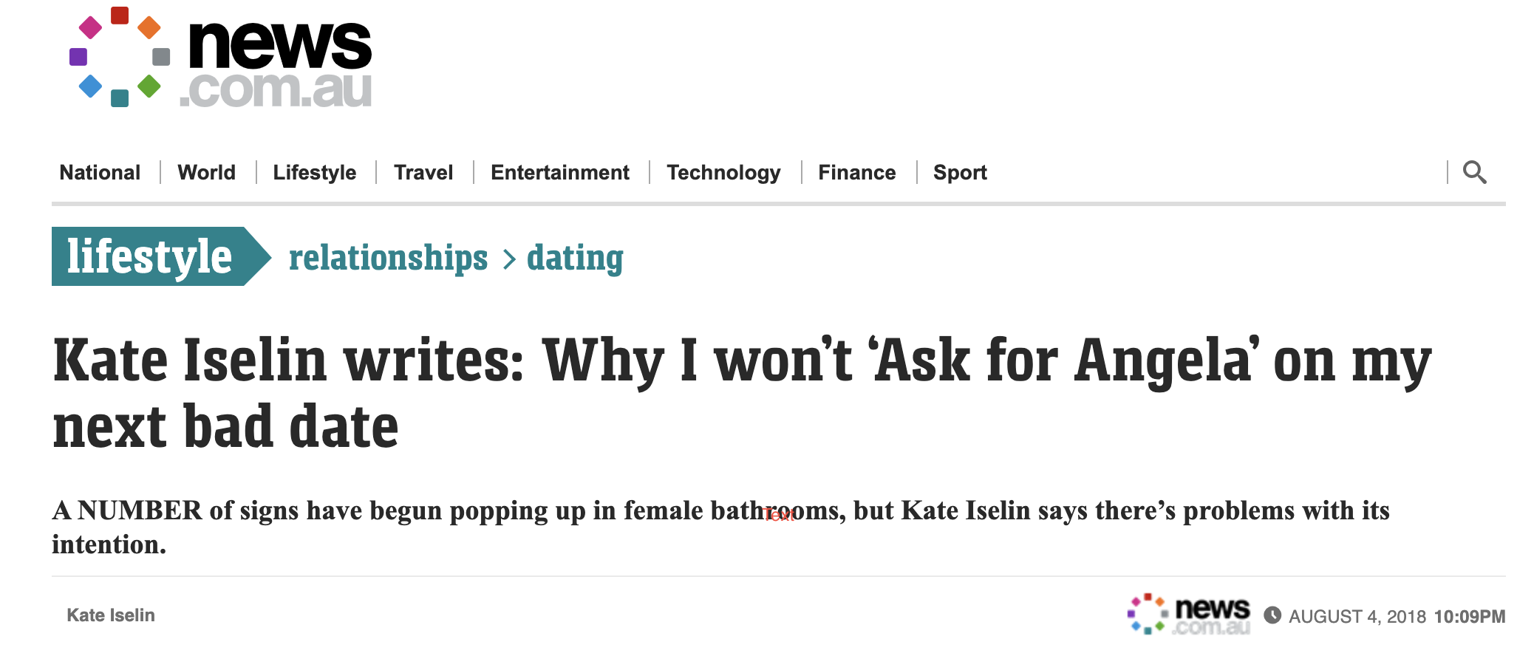

Slide 4
A HackSC Project 2020
William Chang
Ryan Li
Justin Nakama
Akash Sareen

