Slide 1
DevOps & CI/CD Pipeline
Vaibhav Jain
Aakash Sarwade
Raju Kumaresan
Subhashree Swain
30th Aug 2022

Slide 2
What is DevOps?
The DevOps is the combination of two words, one is Development and other is Operations. It is a culture to promote the development and operation process collectively.
DevOps is a software development approach which involves Continuous Development, Continuous testing, Continuous Integration, Continuous Deployment and Continuous Monitoring through its development lifecycle.

Slide 3
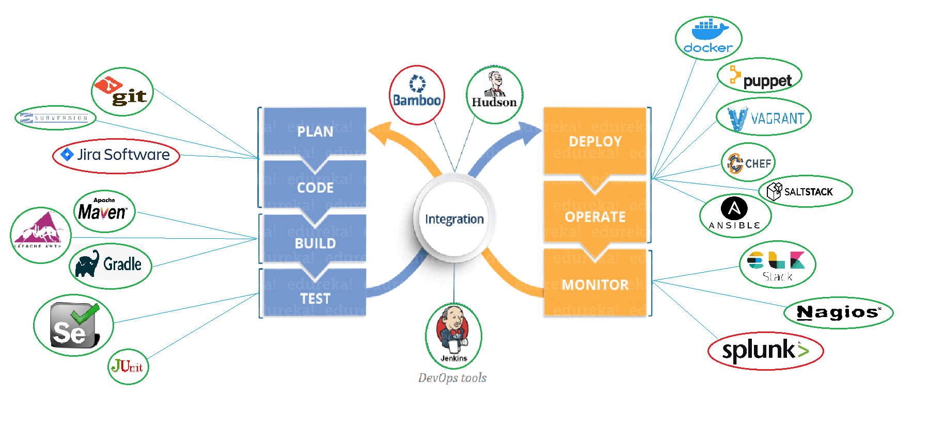
DevOps Lifecycle & its tools
Open Source
Licensed/
Commercial
.

Slide 4
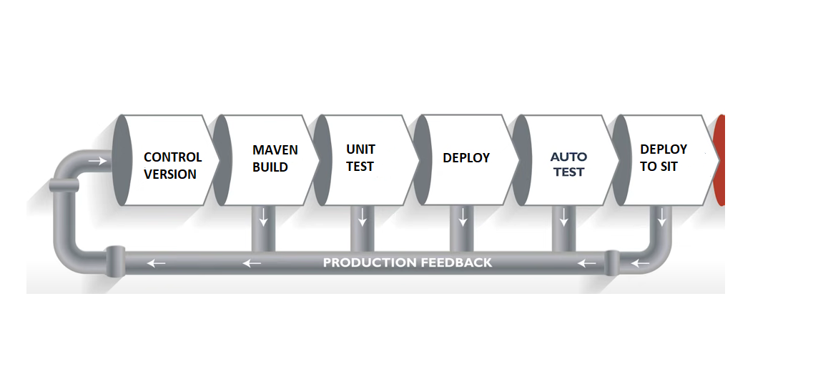
What is CI/CD?
Continuous Integration: Continuous Integration (a.k.a. Cl) is a software engineering process. It can be defined as running an automated test suite on every commit to a software project and notifying on success and failure.
Continuous Deployment: At a high level, Continuous Deployment (a.k.a. CD) extends Continuous Integration to include automated deployment.
////

Slide 5
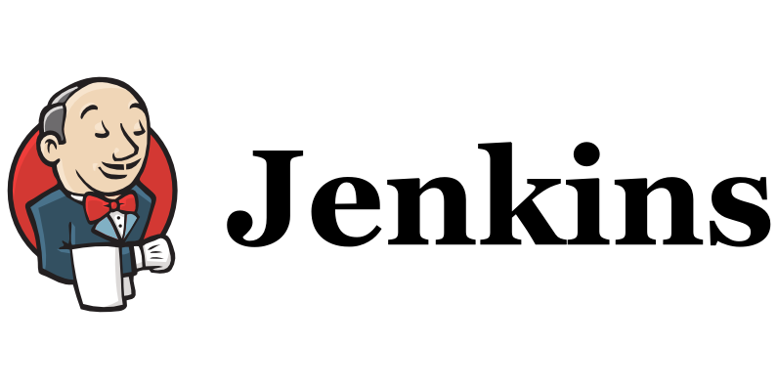
Jenkins CI/CD Tool
Jenkins is a Contiguous integration tool used to build(compile, test) code and deploy it to the production.
Jenkins provides hundreds of plugins to support building, deploying and automating any project.
It is a server-based system that runs in servlet containers such as Apache Tomcat etc. It supports version control tools like SVN, Git, to automate build divide into two parts Jenkins and CICD
write the details about Gitlab Repo---- Action Items

Slide 6
Problem Before Continuous Integration
Current State
-Drawbacks

Slide 7
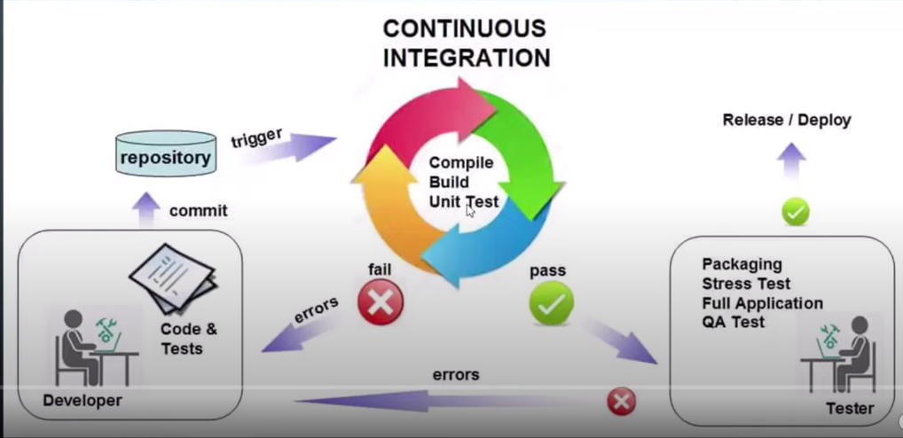
Continuous Integration Workflow
G Future state and Benifits

Slide 8
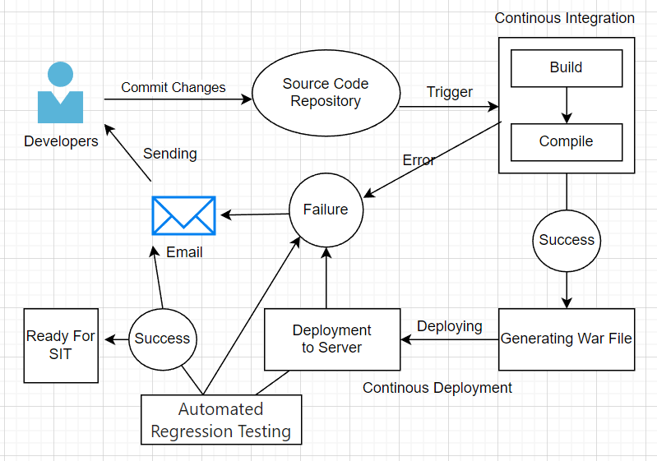
CI/CD Pipeline Architecture Proposed Archi
Highlight with colours
Benefits
educe Deployment Time.
Efficient Software Delivery.
Easier rollback of code changes.
Improved Product Quality.

Slide 9
CI/CD Pipeline Architecture Proposed Archi
Highlight with colours
Benefits
educe Deployment Time.
Efficient Software Delivery.
Easier rollback of code changes.
Improved Product Quality.

Slide 11
MDM CI/CD Implementation
Table form
Action States
GitLab Setup for java --Implemented GitLab for MDM --pending
POC For Java API --Completed
POC For MDM --not Started
CICD for MDM --Pending
CICD for JAVA --Completed

Slide 12
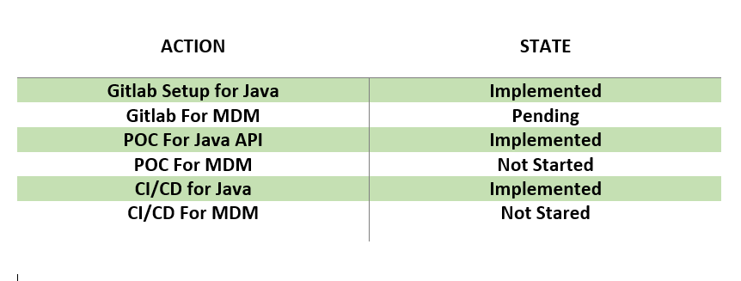
MDM CI/CD Implementation

