Slide 1
DevOps & CI/CD Pipeline
Vaibhav Jain
Aakash Sarwade
Raju Kumaresan
Subhashree Swain
30th Aug 2022

Slide 2
What is DevOps?
The DevOps is the combination of two words, one is Development and other is Operations. It is a culture to promote the development and operation process collectively.
DevOps is a software development approach which involves Continuous Development, Continuous testing, Continuous Integration, Continuous Deployment and Continuous Monitoring through its development lifecycle.

Slide 3
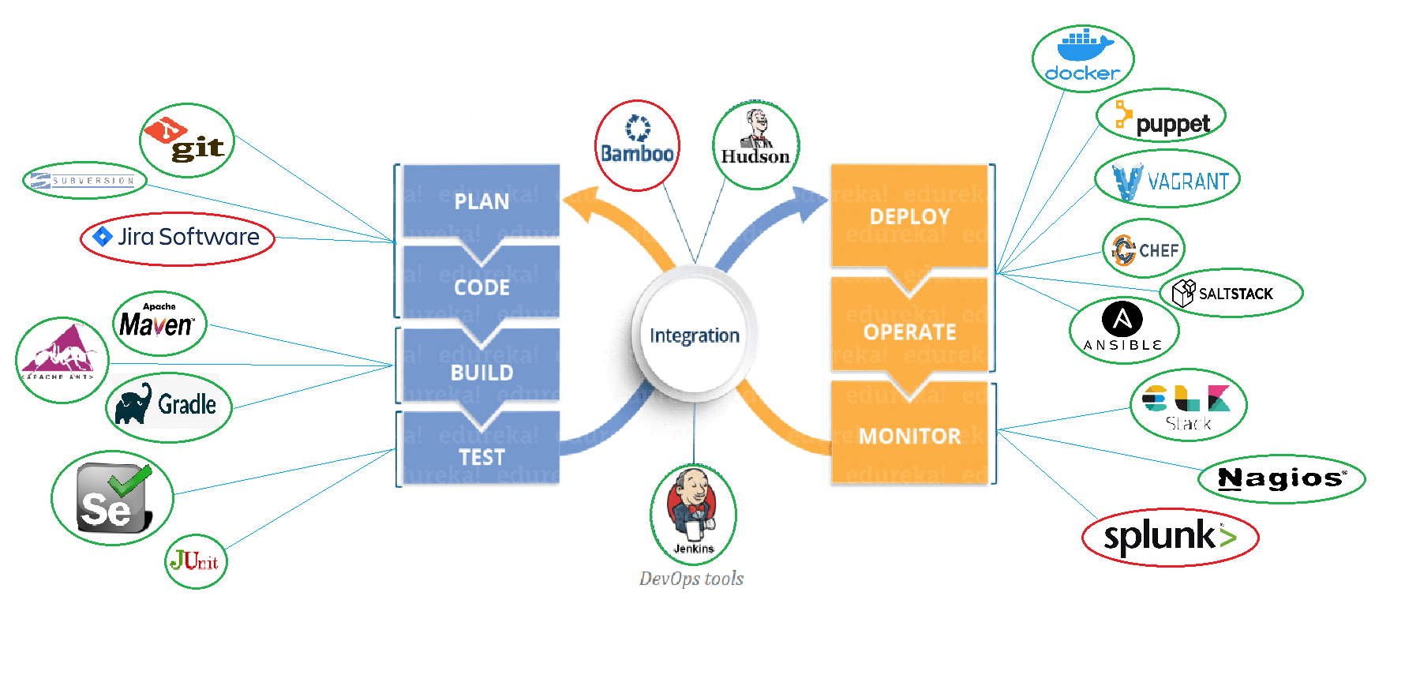
DevOps Lifecycle & Tools
Open Source
Licensed/
Commercial
.

Slide 4
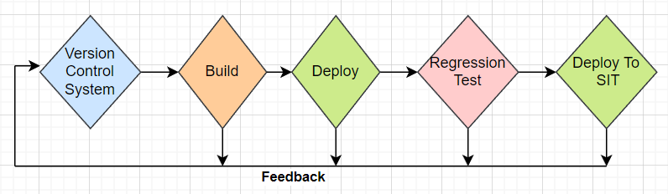
What is CI/CD?
Continuous Integration: Continuous Integration (a.k.a. Cl) is a software engineering process. It can be defined as running an automated test suite on every commit to a software project and notifying on success and failure.
Continuous Deployment: At a high level, Continuous Deployment (a.k.a. CD) extends Continuous Integration to include automated deployment.

Slide 5
Jenkins
Jenkins is a Contiguous integration tool used to build(compile, test) code and deploy it to the production.
Jenkins provides hundreds of plugins to support building, deploying and automating any project.
It is a server-based system that runs in servlet containers such as Apache Tomcat etc. It supports version control tools like SVN, Git, to automate build.
GitLab
GitLab is a web-based Git Repository that provides free open and private repositories, issue-following capabilities.
It is a complete DevOps platform that enables professionals to perform all the tasks in a project from project planning and source code management to monitoring and security.

Slide 6
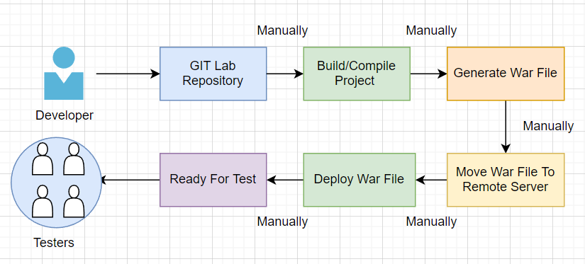
Current State Without CI/CD
Drawbacks-
The Entire Source Code was built and then tested.
Testers need to wait until end of sprint for begin testing.
Developers have to do each and every steps manually.
For Production Defects Fix need to wait for system testing and then move to UAT/Production.

Slide 7
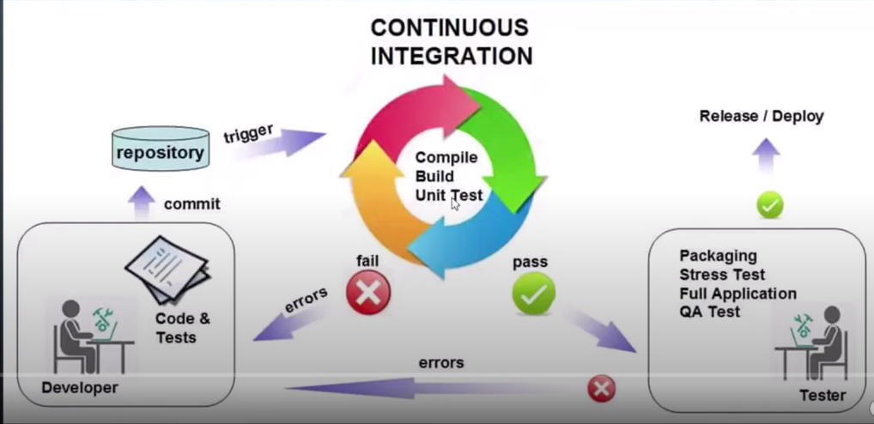
Future State After CI/CD
Benefits
Every commit made in the source code is build & regression tested.
Testers don’t need to wait until end of sprint for begin testing.
Developers doesn’t have to do every steps manually.
For Production Defects Fix immediately move to production as soon as fix completed.

Slide 8
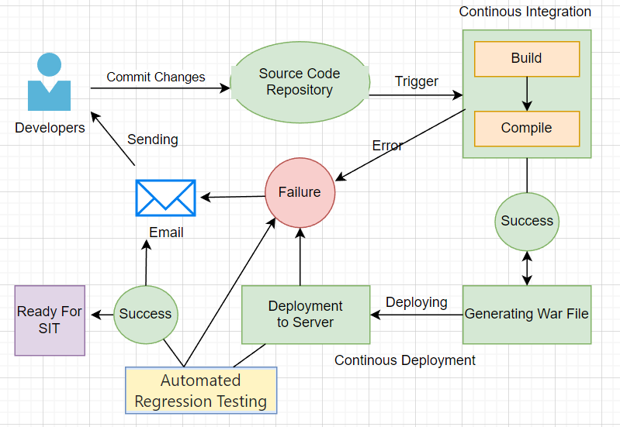
CI/CD Pipeline Proposed Architecture
Benefits
Reduce Deployment Time.
Efficient Software Delivery.
Easier rollback of code changes.
Improved Product Quality.

Slide 9
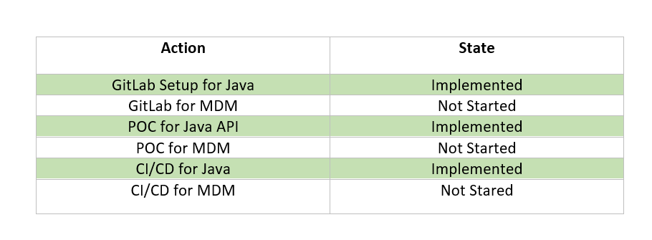
Java/MDM CI/CD Implementation

