Slide 1
Basic Introduction to
Machine Learning
Anurag Srivastava
Software Consultant
Knoldus Software LLP

Slide 2
Topics Covered
What is machine learning
Different kinds of machine learning
Key elements of machine learning
Types of machine learning
Techniques for machine learning

Slide 3

What is Machine Learning ?

Slide 4
What is Machine Learning ?
Machine learning is a type of artificial intelligence (AI) that provides computers with the ability to learn without being explicitly programmed. Machine learning focuses on the development of computer programs that can teach themselves to grow and change when exposed to new data.
Notes:
science of creating algorithms and program which learn on their own. Once designed, they do not need a human to become better. Some of the common applications of machine learning include following: Web Search, spam filters, recommender systems, ad placement, credit scoring, fraud detection, stock trading, computer vision and drug design. An easy way to understand is this - it is humanly impossible to create models for every possible search or spam, so you make the machine intelligent enough to learn by itself. When you automate the later part of data mining - it is known as machine learning.
E. Fredkin University Professor.

Slide 5
Different kinds of machine learning
Data Mining :
Data Mining is the combination Artificial Intelligence and statistical analysis tools that are bringing together to discover hidden information in our data. There are many hidden information in data and these are :
Association
Sequence : Sequence for tie events to together.
Classification : Classification for recognizing patterns.
Forecasting : Forecasting is used for predicting on the based on their past pattern.
Anomalies : Anomalies, outliers, frauds, many different types of things we can do.
Grouping : Grouping of data
Predictive Analysis :
Predictive models and analysis are typically used to forecast future probabilities. Applied to business, predictive models are used to analyze current data and historical facts in order to better understand. It uses a number of techniques, including data mining, statistical modeling and machine learning to help analysts make future business forecasts.
Notes:
In data mining we combine AI and Statical Analysis(study of collection, organization, analysis and presentation of data),We find hidden information from the data like,
Association, sequence, classification, forcasting anomalies and grouping.
In association, data mining function that discovers the probability of the co-occurrence of items in a collection, In sequence, finding statistically relevant patterns between data examples where the values are delivered in a sequence.
Predictive: This is a loosely used term. People running reporting also say that they are analysing data and so do predictive modelers. I would just take this as any attempt to make sense of data can be called as data analysis.

Slide 6
Different kinds of machine learning
Advance Analytic :
It is the autonomous or semi-autonomous process on data using sophisticated techniques and tools. Its beyond of traditional Business Intelligence. It helps to find more deeper information of data, to make prediction and generate recommendations.
Data Science :
Data science is an interdisciplinary field about processes and systems to extract knowledge or insights from data in various forms, either structured or unstructured,which is a continuation of some of the data analysis fields such as statistics, data mining, and predictive analytic, similar to Knowledge Discovery in Databases.
Notes:
Advance Analytic is does not use Business Intelligence. In BI we used earlier information like what happened, when happened but with the help of advance analytic we asked question what will happen, what will be the outcome. So basically with the help of Advance Analytic we work for the future changes.
Data science is the future. It is combination of mathematics, statistics, programming, the context of the problem being solved, with the ways of capturing data that may not be being captured right now plus the ability to look at things

Slide 7
Key elements of machine learning
Explore Data
Find Patterns
Performs Prediction
Notes:
There are two types of data 1. Labeled data(structured data, Images with name, sound with data) 2. Unlabeled data(unstructured data).
1. explore data : we explore whole data and clean it and remove all unnecessary data from the data.
2. Find pattern : we find the patterns between the data and than so we can apply algorithm on that.
3. Perform prediction : after that we apply the algorithm for prediction.
We divide data into 3 part Training Data, Testing Data, validating Data.
Re-substitution error when training and testing data are same. Validation data doesn't always come into play. It's very useful when you have a model on your network when you have to do all the tuning and optimization of the parameters and layers and things like that.

Slide 8
Types of machine learning
Supervised Learning :
Supervised learning is to build a model which can make prediction based on the the previous result. It provide labeled data. So we provide our inputs are provided along with their corresponding class variable, and our goal is to predict the evaluate.
Unsupervised Learning :
Unsupervised learning is data points have no labels associated with them. We don't have any prior knowledge of any information related to the data. We don't have provided class value or output value for each one of our vectors or instances. we are using this in applications of which training data comprises examples of the input without any corresponding target variable and the goal is to find the naturally co-occurring patterns such as groupings or clustering or segmentation.
Notes:
Supervised learning as we learn in the college.
Unsupervised learning, on the other hand, allows us to approach problems with little or no idea what our results should look like. We can derive structure from data where we don't necessarily know the effect of the variables. We can derive this structure by clustering the data based on relationships among the variables in the data. there is no feedback based on the prediction results.

Slide 9
Types of machine learning
Reinforcement learning:
A computer program interacts with a dynamic environment in which it must perform a certain goal, without a teacher explicitly telling it whether it has come close to its goal.
Semi-supervised learning :
It uses unlabeled data for training, typically a small amount of labeled data with a large amount of unlabeled data.
Notes:
Reinforcement Learning is the area of Machine Learning concerned with the actions that software agents ought to take in a particular environment in order to maximize rewards. You can apply Reinforcement Learning to robot control, chess, backgammon, checkers, and other activities that a software agent can learn. Reinforcement Learning uses behaviorist psychology in order to achieve reward maximization.
Semi-supervised learning involves function estimation on labeled and unlabeled data. This approach is motivated by the fact that labeled data is often costly to generate, whereas unlabeled data is generally not. The challenge here mostly involves the technical question of how to treat data mixed in this fashion.

Slide 10
Technique for machine learning
Classification Algorithms - Naive Bayes Method
Naive Bayes's rule is used for finding the probability of events. If we have events E and total number of instance H, So, we can calculate the probability of the events.
Naive Bayes rule is : Pr[H|E]= (𝑷𝒓 [𝑬 |𝑯] 𝑷𝒓[𝑯]) / 𝑷𝒓[𝑬]
Where,
Evidence E = instance Event.
H = class value for instance.
Pr [H|E] = Probability of event after evidence has been seen.
Notes:
Bayes's Rule says if you have a hypothesis H, and an evidence E, that bares on that hypothesis, then we can use this notation that the probability of hypothesis versus the evidence. And we can calculate the probability of the posterior probability and the conditional event of hypothesis, and so the probability of H/E is going to turn out to be result.

Slide 11
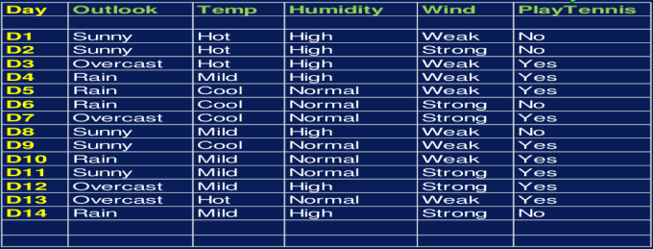
Problem For Naive Bayes's Method

Slide 12
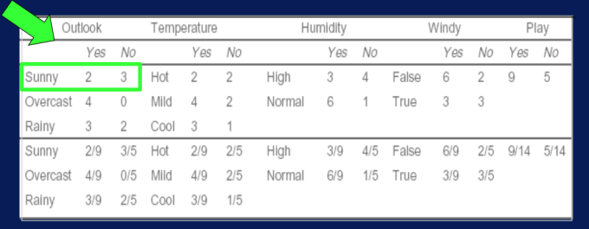
Problem For Naive Bayes's Method

Slide 13

Find the probability condition with the data set :
Pr[Outlook = Sunny | yes] = 2/9
Pr[Temp= Cool | yes] = 3/9
Pr[Humidity= High | yes] = 3/9
Pr[Windy = True | yes] = 3/9
Pr[yes] = 9/14
Pr[Outlook = Sunny | no] = 3/5
Pr[Temp= Cool | no] = 1/5
Pr[Humidity= High | no] = 4/5
Pr[Windy = True | no] = 3/5
Pr[no] = 5/14
Problem For Naive Bayes's Method

Slide 14
Problem For Naive Bayes's Method
P(Yes | Sunny) = (2/9 * 3/9 * 3/9 * 3/9 * 9/14) = .0053
P(No | Sunny) = (3/5 * 1/5 *4/5 * 3/5 * 5/14) = .0206
Now we convert probabilities by normalization :
P[YES] = (.0053) / (.0053 + .0206) = .205
P[NO] = (.0206) / (.0053 + .0206) = .795
So we can see that the probability for not playing tennis in the ~80%.
This is the basic for the Machine Learning and Naive Bayes Method for doing prediction.
Notes:
Web search: ranking page based on what you are most likely to click on.
Computational biology: rational design drugs in the computer based on past experiments.
Finance: decide who to send what credit card offers to. Evaluation of risk on credit offers. How to decide where to invest money.
E-commerce: Predicting customer churn. Whether or not a transaction is fraudulent.
Space exploration: space probes and radio astronomy.
Robotics: how to handle uncertainty in new environments. Autonomous. Self-driving car.
Information extraction: Ask questions over databases across the web.
Social networks: Data on relationships and preferences. Machine learning to extract value from data.
Debugging: Use in computer science problems like debugging. Labor intensive process. Could suggest where the bug could be.

Slide 15
References
Coursera

Slide 16

Any Question?

Slide 17


