Slide 1
Loops
Akash Hegde
Seventh Sense Talent Solutions
Vivekananda Institute of Technology
25 March 2021

Slide 2
Introduction to Loops
When a block of code needs to be executed several number of times.
In general, statements are executed sequentially: The first statement in a function is executed first, followed by the second, and so on.
Programming languages provide various control structures that allow for more complicated execution paths.
A loop statement allows us to execute a statement or group of statements multiple times.

Slide 3
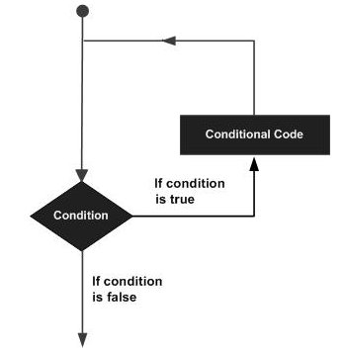
Introduction to Loops
General form of a loop statement in most of the programming languages −

Slide 4
Types of Loops
while loop − Repeats a statement or group of statements while a given condition is true. It tests the condition before executing the loop body.
for loop – Executes a sequence of statements multiple times and abbreviates the code that manages the loop variable.
do..while loop - It is more like a while statement, except that it tests the condition at the end of the loop body.
Nested loop - one or more loops inside any other while, for, or do..while loop.

Slide 5
while Loop
Repeatedly executes a target statement as long as a given condition is true.
Syntax: while(condition) { statement(s); }
Here, statement(s) may be a single statement or a block of statements.
The condition may be any expression, and true is any nonzero value.
The loop iterates while the condition is true.
When the condition becomes false, the program control passes to the line immediately following the loop.

Slide 6
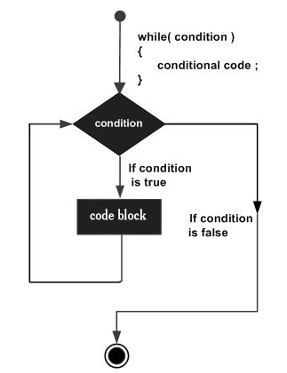
while Loop
Flow diagram –

Slide 7
while Loop
Note: A while loop might not execute at all.
When the condition is tested and the result is false, the loop body will be skipped and the first statement after the while loop will be executed.

Slide 8
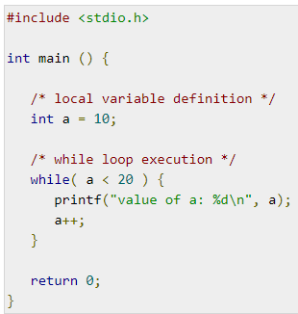
while Loop
Example:

Slide 9
for Loop
A for loop is a repetition control structure that allows you to efficiently write a loop that needs to execute a specific number of times.
Syntax: for( init; condition; increment ) { statement(s); }
The init step is executed first, and only once. This step allows you to declare and initialize any loop control variables. You are not required to put a statement here, as long as a semicolon appears.

Slide 10
for Loop
Next, the condition is evaluated. If it is true, the body of the loop is executed. If it is false, the body of the loop does not execute and the flow of control jumps to the next statement just after the 'for' loop.
After the body of the 'for' loop executes, the flow of control jumps back up to the increment statement. This statement allows you to update any loop control variables. This statement can be left blank, as long as a semicolon appears after the condition.
The condition is now evaluated again. If it is true, the loop executes and the process repeats itself (body of loop, then increment step, and then again condition). After the condition becomes false, the 'for' loop terminates.

Slide 11
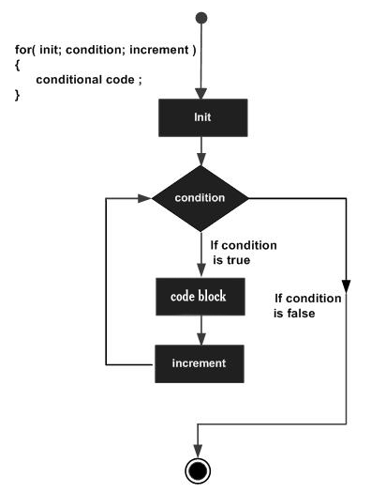
for Loop
Flow diagram -

Slide 12
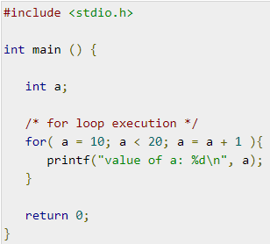
for Loop
Example -

Slide 13
do...while Loop
Unlike for and while loops, which test the loop condition at the top of the loop, the do...while loop in C programming checks its condition at the bottom of the loop.
A do...while loop is similar to a while loop, except the fact that it is guaranteed to execute at least one time.
Syntax: do { statement(s); } while(condition);

Slide 14
do...while Loop
Notice that the conditional expression appears at the end of the loop, so the statement(s) in the loop executes once before the condition is tested.
If the condition is true, the flow of control jumps back up to do, and the statement(s) in the loop executes again. This process repeats until the given condition becomes false.

Slide 15
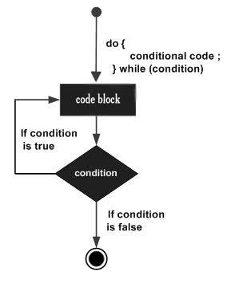
do...while Loop
Flow Diagram -

Slide 16
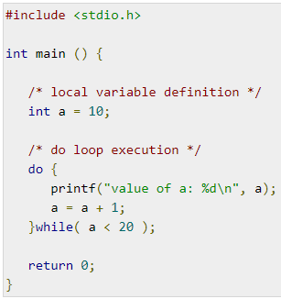
do...while Loop
Example -

Slide 17
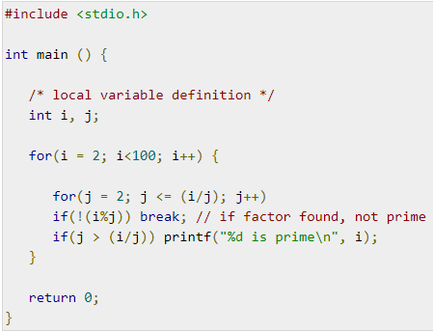
Nested Loop
C programming allows to use one loop inside another loop.
Example:

Slide 18
Loop Control Statements
Loop control statements change execution from its normal sequence.
When execution leaves a scope, all automatic objects that were created in that scope are destroyed.
Types of loop control statements:
break
continue
goto

Slide 19
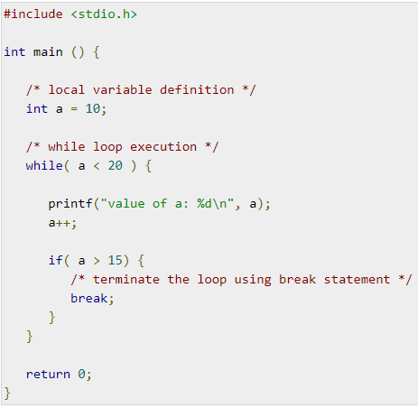
break statement
break - Terminates the loop or switch statement and transfers execution to the statement immediately following the loop or switch.
Example:

Slide 20
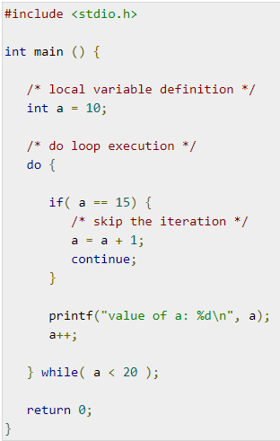
continue statement
continue - Causes the loop to skip the remainder of its body and immediately retest its condition prior to reiterating.
Example:

Slide 21
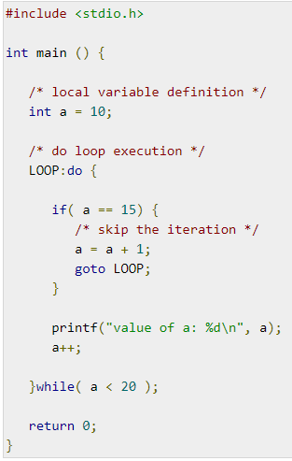
goto statement
goto - Transfers control to the labeled statement.
Example:

Slide 22
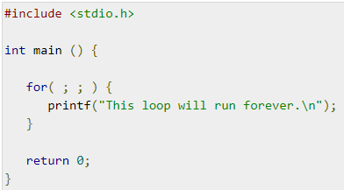
Infinite Loop
A loop becomes an infinite loop if a condition never becomes false.
The for loop is traditionally used for this purpose.
Since none of the three expressions that form the 'for' loop are required, you can make an endless loop by leaving the conditional expression empty.
Example:

Slide 23
Thank you!

