Slide 1
Trees
Akash Hegde
Seventh Sense Talent Solutions
Vivekananda Institute of Technology
26 March 2021

Slide 2
Introduction to Tree
Tree represents the nodes connected by edges.
We will discuss binary tree or binary search tree specifically.
Binary Tree is a special data structure used for data storage purposes.
A binary tree has a special condition that each node can have a maximum of two children.
A binary tree has the benefits of both an ordered array and a linked list as search is as quick as in a sorted array and insertion or deletion operation are as fast as in linked list.

Slide 3
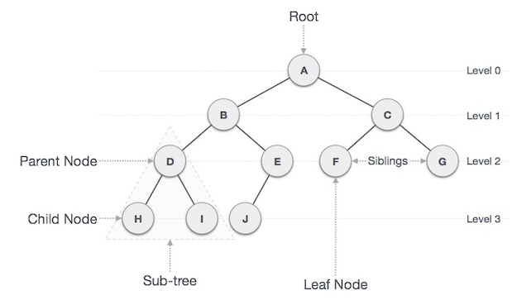
Introduction to Tree
Representation of a tree –

Slide 4
Tree Terminology
Path − Path refers to the sequence of nodes along the edges of a tree.
Root − The node at the top of the tree is called root. There is only one root per tree and one path from the root node to any node.
Parent − Any node except the root node has one edge upward to a node called parent.
Child − The node below a given node connected by its edge downward is called its child node.
Leaf − The node which does not have any child node is called the leaf node.

Slide 5
Tree Terminology
Subtree − Subtree represents the descendants of a node.
Visiting − Visiting refers to checking the value of a node when control is on the node.
Traversing − Traversing means passing through nodes in a specific order.
Levels − Level of a node represents the generation of a node. If the root node is at level 0, then its next child node is at level 1, its grandchild is at level 2, and so on.
Keys − Key represents a value of a node based on which a search operation is to be carried out for a node.

Slide 6
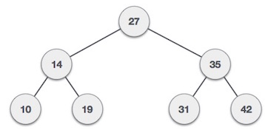
Binary Search Tree – Introduction
Binary Search Tree exhibits a special behavior.
A node's left child must have a value less than its parent's value and the node's right child must have a value greater than its parent value.

Slide 7
Binary Search Tree – Implementation
Tree is represented as a node.
In a tree, all nodes share common construct.
struct node { int data; struct node *leftChild; struct node *rightChild; };

Slide 8
Binary Search Tree – Operations
Insert − Inserts an element in a tree, OR, create a tree.
Search − Searches an element in a tree.
Preorder Traversal − Traverses a tree in a pre-order manner.
Inorder Traversal − Traverses a tree in an in-order manner.
Postorder Traversal − Traverses a tree in a post-order manner.

Slide 9
Binary Search Tree – Insert
The very first insertion creates the tree.
Afterwards, whenever an element is to be inserted, first locate its proper location.
Start searching from the root node, then if the data is less than the key value, search for the empty location in the left subtree and insert the data.
Otherwise, search for the empty location in the right subtree and insert the data.

Slide 10
Binary Search Tree – Insert
Algorithm: If root is NULL then create root node return If root exists then compare the data with node.data while until insertion position is located If data is greater than node.data goto right subtree else goto left subtree endwhile insert data end If

Slide 11
Binary Search Tree – Search
Whenever an element is to be searched, start searching from the root node, then if the data is less than the key value, search for the element in the left subtree.
Otherwise, search for the element in the right subtree.
Follow the same algorithm for each node.

Slide 12
Binary Search Tree – Search
Algorithm: If root.data is equal to search.data return root else while data not found If data is greater than node.data goto right subtree else goto left subtree If data found return node endwhile return data not found end if

Slide 13
Binary Search Tree – Tree Traversal
Traversal is a process to visit all the nodes of a tree and may print their values too.
Because, all nodes are connected via edges (links) we always start from the root (head) node.
That is, we cannot randomly access a node in a tree.
There are three ways which we use to traverse a tree −
In-order Traversal
Pre-order Traversal
Post-order Traversal
Generally, we traverse a tree to search or locate a given item or key in the tree or to print all the values it contains.

Slide 14
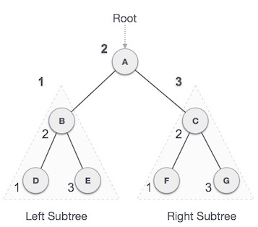
Binary Search Tree – In-order Traversal
In this traversal method, the left subtree is visited first, then the root and later the right sub-tree.
Every node may represent a subtree itself.

Slide 15
Binary Search Tree – In-order Traversal
We start from A, and following in-order traversal, we move to its left subtree B.
B is also traversed in-order.
The process goes on until all the nodes are visited.
The output of inorder traversal of this tree will be − D → B → E → A → F → C → G
Algorithm: Until all nodes are traversed − Step 1 − Recursively traverse left subtree. Step 2 − Visit root node. Step 3 − Recursively traverse right subtree.

Slide 16
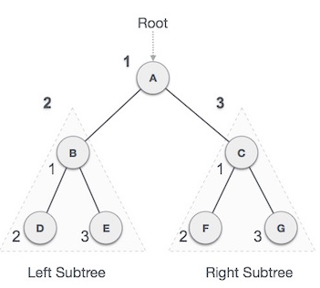
Binary Search Tree – Pre-order Traversal
In this traversal method, the root node is visited first, then the left subtree and finally the right subtree.
Every node may represent a subtree itself.
If a binary tree is traversed pre-order, the output will produce sorted key values in an ascending order.

Slide 17
Binary Search Tree – Pre-order Traversal
We start from A, and following pre-order traversal, we first visit A itself and then move to its left subtree B.
B is also traversed pre-order.
The process goes on until all the nodes are visited.
The output of pre-order traversal of this tree will be − A → B → D → E → C → F → G
Algorithm: Until all nodes are traversed − Step 1 − Visit root node. Step 2 − Recursively traverse left subtree. Step 3 − Recursively traverse right subtree.

Slide 18
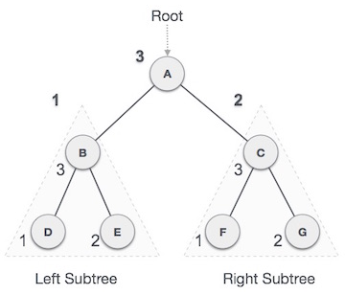
Binary Search Tree – Post-order Traversal
In this traversal method, the root node is visited last, hence the name.
First we traverse the left subtree, then the right subtree and finally the root node.
Every node may represent a subtree itself.

Slide 19
Binary Search Tree – Post-order Traversal
We start from A, and following Post-order traversal, we first visit the left subtree B.
B is also traversed post-order.
The process goes on until all the nodes are visited.
The output of post-order traversal of this tree will be − D → E → B → F → G → C → A
Algorithm: Until all nodes are traversed − Step 1 − Recursively traverse left subtree. Step 2 − Recursively traverse right subtree. Step 3 − Visit root node.

Slide 20
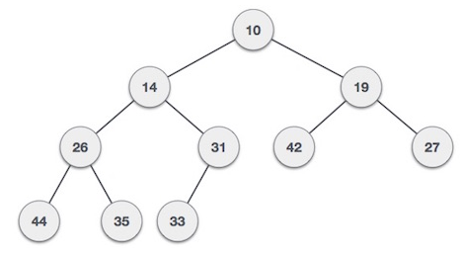
Heap
Heap is a special case of balanced binary tree data structure where the root-node key is compared with its children and arranged accordingly.
Min-Heap − Where the value of the root node is less than or equal to either of its children.

Slide 21
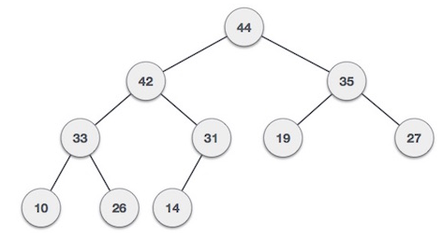
Heap
Max-Heap − Where the value of the root node is greater than or equal to either of its children.

Slide 22
Thank you!

