Slide 1
Pointers
Akash Hegde
Seventh Sense Talent Solutions
Vivekananda Institute of Technology
25 March 2021

Slide 2
Introduction to Pointers
Some C programming tasks are performed more easily with pointers, and other tasks, such as dynamic memory allocation, cannot be performed without using pointers.
Every variable is a memory location and every memory location has its address defined which can be accessed using ampersand (&) operator, which denotes an address in memory.

Slide 3
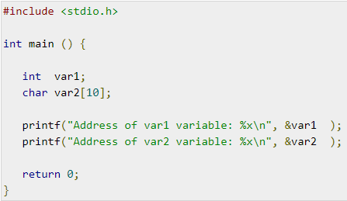
Introduction to Pointers
Example (without pointer):

Slide 4
Introduction to Pointers
A pointer is a variable whose value is the address of another variable, i.e., direct address of the memory location.
Like any variable or constant, you must declare a pointer before using it to store any variable address.
Syntax: type *var_name;
Here, type is the pointer's base type; it must be a valid C data type and var-name is the name of the pointer variable.

Slide 5
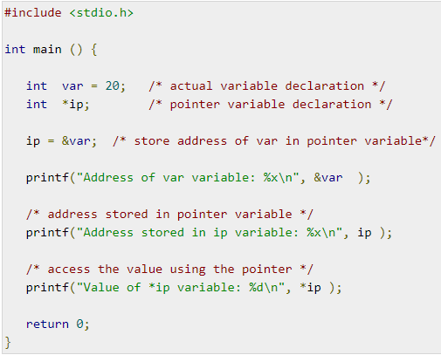
Introduction to Pointers
Example (with pointer):

Slide 6
NULL Pointers
It is always a good practice to assign a NULL value to a pointer variable in case you do not have an exact address to be assigned.
This is done at the time of variable declaration.
A pointer that is assigned NULL is called a null pointer.
The NULL pointer is a constant with a value of zero defined in several standard libraries.

Slide 7
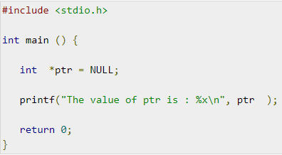
NULL Pointers
Example:

Slide 8
NULL Pointers
In most of the operating systems, programs are not permitted to access memory at address 0 because that memory is reserved by the operating system.
However, the memory address 0 has special significance; it signals that the pointer is not intended to point to an accessible memory location.
But by convention, if a pointer contains the null (zero) value, it is assumed to point to nothing.

Slide 9
Pointer Arithmetic
A pointer in C is an address, which is a numeric value.
Therefore, you can perform arithmetic operations on a pointer just as you can on a numeric value.
There are four arithmetic operators that can be used on pointers: ++, --, +, and -
Other than this, comparison operations can also be done with pointers.
To understand pointer arithmetic, let us consider that ptr is an integer pointer which points to the address 1000.

Slide 10
Pointer Arithmetic
Assuming 32-bit integers, let us perform the following arithmetic operation on the pointer: ptr++
After the above operation, the ptr will point to the location 1004 because each time ptr is incremented, it will point to the next integer location which is 4 bytes next to the current location.
This operation will move the pointer to the next memory location without impacting the actual value at the memory location.
If ptr points to a character whose address is 1000, then the above operation will point to the location 1001 because the next character will be available at 1001.

Slide 11
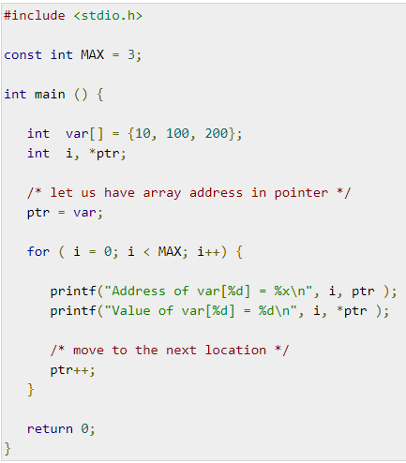
Incrementing a Pointer
Example to increment the variable pointer to access each succeeding element of the array:

Slide 12
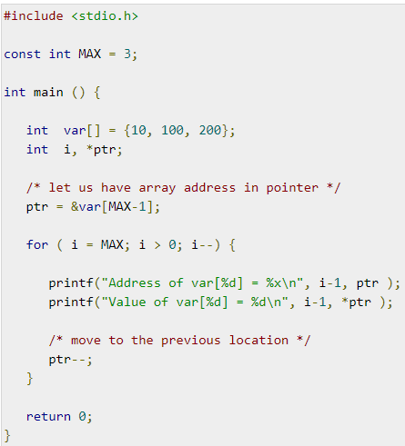
Decrementing a Pointer
Example to decrement the variable pointer to access each preceding element of the array:

Slide 13
Pointer Comparisons
Pointers may be compared by using relational operators, such as ==, <, and >.
If p1 and p2 point to variables that are related to each other, such as elements of the same array, then p1 and p2 can be meaningfully compared.
Example to increment the variable pointer so long as the address to which it points is either less than or equal to the address of the last element of the array, which is &var[MAX - 1]:

Slide 14
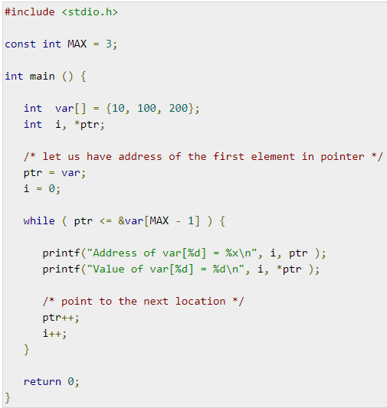
Pointer Comparisons

Slide 15
Array of Pointers
There may be a situation when we want to maintain an array, which can store pointers to an int or char or any other data type available.
Following is the declaration of an array of pointers to an integer − int *ptr[MAX];
It declares ptr as an array of MAX integer pointers. Thus, each element in ptr, holds a pointer to an int value.

Slide 16
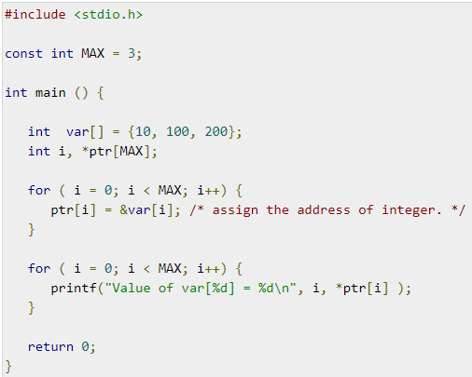
Array of Pointers
Example to store integers in an array of pointers:

Slide 17
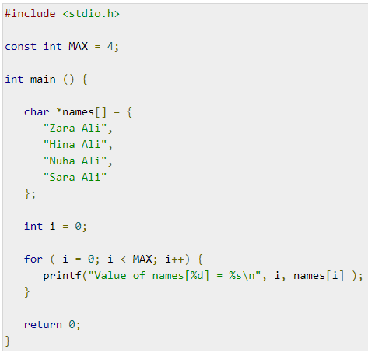
Array of Pointers
Example to store list of strings in an array of pointers:

Slide 18

Pointer to Pointer
A pointer to a pointer is a form of multiple indirection, or a chain of pointers.
Normally, a pointer contains the address of a variable.
When we define a pointer to a pointer, the first pointer contains the address of the second pointer, which points to the location that contains the actual value as shown below.

Slide 19
Pointer to Pointer
A variable that is a pointer to a pointer must be declared as such.
This is done by placing an additional asterisk in front of its name.
For example, the following declaration declares a pointer to a pointer of type int − int **var;
When a target value is indirectly pointed to by a pointer to a pointer, accessing that value requires that the asterisk operator be applied twice.

Slide 20
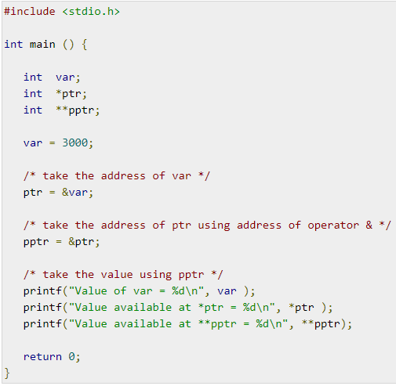
Pointer to Pointer
Example:

Slide 21
Thank you!

