Slide 1
ADVANCES IN ALGORITHMS (18MCS2D2)
SNAKE GAME WITH GENETIC ALGORITHM
Guided by:
Praveena T.
Assistant Professor, Dept. of CSE
Submitted by:
Akash Hegde – 1RV18SCN01

Slide 2
AGENDA
Introduction to Snake Game
Introduction to Genetic Algorithm
Creating Snake Game
Training Snake Game with Genetic Algorithm
Conclusion and Future Scope

Slide 3
INTRODUCTION TO SNAKE GAME
Snake – a player manoeuvres a line (snake) which grows in length as it consumes blocks (food).
Primary obstacles – the boundaries and the snake itself.
Preloaded on Nokia phones in 1998 – became popular.
Objective – to consume as many food blocks as possible and obtain highest score.
Game Over scenario – snake runs into the boundaries or itself.

Slide 4
INTRODUCTION TO GENETIC ALGORITHM
Metaheuristic inspired by the process of natural selection.
“Survival depends not on the strongest or most intelligent of species, but those who adapt to change.” – Charles Darwin, Theory of Evolution.
Uses – generate high-quality solutions to optimization and search problems.
Operators – mutation, crossover and selection.
Requires initial population in the solution domain and fitness function to find the fittest individual.

Slide 5
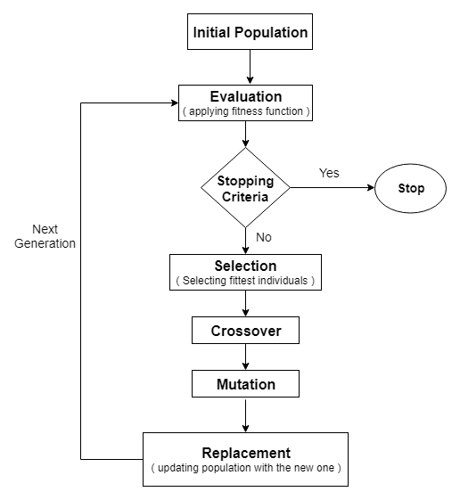
INTRODUCTION TO GENETIC ALGORITHM
Steps of a Genetic Algorithm

Slide 6
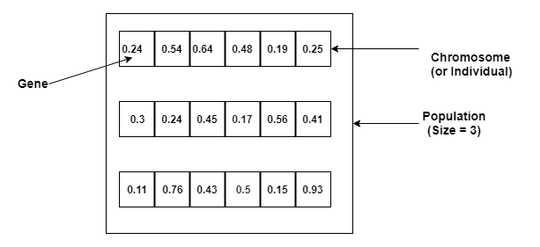
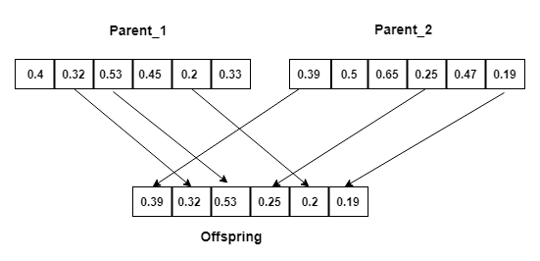
INTRODUCTION TO GENETIC ALGORITHM
Initial Population
Crossover

Slide 7
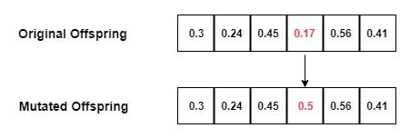
INTRODUCTION TO GENETIC ALGORITHM
Mutation
Applied to train neural networks instead of techniques like gradient descent.
Used to select the neural network architecture with respect to hyperparameters.

Slide 8
CREATING SNAKE GAME
Pygame – free and open-source programming library for making multimedia applications.
Initialization – pygame.init()
Game window – 500x500.
Display of snake and apple – pygame.draw.rect() and display.blit()
Define frame rate – pygame.time.Clock() and clock.tick()
Directions and movement.
Running game and displaying score at the end of the game.

Slide 9
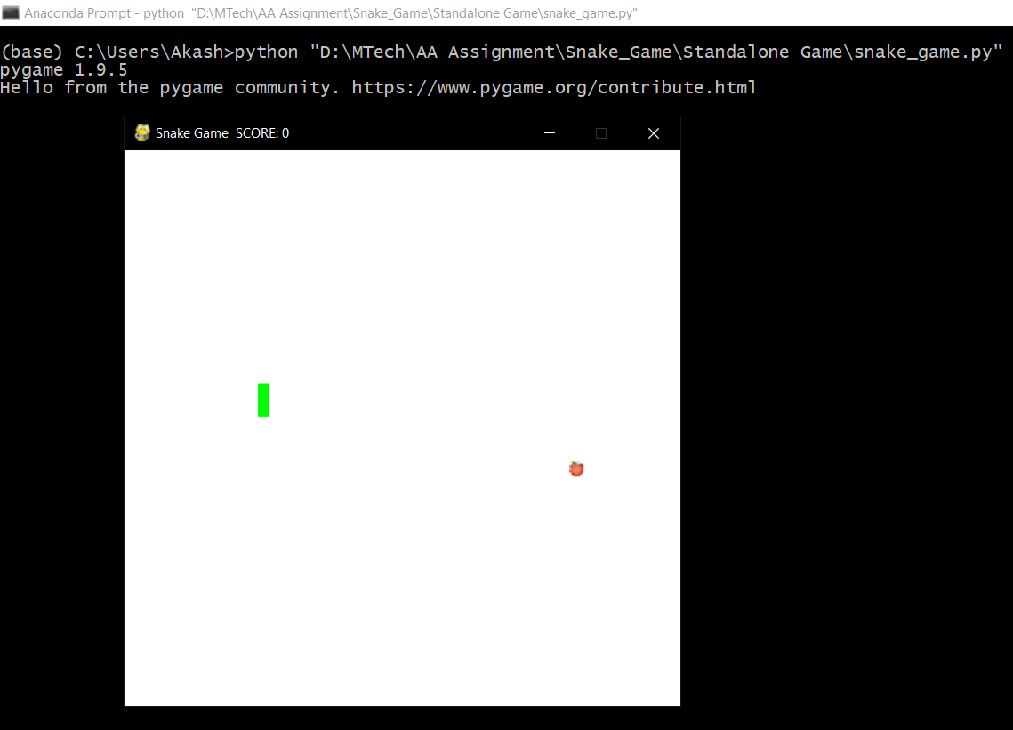
CREATING SNAKE GAME
Snake Game in Progress

Slide 10
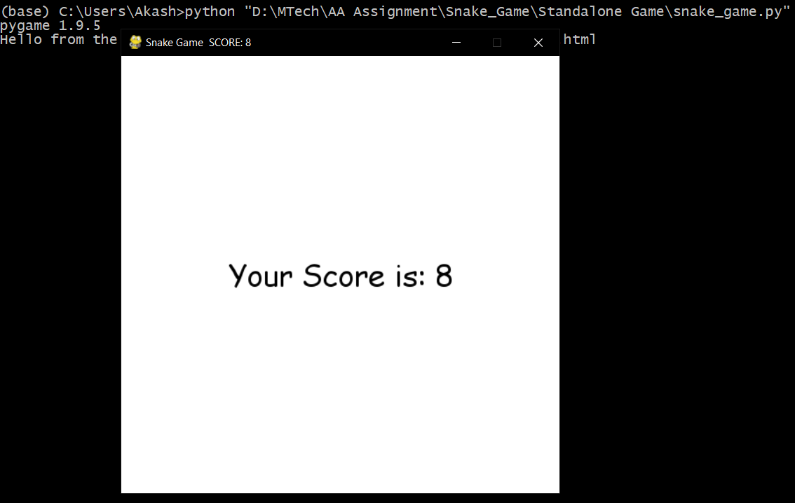
CREATING SNAKE GAME
Displaying the Score Board

Slide 11
TRAINING SNAKE GAME WITH GENETIC ALGORITHM
Creating a snake game and deciding neural network architecture.
Creating an initial population.
Deciding the fitness function.
Play a game for each individual in the population and sort each individual in the population based on the fitness function score.

Slide 12
TRAINING SNAKE GAME WITH GENETIC ALGORITHM
Select a few top individuals from the population and create the remaining population from these top selected individuals using crossover and mutation.
The new population is created (meaning the next generation).
Repeat until the stopping criteria are not satisfied.
Neural network –
Input layer – 7 units.
Output layer – 3 units.
Hidden layers – 9 units and 15 units.

Slide 13
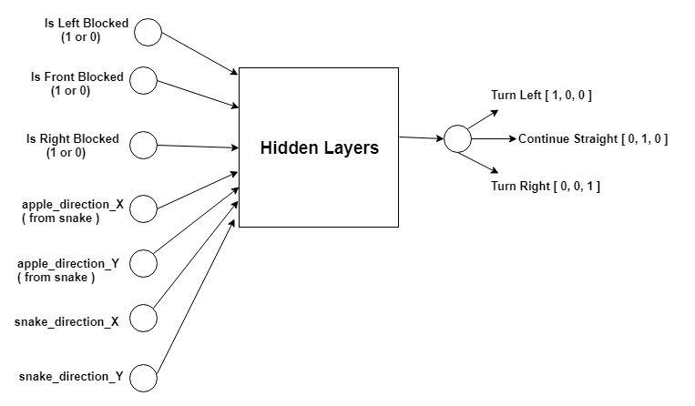
TRAINING SNAKE GAME WITH GENETIC ALGORITHM
Neural Network Architecture

Slide 14
TRAINING SNAKE GAME WITH GENETIC ALGORITHM
Initial population – 30 individuals.
Fitness function – every grasp of food gives 5000 points and every loss (Game Over) has penalty of 150 points.
Number of generations – 5
Number of steps in each game – 2500
5 Python scripts –
main.py
Snake_Game.py
Run_Game.py
Genetic_Algorithm.py
Feed_Forward_Neural_Network.py

Slide 15
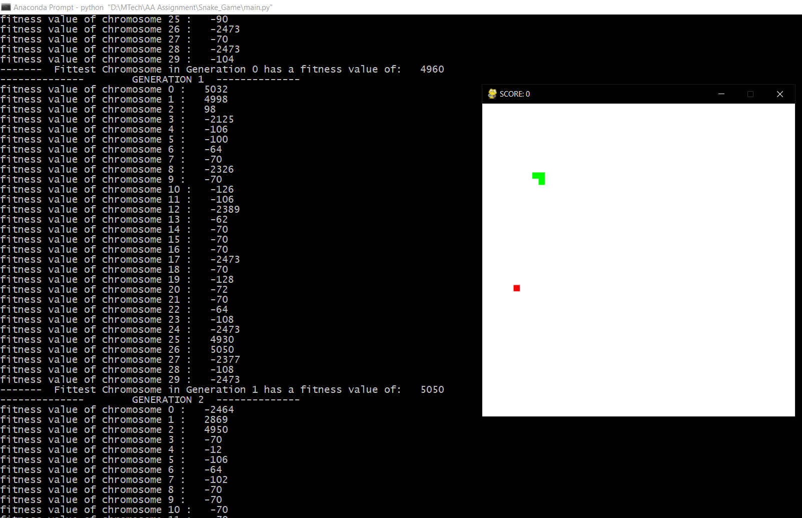
TRAINING SNAKE GAME WITH GENETIC ALGORITHM
Training in Progress

Slide 16
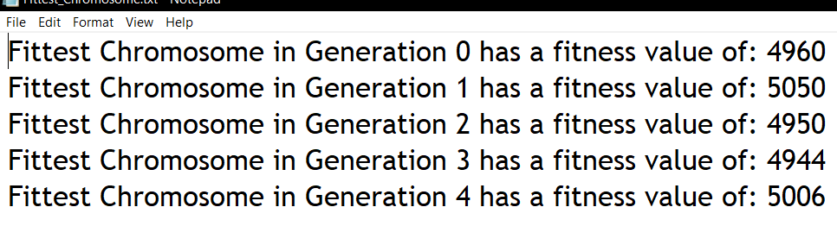
TRAINING SNAKE GAME WITH GENETIC ALGORITHM
Output of Fittest Chromosome in Each Generation

Slide 17
CONCLUSION AND FUTURE SCOPE
Snake Game is a popular and simple game which consists of a snake growing in length as it consumes food.
Genetic Algorithm is a metaheuristic inspired by the process of natural selection and consists of selection, crossover and mutation operations.
Snake game is trained using combination of genetic algorithm and neural network.
5 generations, 2500 steps per game and 30 individuals.
Future scope – using deep learning techniques and real-time speech recognition.
Created using OpenCV, Python Curses and Tensorflow Object Detection API.

Slide 18
THANK YOU

