Slide 1

MINOR PROJECT PRESENTATION
PHASE-II
Department of Computer Science and Engineering,
R V College of Engineering, Bengaluru

Slide 2
IMPLEMENTATION OF A DEFENSE MECHANISM FOR SYN FLOOD ATTACK
Guided by:
Dr. Sowmyarani C. N.
Associate Professor, Dept. of CSE, RVCE
Submitted by:
Akash Hegde – 1RV18SCN01
Krithika L – 1RV18SCN08

Slide 3
AGENDA
Objectives
Experimental Setup
Demonstration
Experimental Results
Comparative Analysis
Testing
Conclusion
Future Enhancements

Slide 4
OBJECTIVES
Understand the working of SYN Flood attack and its effects on legitimate users of the system.
Goal – provide a better solution for defending against a SYN Flood attack using iptables rules with minimum configuration and faster execution.

Slide 5
EXPERIMENTAL SETUP
Virtual Machines (VMs) setup on the Oracle VirtualBox 6.0.8.
VMs configured with host-only network adapters.
Ubuntu 16.04 LTS OS (Linux) used for the VMs.
Two types of attack environments:
single attacker, single target (DoS)
multiple attackers, single target (DDoS)
Python 3.6 with Scapy 2.4 used to script the SYN flood attack.

Slide 6
EXPERIMENTAL SETUP
Source ports – randomized.
Destination ports – 22 (SSH) and 80 (HTTP).
Shell script written to defend against the SYN Flood attack.
iptables rule chains to accept/reject packets over the ports.
Wireshark packet analyzer tool used to capture and analyze the packets.

Slide 7
DEMONSTRATION
Packet generated by srloop function in scapy.
SYN
SYN replied back by target system with SYN-ACK.
SYN-ACK
Attacker’s system kernel RST packet blocked by iptables.
RST
X
SYN-ACK
No RST received from attacker for the random ports. Send SYN-ACK again.
SYN-ACK
SYN-ACK
Attacker
Target
Without Defense Mechanism

Slide 8
DEMONSTRATION
Packet generated by srloop function in scapy.
SYN
SYN replied back by target system with SYN-ACK.
SYN-ACK
Attacker’s system kernel RST packet blocked by iptables.
RST
X
No RST received from attacker for the random ports. Send SYN-ACK again.
SYN-ACK
RST
After specific time interval, target server sends RST packets to all connections in WAIT state using iptables.
RST
Attacker
Target
With Defense Mechanism

Slide 9
DEMONSTRATION
Individual VMs booted up.
Wireshark opened in target system – checking for received packets.
iptables rules defined to accept the packets.
Attack script run on one attacker VM (DoS).
Output observed in Wireshark and log files.
Attack script run on all the VMs (DDoS).
Output observed in Wireshark and log files once again.

Slide 10
DEMONSTRATION
Defense shell script run in the target VM.
Attack script run in all the VMs together.
Final output observed in Wireshark and the log files.

Slide 11
EXPERIMENTAL RESULTS
SYN flood occurs extremely fast due to less intervals and time-to-live (TTL) value.
Continuous RST+ACK observed in output without defense mechanism → buffer overflow.
Continuous RST+ACK observed in output with defense mechanism → packets rejected.
iptables allow easier filtering of the packet flow – only necessary packets are allowed into the network.

Slide 12
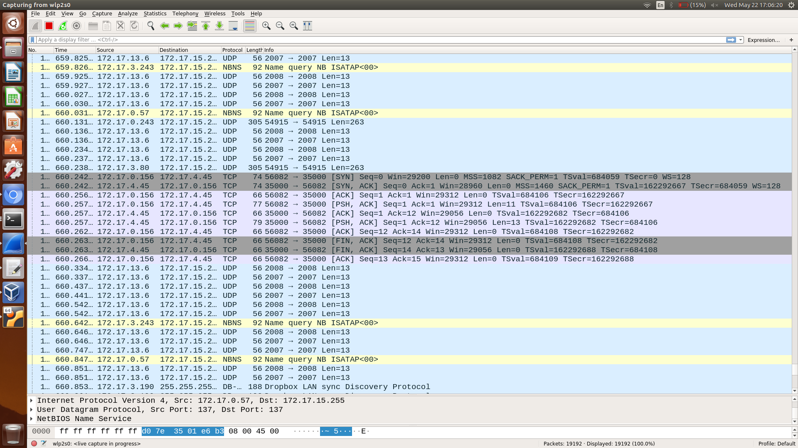
EXPERIMENTAL RESULTS
TCP 3-way Handshake

Slide 13
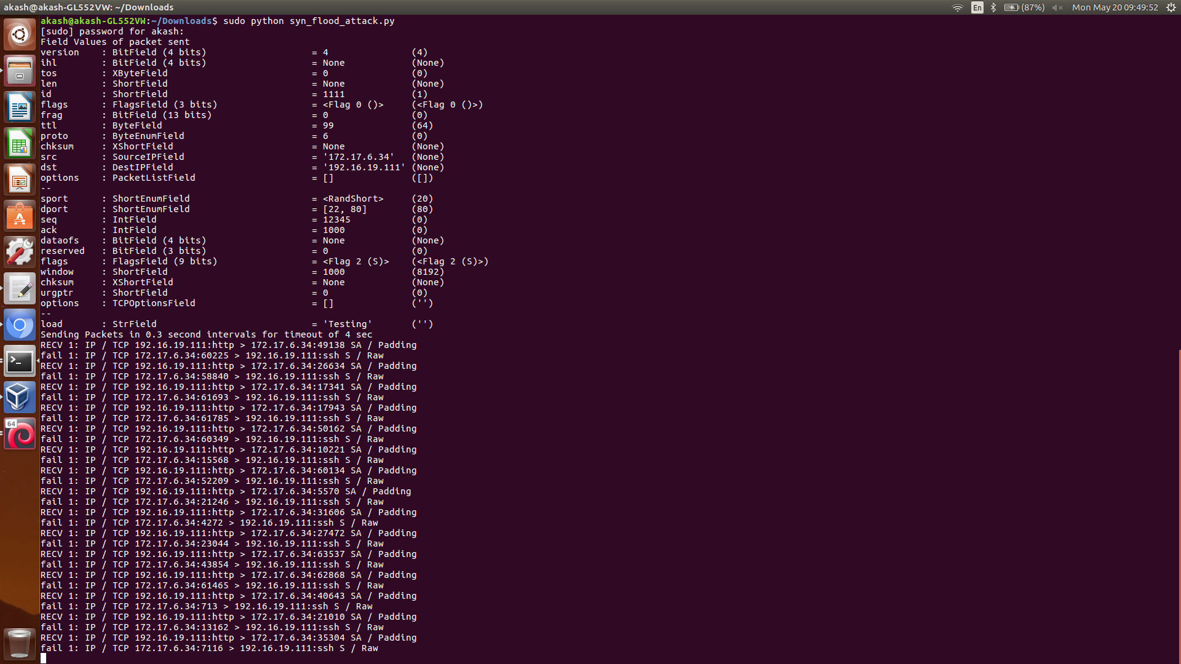
EXPERIMENTAL RESULTS
Logged output for the 3-way handshake

Slide 14
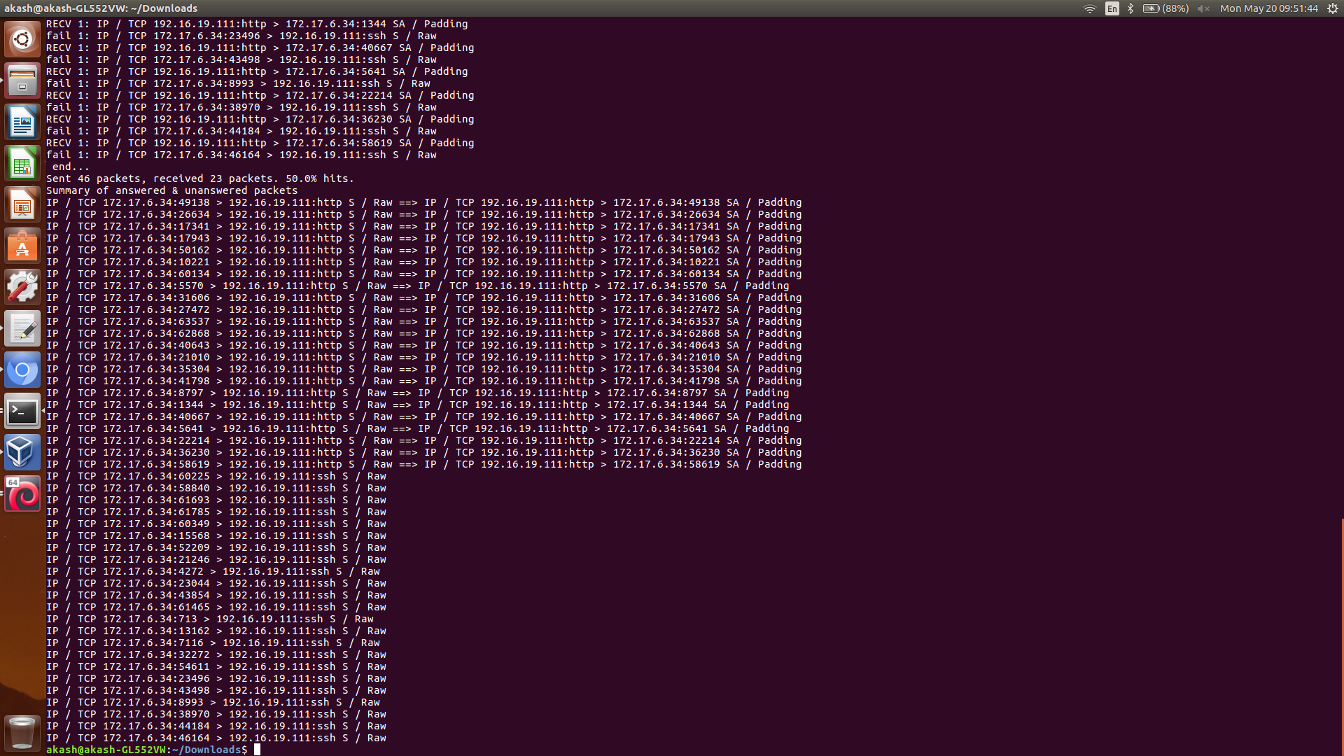
EXPERIMENTAL RESULTS
Summary of the transmitted packets

Slide 15
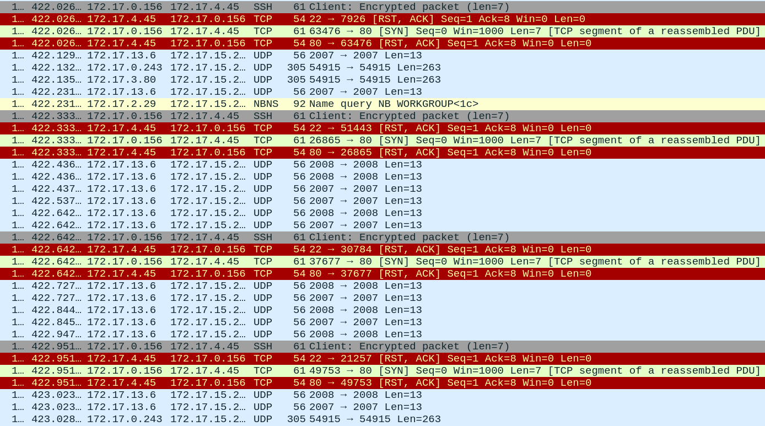
EXPERIMENTAL RESULTS
RST-ACK received upon SYN flooding

Slide 16
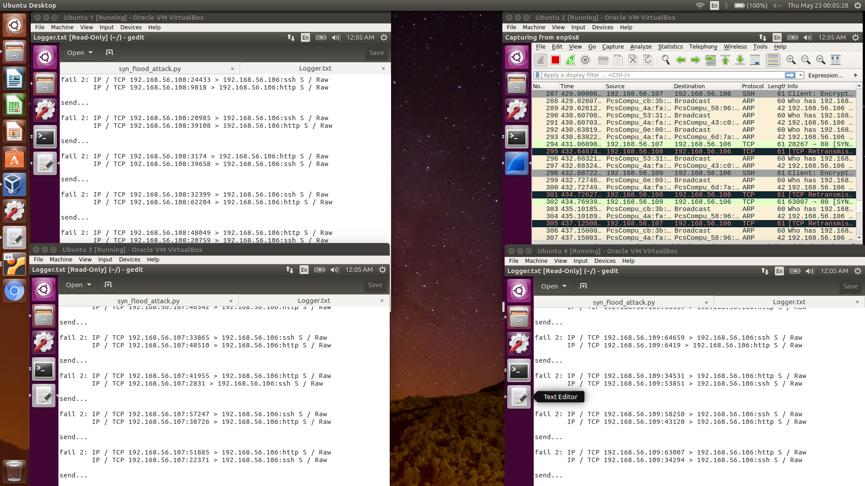
EXPERIMENTAL RESULTS
DDoS Implementation of SYN Flood

Slide 17
COMPARATIVE ANALYSIS
SYN Flood compared against ICMP Flood (Ping of Death) with respect to attack time and average round trip time (RTT).
Similar environment setup as SYN Flood – multiple attackers, one target.
Ping commands run on the attacker machines and output observed at the target via Wireshark.

Slide 18
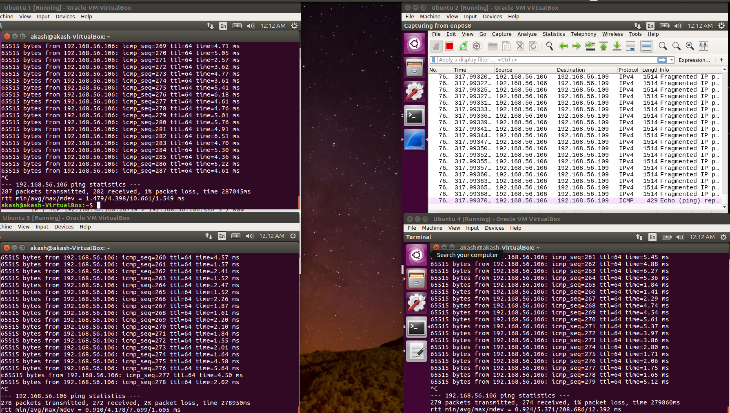
COMPARATIVE ANALYSIS
Implementation of ICMP Flood

Slide 19
COMPARATIVE ANALYSIS
Total attack time observed to be lesser for SYN Flood than ICMP Flood (No. of packets = 100).
Trials (No. of packets = 100) | Total Attack Time for SYN Flood | Total Attack Time for ICMP Flood
Trial 1 | 31.56 s | 92.74 s
Trial 2 | 30.78 s | 93.98 s
Trial 3 | 31.73 s | 91.54 s
Trial 4 | 29.43 s | 92.09 s
Trial 5 | 30.21 s | 93.17 s

Slide 20
COMPARATIVE ANALYSIS
Total attack time observed to be lesser for SYN Flood than ICMP Flood (No. of packets = 200).
Trials (No. of packets = 200) | Total Attack Time for SYN Flood | Total Attack Time for ICMP Flood
Trial 1 | 62.64 s | 189.23 s
Trial 2 | 61.12 s | 188.07 s
Trial 3 | 59.93 s | 190.35 s
Trial 4 | 60.76 s | 191.54 s
Trial 5 | 61.33 s | 189.88 s

Slide 21
COMPARATIVE ANALYSIS
Total attack time observed to be lesser for SYN Flood than ICMP Flood (No. of packets = 300).
Trials (No. of packets = 300) | Total Attack Time for SYN Flood | Total Attack Time for ICMP Flood
Trial 1 | 89.64 s | 278.95 s
Trial 2 | 91.82 s | 287.04 s
Trial 3 | 90.73 s | 279.86 s
Trial 4 | 90.01 s | 280.45 s
Trial 5 | 88.62 s | 279.08 s

Slide 22
COMPARATIVE ANALYSIS

Slide 23
COMPARATIVE ANALYSIS

Slide 24
COMPARATIVE ANALYSIS

Slide 25
COMPARATIVE ANALYSIS
Average RTT observed to be lesser for SYN Flood than ICMP Flood (No. of packets = 100).
Trials (No. of packets = 100) | Average RTT for SYN Flood | Average RTT for ICMP Flood
Trial 1 | 0.66 ms | 2.43 ms
Trial 2 | 0.68 ms | 2.54 ms
Trial 3 | 0.65 ms | 2.48 ms
Trial 4 | 0.70 ms | 2.69 ms
Trial 5 | 0.62 ms | 2.77 ms

Slide 26
COMPARATIVE ANALYSIS
Average RTT observed to be lesser for SYN Flood than ICMP Flood (No. of packets = 200).
Trials (No. of packets = 200) | Average RTT for SYN Flood | Average RTT for ICMP Flood
Trial 1 | 0.76 ms | 3.46 ms
Trial 2 | 0.78 ms | 3.39 ms
Trial 3 | 0.71 ms | 3.51 ms
Trial 4 | 0.72 ms | 3.66 ms
Trial 5 | 0.81 ms | 3.25 ms

Slide 27
COMPARATIVE ANALYSIS
Average RTT observed to be lesser for SYN Flood than ICMP Flood (No. of packets = 300).
Trials (No. of packets = 300) | Average RTT for SYN Flood | Average RTT for ICMP Flood
Trial 1 | 0.89 ms | 4.39 ms
Trial 2 | 0.98 ms | 4.17 ms
Trial 3 | 0.93 ms | 5.37 ms
Trial 4 | 0.86 ms | 5.24 ms
Trial 5 | 0.89 ms | 4.77 ms

Slide 28
COMPARATIVE ANALYSIS

Slide 29
COMPARATIVE ANALYSIS

Slide 30
COMPARATIVE ANALYSIS

Slide 31
TESTING
Unit Testing – each script is tested under different parameters. Example: varying TCP connection values.
Integration Testing – both scripts are run with all VMs.
System Testing – test for entire system, including OS, VM environment, adapters.

Slide 32
CONCLUSION
A study is made on Denial of Service (DoS) and its distributed variant DDoS.
A brief study is made on iptables and its rules.
Flooding results in closing of established connection and TCP reset.
iptables allow for easier filtering of packets.
Total attack time and average RTT of SYN Flood is comparatively lesser than that of ICMP Flood (Ping of Death).

Slide 33
FUTURE ENHANCEMENTS
Automated setting of iptables rules from detection of malformed incoming packets.
Blacklist frequent attacking IPs and improve response time.

Slide 34
REFERENCES
[1] | Nagai R., Kurihara W., Higuchi S. and Hirots T., "Design and Implementation of an OpenFlow-based TCP SYN Flood Mitigation", IEEE International Conference on Mobile Cloud Computing, Services, and Engineering, Bamberg, Germany, 2018, pp. 37-42.
[2] | Thang T. M., Nguyen C. Q. and Nguyen V. K., "Synflood Spoofed Source DDoS Attack Defense Based on Packet ID Anomaly Detection with Bloom Filter", Asian Conference on Defense Technology (ACDT), Hanoi, Vietnam, 2018, pp. 75-80.
[3] | Kavisankar L., Chellappan C., Venkatesan S. and Sivasankar P., "Efficient SYN spoofing Detection and Mitigation Scheme for DDoS attack", International Conference on Recent Trends and Challenges in Computational Models (ICRTCCM), Tindivanam, India, 2017, pp. 269-274.
[4] | Rani D. D., Krishna T. V. S., Dayanandam G. and Rao T. V., "TCP Syn Flood Attack Detection And Prevention", International Journal of Computer Trends and Technology (IJCTT), vol. 4, issue10, 2013, pp. 3412-3417.
[5] | Al-Musawi B. Q. M., "Mitigating DoS/DDoS Attacks using iptables", International Journal of Engineering & Technology IJET-IJENS, vol. 12 issue 03, 2012, pp. 101-111.

