Slide 1

MINOR PROJECT PRESENTATION
PHASE-I
Department of Computer Science and Engineering
R V College of Engineering, Bengaluru

Slide 2
IMPLEMENTATION OF A DEFENSE MECHANISM FOR SYN FLOOD ATTACK
Guided by:
Dr. Sowmyarani C. N.
Associate Professor, Dept. of CSE, RVCE
Submitted by:
Akash Hegde – 1RV18SCN01
Krithika L – 1RV18SCN08

Slide 3
INTRODUCTION
SYN Flood attack – a form of denial-of-service (DoS) attack.
Here the attacker sends a succession of SYN requests to a target’s system.
An attempt is made to consume enough server resources to make the system unresponsive to the legitimate traffic.

Slide 4
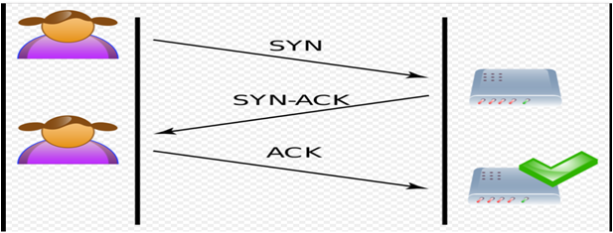

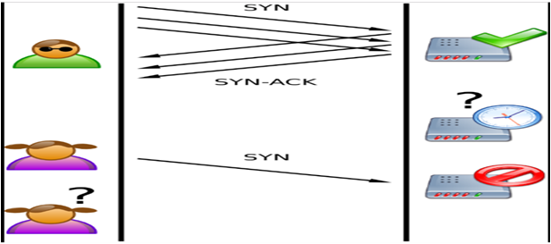


Slide 5
OBJECTIVES
Implement a SYN Flood attack and analyze the attack.
Goal – provide a better solution for defending against a SYN Flood attack using iptables rules with minimum configuration and faster execution.

Slide 6
LITERATURE SURVEY
Sl.No | Authors and Publications | Topic
01 | Ryosuke Nagai, et al., IEEE Transactions, Oct. 2018. | "Design and Implementation of OpenFlow-based TCP SYN Flood Mitigation"
02 | Tran Manh Thang, et al., IEEE ACDT, Oct. 2018. | “Synflood Spoofed Source DDoS Attack Defense Based on Packet ID Anomaly Detection with Bloom Filter"
03 | Kavisankar L, et al., International Journal on Recent Trends and Challenges in Computational Models, Jul. 2017. | “Efficient SYN Spoofing Detection and Mitigation Scheme for DDoS Attack"
04 | D. Deepthi Rani, et al., International Journal of Computer Trends and Technology, Oct. 2013. | "TCP SYN Flood Attack Detection And Prevention"
05 | Bahaa Qasim M. Al-Musawi, International Journal of Engineering and Technology, Jun. 2012. | "Mitigating DoS/DDoS Attacks using iptables"

Slide 7
Title and Year | Objectives/ Methodology | Limitations | Future Scope
"Design and Implementation of OpenFlow-based TCP SYN Flood Mitigation" (2018) | Mitigation mechanism built into the infrastructure using OpenFlow. Centralized and flexible network management. Behaviour of packets decided by the controller software. | Entries in flow tables exhausted if DDoS attack exceeds resources of OpenFlow switch. Overhead of processing the controller leads to performance loss. | Switch-level redesign will improve performance and reduce overhead.

Slide 8
Title and Year | Objectives/ Methodology | Limitations | Future Scope
“Synflood Spoofed Source DDoS Attack Defense Based on Packet ID Anomaly Detection with Bloom Filter" (2018) | Packet Identification Anomaly Detection (PIDAD) to detect spoofed packets. Multi-layer Bloom Filter to determine the packets that have been sent from different IP. | To determine the packet to be real or not, the method needs to collect at least 3 times of packets sent to the system. It needs to store the info of 45 million values. | Efficient storage of packet information such that it provides faster access.
8

Slide 9
Title and Year | Objectives/ Methodology | Limitations | Future Scope
“Efficient SYN Spoofing Detection and Mitigation Scheme for DDoS Attack" (2017) | Efficient Spoofed Mitigation Scheme(ESMS) is used that uses TCP probing. Provides accurate information regarding the spoofed packets during DDoS attacks. | Host-based solution. There maybe attacks in the backbone networks also. | Getting the spoofed packets in the router itself.
9

Slide 10
Title and Year | Objectives/ Methodology | Limitations | Future Scope
"TCP SYN Flood Attack Detection And Prevention" (2013) | Efficient packet filtering technique using firewall to defend TCP SYN Flood attacks. Firewall scripts are written using command-line tool iptables in Linux to deny the suspicious traffic. | iptables are complex. Vast iptables are difficult to maintain and affect the performance. | Improving the performance of the system by using modified iptables.
10

Slide 11
Title and Year | Objectives/ Methodology | Limitations | Future Scope
“Mitigating DoS/DDoS Attacks using iptables” (2012) | Efficient packet filtering technique using packet analyzer tool. Packet Analyzer tool used to show the effectiveness of the scripts in mitigating the attack. | Depends on the traffic rate of the IP addresses sending the packets. iptables rely on set of predefined rules. | Application of iptables within openwrt. Adaptive iptables rules concept.
11

Slide 12
METHODOLOGY
Environment set up with multiple virtual machines (VMs) - one target, two or more attackers.
Two stages of implementation -
Perform DDoS attack on target.
Implement defense mechanism at target and run attack again.

Slide 13
DESIGN
Designed in Python using scapy framework.
Functions present in scapy to manually craft abnormal packets with desired field values.
Abnormal packets sent to target from the attackers by modifying iptables rules.
ID obfuscated and TCP SYN packets sent from random ports.

Slide 14
SIMULATION/ ALGORITHM DEVELOPMENT
Observe incoming malicious packets at target.
Suspicious TCP packets rejected with a TCP RST packet, to prevent further DDoS.
Create iptables rules for defense – add the malicious IPs to be rejected.
Logs maintained for tracking purposes.

Slide 15
REFERENCES
[1] | Nagai R., Kurihara W., Higuchi S. and Hirots T., "Design and Implementation of an OpenFlow-based TCP SYN Flood Mitigation", IEEE International Conference on Mobile Cloud Computing, Services, and Engineering, Bamberg, Germany, 2018, pp. 37-42.
[2] | Thang T. M., Nguyen C. Q. and Nguyen V. K., "Synflood Spoofed Source DDoS Attack Defense Based on Packet ID Anomaly Detection with Bloom Filter", Asian Conference on Defense Technology (ACDT), Hanoi, Vietnam, 2018, pp. 75-80.
[3] | Kavisankar L., Chellappan C., Venkatesan S. and Sivasankar P., "Efficient SYN spoofing Detection and Mitigation Scheme for DDoS attack", International Conference on Recent Trends and Challenges in Computational Models (ICRTCCM), Tindivanam, India, 2017, pp. 269-274.
[4] | Rani D. D., Krishna T. V. S., Dayanandam G. and Rao T. V., "TCP Syn Flood Attack Detection And Prevention", International Journal of Computer Trends and Technology (IJCTT), vol. 4, issue10, 2013, pp. 3412-3417.
[5] | Al-Musawi B. Q. M., "Mitigating DoS/DDoS Attacks using iptables", International Journal of Engineering & Technology IJET-IJENS, vol. 12 issue 03, 2012, pp. 101-111.

