Slide 1

Step-Up
Presented By : Sparsh Pal
MCA 2nd semester, PES University
Under guidance of : Dr. S. Thenmozhi (Associate Professor)

Slide 2
ABSTRACT :
Step-Up is a web enabled application designed to manage the entire admission procedures of an institution.
Step-Up is simple yet powerful joint integrated platform that connects all the various departments of an institution like Administration, Account, Student section, Faculties and many more specialized modules.
The main objective of Step-Up is to accelerate the journey of a potential student until enrollment, it also simplifies and streamlines the admission process, which is otherwise very long and consists of various stages.
Notes:
Web application which is used to make easy and comfortable the overall procedure of an admission for college

Slide 3
INTRODUCTION :
Problem Statement :
Now-a-days the admission process for institutes comprises of several stages like conducting exam, quizzes and interviews all these process consumes much effort and time both by institute and students.
Also, there are few candidates who just applies for the college and have no intention to get enrolled.
Notes:
Some students apply just for seeking experience and some students are so far from the desirable university

Slide 4
Proposed Solution :
Step-Up primarily focuses on admission of new student, generate the fee payment receipts, scanning and uploading the students documents, saving it with permanent unique id provided, providing the details regarding institute, courses and conducting all the admission process in an efficient and concise manner.
Step-Up collects the details of student and accordingly allot them for quick-tests afterwards student can upload all the required documents which will be verified by the faculties and student can go for the interview round.
This web enabled application provides a layer between the aspiring candidates and the institute for shortlisting really interested candidates. This will make admission process concise.
Notes:
Step-up provides all the facilities like conducting exams and interviews, payments, documents and generating final results

Slide 5
Purpose :
Manage large number of student details.
Create student accounts and maintain the data’s effectively.
Reduce the work load in interview the students for selection and Counseling should be very effective rather then direct methods.
Activities like updating, modification, deletion of records should be easier.
The System must support Undo the Previous activities if any Problem Occurs.

Slide 6

Scope :
This project’s aim is to automate the system, pre-checking the inclusion of all required material and automatically ranking each student’s application based on a number of criteria.
The data used by the system is stored in a database that will be the centre of all information held about students and the base for the remainder of the process after the initial application has been made
This enables things to be simplified and considerably quickened, making the jobs of the people involved easier.
It supports the current process but centralizes it and makes it possible for decisions to be made earlier and easier way.
Notes:
Aim is to automate the whole admission process and make the process concise with a clearity of students who are selected for admission

Slide 7
Literature Survey :
Domain Study :
Reach to geographically scattered students
Reducing time in activities
Centralized data handling.
Paperless admission with reduced manpower .
Cost cutting
Operational efficiency ..

Slide 8
Literature Survey :
EXISTING SYSTEM :
 | Mastersoft | Infinite Campus | Step-Up
Automation | YES | YES | YES
Security | YES | YES | YES
Centralized Platform | YES | NO | YES
Easy Payment Processing | YES | YES | YES
Flexibility 24*7 | NO | NO | YES
Virtual Mode exams | NO | NO | YES
Universities Ratings | NO | NO | YES
Documents Verification | NO | NO | YES
Generate Report | YES | YES | YES

Slide 9
Literature Survey :
Research Paper 1:
-Title : Modelling Online Admission System: A MultiAgent Based Approach
-Author : Ajay Auddy and Sripati Mukhopadhyay
-Publisher : MECS (Modern Education and Computer Science)
-Summary :
This paper has proposed multi-agent based architecture for Online Admission System for affiliated institutions under Higher Education system

Slide 10
This online admission system is a major reform initiative in education sector to bring about greater transparency, efficiency and accountability in complicated and time-consuming admission process
Distribution of tasks among the agents which are autonomous, communicable among them and conveniently pluggable to existing system can make this complex system more robust and compactable to future technical expansion
This system can further be upgraded with features as applicable in future and to implement the same.

Slide 11

Research Paper 2:
-Title : Learner Friendly Admission System in Open University: A Case of IGNOU
-Author : K. Gowthaman, Oum Sharma and Jyotsna Dikshit
-Publisher : Indira Gandhi Nation Open University
-Summary :
As a part of its ongoing efforts for offering Information and Communication Technology enabled learner-friendly services, IGNOU has designed and developed an Online Admission System which was launched in May 2015

Slide 12

There is a provision of online submission of the documents and online payment of programme fee through online payment gateway.
Architectural design of the learner friendly hybrid model of admission in IGNOU, the present paper discusses about the design, development, implementation and benefits of the online admission system
The paper also discusses about the first hand feedback from the prospective learners of IGNOU and further it explores the possibilities of improvements and research in the newly designed system of Online Admission at IGNOU.

Slide 13
Research Paper 3:
-Title :Centralized admission system for advanced level private schools: case of Kilimanjaro region, Tanzania
-Author : Mwapashua H. Fujo
-Publisher : Nelson Mandela African Institution of Science and Technology
-Summary :
Applicants get confused and face difficulties in choosing the A-level private schools and going through there admission process in Tanzania

Slide 14
The newly designed admission system has the capability to reduce the stress of applicants while filling the application forms just in one click.
Just in one click system will provide possible A-Level private schools and subjects an applicant can get admissions.
Also, admission cost in terms of time and money will be reduced.
Still this study leaves an ample room for others to contribute their technological innovation in a pre-college education in Tanzania, by adding another module in this designed software solution which will enhancing in the area of monitoring and managing academic progress for both public and private schools.

Slide 15
Literature Survey :
Technology Survey :
MERN Stack, MERN Stack is a compilation of four different technologies that work together to develop dynamic web apps and websites. i.e. :
M - MongoDB
E - ExpressJS
R - ReactJS
N - NodeJS

Slide 16
The first component is MongoDB, which is a NoSQL database management system.
The second MERN stack component is ExpressJS. It is a backend web application framework for NodeJS.
The third component is ReactJS, a JavaScript library for developing UIs based on UI components.
The final component of the MERN stack is NodeJS. It is a JS runtime environment, i.e. it enables running JavaScript code outside the browser.
MERN Stack allows the creation of a 3-tier architecture that includes frontend, backend, and database using JavaScript and JSON.

Slide 17
Literature Survey :
Feasibility Study :
ECONOMIC FEASIBILITY :
Cost of custom plans of myInterview web application (for conducting interviews)
There is no cost of development
TECHNICAL FEASIBILITY :
The whole system is designed into the latest technologies like React, MongoDB, NodeJS which are the most recent technologies to develop web based systems and design databases.

Slide 18

The system offers great level of user friendliness combined with greater processing speed
OPERATIONAL FEASIBILITY :
The system is providing a attractive user interface to the operator/end user, so he feel very easy to work onto it.
Response to operator/end user is very fast and very good.

Slide 19
REQUIREMENT SPECIFICATIONS :
Hardware Specifications:
Windows / Linux / mac Operating System
Min. 2GB RAM (recommended 4GB RAM)
Min. 20GB HDD (recommended 40GB)
Software Specifications :
NodeJS v.16 LTS
Express
React v.18
MongoDB Community Server v.5
MongoDB Compass
Visual Studio Code IDE

Slide 20
REQUIREMENT ANALYSIS :
Users :
Some required candidates' information are :
Name
E-mail
Programme Name (UG/PG)
Course
and other personal candidates' details

Slide 21
FUNCTIONAL REQUIREMENTS :
Sign-Up :
User must sign-up by clicking on Sign_Up button.
User must fill the information form and click on Submit button.
System will verify the information.
Login :
User must key in the username and password and press Sign In button to login.
User can press Forget User-pass button.
System will verify the login information.
Login :
User must key in the username and password and press Sign In button to login.
User can press Forget User-pass button.
System will verify the login information.
Notes:
User interface, Student view functionality,

Slide 22
Apply Online :
User can apply online by click on apply online button.
User must fill the information form.
User can return back to main page by click on Home button.
View Application Status :
User can view application status by click on view button.
User can return back to main page by click on Home button.

Slide 23
Update Application Status :
Administrator can update application status by click on update button.
The system will be send notification about updating to the user email.
Administrator can return back to main page by click on Home button.
Update Application Status :
Administrator can update application status by click on update button.
The system will be send notification about updating to the user email.
Administrator can return back to main page by click on Home button.
Update Personal Information:
User must press Update Information button.
User can update the information form and press Submit button.
Update Personal Information:
User must press Update Information button.
User can update the information form and press Submit button.

Slide 24
Manage Users:
Administrator can add user account.
Administrator can remove user account.
Administrator can update user information.

Slide 25
NON-FUNCTIONAL REQUIREMENTS :
Availability
All cached data will be rebuilt during every startup
There is no recovery of user data if it is lost
Default values of system data will be assigned when necessary
Security
Utilize certain cryptographic techniques
Keep specific log or history data sets
Assign certain functions to different modules

Slide 26
Restrict communications between some areas of the program
Check data integrity for critical variables
Later version of the software will incorporate encryption techniques in the user/license authentication process.
Usability
A logical interface is essential to an easy to use system, speeding up common tasks.
Error prevention is integral to the system and is provided in a number of formats from sanity checks to limiting free-text input.

Slide 27
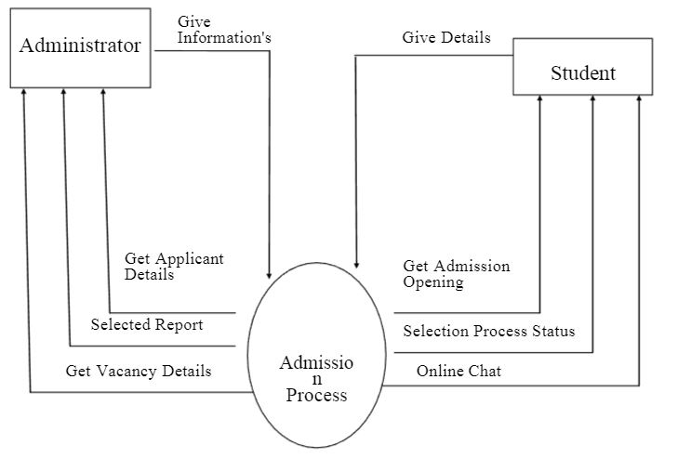
System Design :
Level 1

Slide 28
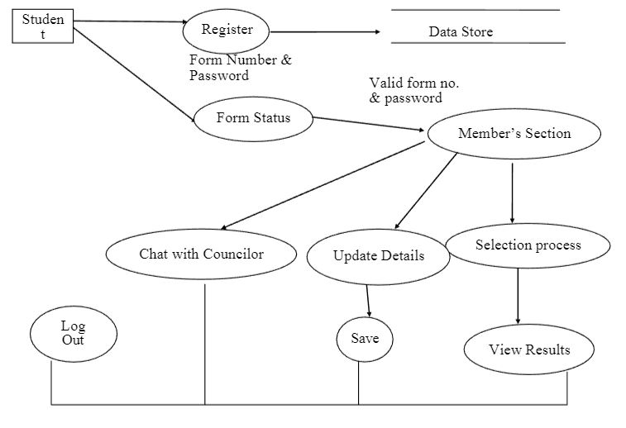
Level 2 :

Slide 29
Detailed design diagrams :
Class diagram
Use case diagram
Activity diagram
ER diagram

Slide 30
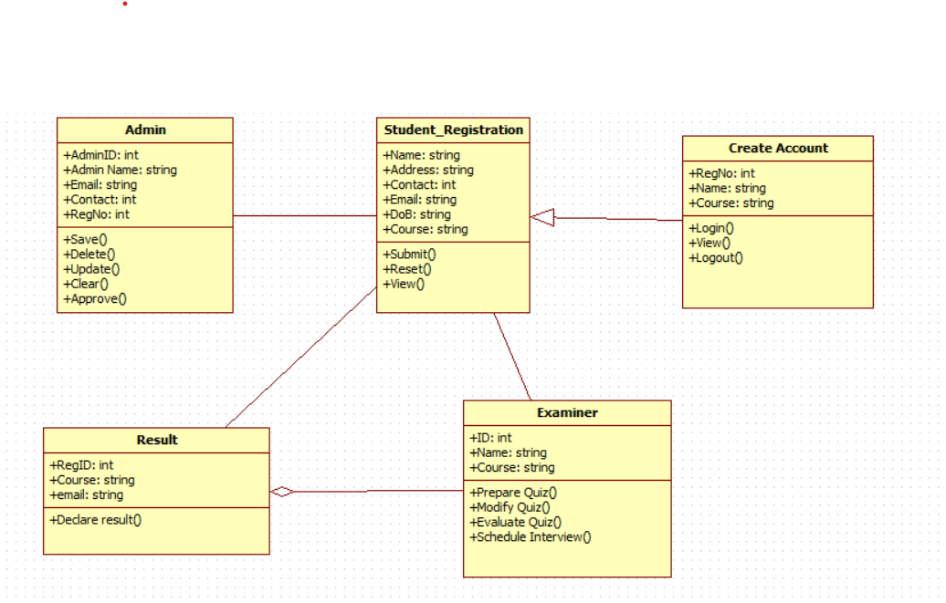
1. Class diagram :
Notes:
Class name , attributes and operations

Slide 31
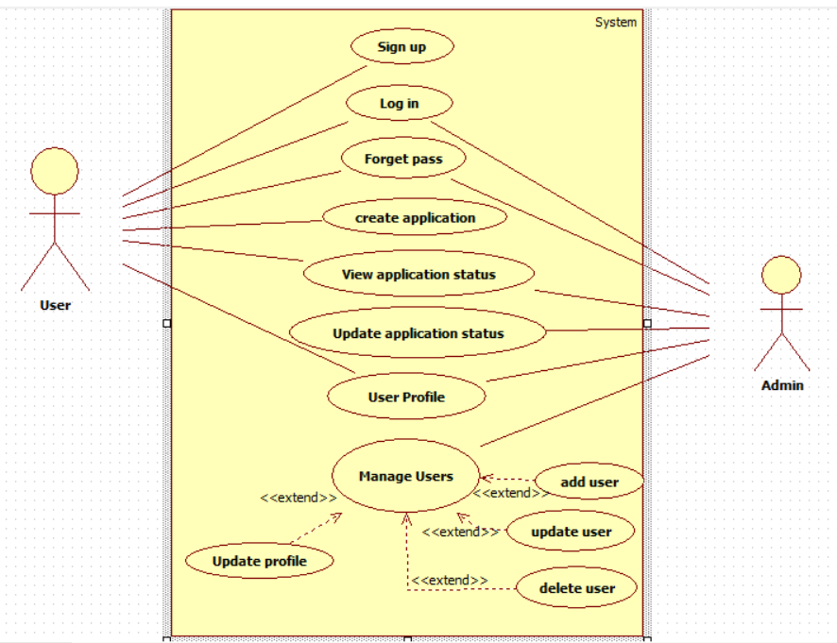
2. Use-case diagram :
Notes:
Student can access through registration form, admission form, entrance exams,login, log-out payment likewise administrator

Slide 32
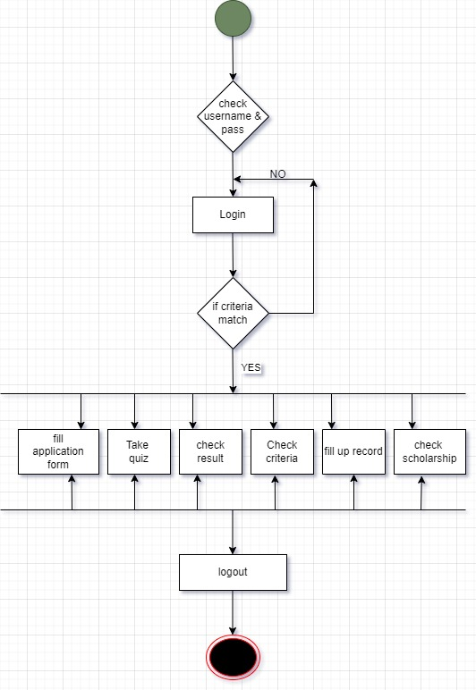
3.
Activity diagram:
(User side)

Slide 33
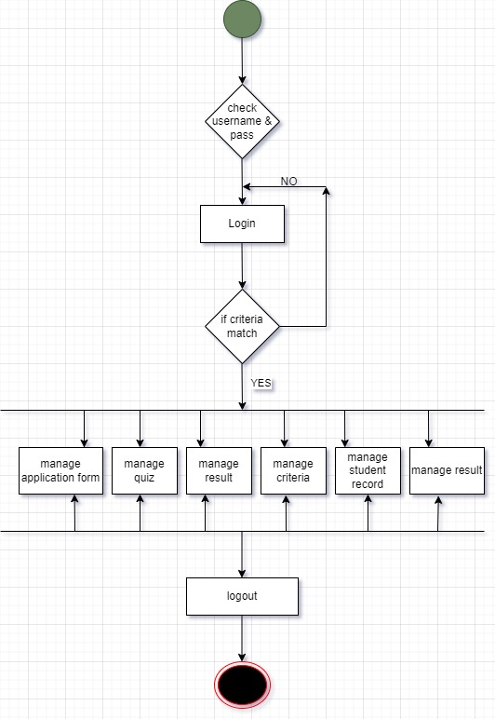
3.
Activity diagram:
(Admin side)

Slide 34
4.
ER diagram :

Slide 35
THANK YOU

