Slide 1
Minesweeper Project
By: Akash Singh

Slide 2
Introduction
Minesweeper is a classic puzzle game.
Objective: Reveal all safe cells without hitting mines.
Popular example of logic and problem-solving in games.

Slide 3
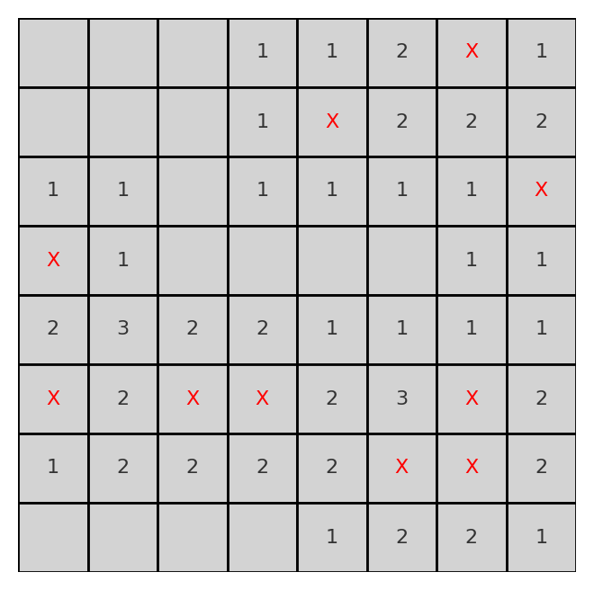
Features
Grid-based board with random mine placement.
Left-click to reveal cells.
Right-click to place flags.
Flood-fill algorithm for empty cells.
Win/Loss detection with game over state.

Slide 4
Implementation
Language: Python
Library: Pygame
Core Logic:
- Random mine placement
- Neighbor count calculation
- Recursive reveal for empty cells
- Event handling for clicks

Slide 5
Gameplay Demo
Sample Minesweeper board:

Slide 6
Improvement Required
Some errors are still present such as :-
As we click on Mine it does not show game over.
It needs better graphics.

Slide 7
Conclusion
Learned about event handling and grid-based logic.
Minesweeper is a great example of algorithmic thinking.
Future Work: Difficulty levels, animations, and restart option.

