Slide 1

INDUSTRY PERFORMANCE ANALYSIS USING EXPLORATORY DATA ANALYSIS (EDA)

Slide 2
Objective
The objective of this project is to analyze industry-level business performance
This analysis focuses on:
Understanding revenue patterns
Identifying employee distribution
Detecting outliers
Measuring relationships between variables
Finding business trends across industries
Tools Used:
- Python
- Pandas
- NumPy
- Matplotlib
- Seaborn
Business Goal:
The goal is to help organizations understand company performance trends and market behavior for better business decision-making.

Slide 3
DATASET OVERVIEW
Dataset Information:
• Total Records: 15,000 • Total Columns: 12
Key Features: • Industry • Country • Region • Revenue • Employees • Customers • Profit Margin • Market Rating • Founded Year • Created Date
The dataset contains information about companies operating across different industries and regions.

Slide 4
DATA UNDERSTANDING
Before analysis, the dataset was explored to understand:
• Data types • Unique values • Statistical summary • Data distribution • Feature relationships
This step helped identify important variables and prepare the data for analysis.

Slide 5
DATA CLEANING & PREPROCESSING
Data quality checks were performed to ensure reliable analysis.
Activities Performed:
• Checked missing values • Checked duplicate records • Validated data consistency • Converted Created Date into datetime format • Verified column data types
Result: The dataset was clean and ready for analysis.

Slide 6
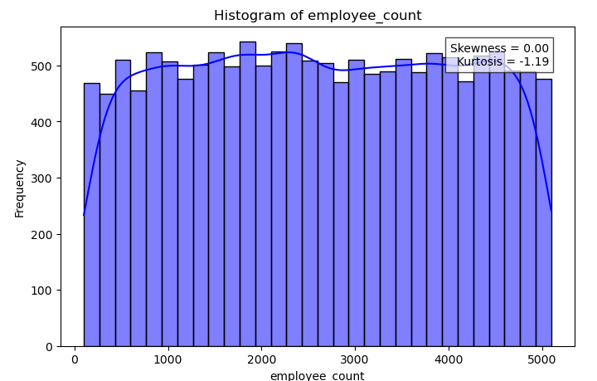
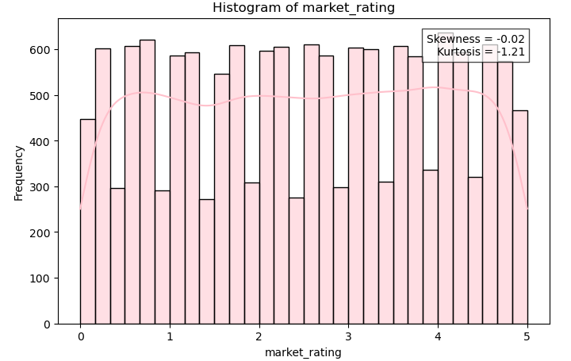
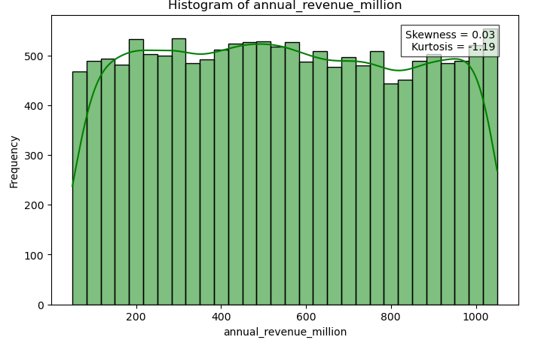
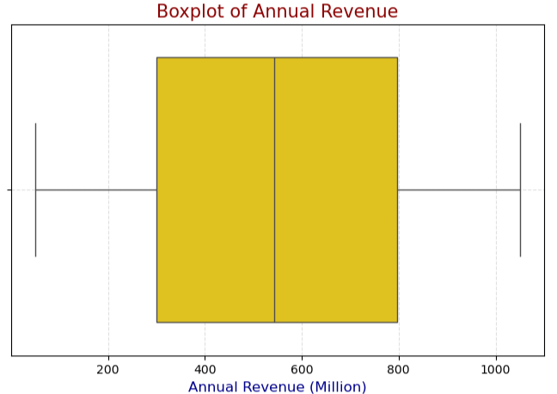
Univariate Analysis

Slide 7
Objective of Univariate Analysis
Analyze individual variables independently.
Understand distribution, spread, and outliers.
Visualizations Used:
Revenue Distribution Histogram
Employee Count Histogram
Market Rating Histogram
Revenue Boxplot
Key Findings:
Revenue shows a wide distribution across industries.
Employee count varies significantly among companies.
Market ratings are concentrated within a limited range.
Revenue contains several extreme observations (outliers).

Slide 8
CATEGORICAL ANALYSIS
Categorical variables were analyzed using count plots.
Features:
• Industry • Country • Region
Insights:
• Some industries have significantly more companies. • Country distribution varies considerably. • Regional representation differs across the dataset.

Slide 9
OUTLIER ANALYSIS
Outlier detection was performed using:
• Boxplots • IQR Method • Z-Score Method
Observations:
• Revenue contains extreme values. • Employee count shows large variations. • Customer count contains several outliers.
Outlier analysis helps improve business understanding and model performance.

Slide 10
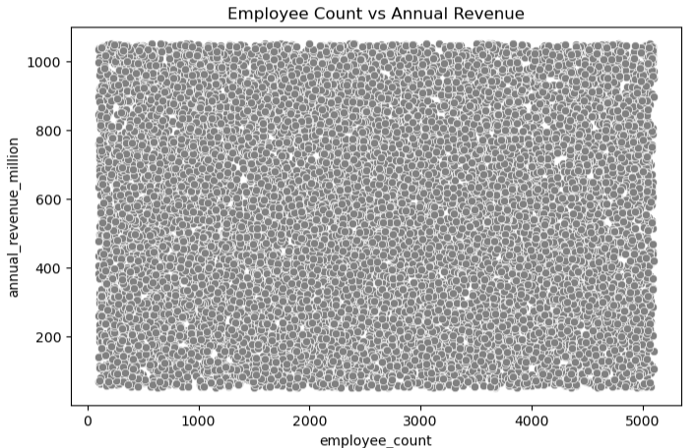
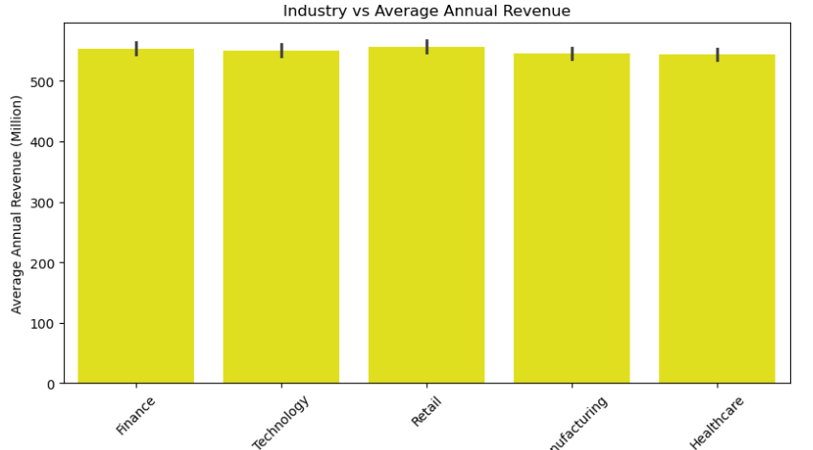
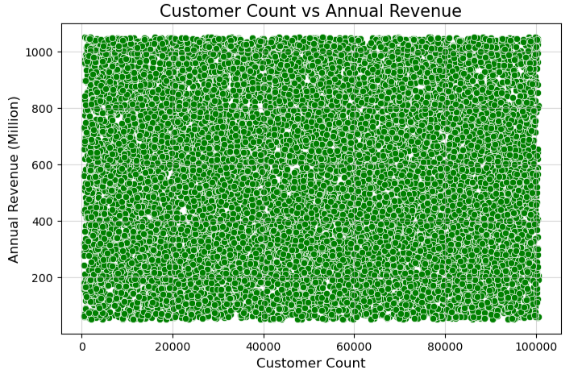
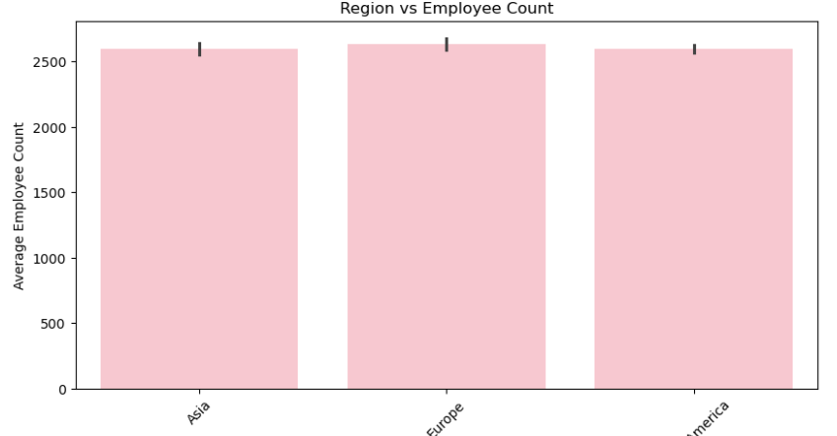
BIVARIATE ANALYSIS

Slide 11
Objective of Bivariate Analysis
Analyze relationships between two variables.
Identify trends and correlations affecting business performance.
Key Findings:
Revenue shows a weak relationship with employee count.
Customer count has limited influence on company revenue.
Certain industries generate higher average revenue than others.
Regional differences are observed in employee distribution and business scale.
Conclusion:
Most variables exhibit weak to moderate correlation.
Business performance appears to be influenced by multiple factors rather than a single variable.

Slide 12
Correlation Heatmap
A correlation matrix was created to measure relationships among numerical features.
Benefits:
• Identify positive relationships. • Identify negative relationships. • Detect highly correlated variables.
Observation:
Most variables showed weak to moderate correlation, indicating independent business factors.

Slide 13
INDUSTRY PERFORMANCE ANALYSIS
Industry-wise analysis was performed using:
• Average Revenue • Employee Count • Market Rating
Insights:
• Certain industries consistently generate higher revenue. • Industry size varies significantly. • Market ratings differ across sectors.
This helps identify high-performing industries.

Slide 14
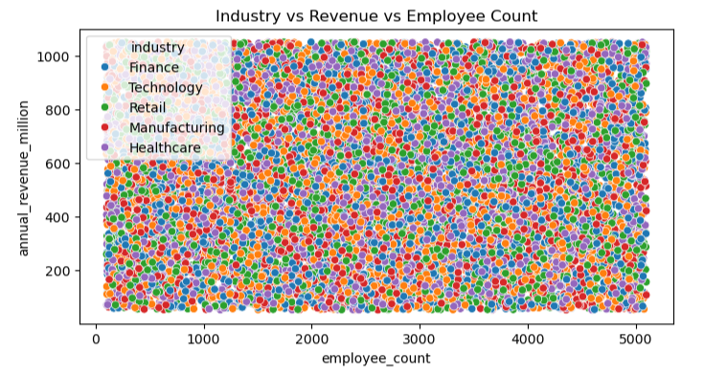
Multivariate Analysis

Slide 15
Objective of Multivariate Analysis
Analyze the interaction among multiple variables simultaneously.
Identify patterns that cannot be observed through univariate or bivariate analysis.
Variables Analyzed:
Employees
Revenue
Industry
Key Findings:
Revenue varies significantly across industries.
Companies with similar employee counts can generate different revenue levels.
Industry type plays an important role in business performance.
No strong linear relationship is observed across all variables.
Business Insight
Business success depends on multiple factors rather than a single variable.
Industry characteristics influence revenue generation and workforce requirements.

Slide 16
Conclusion
Cleaned and prepared the dataset by handling missing values and duplicates.
Performed univariate, bivariate, and multivariate analysis to understand data patterns.
Identified key trends, relationships, and distributions within the dataset.
Used visualizations to gain meaningful business insights.
Found important factors that influence the target variables and overall performance.
The analysis provides valuable insights for data-driven decision-making.
This EDA can serve as a foundation for future predictive modeling and machine learning projects.
Thank You
Presented By: Akash Srivastava

