Slide 1
SMART INDIA HACKATHON-2020
ORGANIZATION: GE HEALTHCARE
CATEGORY: SOFTWARE
PROBLEM STATEMENT: EARLY PREDICTION OF SEPSIS FROM CLINICAL DATA
TEAM NAME: CYBER TECHZ
TEAM LEADER: J.HARISH SANMUGAM
PROBLEM STATEMENT ID: UP49

Slide 2
EARLY PREDICTION OF SEPSIS FROM CLINICAL DATA
Abstract :-
Sepsis is a life-threatening condition that occurs when the body's response to infection causes tissue damage, organ failure, or death. Internationally, an estimated 30 million people develop sepsis and 6 million people die from sepsis each year; an estimated 4.2 million newborns and children are affected (WHO). The diagnosis sepsis is based on the symptoms, physical examination and medical history of a patient. There have been many cases where treatment for a disease has not been carried out accurately due to lack of proper analysis and ignorance of a number of important factors. To make the essentials of good health practices accessible to everyone, a Naive Bayes approach for Disease Diagnosis is proposed here. This service aims to help patients and doctors by guiding them to predict possible diseases using the symptoms provided by the user/hospital. Naïve Bayes classifier is used for classification of data. The system comprises of a symptom data set which is further categorized as Name, Attributes, and Record data. Based on the ranking of each symptom provided, the diagnosed result suggests the possibility weight of each disease. It also gives the detail of identified diseases including the cure, prevention and the possible treatment. An analysis of Naïve Bayes classification accuracy in the system is also studied.

Slide 3
TECHNOLOGY STACK
Front-end
Bootstrap 4
React JS
Back-end
Django
Sklearn, pandas
Data Science
Machine learning
Data analysis
Blockchain

Slide 4
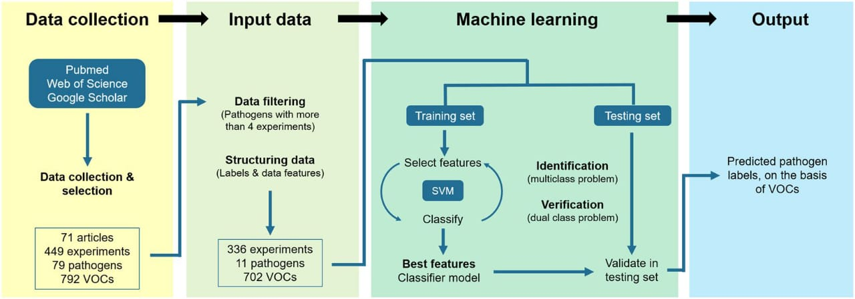
USE CASE DIAGRAM

